Slide 1
Bleichenbacher Attacks against RSA (PKCS#1)
Yuan Xiao
(Slides borrowed from several online sources)

Slide 2
The RSA cryptosystem
First published:
Scientific American, Aug. 1977.
(after some censorship entanglements)
Currently the “work horse” of Internet security:
Most Public Key Infrastructure (PKI) products.
SSL/TLS: Certificates and key-exchange.
Secure e-mail: PGP, Outlook, …

Slide 3
The RSA trapdoor permutation
Parameters:
N=pq. N ≈1024 bits. p,q ≈512 bits.
e – encryption exponent. gcd(e, ϕ(N) ) = 1 .
Permutation:
RSA(M) = Me
(mod N)
where M∈Z_{N}
Trapdoor:
d – decryption exponent.
Where
RSA(M)^{d} = M
e⋅d = 1
(mod N)
(mod ϕ(N) )
Inversion:
“Assumption”:
no efficient alg. can invert RSA without trapdoor.

Slide 4
Textbook RSA is insecure
Textbook RSA encryption:
public key: (N,e)
private key: d
Encrypt: C = Me (mod N) Decrypt: C^{d} = M (mod N)
(M χ Z_{N} )
Completely insecure cryptosystem:
Does not satisfy basic definitions of security.
Many attacks exist.
The RSA trapdoor permutation is not a cryptosystem !

Slide 5
Textbook RSA?
Ciphertext = cleartext ^{e} % n
Cleartext is a number which cannot be larger than the keysize
RSA with no padding is referred to as Textbook RSA
It has problems:
It’s predictable, same encrypted result for same cleartext input
It’s malleable, due to homomorphism

Slide 6




Textbook RSA problems
Predictability:
➜ pyorapad git:(master) ✗ ./rsa_test_client.py keypairs/256.pub "05" 42f7816006de56bc4899a96645dff79227b6ebe40e6c82363c35b07fe4e8d63b
➜ pyorapad git:(master) ✗ ./rsa_test_client.py keypairs/256.pub "05" 42f7816006de56bc4899a96645dff79227b6ebe40e6c82363c35b07fe4e8d63b
Malleability
➜ pyorapad git:(master) ✗ ./rsa_test_client.py keypairs/256.pub "02" 4129a5c8ade1f1a001fef7a6eedbde3d751c9897cbe9762ebb6c968d4046bd08
➜ pyorapad git:(master) ✗ ./rsa_test_client.py keypairs/256.pub "03" 7025b707f05ad5d7148f01eaf17fda3aac178f4aa48ace00bc8ef6ecf4ce40eb
>>> hex((two * three) % n)
'0x2d06ea3806280fddaa35137e3d2bad0152d512a23368c65470dbb5072685a50eL'
➜ pyorapad git:(master) ✗ ./pkcs1_test_oracle.py keypairs/256.priv 2d06ea3806280fddaa35137e3d2bad0152d512a23368c65470dbb5072685a50e 2> /dev/null
0000000000000000000000000000000000000000000000000000000000000006

Slide 7
Solutions
Add random padding
Several proposals:
PKCS1 v1.5
PKCS1 v2.0 referred to as OAEP
Add random bytes in front of the cleartext before encryption
Addresses the problems of predictability and malleability

Slide 8




Problems fixed (PKCS1 v1.5 example)
Predictability
➜ pyorapad git:(master) ✗ ./pkcs1_test_client.py -f keypairs/256.pub -x "03" 061b8a582937938990c284fda22c8016af6b729ff4ef1dc938917321fdfef893
➜ pyorapad git:(master) ✗ ./pkcs1_test_client.py -f keypairs/256.pub -x "03" 297a509da9dc28d6f052febb3c6ae265e6e2905f851e380a5c9a03de519c5c7b
Malleability
➜ pyorapad git:(master) ✗ ./pkcs1_test_client.py -f keypairs/256.pub -x "02" 76054771607245a9ad162b4aacb1573c444da8d4c1c7e5afaa3679b383d8fd6b
➜ pyorapad git:(master) ✗ ./pkcs1_test_client.py -f keypairs/256.pub -x "03” ae367c29f4fb340d02c7fae4bd43e699e50afae443f41c1383d49d927d5ff5fd
>>> hex((two * three) % n) '0x79f58ce744adb456c35e1391e7dba658a9acece7d400958cebeb385450d925ecL'
➜ pyorapad git:(master) ✗ ./pkcs1_test_client.py -f keypairs/256.pub -x "06"
c89593ba78d465d94eb8fab8fccfcfe94ade1369a849671ccc256dc52b009e62

Slide 9


PKCS1 v1.5
Specifies a padding format
Which looks like this:
A header: “\x00\x02”
Some random bytes (minimum 8)
A delimiter “\x00”
Data
➜ pyorapad git:(master) ✗ ./pkcs1_test_client.py -f keypairs/256.pub -c -x "123456789a" 0002c14dcfc27870fa657d0a3446e6571c7f626342e59c1777c600123456789a
• Pretty simple in reality (e.g: for 0x123456789a)

Slide 10
Oh no, wait…
What’s a padding oracle
A padding oracle is something which can tell you whether:
Padding is correct
Or not
E.g:
You failed authentication => HTTP 403
The padding of your authentication request is invalid
=> HTTP 500

Slide 11
Bleichenbacher attack
Is a padding oracle attack on PKCS1 v1.5
Original paper from 1998 available here
Given an oracle which:
Uses PKCS1 v1.5 padding
Can tell you if RSA decryption failed due to incorrect padding
You can:
retrieve the associated cleartext
by issuing a high number of request (~1 million)
Private key is NOT retrieved

Slide 12

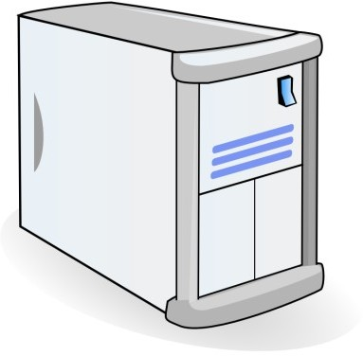






Bleichenbacher's Attack
Requires a “ciphertext validity oracle” Adaptive Chosen-ciphertext attack
●
●
ClientKeyExchange
Chosen ciphertext C₁ valid/invalid Chosen ciphertext C₂ valid/invalid
…
(repeated several times)
TLS Server
Dec(C_{PKCS}) =
00 || 02 || “bytes”
???
Client
Snidely Whiplash
(Dudley Do-Right of the Mounties)
M = Dec(C)
12

Slide 13
Attack Intuition
d: private key (e,N): public key
m = 00 || 02 || “bytes”
●
●
●
●
In RSA we can multiply the encrypted plaintext without knowing the private key
m = c^{d} mod N c = m^{e} mod N
c’ = (c · s^{e}) mod N s ∈ Z_{N}
c’ = (ms)^{e} mod N
●
●
●
●
13

Slide 14

Attack Intuition
OK, so we can multiply a plaintext ...
We define: B = 2^{(|N|-2)}, where |N| is byte length
– Example: 2B = 00 02 00 … 00 Attack Approach:
●
●
●
Multiply “plaintext” with s: c’ = (c · s^{e}) mod N
Query oracle if the decrypted plaintext is in interval <2B,3B)
–
–
Somewhere here is the secret m_{x}
s=2
Modulo Reduction!
s=s_{x}
s=s_{x}
s=3
s=4
s=s_{x}-1
0
2B
3B
N
valid
18

Slide 15
Attack Intuition
m_{x}
s=s_{x}
s=2
s=3
s=4
s=s_{x}-1
s=s_{x}
0
2B
3B
N
m_{y}
s=s_{y}-1
s=s_{y}
s=2
s=3
s=4
s=5
s=6
s=s_{y}-2
s=s_{y}-1
0
2B 3B
s_{y} > s_{x} Intuition:
– Large s value indicates m is in the near of 2B
N
●
●
– Small s value indicates m is in the near of 3B
19

Slide 16
Attack
s_{x} allows us to compute new interval for m:
2B ≤ m_{x} s_{x} − N < 3B
From this follows:
(2B + N) / s_{x} < m_{x} < (3B + N) / s_{x}
●
●
Full algorithm:
Searches for further s values
Reduces the interval
●

Slide 17
PKCS1 V2.0 - OAEP
New preprocessing function: OAEP
(BR94).
M | 01 | 00..0
rand.
+
H
Check pad
on decryption. Reject CT if invalid.
G
+
Plaintext to encrypt
with RSA
∈{0,1}^{n-1}
Thm: ∀ trap-door permutation F ⇒
when H,G are “random oracles”.
F-OAEP is CCS
In practice: use SHA-1 or MD5 for H and G.

Slide 18
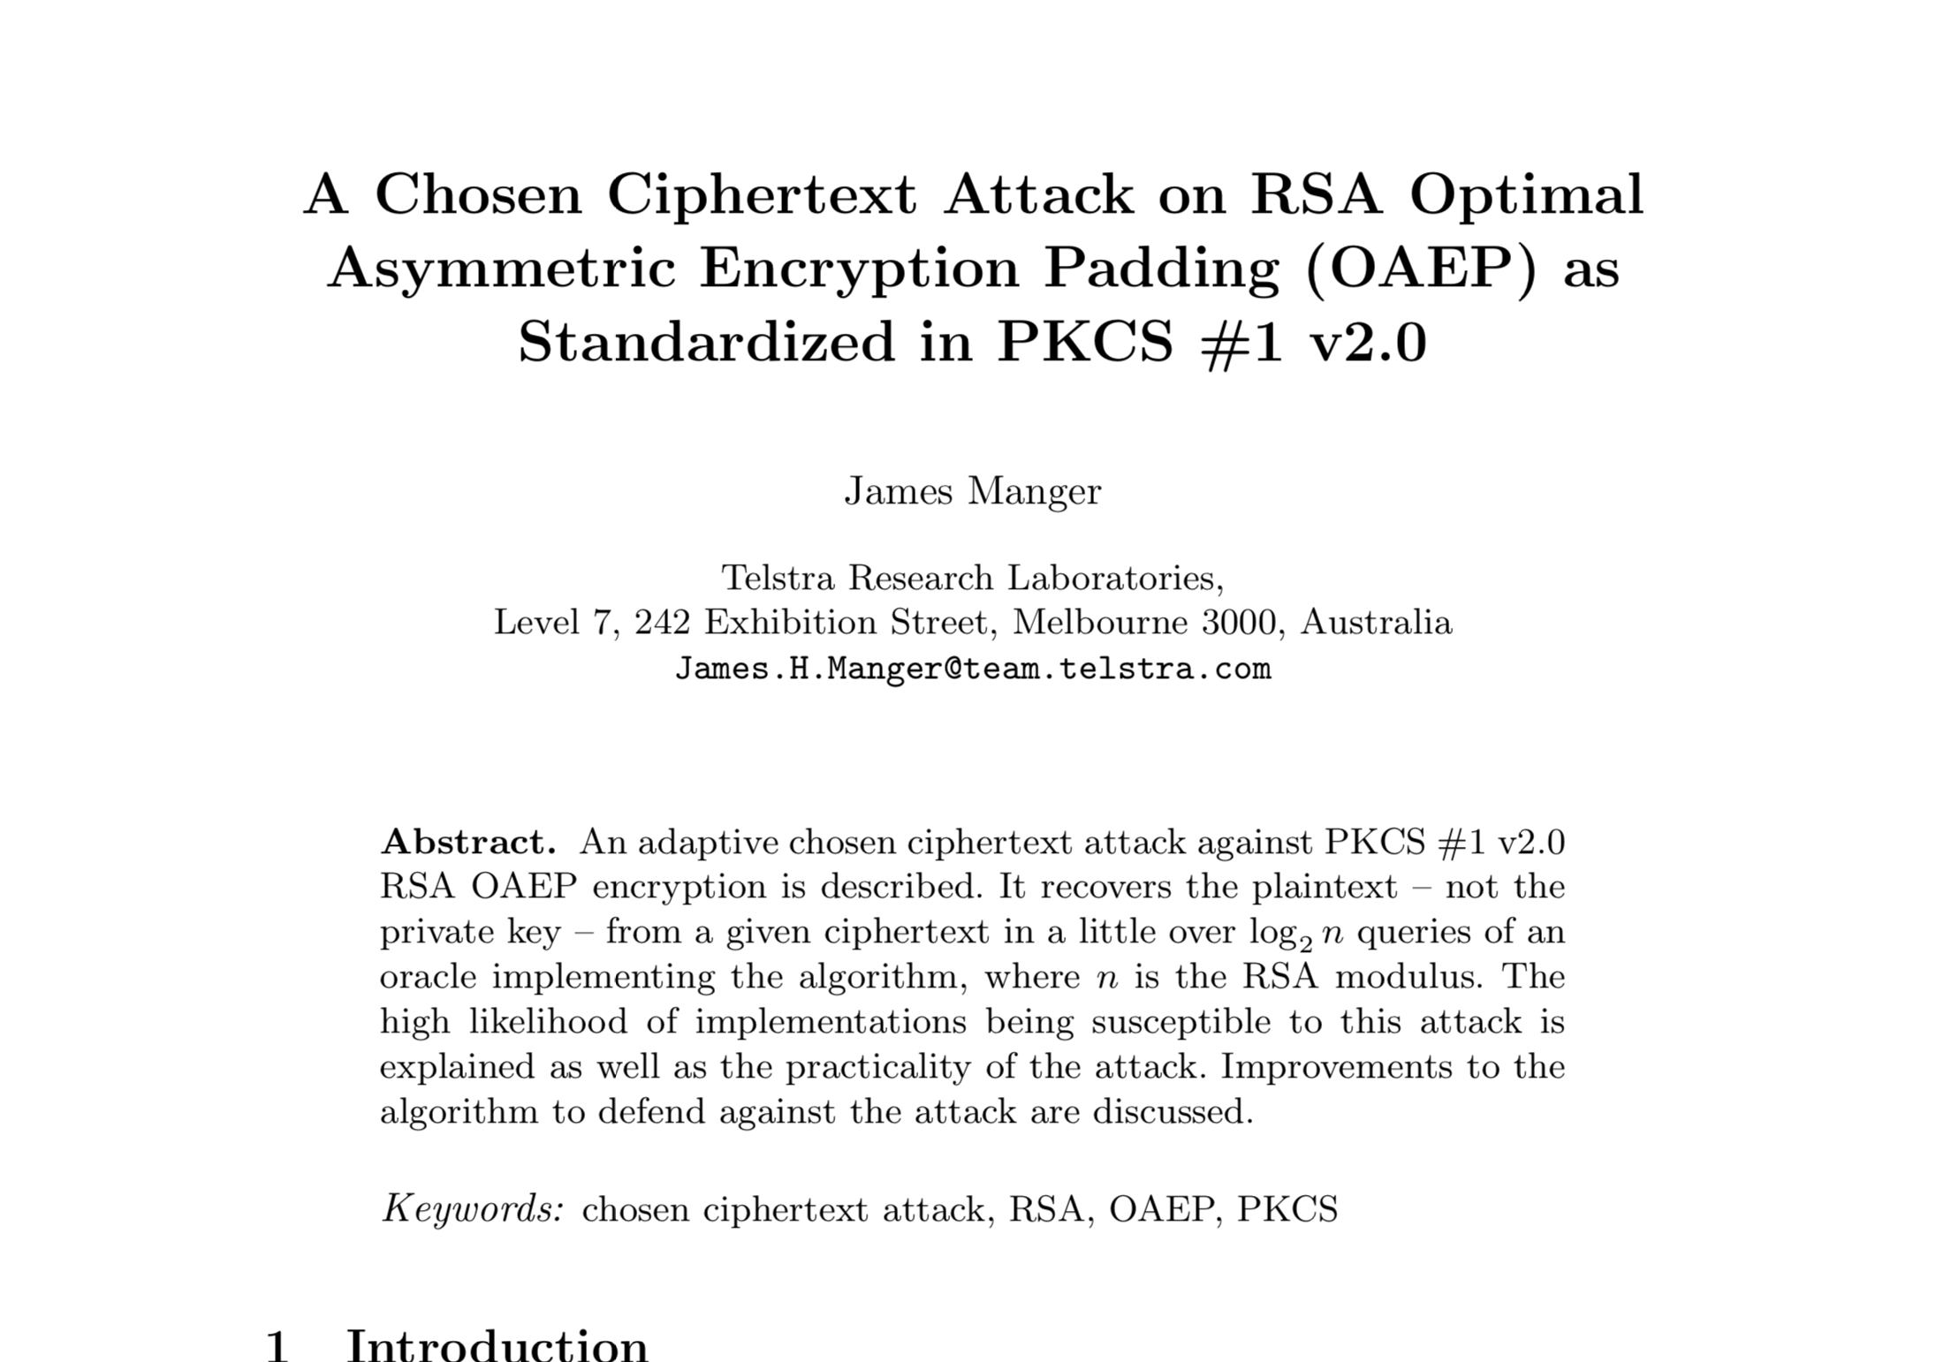
REF @ http://archiv.infsec.ethz.ch/education/fs08/secsem/Manger01.pdf

Slide 19
References

Slide 20
The RSA Cryptosystem
Dan Boneh Stanford University

Slide 21

Practical RSA padding oracle Attacks
Alex Moneger
Security Engineer – Cisco Systems
03/12/2014

Slide 22


Revisiting SSL/TLS Implementations: New Bleichenbacher Side Channels and Attacks
Juraj Somorovsky Ruhr University Bochum
3curity GmbH juraj.somorovsky@3curity.de

