Slide 1
IMS Project
By Elizabeth Lewis

Slide 2
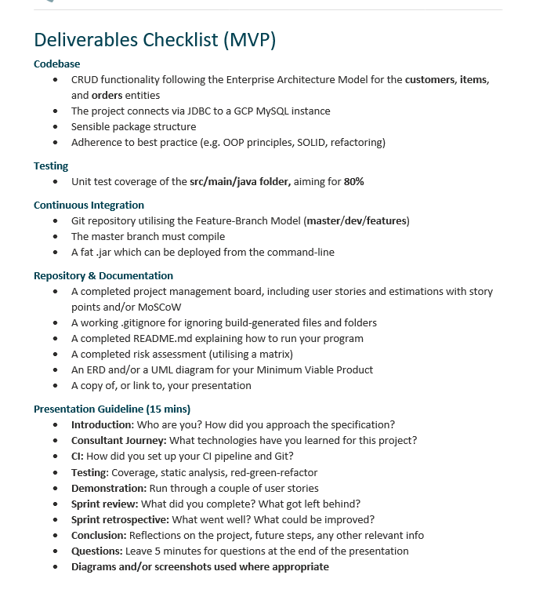
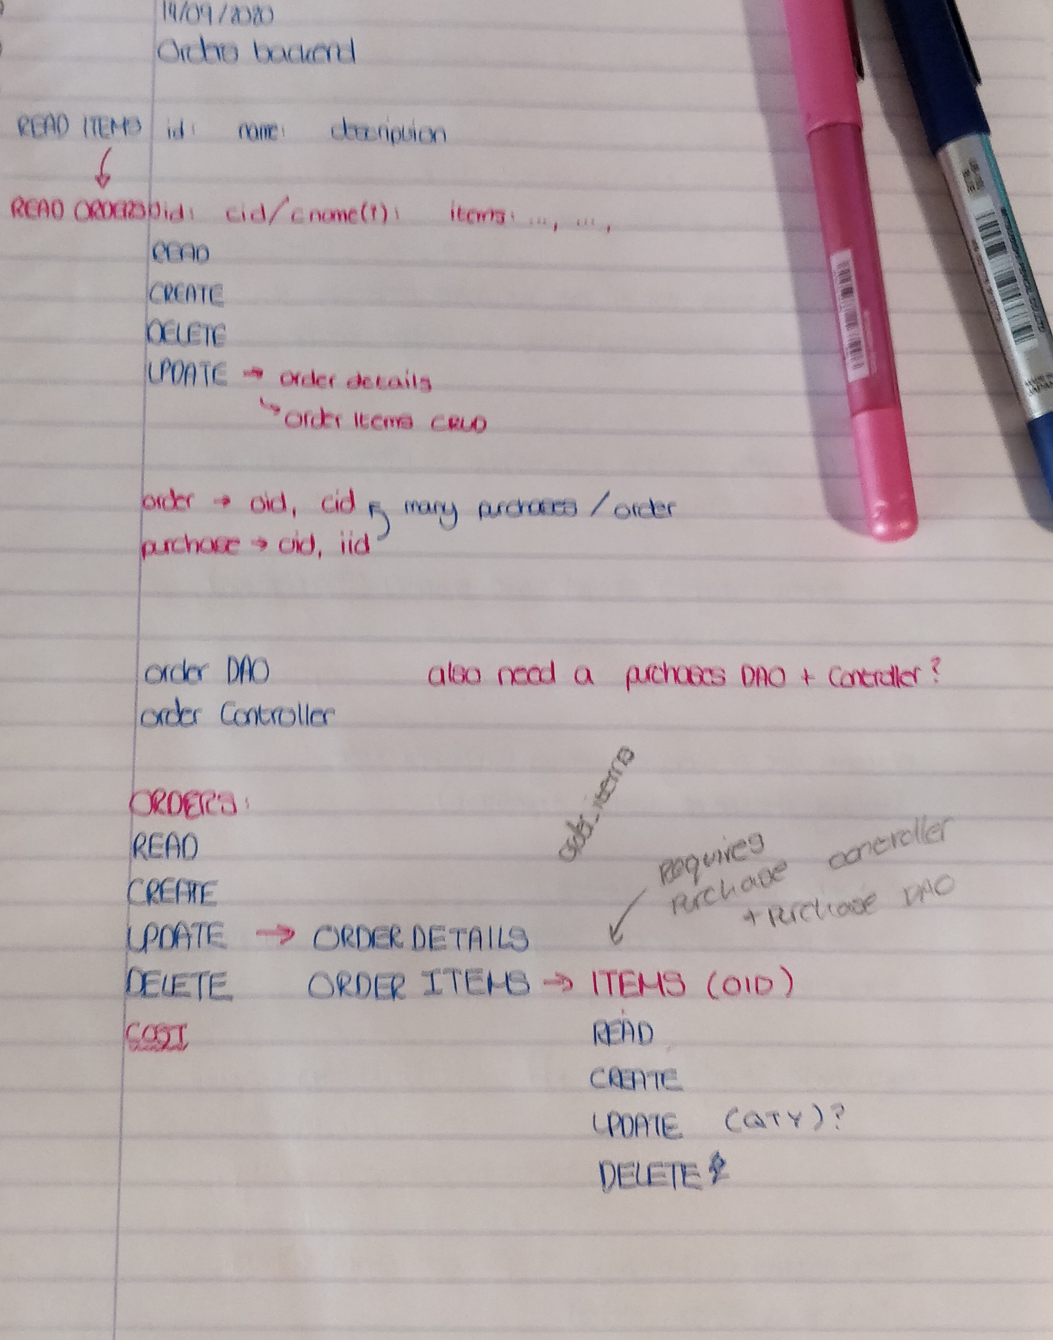
Introduction
Approaching the Specification:
Looked through the requirements
Studied the code in the IMS
Planned out tasks, matching them up with User-Stories on my JIRA
Started with creating Items, due to its similarity to Customers
Then planned out how to structure Orders & Order-Items
Notes:
Starting with my approach to the project and the specification – I started by looking through the requirements document and then looking through the code provided in the IMS starter. This gave me a good idea of the level of work required and the complexity involved. I then put my user-stories on to my JIRA, added planned out tasks – matching them with these user-stories where possible.
I then planned out which tasks to complete first – starting with the Items table, since it as similar to Customer, so working on it would get me used to the functionality of the code. I also figured it would be required by an Orders table.

Slide 3






Consultant Journey
Learned Technologies:
JUnit Tests
Maven
Other things learned:
Organization of projects i.e: package structure
Enterprise style repository management
MoSCoW estimation
Risk Assessment
Notes:
When I started this project, I already had some familiarity with Java and SQL, but I learned a lot about using Junit for testing and using Maven – the build tool for this project. I also learned a lot about managing and organising a project, including how to properly manage a git-repo in Enterprise style, and how to prioritise tasks using MoSCoW estimation.

Slide 4
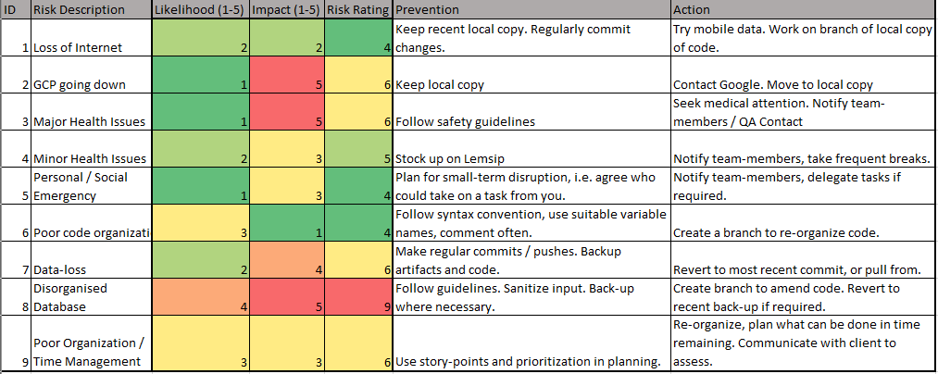
Consultant Journey
Risk Assessment
Notes:
When I started this project, I already had some familiarity with Java and SQL, but I learned a lot about using Junit for testing and using Maven – the build tool for this project. I also learned a lot about managing and organising a project, including how to properly manage a git-repo in Enterprise style, and how to prioritise tasks using MoSCoW estimation.

Slide 5
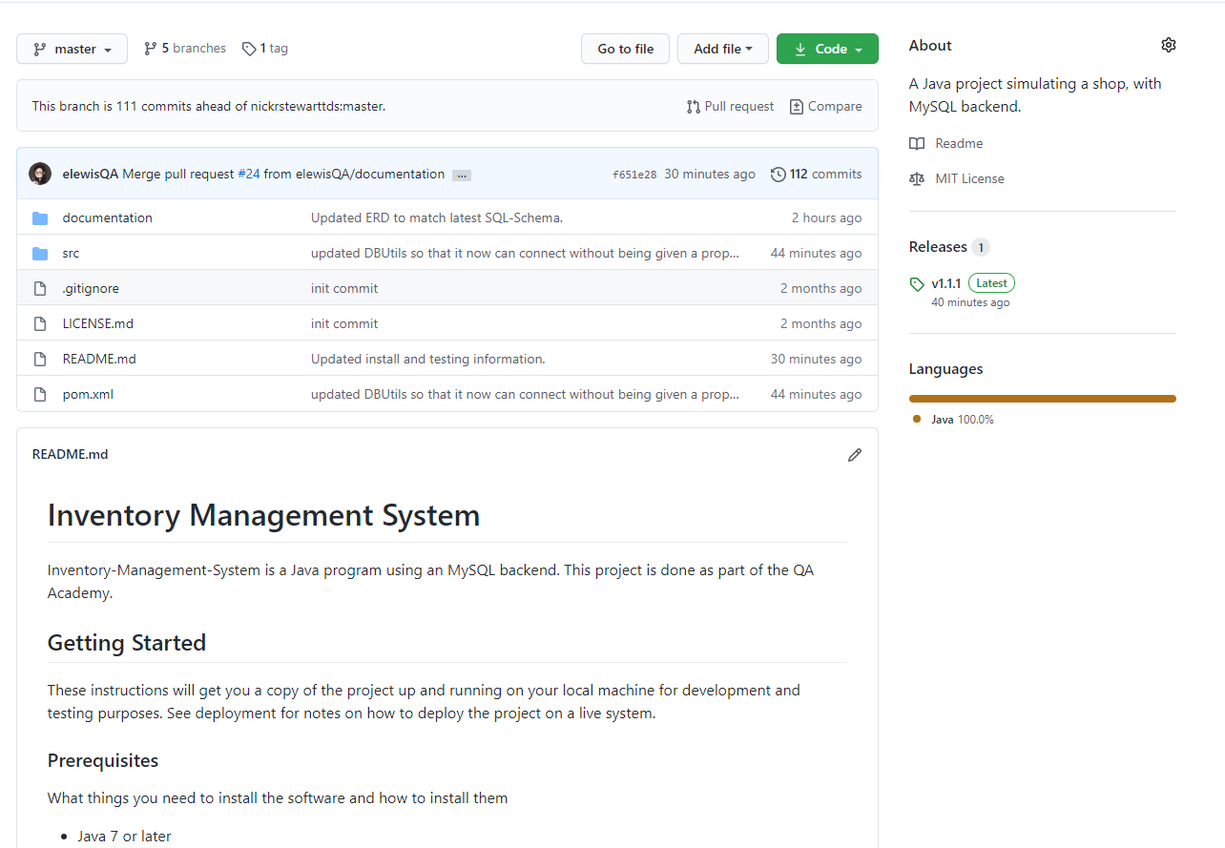
CI / Git
Forked my Git from the IMS Starter
Followed the dev/feature model
Feature branches
Test branches
A hotfix after my first dev/master pull-request
Followed semantic versioning
Notes:
As mentioned, I learned a lot about properly organising a git-repo. For this project, I started with forking from the IMS Starter, and made sure to follow the dev/feature branch model set-out. So I completed most of my work in the dev branch, using feature branches as I worked on elements of the project like adding Items or Orders functionality. I also used ‘test’ branches when I was writing out test code.
In addition to this, I also created a hot-fix branch after my first merge from dev to master, after realising I’d missed a problem with the Order CRUD functionality.
When I did have working code to be pushed to master, I pushed these as Versions, using semantic versioning – you can see the ‘release’ on my git-page is marked as 1.1.1

Slide 6
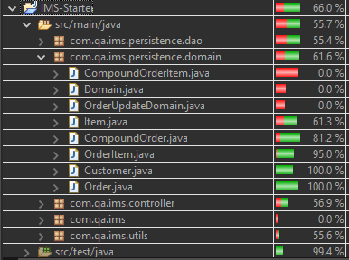
Testing
Achieved approximately 66% testing coverage
Primarily using JUnit for unit testing
Also used some Mockito where I was able to adapt it from the Customer-Controller testing
Went through re-writing code to better fit tests as well as changing tests to fit changes to the IMS
Notes:
Moving on to testing my project, I achieved around 66% coverage, most of which is done using JUnit. There is some Mockito code for testing the Customer controller, which I was able to replicate for the Item controller – but not for the Order / Order-Item controllers as they are a bit more complex and we have not yet covered Mockito.
The testing did come in useful, as I had not properly written out the HashCode for my order class, which caused problems when using a HashMap later – I was able to diagnose and fix the problem thanks to the tests.
Some of the lacking coverage is with the Controllers, as I said, we haven’t covered Mockito. There is also some missing Junit tests for the Domain classes, as shown, since they are Enumerator classes and I wasn’t sure how to test / whether it was necessary to test them since they don’t contain any complex methods.
A lot of the DAO classes are also missing some coverage in the “catch” segments, where they simply report to the user the nature of the error. I wasn’t sure how to test for catching of exceptions and even if I did, the code tested in the catch is print statements.

Slide 7
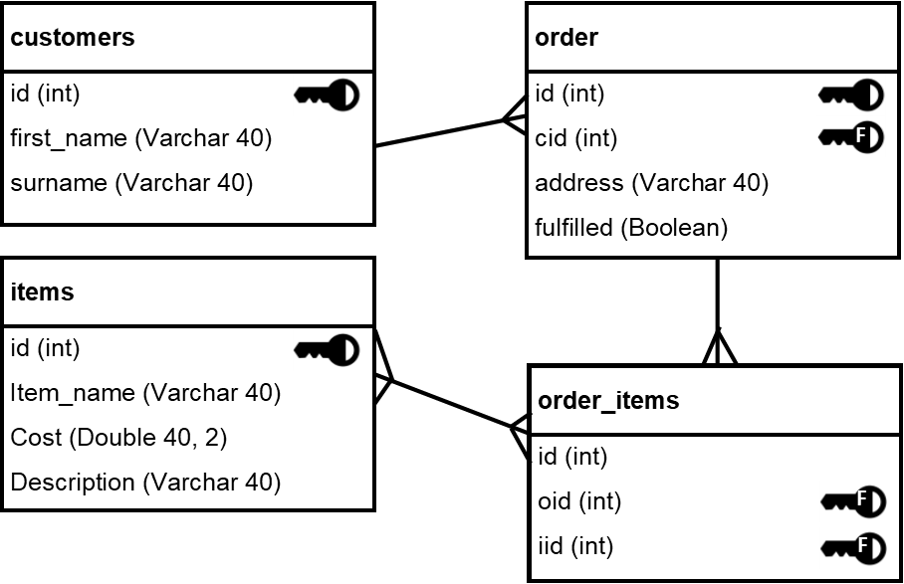
Operational Structure
IMS Operations
Database Backend
Customers
Create
Read
Update
Delete
Items
Create
Read
Update
Delete
Orders
Create
Read
Update
Details
Items
Delete
Order-Items
Create
Read
Update
Delete
Notes:
Before I demo, I just want to walk you through my project operational structure. On the left, shown is how the user performs operations through the Command-Line interface. The Customer and Items behave the same. Orders are done differently – with Read, Create and Delete being the same, however Update branches into update-details (behaves like Items, Customers) or to update Order-Items which leads to another CRUD menu.
On the right is my Entity-Relationship diagram.

Slide 8
Demonstration

Slide 9
Sprint Review
Completed
Returned to Backlog
All tasks tagged as ‘Must’
Includes all Customer / Item operations and their user stories
Majority Order Operations
Create, Read, Update, Delete
Read gives a total cost
Can CRUD each item in an order
GCP Connection
User-Login
User Story
Related / ‘Blocked-by’ tasks i.e: assigning transactions to a user
Notes:
In my sprint, I achieved all the tasks tagged with ‘Must’ and ‘Should’, as well as a number of those tagged as ‘could’.
This includes all the Customer and Item operations specified, as well as a majority of the order operations.
A couple of tasks / stories were returned to the backlog, including setting up a GCP connection – after being told it was no-longer necessary, and tasks related to user login, as this was not a minimum requirement.

Slide 10
Sprint Retrospective
Accomplishments
Areas for Improvement
My product still bears some resemblance to my planning
Table structures
Features
Task prioritisation seemed to work
Completing ‘small’ or ‘easier’ tasks, first
Moving on to more complex ones
Could do with greater User-Story coverage
Better Story-pointing
Would be useful for gauging time needed
More detailed break-down of tasks
Creating / Updating tasks as changes in project occur i.e: Viewing Order History
Notes:
Reflecting on this sprint, I am pleased that my project bears some semblance to what I planned – the classes I thought would be there exist in some form, my database schema has remained largely the same. I feel my prioritisation of tasks worked well, helping me get quickly up to speed with the way the code works and enabling me to write my own and make changes that I understood the consequences of.
I think I could do much better in terms of user-story coverage, as well as story-points. I could also have a more detailed break-down of tasks, i.e. instead of having “make the Item-Controller” I could have had “Make the controller create method”… and so on.

Slide 11
Concluding Remarks
Conclusions
If I were to continue this project…
Picked up a lot of useful skills and techniques
Need to work on my project-management skills
Managing sprints
Setting story-points
Would try to aim for a more test-driven approach
User login-system
With user’s assigned to customer /order /item operations
Find a way to preserve completed orders, even when items or the ordering customer are deleted

Slide 12
Any Questions?

