Slide 1
IMS Project
By Elizabeth Lewis

Slide 2
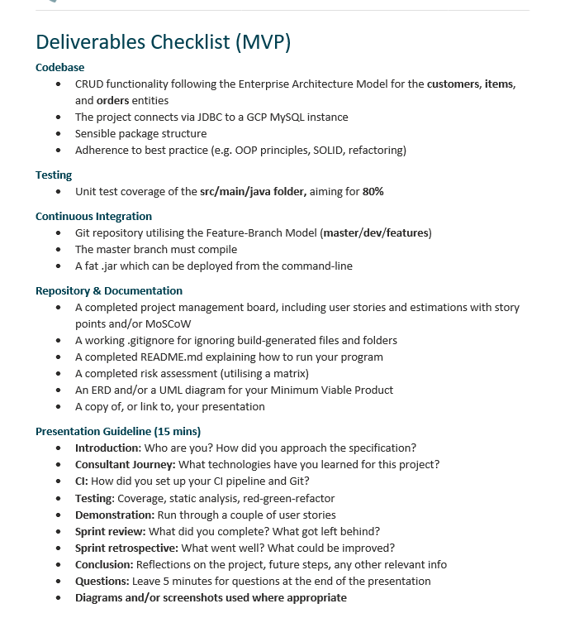
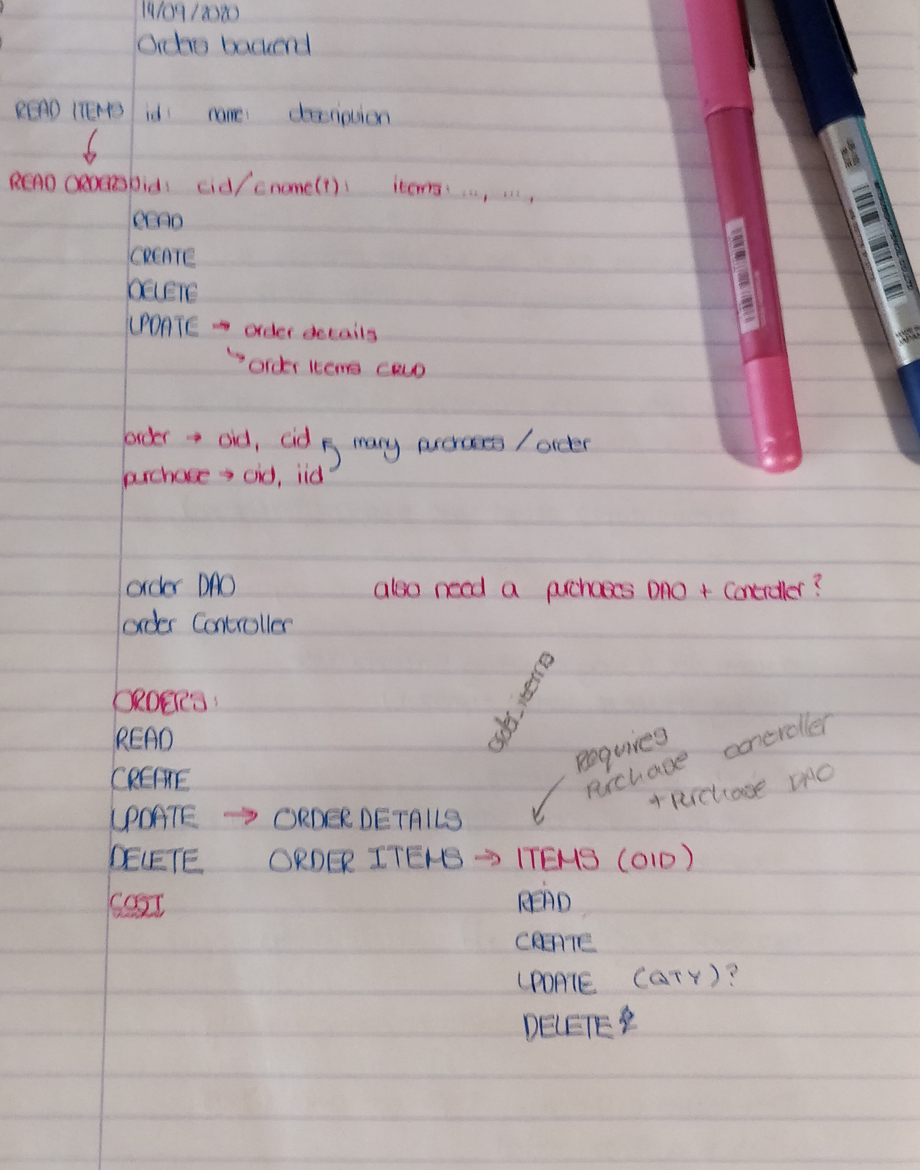
Introduction
Approaching the Specification:
Looked through the requirements
Studied the code in the IMS
Planned out tasks, matching them up with User-Stories on my JIRA
Started with creating Items, due to its similarity to Customers
Then planned out how to structure Orders & Order-Items

Slide 3



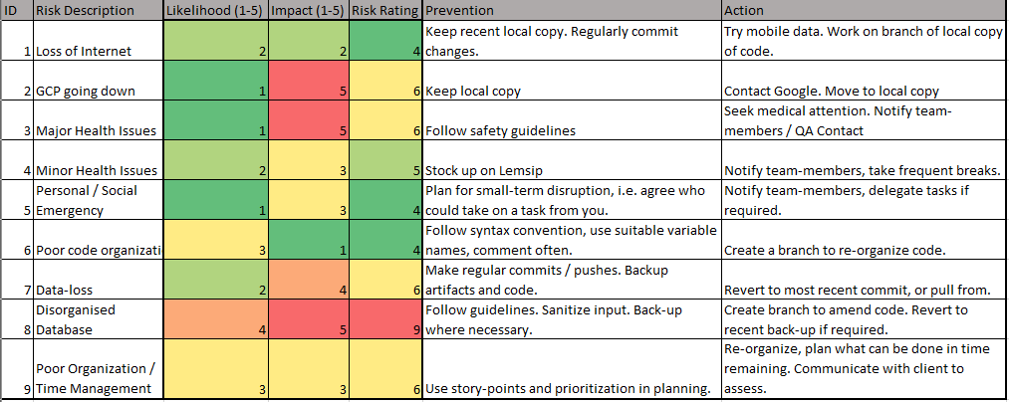



Consultant Journey
Learned Technologies:
JUnit Tests
Maven
Other things learned:
Organization of projects i.e: package structure
Enterprise style repository management
MoSCoW estimation
Cloud Technology i.e: GCP
Risk Assessment

Slide 4
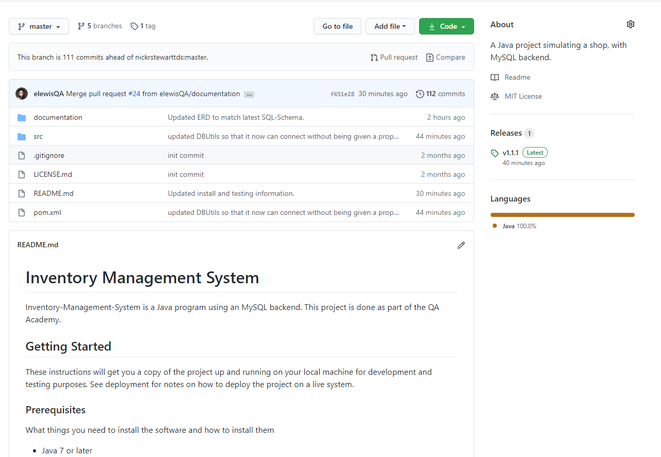
CI / Git
Forked my Git from the IMS Starter
Followed the dev/feature model
Feature branches
Test branches
A hotfix after my first dev/master pull-request
Followed semantic versioning

Slide 5
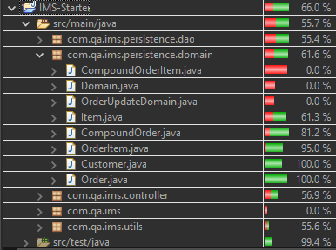
Testing
Achieved approximately 66% testing coverage
Primarily using JUnit for unit testing
Also used some Mockito where I was able to adapt it from the Customer-Controller testing
Went through re-writing code to better fit tests as well as changing tests to fit changes to the IMS

Slide 6
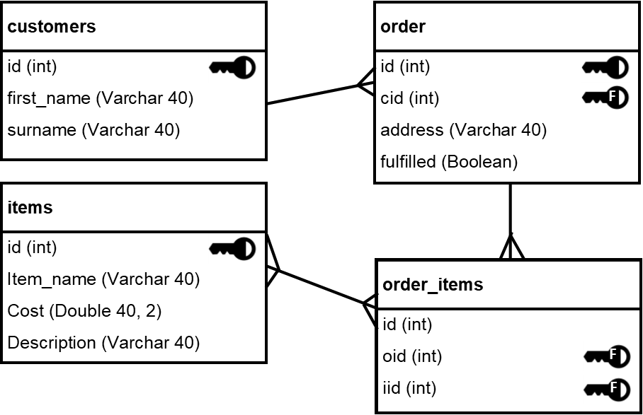
Operational Structure
IMS Operations
Database Backend
Customers
Create
Read
Update
Delete
Items
Create
Read
Update
Delete
Orders
Create
Read
Update
Details
Items
Delete
Order-Items
Create
Read
Update
Delete

Slide 7
Demonstration

Slide 8
Sprint Review
Completed
Returned to Backlog
All tasks tagged as ‘Must’
Includes all Customer / Item operations and their user stories
Majority Order Operations
Create, Read, Update, Delete
Read gives a total cost
Can CRUD each item in an order
GCP Connection
User-Login
User Story
Related / ‘Blocked-by’ tasks i.e: assigning transactions to a user

Slide 9
Sprint Retrospective
Accomplishments
Areas for Improvement
My product still bears some resemblance to my planning
Table structures
Features
Task prioritisation seemed to work
Completing ‘small’ or ‘easier’ tasks, first
Moving on to more complex ones
Could do with greater User-Story coverage
Better Story-pointing
Would be useful for gauging time needed
More detailed break-down of tasks
Creating / Updating tasks as changes in project occur i.e: Viewing Order History

Slide 10
Concluding Remarks
Conclusions
If I were to continue this project…
Picked up a lot of useful skills and techniques
Need to work on my project-management skills
Managing sprints
Setting story-points
Would try to aim for a more test-driven approach
User login-system
With user’s assigned to customer /order /item operations
Find a way to preserve completed orders, even when items or the ordering customer are deleted

Slide 11
Any Questions?

