Slide 1


Recipe-List Project
(To-Do List Project)
By Elizabeth Lewis

Slide 2
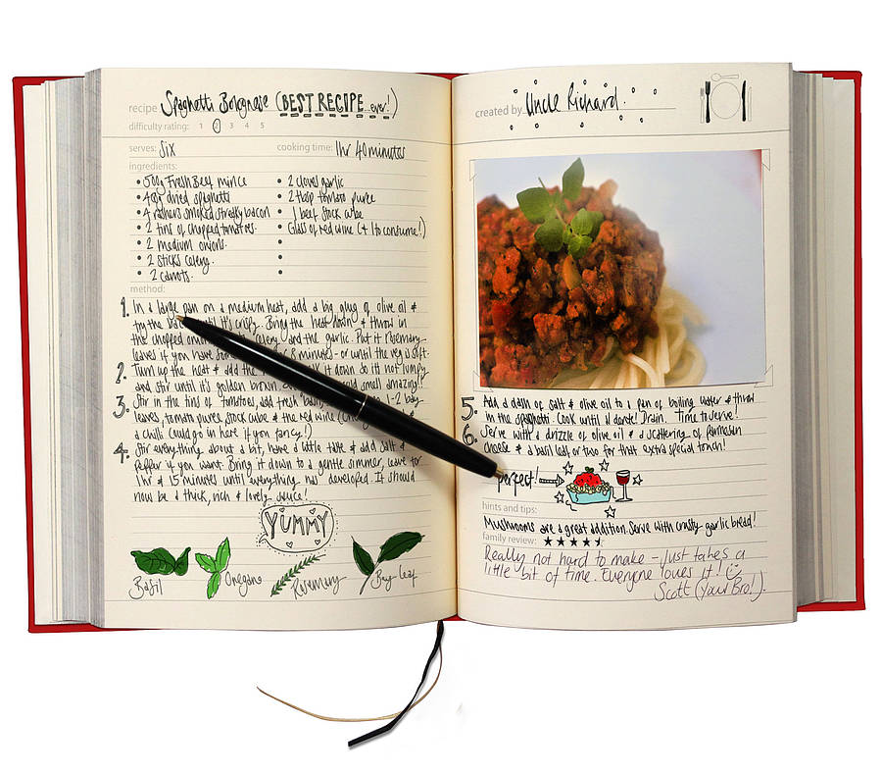
Introduction
Idea
Decided to go with Recipes as my project idea
Organised similarly to a To-Do list
Slightly expanded the scope by having:
Ingredients List
Method List

Slide 3
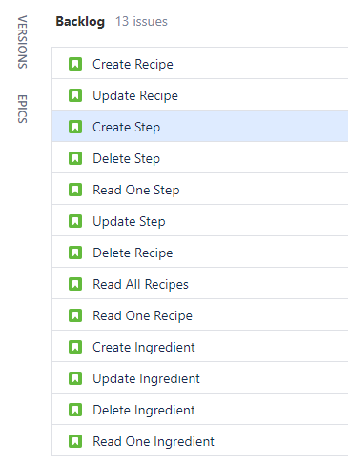
Introduction
Planning
Began planning by generating my user-stories
Created the tasks that would be needed to generate a functional system
Planned out the tests required to maximise coverage

Slide 4
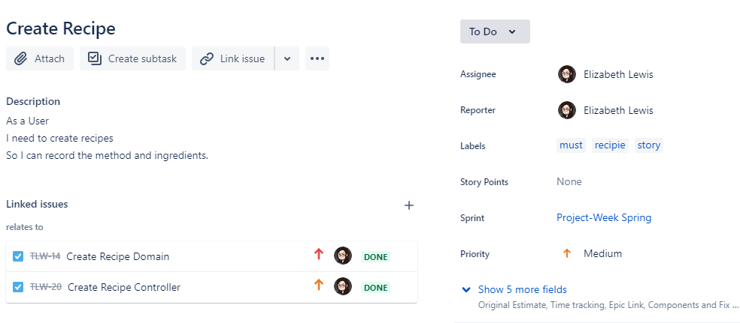
Introduction

Slide 5
Sprint - Planning
Generated (almost) all tasks and stories on the back-log before-hand
Linked tasks together using JIRA’s ‘relates-to’ and ‘blocks’ / ‘is-blocked-by’ feature
Used MoSCoW scheme in user-stories
Made sure to use ‘Epics’ to group tasks together
Useful in highlighting tasks on my Kanban board

Slide 6
Sprint - Execution
Started with back-end tasks
Domain classes
Repository & DTO classes
Service classes
Controller classes
Tried to generate basic JUnit tests along-side / after classes
Created all Integration (Mockito) tests once all my back-end tasks were complete

Slide 7
Sprint - Execution
Moved on to front-end
Expanded the sprint by adding more tasks
Added things like bugs to Sprint where back-end problems were discovered

Slide 8
Sprint Summary
Review
Retrospective
Completed all tasks in both back-end and front-end epics
Missed some testing tasks
Some unfinished due to problems or complexity
Some simply un-completable
Planning out tasks in a fine-grained manner was very helpful
Organising into groups also helped keep track on how much progress had been made

Slide 9

Demonstration

Slide 10
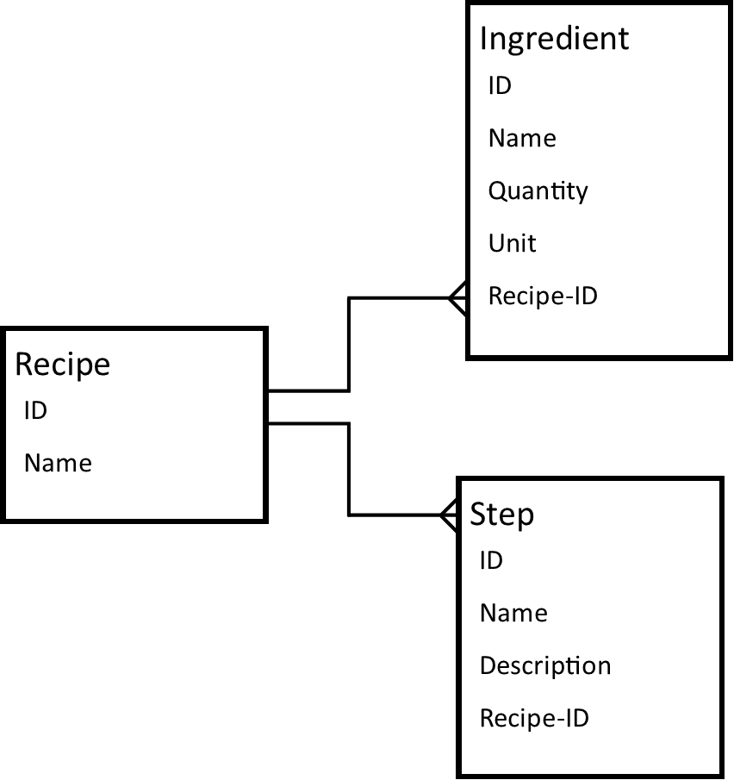
Operational Structure
Back-End: (classes)
Domain
DTO
Repository
Service
Controller
Front-End:
Index and Edit pages
Javascript
Style-sheet(s)

Slide 11
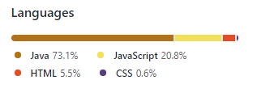
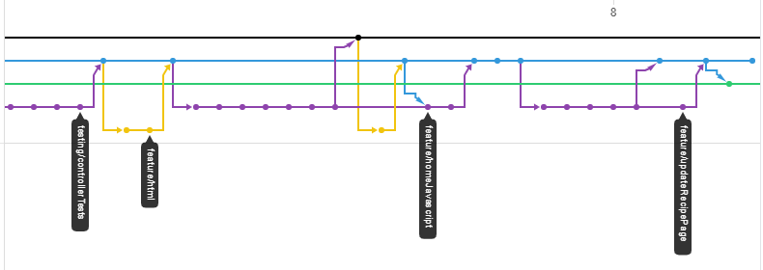
Version Control - Git
Used the Feature-Branch model
Feature branches
Testing branches

Slide 12
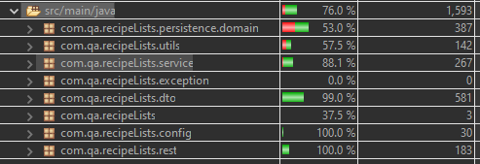
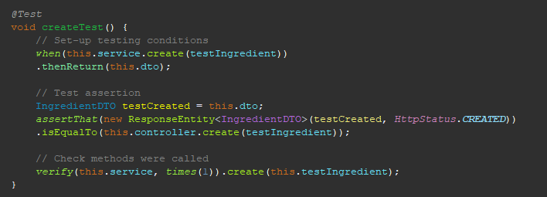
Testing – Unit Testing
Achieved 76% test coverage (this includes Integration tests)
Test all CRUD functions of both service and controller classes
DTO and Domain classes tested using ‘Equals Verifier’
Code for these classes is mainly generated by Lombok

Slide 13
Testing – Integration Testing
Using Mockito
Integration tests were particularly useful in finding problems with my program
Service tests brought up problems with the Recipe class
Led to making changes to the functionality of the Service class
Recipe Service integration test not completed

Slide 14
Testing – GUI Testing
Looked to my user-stories when planning out GUI tests in Selenium
Cover Create, Update and Delete functionality for each of the list types
Only tested in using the Chrome-driver
Brought up some issues I couldn’t find the source of, or that may be down to the tests themselves

Slide 15
Conclusion
Satisfied with the quality of the produced product
Satisfied with the testing coverage I was able to achieve
Given more time I would make some changes to the structure
i.e: making the ‘steps’ list ordered
Solving more of the bugs

Slide 16
Any questions?

