Slide 1

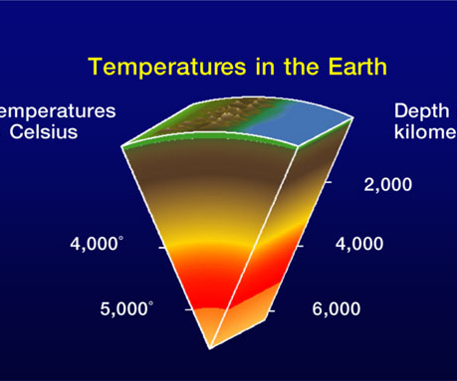
Geothermal Energy
Heat of the earth

Slide 2
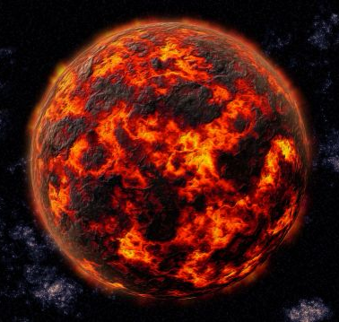
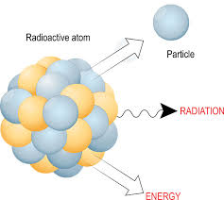
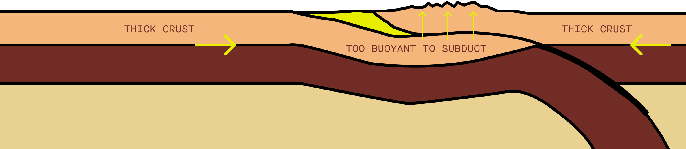
Processes
Earth's Formation
Decay of radioactive elements
Friction

Slide 3
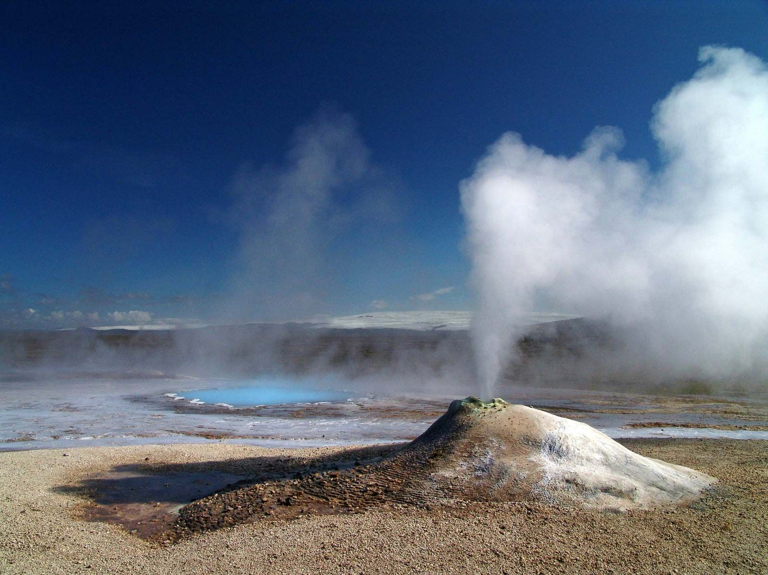
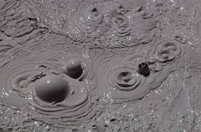
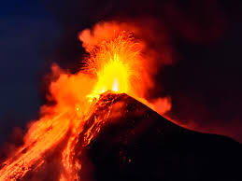
Geothermal Reservoirs
Geysers
Boiling mud pots
Volcanos

Slide 4
Uses
Direct Uses
Indirect Uses

Slide 5
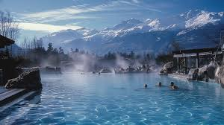
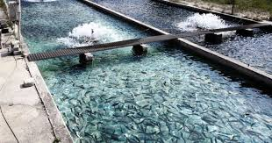
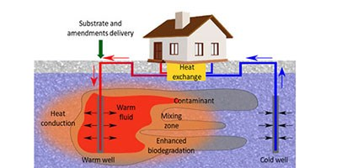
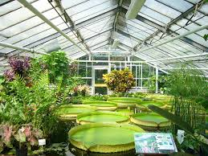
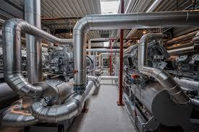
Direct Uses
Spas
Fish Farms
Heating Buildings
Heating in industries
Greenhouses

Slide 6
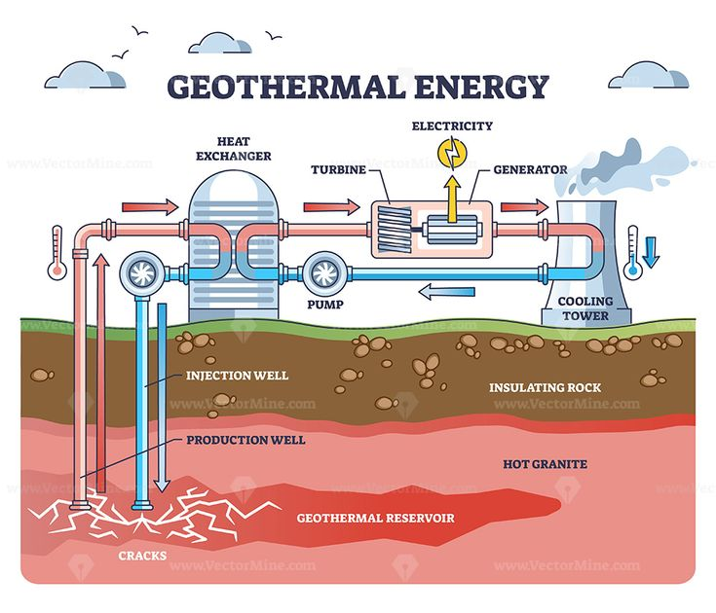
Indirect Uses

Slide 7

Advantages
Disadvantages

