Slide 1
Digital Humanities: An Introduction
Harriett Green
University of Illinois at Urbana-Champaign
Data Driven Scholarship Autumn Institute
University of Hong Kong, November 28-30, 2016
green19@illinois.edu | @greenharr

Slide 2
Today’s Talk
What Is Digital Scholarship and Digital Humanities?
Example projects in DH
Librarians and DH: New Roles in an Evolving Research Ecosystem
green19@illinois.edu @greenharr
Notes:
Here’s what I’d like to talk about today: After a brief consideration of why librarians are positioned to collaborate on DH research, I’d like to speak about my work in digital humanities with colleagues at the University of Illinois and beyond, and then briefly discuss some possible ideas for how librarians and scholars can forge new collaborations for scholarship.

Slide 3
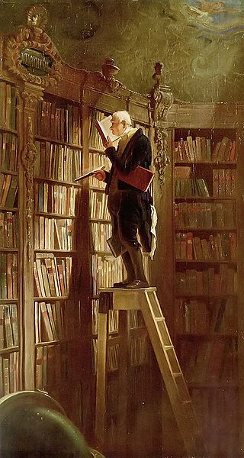
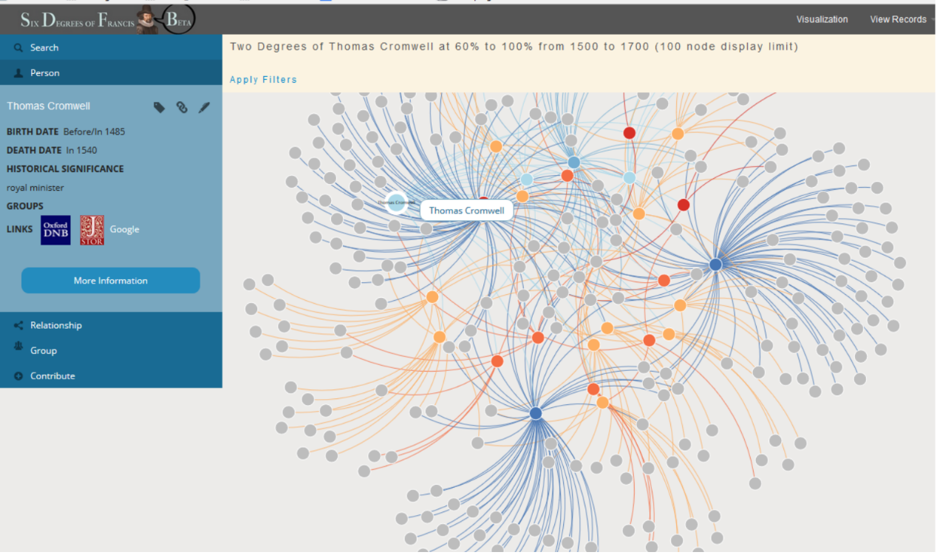
From the stacks to the screen….
Six Degrees of Francis Bacon, “Two Degrees of Thomas Cromwell at 60% to 100%”
Carl Spitzweg. 1850 The Bookworm (Der Bücherwurm)
Notes:
Scholars have long used and still use books, archival materials, photographs, and othe rmaterial objects found in libraries and archives for their research. But the research practices in the humanities and social sciences are changing with the rise in digital tools.

Slide 4
What is the digital humanities?
“An area of research, teaching, and creation concerned with the intersection of computing and the disciplines of the humanities…. Digital humanities scholars use computational methods either to answer existing research questions or to challenge existing theoretical paradigms, generating new questions and pioneering new approaches.”
—Wikipedia (http://en.wikipedia.org/wiki/Digital_humanities )

Slide 5
What Does Digital Humanities Look Like?
“Digital humanities as it is currently practiced isn’t just located in literary studies departments; the field is broadly humanities based and includes scholars in history, musicology, performance studies, media studies, and other fields that can benefit from bringing computing technologies to bear on traditional humanities materials.”
Kathleen Fitzpatrick
Notes:
My area of interest is what we now call digital humanities, which to summarize this definition from Kathleen Fitzpatrick, is a broad umbrella of humanistic disciplines who apply computational tools to research inquiry. And the key resource that begins to connect digital scholarship and libraries is the data:

Slide 6
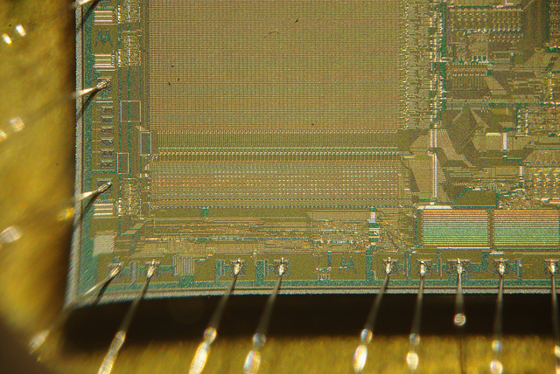
Humanities Scholarship and Data
“A critical mass of information is often necessary for understanding both the context and the specifics of an artifact or event, and this may include large collections of multimedia content: images, text, moving images, audio.”
Our Cultural Commonwealth: The report of the American Council of Learned Societies Commission on Cyberinfrastructure for the Humanities and Social Sciences (2006)
Notes:
When we think of humanities research, “data” is usually one of the last words to come to mind. The sciences have lab results and the social sciences have sample surveys and statistical analyses, but for the humanities, we often think of books, images, music scores, or manuscripts—materials that on the face of it, cannot be broken down into columns and rows for a table or graph.
This quote from the landmark 2006 white paper commissioned by the American Council of Learned Societies on data in the humanities, Our Cultural Commonwealth, explains how humanities and social sciences data is critically unique, noting,
“A critical mass of information is often necessary for understanding both the context and the specifics of an artifact or event, and this may include large collections of multimedia content: images, text, moving images, audio.”
And this is where the library’s role in digital humanities most immediately begins to emerge: We have this data in the form of our digital collections, our metadata and catalog records, our archives, and our networks of resources that scholars turn to and incorporate into their research.

Slide 7
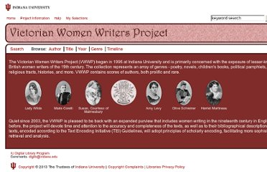
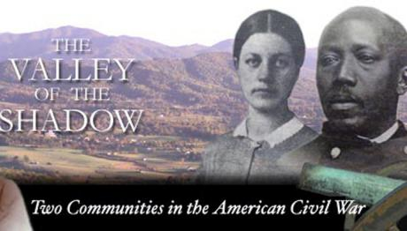
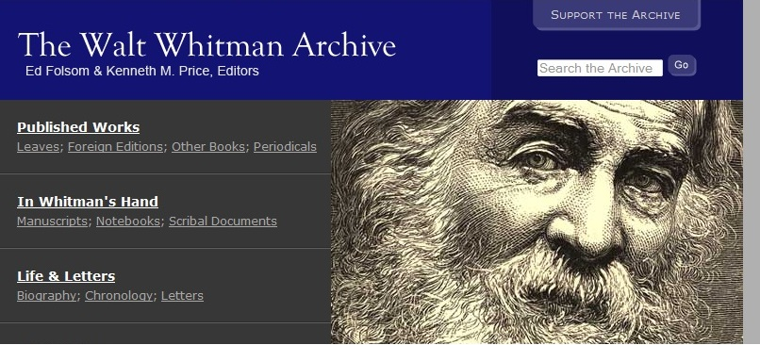
Early Digital Humanities Projects
Notes:
There is a legacy of digital humanities research in libraries: some of the pioneering DH projects such as Indiana University Libraries’ text encoding projects of Wright American Fiction and Victorian Women Writers Projects, or the University of Virginia’s Valley of the Shadow were pioneering digital humanities tools and resources over the past several decades.

Slide 8
DH Research: Recovering Archives
Women Writers Project: http://www.wwp.northeastern.edu/
Transatlantic Slave Database: http://slavevoyages.org/
Shelley-Godwin Archive: http://mith.umd.edu/research/shelley-godwin-archive/
Civil War Washington: http://civilwardc.org/
Emblematica Online: http://emblematica.library.illinois.edu

Slide 9
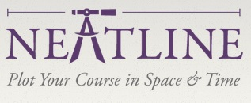

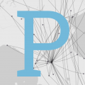
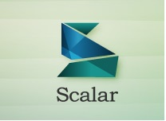
DH Research: Tool Building
Online Exhibitions
Omeka
Scalar
Mapping and Visualization:
Pleiades
Neatline
Palladio
ConTexT
Text Mining
Voyant
MALLET
TaPoR
Digital Editions
TAPAS
Juxta

Slide 10
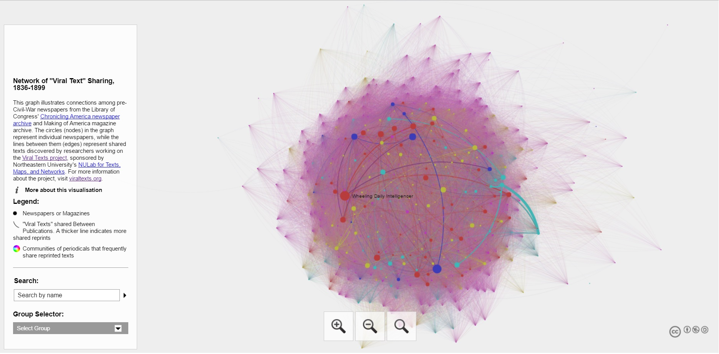
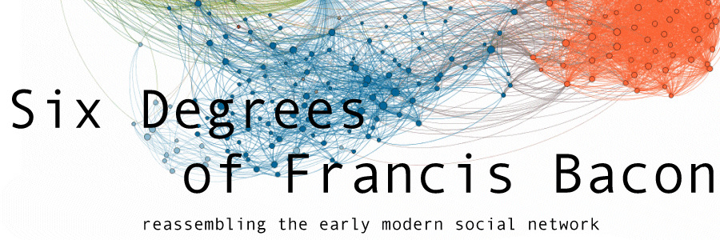
DH Research: Comparing and Visualizing “Big Data”
Network Analysis
Text Mining
Viral Texts, http://viraltexts.org/
Six Degrees of Francis Bacon, http://www.sixdegreesoffrancisbacon.com/
Notes:
Here are a selection of global digital humanities projects: As you can see, they seek to address various issues, cultural areas, and topics, ranging from Latinos to Native Americans to early histories.
I particularly want to point out Murkutu: This is more than a project, but a full content management system that enables indigenous peoples and cultural groups to gather heritage objects within the traditions and customs of their culture.

Slide 11

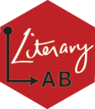

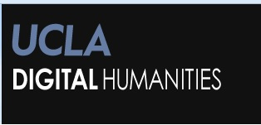
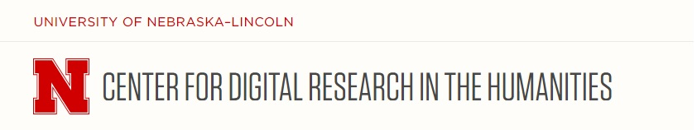
DH Research Is… Collaboration
Digital Humanities Centers
Digital Studios
Media Commons
Scholarly Commons

Slide 12
Global DH: Digital Projects Around the World
Digital Gazetter of the Song Dynasty: http://songgis.ucmerced.edu/
Chinese Civilization in Time and Space: http://ccts.sinica.edu.tw/
Murkutu: http://mukurtu.org/
Early Caribbean Digital Archive: http://omekasites.northeastern.edu/ECDA/
Chicana Por Mi Raza: http://chicanapormiraza.org/
Invisible Australians: http://invisibleaustralians.org/
Performing Archive: Curtis and the ‘Vanishing Race’: http://scalar.usc.edu/works/performingarchive/index
Soweto ‘76: http://www.soweto76archive.org/
Notes:
Digital Humanities admittedly has been dominated by Western, Anglo canonical works and scholars, but other cultures and languages are rising to be equally vibrant.

Slide 13



Digital Projects @ Illinois
HathiTrust Digital Library: http://www.hathitrust.org
HathiTrust Research Center: http://analytics.hathitrust.org
Publishing Without Walls: http://publishingwithoutwalls.illinois.edu/
Illinois Digital Newspapers: http://idnc.library.illinois.edu/
Emblematica Online:
http://emblematica.library.Illinois.edu
Notes:
Now when I arrived at Illinois nearly 8 years ago, I found that we had quite a legacy of digital scholarship research in the Library and the Graduate School of Library and Information Science:
Legacy projects such as MONK and SEASR, two text mining platforms; Digital libraries like our digitized newspaper collections and the HathiTrust Digital Library; and grant funded projects like Emblematica Online (which I’ll talk a bit more about in a moment).
Thus libraries and LIS professionals long have been important participants in digital scholarship research.

Slide 14
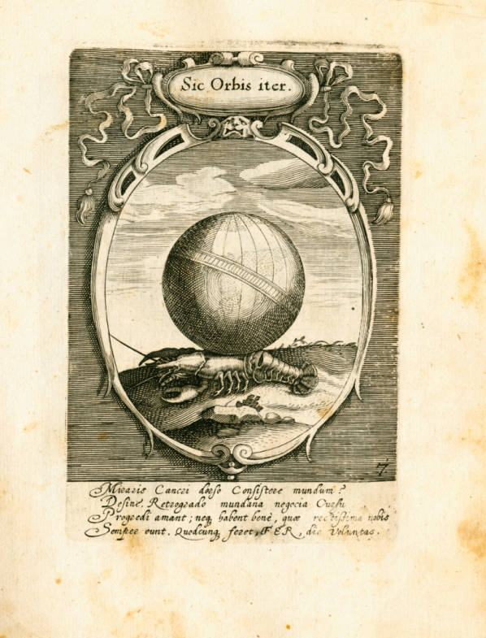
Emblematica Online
Provides single point of access to digitized emblem books from libraries in U.S., Germany, Netherlands, UK
Funded by a NEH/DFG Bilateral Digital Humanities grant (2008) and NEH Humanities Collections and Reference Resources grant (2013)
http://emblematica.library.illinois.edu
Notes:
But over the years, many emblem books have been digitized to varying extents, and Emblematica Online seeks to bring these disparate collection together via a single online portal that we call the Open Emblem Portal.
The initial instance of Emblematica Online was funded by a 2009 National Endowment for the Humanities/DFG Bilateral Digital Humanities Grant, and the latest phase is concluding a 2012-2015 Humanities Collections and Reference Resources grant from the National Endowment for the Humanities.
One major research project I recently wrapped up was Emblematica Online, an grant-funded digital humanities project on which I served as a co-PI with my Library colleagues Tim Cole and MJ Han and the lead investigator Mara Wade, a professor in the German department. Emblematica Online has received multiple NEH grants to digitize and annotate rare emblem books from the 16th through 19th centuries from our Rare Book and Manuscript Library in collaboration with libraries in Germany, the Netherlands, Scotland, and the U.S.
My role on the most recent grant with an NEH Humanities Collections and Access grant award has been to examine how this digital humanities resource can be utilized by scholars, and to study scholarly practices with digital collections. I drew upon my experience in working with students and faculty users, and my research on the usability of digital humanities resources for this richer research collaboration--I think this testifies to how we can draw upon our existing subject expertise in LIS to contribute vitally to digital projects.

Slide 15
Publishing Without Walls
http://publishingwithoutwalls.illinois.edu
Received $1 million grant from Andrew W. Mellon Foundation to develop library-based digital publishing services
Two imprints launched: Humanities Without Walls, African-American Studies
Partners:
University Library
School of Information Sciences
Department of African-American Studies
Illinois Program for Research in the Humanities
Notes:
One of the newest collaborative projects we’ve embarked on is Publishing Without Walls, a new 3-year Mellon funded initiative at Illinois to develop digital publishing services. We in the Library are partnering with GSLIS, our humanities institute, and the African American Studies department to engage with scholars around digital publications across the disciplines:
We will have two imprints, Humanities Without Walls, which is a Mellon-funded initiative out of the humanities institute to support experimental collaborative humanities research; and an African-American Studies imprint that supports HBCU scholars. We are already collaborating with scholars in musicology, media studies, history, and English literature on digital projects and publications, and we anticipate building out these collaborations. This work is part of our effort to support digital scholarship by facilitating new modes of publication.

Slide 16
DH in the Classroom = Digital Pedagogy
Digital Literacies
History
Media and Cinema Studies
Architecture
English
Omeka
Scalar
Voyant
Wordpress
Notes:
And another aspect of digital humanities is working in the classroom with students: This involves partnering with faculty to teaching digital humanities tools to undergraduates, and helping them use these tools to analyze and publish their research for their final projects.
These types of collaborations have included teaching Omeka, the online exhibition platform, to students in English, Media & Cinema Studies, and Architecture courses for hosting their final research projects that often included digital content created by the students such as videos, and for digital writing essays. We also have used Wordpress, the well-known blogging platform; and Scalar, a relatively new digital publishing platform developed by researchers at the University of Southern California, in Media and Cinema Studies courses for enabling students to create interactive media-rich digital projects that are published with a variety of media content.

Slide 17
DH + Undergraduate Research
Undergraduate research journals in Open Journal Systems (OJS):
https://ugresearchjournals.illinois.edu/index.php/ujlc
Other digital publishing tools used by students:
Omeka
Wordpress
Scalar
Notes:
Additionally, we have a relatively new program in the Scholarly Commons for publishing undergraduate research journals via the Open Journal System software (better known as OJS):
We publish undergraduate research journals for Political Science, an interdisciplinary initiative called Ethnography of the University, the agriculture and consumer sciences college, and the English department, where I serve as a faculty advisor to their undergraduate research journal.
And all of this feeds into our library services and serves to advance our research and teaching collaborations for digital scholarship.

Slide 18
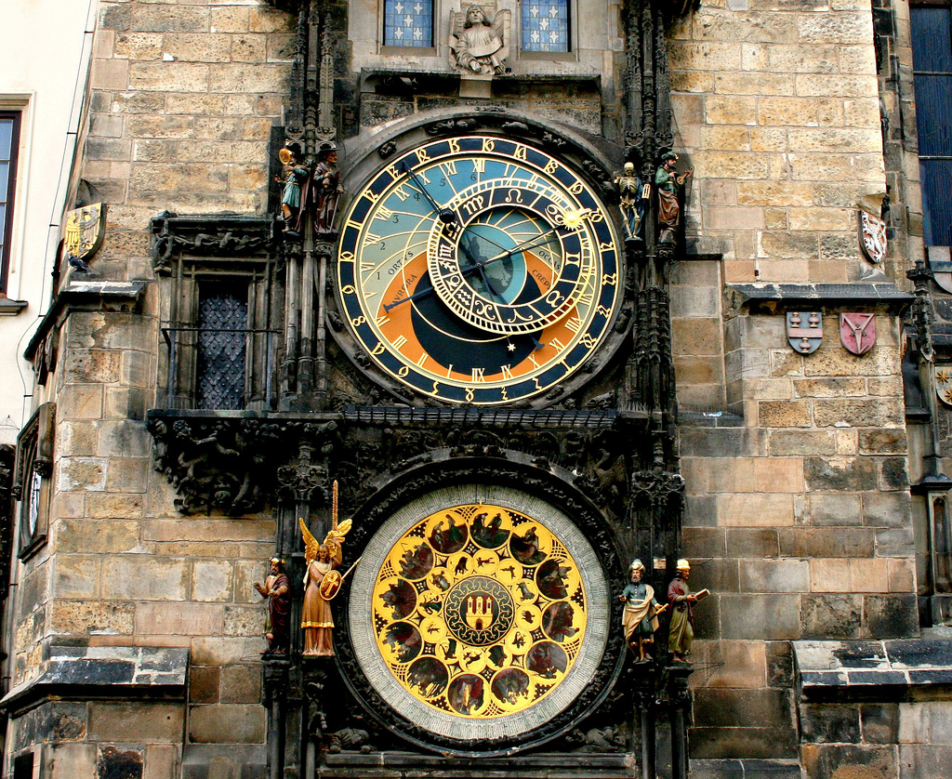
Librarians + DH: The Time Is Now
Notes:
Drawing upon these examples from our library, as well as the many other models for digital humanities research initiatives we see at other institutions around the world, I believe I’ve begun to build an argument for urgency of libraries to become engaged in digital scholarship through research collaborations, teaching and learning, and providing hubs of services.

Slide 19
Why Should Librarians Become Involved In Digital Humanities?
“Research collaborations between faculty and librarians continue to benefit both partners. Faculty benefit from library resources and librarian expertise. . . . librarians benefit from the opportunity to ‘secure the library’s future as a significant partner in research and scholarship.’”
Association for College and Research Libraries, Value of Academic Libraries (2011)
“Digital Humanities practitioners are producing many different types of content, all of which require ongoing management in order to maintain their viability. Regardless of the location of the digital humanities group(s) within the campus setting, the library has roles to play in helping these initiatives to produce and to manage sustainable resources for present and future generations.”
Walters and Skinner, New Roles for New Times: Digital Curation for Preservation (2012)
Notes:
For some expert views, there is a growing body of literature on how librarians can build skills and capacities for supporting digital scholarship:
The 2011 ACRL Value of Academic Libraries report argues that “research collaborations between faculty and librarians continue to benefit both partners. Faculty benefit from library resources and librarian expertise. . . . librarians benefit from the opportunity to ‘secure the library’s future as a significant partner in research and scholarship.’”
And the ARL report New Roles for New Times: Digital Curation for Preservation explicitly identifies digital humanities as a research area where libraries can become research collaborators, as quoted here.
These reports are among a number of studies that suggests research partnerships between faculty and librarians—as well as with other types of users—is more necessary than ever, and it also deepening to the point of revolutionizing user services: As we have seen at Illinois and at our counterparts across North America and abroad, academic libraries have begun positioning themselves as key spaces for our users: integrated learning spaces and media commons, hubs for digitization, and multi-service research centers. These initial transformations in user services and collections are key indicators that reveal ways in which libraries can begin to insert themselves into the conversation of digital humanities research and practice.

Slide 20
DH + Library = Community of Connections
Connections → Community of Practice
Digital Scholarship Centers
Research Collaborations
Teaching and Learning
Notes:
For the last part of my talk, I’d like to think about how we can build a community of practice for digital scholarship in the library. I’d like to discuss how librarians can be partners in digital scholarship and embed themselves in this research ecosystem in three ways:
library support services for digital scholarship
research collaborations with other units and institutions; and
Working with faculty on teaching and learning with digital humanities tools.

Slide 21
Challenges for DH in Libraries
“The research library will survive because of the introduction of ever more and newer digital technologies, not in spite of them.”
Bernard Frischer
Davis and Dombrowski, Divided and Conquered (2010, NITLE report)
Zorich, A Survey of Digital Humanities Centers in the United States (2008, CLIR)
ARL SPEC #326 kit: Digital Humanities and ARL SPEC Kit #350: Supporting Digital Scholarship (2016)
Studies and reports from Ithaka S+R, Association for Research Libraries (ARL), and Coalition for Networked Information (CNI)
White and Gilbert (eds.), Laying the Foundation: Digital Humanities in Academic Libraries (2016)
Hartsell-Gundy et al. (eds.), Digital Humanities in the Library: Challenges and Opportunities for Subject Specialists (2014)
Notes:
Digital humanities research support initiatives have been expanding in academic libraries in recent years, and with good reason: As Bernard Frischer wrote in a CLIR’s Library As Place report, “The research library will survive because of the introduction of ever more and newer digital technologies, not in spite of them.”
I’d recommend several reports: Davis and Dombrowski’s Divided and Conquered NITLE report; Diane Zorich’s 2008 CLIR report on digital humanities research centers in the U.S., and the Association of Research Libraries SPEC #326 kit on digital humanities centers in libraries published in 2011. Zorich notes in her study that in order for digital humanities centers to survive, collaborations with librarians and information scientists are vital. But how many libraries are taking part in digital scholarship initiatives?
ARL’s SPEC study on digital humanities in 2011 noted that of the sixty-four ARL libraries that responded to the SPEC survey, many were still developing staffing profiles and support structures for fully supporting digital humanities research: only five libraries had specifically digital humanities centers, while nearly twenty-five percent had some type of digital scholarship center and another forty-eight percent reported providing ad hoc services. As we build out these services, we need to think about the modes that most effectively reach our users and researchers.

Slide 22
People, not Projects
“What if you saw that training period as an investment in healthy, long-lasting relationships? What if we saw digital humanities as a long-term investment in scholarly growth, not a short-term investment in projects?”
Miriam Posner, http://miriamposner.com/blog/commit-to-dh-people-not-dh-projects/#more-1687
Notes:
I think one key is to ask ourselves, “Who are the users of digital humanities tools and services?” They have a vast spectrum of research interests and concerns, and range in type from the public patrons who may walk through our doors to the students, researchers, and faculty who conduct advanced research and make groundbreaking discoveries.
But the core of every digital project is the same as when we work with researchers in other contexts: the user and their research experience are the central concerns, not the hot, new tool or digital collection of the moment.
This quote from Miriam Posner at UCLA encapsulates the philosophy of this user-centered focus--a focus on “healthy, long-lasting relationships” and “long-term investment in scholarly growth.” She frames digital humanities services as not a series of one-off research projects or sporadic scattering of services, but rather a sustained philosophy of collaboration and scholarly services, and calls us to look beyond the immediate, short-term project or grant, and instead think about the broader strategies for user services and research support that we hope to achieve from digital scholarship work.

Slide 23
Librarians’ Advantages in Digital Humanities
Strong Faculty Relationships
Institutional Prominence
Information professional skills
Notes:
And involvement in digital humanities doesn’t mean that we need to run out and learn how to be computer programmers, web designers, and acquire a ton of other new skills. Librarians can leverage several inherent advantages:
The strong faculty relationships we have that can help us both make incursions into existing projects and find ways to connect to digital scholarship;
Institutional Prominence: the centrality and deep respect that libraries have on campus and in research communities across disciplines can be a critical force in connecting to digital scholarship research and provide it with the sustainability it needs;
And the skills we have as information professionals in areas like information organization, metadata and cataloging, information architecture, and the like.

Slide 24
My Work in Digital Humanities
Acquiring Tools and Resources
My Research
Consultations and DH Center Support
Notes:
Six years in, my work in digital humanities now primarily involves three aspects:
Within the Library, I work with colleagues and on my own to acquire resources and tools for digital scholarship: this includes acquiring texts (Gale Digital Collections), subscribing to digital tools such as Omeka.net, and of course, leading texts and guides for various digital methods, as we keep a collection in the Scholarly Commons.
I also engage in my own research, which is another avenue of engagement, as I investigate use and users of digital humanities resources, and build up connections with faculty and students around their needs for new modes of scholarship.
These connections are core to the most increasingly prominent piece of my work, which is advising on digital humanities projects. This includes working with faculty and students, working on grant-funded digital humanities projects with teaching faculty, and working in the Scholarly Commons, our digital scholarship center. My work with the Scholarly Commons gives us a way to expand our library services and advance potential research collaborations. Before I talk about the details of the digital scholarship centers on our campus, I wanted to think a bit about them:

Slide 25
Not Just A Service…
Librarian
Scholar
Computer Programmer
Exciting DH Project!
Notes:
So ultimately, a digital research project shouldn’t just look like this: The librarian looking in from the outside, while the scholar and computer programmer work together to produce an amazing Work of digital scholarship.…

Slide 26
Librarians in the DH Collaboratory
Scholar
Librarian
Technologist
Notes:
But ideally, librarians can be an integral part of a digital humanities collaboratory—part of a team that co-equally works together to produce innovative and thought-provoking research.

Slide 27
How To Get Involved
Association for College & Research Libraries:
Digital Humanities Interest Group
Digital Scholarship Centers Interest Group
Digital Curation Interest Group
Digital Library Federation (DLF) Forum
Association of Digital Humanities Organizations (ADHO): Libraries Special Interest Group, Global Outlook DH Special Interest Group
Text Encoding Initiative (TEI) Libraries Working Group
Notes:
If you want to learn more and get involved in digital scholarship, there are several avenues now:
In the Association for College and Research Libraries, we have several relatively new interest groups—the Digital Humanities Interest Group, the Digital Scholarship Centers, and Digital Curation.
Another major library organization is the Digital Library Federation, or DLF, and the DLF Forum—which is being hosted by you all this year in Milwaukee!—has become a de-facto conference for librarians in digital scholarship.
Code4Lib is another organization/conference to note, and its focus is primarily on issues for the technologists and IT people.
Beyond libraries, the Association for Digital Humanities Organizations has a brand new Libraries Special Interest Group, and the Text Encoding Initiative (TEI) also has a Libraries working group as well.
But these are just the tip of a growing iceberg—there are several other organizations whose focus overlaps with digital scholarship, such as Open Repositories and Library Publishing Coalition, and if you look at ALA Annual programs as well as year-round webinars, you’ll see that many sections, divisions, and interest groups host digital scholarship-related programming.

Slide 28
International DH Organizations
Japanese Association for Digital Humanities: https://www.jadh.org/
Digital Humanities in Nordic Countries: http://dig-hum-nord.eu/
Red de Humanidades Digitales (RedHD): http://www.humanidadesdigitales.net/
Humanidades Digitales Hispánicas (HDH)
Associazione per l’Informatica Umanistica e la Cultura Digitale
Digital Humanities Deutschland
Associação das Humanidades Digitais (AHDig)
Asociación de Humanidades Digitales en Argentina (HDA)
Ruach Digitalit – Digital Humanities Israel
Notes:
There are also a host of regional organizations around the world that focus on digital humanities research in their own languages and cultures, and this is a list of a few.

Slide 29
Resources
Association for Digital Humanities Organizations: http://digitalhumanities.org
Text Encoding Initiative: http://www.tei-c.org
Digital Humanities Now: http://digitalhumanitiesnow.org
DH Answers: http://digitalhumanities.org/answers/
Digital Humanities Quarterly: http://digitalhumanities.org/dhq/
Journal of Digital Humanities: http://journalofdigitalhumanities.org/
Minimal Computing: http://go-dh.github.io/mincomp/
Global Perspectives on Digital History: http://gpdh.org/
Notes:
There are a number of resources out there if you’re interested in learning more about Global Digital Humanities:
ADHO has a special interest Group,

Slide 30
DH Needs Us
DH communities
Scholars
Librarians
”One of the hallmarks of digital humanities practice has been the desire to experiment, to make things, to dig into our data – to see how humanities ‘things’ are ‘made.’ There is nothing contrary to the library spirit in that desire either…. What is all this traditional library work if not an engagement with how knowledge is ‘made’? And what are we, if not co-makers of that knowledge?”—Glen Worthey
Notes:
To wrap up, I believe that when it comes to digital scholarship, we can think of ourselves as not just supporters in the wings, but as Glen Worthey describes here, “co-makers of knowledge”, which is at the heart of the librarianship and DH ethos alike.
Digital humanities crucially intersects with skillsets and philosophy of library and information science, curation, and bibliography to make collaborations between librarians and researchers doing digital scholarship meaningful and necessary.
Thus there rarely has been a richer moment than now when libraries can reposition their identities and mission to become even more embedded in the research process and advanced scholarship. Digital scholarship needs us, whether they know or not, and we must capture this valuable opportunity to insert ourselves in dynamic and innovative scholarly conversations.

Slide 31
Works Cited
Digital Humanities Manifesto, http://www.humanitiesblast.com/manifesto/Manifesto_V2.pdf
Kathleen Fitzpatrick, “The Humanities, Done Digitally,” Debates in Digital Humanities, ed. Matthew K. Gold. Minneapolis: University of Minnesota Press, 2012. http://dhdebates.gc.cuny.edu/debates/text/30
American Council for Learned Societies. Our Cultural Commonwealth: The report of the American Council of Learned Societies Commission on Cyberinfrastructure for the Humanities and Social Sciences. New York: ACLS, 2006.
W.A. Wulf, “The Collaboratory Opportunity,” Science (1993)
C. Williford & C. Henry. Computationally intensive research in the humanities and social sciences: A report on the experiences of first respondents to the Digging Into Data Challenge. CLIR Publication No. 151. Washington, D.C.: Council on Library and Information Resources, 2012: p. 4.
Ted Underwood, “Versions of Disciplinary History,” https://tedunderwood.com/2016/05/04/versions-of-disciplinary-history/
Glen Worthey, “Literary texts and the library in the digital age, or, How library DH is made,” http://bit.ly/worthey-dh
Miriam Posner, http://miriamposner.com/blog/commit-to-dh-people-not-dh-projects/#more-1687

Slide 32
Photo Credits
Dippy Duck, "Construction,“ https://farm5.staticflickr.com/4016/4482220417_1a1a26848b_z.jpg
"Magnifying Glass,” by Auntie P, on Flickr, https://www.flickr.com/photos/auntiep/17135231
jay8085, "Astronomical Clock, Prague," On Flickr, https://flic.kr/p/6sUn9G
"classroom” by Lauren Manning, on Flickr, https://www.flickr.com/photos/laurenmanning/2318943806
"Stockholm Train Station“ by lasard on Flickr, https://farm3.staticflickr.com/2224/2264955753_e25bbec9f4_b.jpg
Shawn Harquall, "Abandoned Train Station,' on Flickr, https://flic.kr/p/oM4JXm
Peter Isselburg, Emblemata Politica, 1617, http://libsysdigi.library.uiuc.edu/OCA/Books2009-10/emblematapolitic00isel/

Slide 33
Thank you!
Harriett Green
English and Digital Humanities Librarian
Associate Professor, University Library
University of Illinois at Urbana-Champaign
Email: green19@illinois.edu
Twitter: @greenharr
Notes:
Thank you for your time and I welcome your questions.

