Slide 1
What are Digital Scholarship Centers?
Eleanor Dickson
University of Illinois at Urbana-Champaign

Slide 2
The landscape for supporting digital scholarship
Trends on academic campuses

Slide 3
Digital scholarship
“use of digital evidence and method, digital authoring, digital publishing… and digital use and reuse of scholarship….This work helps produce new forms of hybrid and multimodal scholarship that can combine print and web-based text, video, audio, still images, annotation, and new modes of multithreaded, nonlinear discourse.”
- Association of Research Libraries, SPEC Kit 350

Slide 4
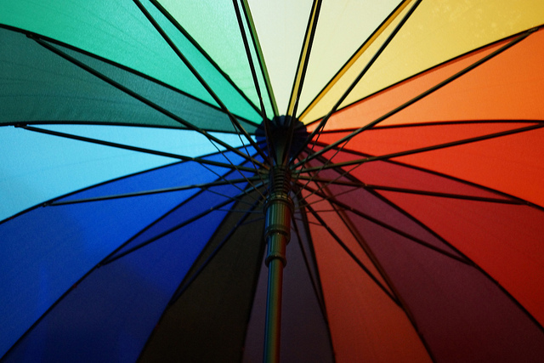
Digital scholarship
Digital Scholarship is an umbrella term
Other related terms:
Digital Humanities
Computational Social Science
Digital Publishing
& Scholarly Communication
Digital Pedagogy
Song Zhen, Rainbow umbrella, http://bit.ly/2fSklFs

Slide 5
Digital scholarship
Multidisciplinary
Humanities
Social Science
Science, Technology, and Math
Interdisciplinary
Collaborative research teams

Slide 6
Institutional locations
Both in and out of libraries
University College London’s Center for Digital Humanities is under the faculties of Engineering and of Arts and Humanities
Brown University’s Center for Digital Scholarship is in the library
“Does Every Research Library Need a Digital Humanities Center?”
OCLC Research publication, 2014
Short answer: No!
Develop program to suit your institutional contexts

Slide 7
What makes a digital scholarship center?
People
Project partners
Instructors
Research consultants
Tool-builders
Spaces
Computer labs
Digital infrastructure
Meeting rooms, shared workspace
Notes:
Not mentioned: projects (http://miriamposner.com/blog/commit-to-dh-people-not-dh-projects/)
Software at Rutgers: https://www.libraries.rutgers.edu/digital-humanities-lab
Geospatial analysis:
QGIS
Text editing:
TextWrangler, oXygen
Image editing:
ImageMagick, Adobe CS6 Production Premium
Moving image editing:
iMovie
Network analysis:
Gephi
File management:
FileZilla
Object oriented programming:
Python 2.7, R
Document processing:
LibreOffice, pandoc, LaTeX, Microsoft Office Suite
Command line utilities:
ImageMagick, wget, pandoc
IDE:
RStudio
Virtualization:
Parallels

Slide 8
People: job titles
Digital projects ________
Digital initiatives ________
GIS ________
Digital humanities ________
Data curation ________

Slide 9
People: job duties
According to ARL SPEC Kit 350, libraries are most engaged in:

Slide 10
People: serving faculty and students
Instruction
One-shots and short courses
Deep-dive workshops
Working groups
Librarian development programs
Faculty “study” groups
Fellowship and residency programs
Incubators
Paid or for-credit
Notes:
Trends toward deeper-dive training
Ex. MITH DH Incubator, Vanderbilt group
University of Virginia’s Praxis Program

Slide 11
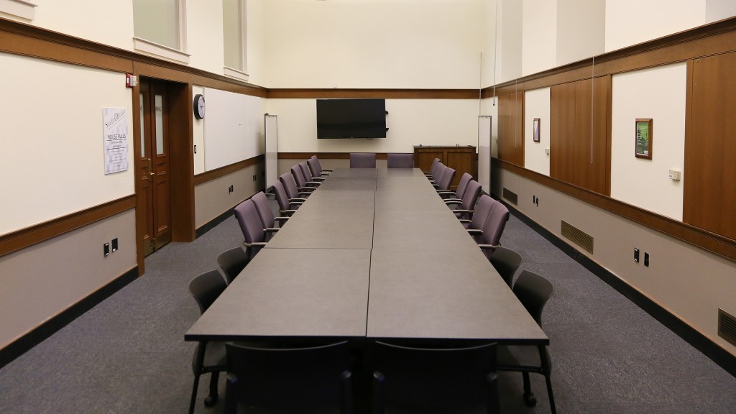
Spaces
Studio at Butler, Columbia University
Notes:
https://studio.cul.columbia.edu/ - run by their DH Center and Center for Teaching and Learning – BYOT, configurable, seminars/workshops/meetings - whiteboards

Slide 12
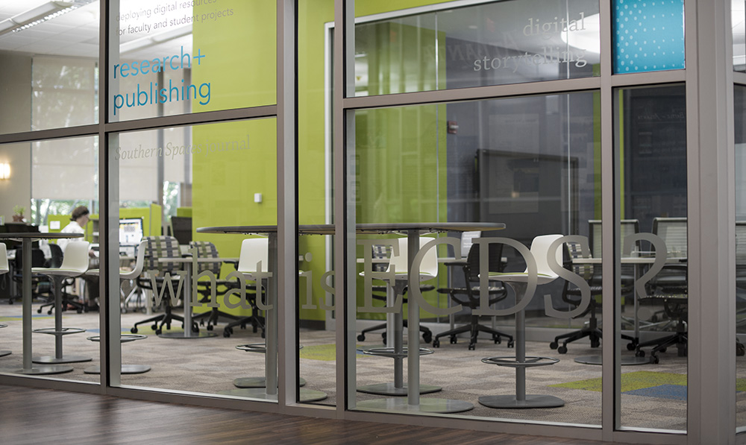
Spaces
Emory Center for Digital Scholarship, Emory University
Notes:
Staff and student workstations, grad student assistants, 2 conference/meeting spaces – desktop computers, printer, regular desks – static, not very configurable

Slide 13
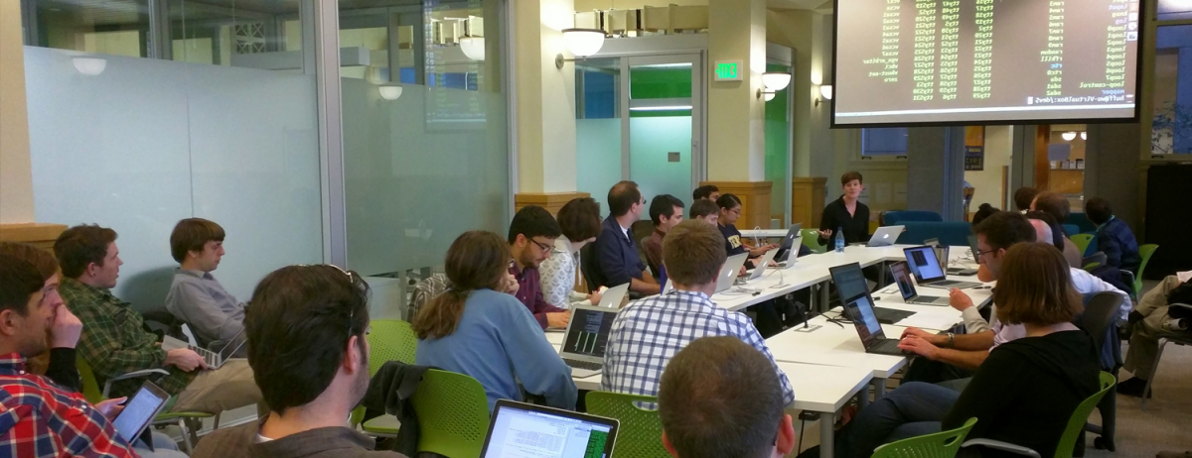
Spaces
Berkley Institute for Data Science, University of California at Berkeley
Notes:
Highly configurable, student workstations (for fellows), seating, tables that move, projector from ceiling

Slide 14
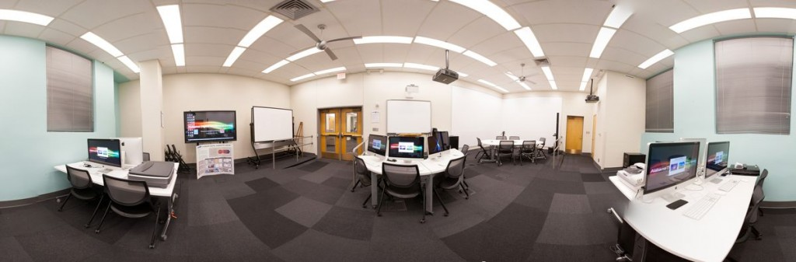
Spaces
Alabama Digital Humanities Center, University of Alabama
Notes:
Scanner, desktop computers, whiteboards, projector

Slide 15
Challenges
Staff
Recruiting expert staff
Training staff who are not experts
Columbia University’s “Developing Librarian Program”
Finding enough time
Developing service model
Determining community needs
Staying relevant for users

Slide 16
Local needs assessments
Step 1 in Ithaka S+R’s DH “Sustainability Implementation Toolkit”
Example: University of Colorado Boulder
Environmental scan
Campus scan
Campus survey
Interviews
White paper report of recommendations

Slide 17
Digital Scholarship at Illinois
A case study

Slide 18
Distributed model
Library centers:
Scholarly Commons
IDEA Lab
Media Commons
Scholarly Communications and Publishing unit
Campus centers:
Center for Interactive Teaching and Learning
Illinois Program for Research in the Humanities
National Center for Supercomputing Applications, Culture & Society Initiative

Slide 19
Scholarly Commons hub-and-spoke model
Subject
specialists
Scholarly Commons
Numeric and Spatial Data Librarian
Digital Scholarship Liaison and Instruction Librarian
HTRC Digital Humanities Specialist
GIS Specialist
English and Digital Humanities Librarian
Library & Information Science Librarian
Art Librarian
Campus partners
Center for Interactive Teaching & Learning
Illinois Program for Research in the Humanities
National Center for Supercomputing Applications
Functional specialists
Data Curators
Digital Publishing Specialist
Visual Resource Curator

Slide 20
Services offered
Space & software
Teaching and Learning
Consultations
Partnering on projects

Slide 21
Space and software
Scanners and OCR
Very popular!
GIS software
Ex. ArcGIS
Statistical software
Ex. SPSS
Qualitative research software
Ex. ATLAS.ti

Slide 22
Teaching and Learning: Library Staff
Savvy Researcher workshops
Research Data Services Interest Group
Webinars on issues in data and digital scholarship
HathiTrust Research Center train-the-trainer initiative
DH Symposium with pre-conference workshops
Digital Scholarship Lunch n’ Learn series
Qualitative methods workshops
Notes:
And we have a number of training opportunities, though not particularly programmatic:
The Scholarly Commons offers a number of workshops in our “Savvy Researcher” series that relate to digital scholarship and several colleagues have shown up to my workshops
The Research Data Services runs an interest group for librarians interested research data
Our staff development and training is always happy nad eager to support webinars
We do special events: I’ve organized two digital humanities symposia and had worksohps that librarians have attended
Two newer initiatives:
We received an IMLS laura Bush 21st Librarian to develop text mining workshops for librarins based on our work with the HathiTrust Research Center
My colleague Merinda Hensley has started this semester a Digital Scholarship Lunch and Learn series to get librarians to start talking
Workshops on qualitiative methods
I’d also add that there are events at the iSchool and around campus that are open;
and several librarians have attended DHSI, HILT, and other DH training workshops around the country

Slide 23
Teaching and Learning : Campus-wide
Savvy Researcher workshops
Humanities data/ Data and Software Carpentry
In-class visits
Humanities-centric Hackathon
HackCUlture: https://publish.illinois.edu/hackculture/

Slide 24
Consultations
Directed via email list
Bring in experts when needed
Para-professional graduate assistants provide front-line support
Traditional reference
Can make appointments with professional staff

Slide 25
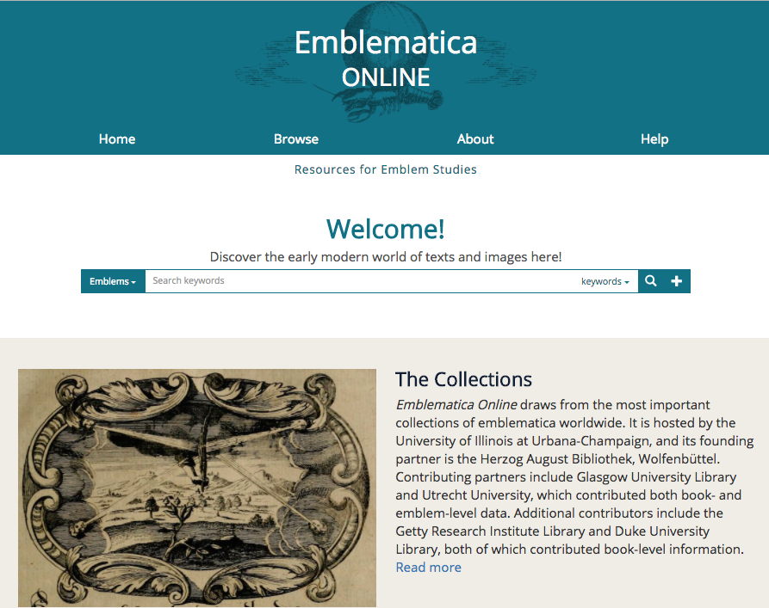
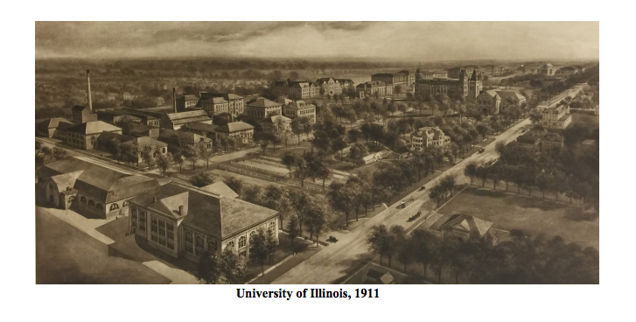
Partnering on projects
Example: Emblematica Online
Example: Mapping History at Illinois

Slide 26
Digital Scholarship Needs Assessment
Assessing current model, needs, expectations
Interviews with faculty, graduate students, post-docs, staff
Targeted survey
Results will inform development of re-imagined library space
Feedback will allow us to tailor our support model
Early results show desire for:
Training in digital scholarship
Assistance acquiring funding
Strengthened community-of-practice

Slide 27
Conclusions

Slide 28
Building a digital scholarship center
Data-driven research spans disciplines
Center = space + people
No one-size-fits-all model for centers
Analyze your community

Slide 29
References
http://www.oclc.org/research/publications/library/2014/oclcresearch-digital-humanities-center-2014-overview.html
http://www.arl.org/focus-areas/scholarly-communication/digital-scholarship-support/4104-library-digital-scholarship-support-profile-university-of-illinois-at-urbana-champaign
http://www.sr.ithaka.org/publications/sustainability-implementation-toolkit/
http://acrl.ala.org/dh/2015/01/30/designing-a-digital-humanities-strategy-using-data-driven-assessment-methods/
http://miriamposner.com/blog/commit-to-dh-people-not-dh-projects/

