Slide 1
Text Analysis with the HTRC Extracted Features
Eleanor Dickson and J. Stephen Downie
University of Illinois at Urbana-Champaign

Slide 2
Considerations for when text is data
Data quality
Clean vs. dirty OCR
HathiTrust OCR is dirty (uncorrected)
Text corpora
“bodies” of text
Refer to big collections, or to an individual’s target of analysis
Drill down to relevant text within corpus
Don’t always need the whole item

Slide 3
Finding text
Not always easy
copyright restrictions
licensing restrictions
format limitations
hard-to-navigate systems
** issues become more pronounced at scale**

Slide 4
Finding text: vendor databases
Be aware of licensing restrictions
Strategies
Addendums to libraries’ contracts
Vendor-provided services
Asking for special permission case-by-case
Some (U.S.) vendors are creating access models accessing text for data mining

Slide 5
Finding text: digital collections
Wealth of material
But:
often siloed
access not formulated for research at scale
Things to look for:
Plain text
Bulk download
Notes:
expand

Slide 6
Finding text: social media
Twitter
Facebook
Reddit
Some platforms make it easier than others to access data
Twitter is more available than Facebook
Can find examples online of code to reuse to grab data

Slide 7
Automating retrieval: APIs
Application Programming Interfaces
Digital paths to and from systems or collections
Can be used to gain programmatic access
Write code to retrieve content
Sometimes have graphical user interface (GUI)
Examples:
Amazon API
HathiTrust APIs
Notes:
expand

Slide 8
Automating retrieval: web scraping
There’s lots of text on the web, and scraping helps you get it without tedious copying-and-pasting
Method for bulk downloading
Unix libraries for scraping
Curl
Wget
Use commands and/or scripts to pull text from webpages

Slide 9
Automating retrieval: transferring files
FTP (File Transfer Protocol) and SFTP (SSH File Transfer Protocol)
Way to move files on and off a server
rsync
Efficient because it sends only the differences between the files at the source location and the files at the destination location
Use to download HTRC Extracted Features data

Slide 10
Non-consumptive research paradigm
Technology-aided research that allows for distant, computational analysis without permitting close, human reading.
Complies with U.S. copyright law
Foundation underlying structure of HTRC work

Slide 11
Non-consumptive access to text
Doesn’t allow you to read the full text
Access is allowed:
For computer reading
To information about the text
To features distilled from the text

Slide 12
HTRC Extracted Features

Slide 13
HTRC Extracted Features Dataset
A dataset of page-level extracted features for volumes in the HathiTrust Digital Library
One approach for ‘non-consumptive,’ malleable representations of works

Slide 14
Larger corpora allow for new insights
Historic
Add example
Cultural
Add example
Linguistic
Add example

Slide 15
What are features?
Features are a translation of text from language that humans understand to language that machines understand.
RAW TEXT
▼
TRANSLATION INTO FEATURES (you are here)
▼
ALGORITHMIC USE

Slide 16
Extracted Features Dataset
Hard to make one size fit all with out-of-the-box algorithms
Extracted features dataset assists in
More obscure questions
Functionality not in HTRC
Better sensitivity to what is happening to data
Avenue for approved access to restricted text

Slide 17
Data
2 trillion tokens (words)
5 billion pages
13.6 million volumes
https://analytics.hathitrust.org/features

Slide 18
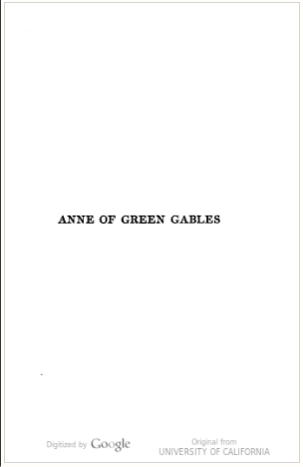
Example

Slide 19
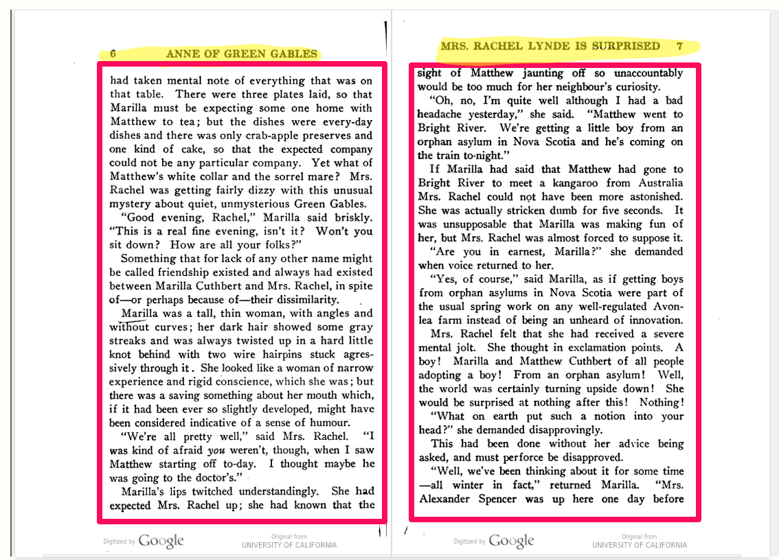
What features?
Page is split into sections:
header, body, footer
For each section:
Token count
Part-of-speech-tagged token frequencies
Distinguish “Rose” (proper noun), “rose” (noun), and “rose” (verb)

Slide 20
EF files: Body
Part-of-speech tagging:
Use Penn Treebank tags (http://www.cis.upenn.edu/~treebank/home.html)
NN – noun
NNP – proper singular noun
NNPS – proper plural noun
JJ – adjective
VB – verb (base form)
IN – preposition
"body":{
"tokenCount":504,
"lineCount":43,”
emptyLineCount":0,”
sentenceCount":12,
"tokenPosCount":{
" Synthesis":{"NNP":1},
"Laws":{"NNP":1},
"beautiful":{"JJ":1},
"philosopher":{"NN":1},
"for":{"IN":1},

Slide 21
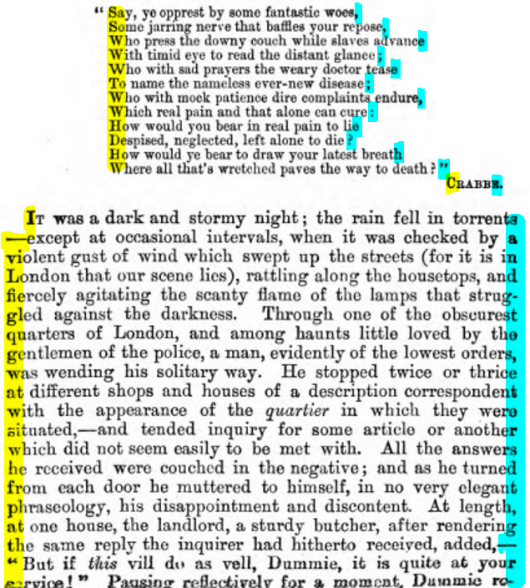
What features?
For each page
Count of longest string of consecutive capital letters
Language inference
For each section
Counts of characters occurring at the beginnings and ends of lines
Sentence count
Line count
Empty line count

Slide 22
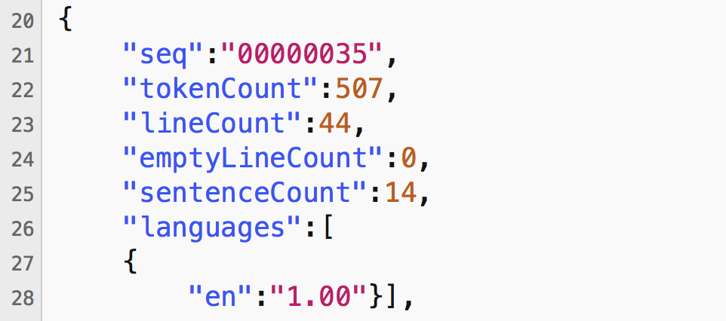
EF files: Page-level metadata

Slide 23
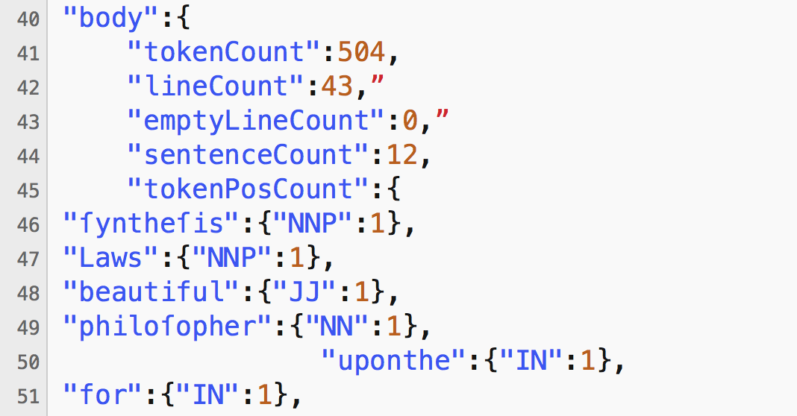
EF files: Body

Slide 24
EF Possibilities
Compare term counts, word clouds
Within-book comparison of themes
Identify part of book
Chapter headings, frontispieces
Classification against metadata
Topic modeling

Slide 25
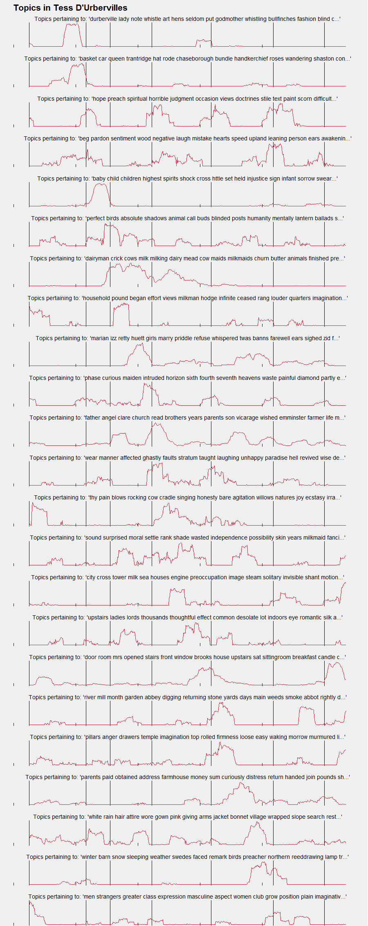

Slide 26

Word similarity tool, David Mimno
https://mimno.infosci.cornell.edu/wordsim/nearest.html

Slide 27
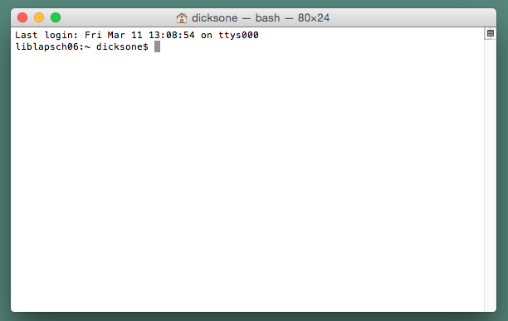
Intro to the command line

Slide 28
Intro to the command line
Command line interfaces
AKA shells
Mac: Terminal
Windows: Command Prompt
Alternative: Cygwin, GitBash
We’ll use the command line interface in PythonAnywhere

Slide 29
Intro to the command line
Tips for working on the command line
Directory = folder
Case, spaces, and punctuation matter
Tab to autocomplete a line
Hit up/down arrow to see last commands entered
Notes:
Some basic tips for working in a shell:
A directory is essentially a folder, so when you need to “change directories” it’s like clicking from “Desktop” to “Downloads”
Cases, spaces, and punctuation matter. If you get an error, check first to make sure you entered the command correctly
Hitting tab while you are typing on the command line attempts to finish the command or file name you are entering
Hitting the up arrow will cycle through the last commands you entered, but will not allow you to move between lines in a multi-line command – use the sideways arrows to navigate one command

Slide 30
Intro to the command line
Some basic commands:
cd – Change directory – ex. cd /Downloads
ls – list the files and directories – ex. ls –l
pwd – see which directory you’re in
mkdir – make a directory – ex. mkdir project1
mv – rename a file – ex. mv book1.txt book5.txt
less – view (but not edit) a file – ex. less book5.txt

Slide 31
Hands on
We’ll do a few activities to practice working with HTRC EF
View proper nouns in the Extracted Features for a volume
Compare word counts in the Extracted Features for a volume

Slide 32
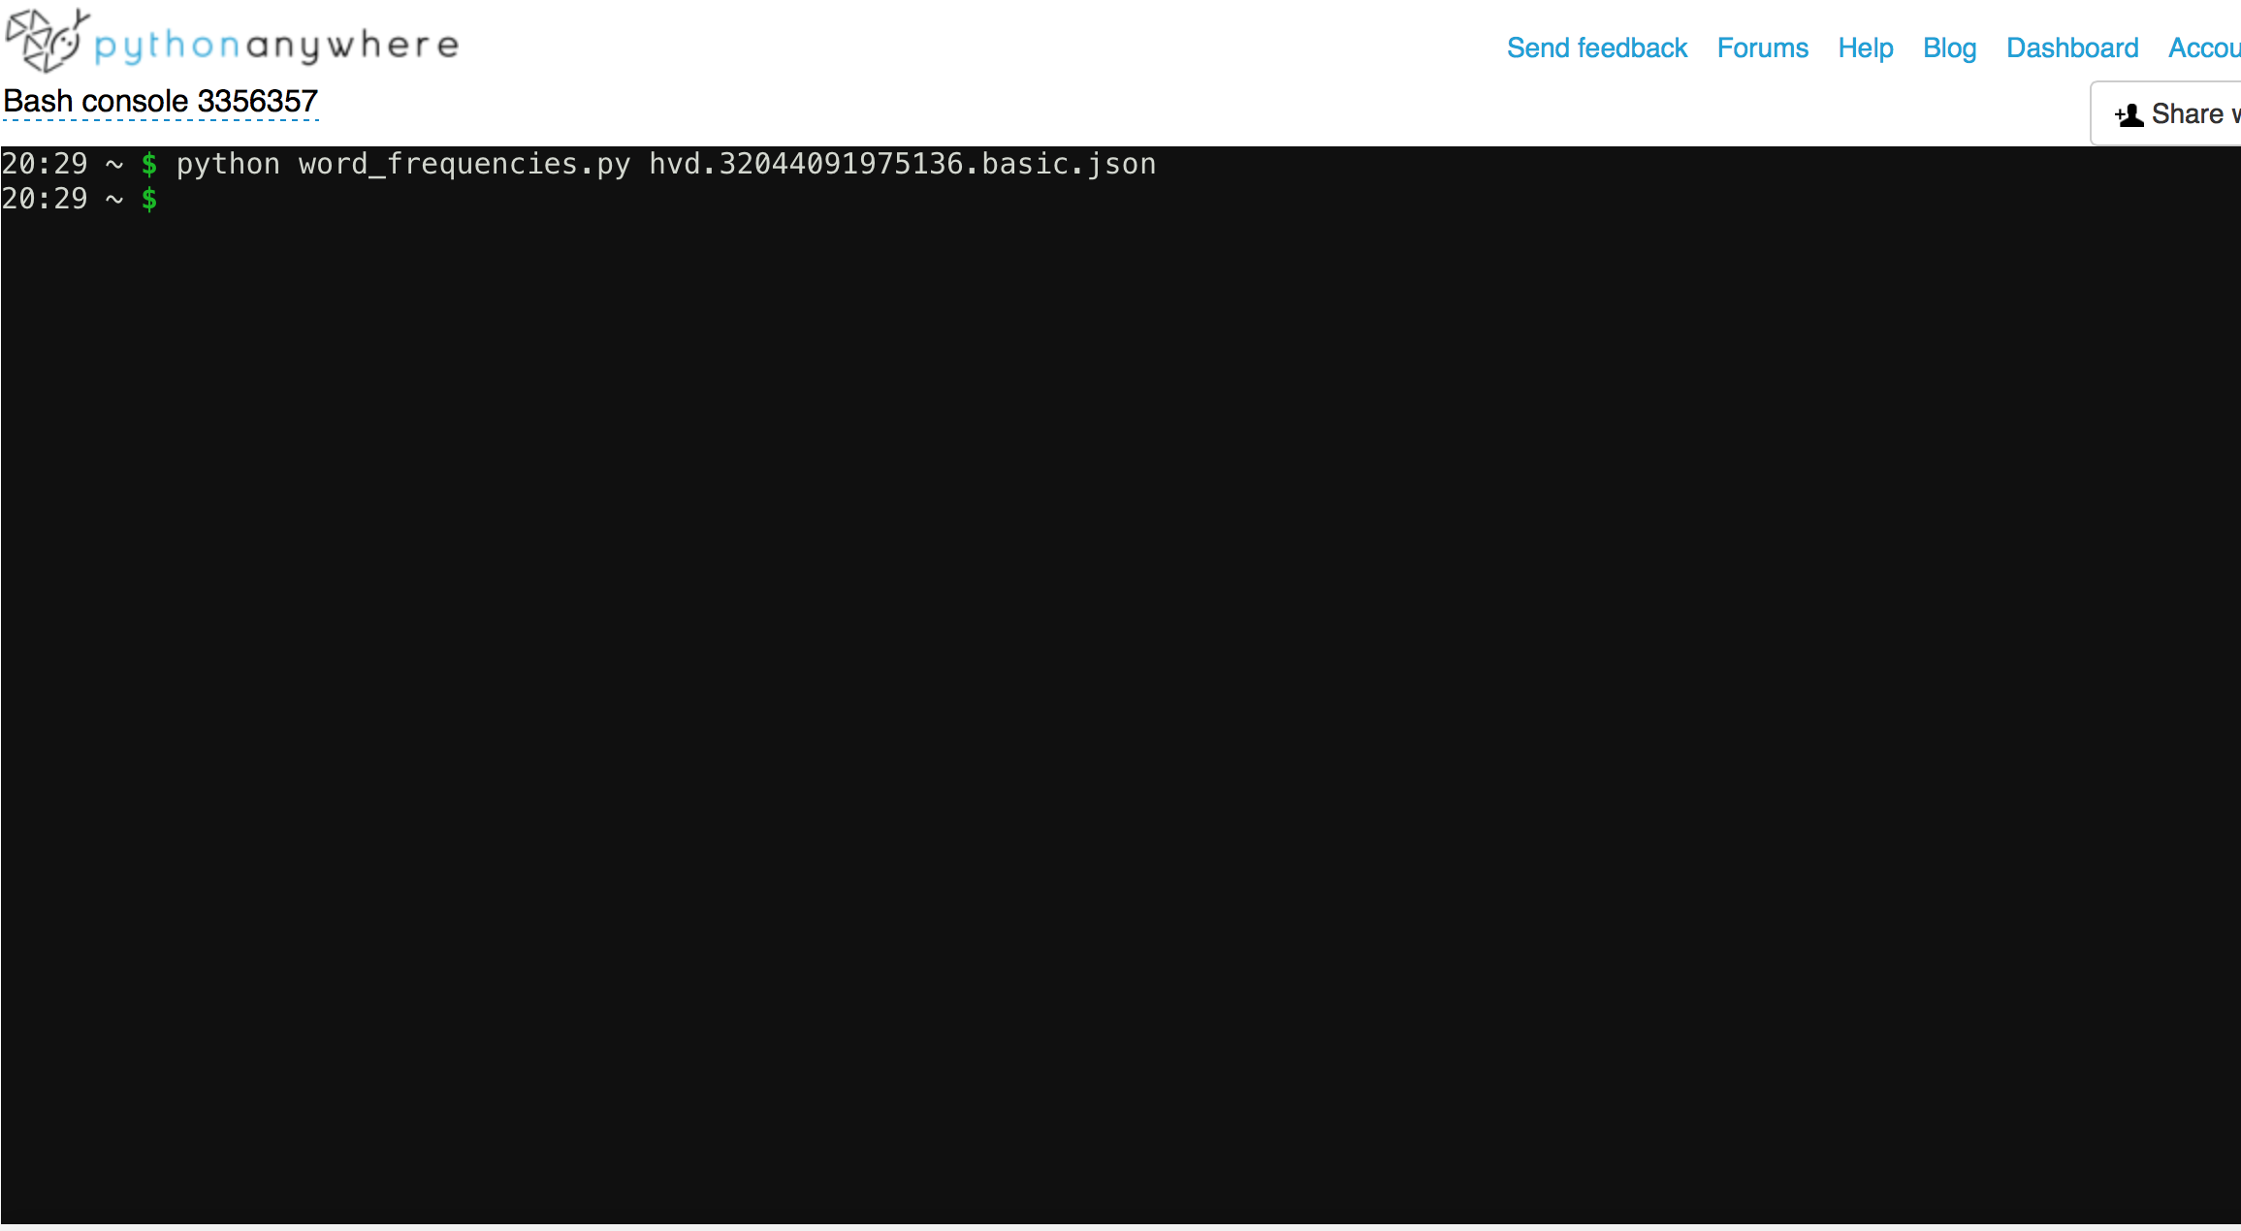
See proper nouns
Open shell and type command:
python word_frequencies.py hvd.hn6ltf.basic.json

Slide 33
See proper nouns
Run command:
If you don’t get an error, it ran correctly.

Slide 34
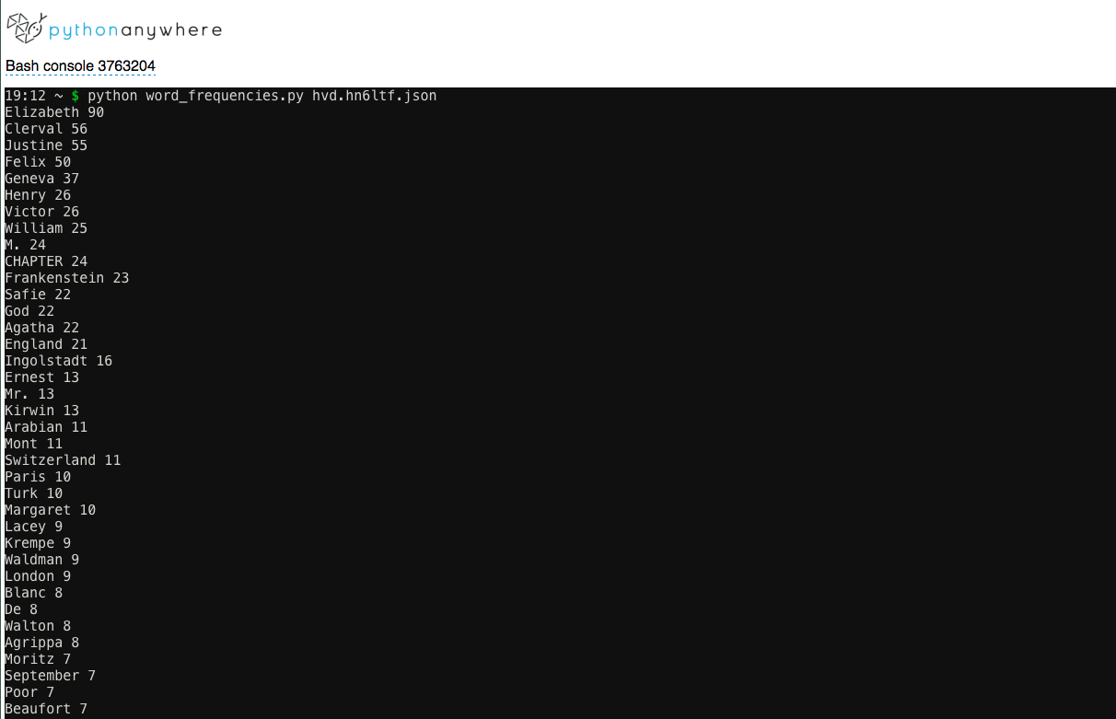
See proper nouns
View results:

Slide 35
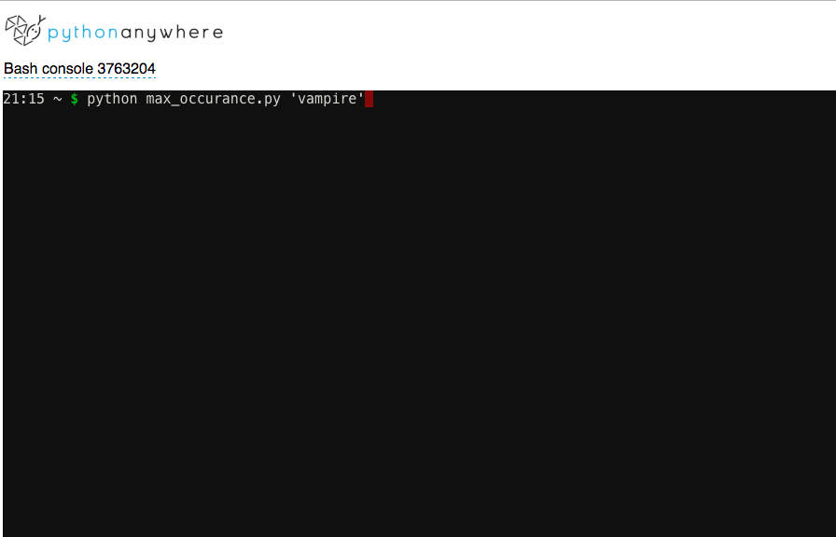
Compare word usage
Run script
python max_occurance.py 'vampire'

Slide 36
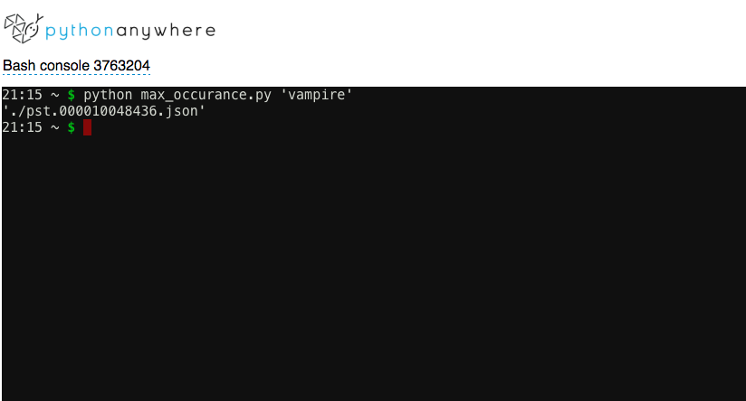
Compare word usage
View results

Slide 37
Beyond features: accessing HT data
Downloadable data to work with on your own machine
Several ways to get access
Metadata
Hathifiles: files of abbreviated bibliographic metadata
Bibliographic API: files of full bibliographic, rights, and volume information
Full text data
Data API: retrieve content (page images and/or OCR) for volumes in the HT
Custom data request: for bulk access to OCR text for volumes in the HT
HTRC Data Capsule

Slide 38
Questions?

