Slide 1
WEKA: A Friendly Interactive Exploration
J. Stephen Downie
School of Information Sciences
University of Illinois at Urbana-Champaign
jdownie@illinois.edu
Xiao Hu
Faculty of Education
University of Hong Kong
xiaoxhu@hku.hk

Slide 2
Agenda
What is WEKA?
Clustering
Classification
Wrap Up and Discussion

Slide 3
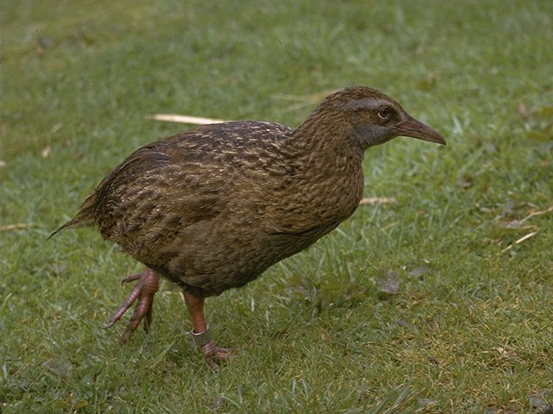
WEKA: the bird
The Weka or woodhen (Gallirallus australis) is an endemic bird of New Zealand. (Source: WikiPedia)
Copyright: Martin Kramer (mkramer@wxs.nl)

Slide 4
WEKA: the tool
Machine learning/data mining software written in Java (distributed under the GNU Public License)
Used for research, education, and applications
Complements “Data Mining” by Witten & Frank
Main features:
Comprehensive set of data pre-processing tools, learning algorithms and evaluation methods
Graphical user interfaces
Environment for comparing learning algorithms

Slide 5
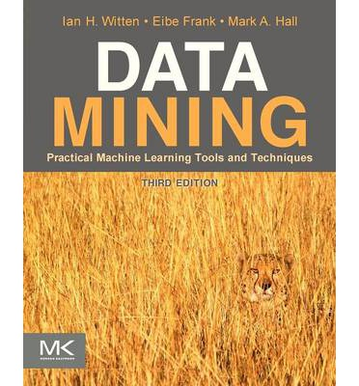
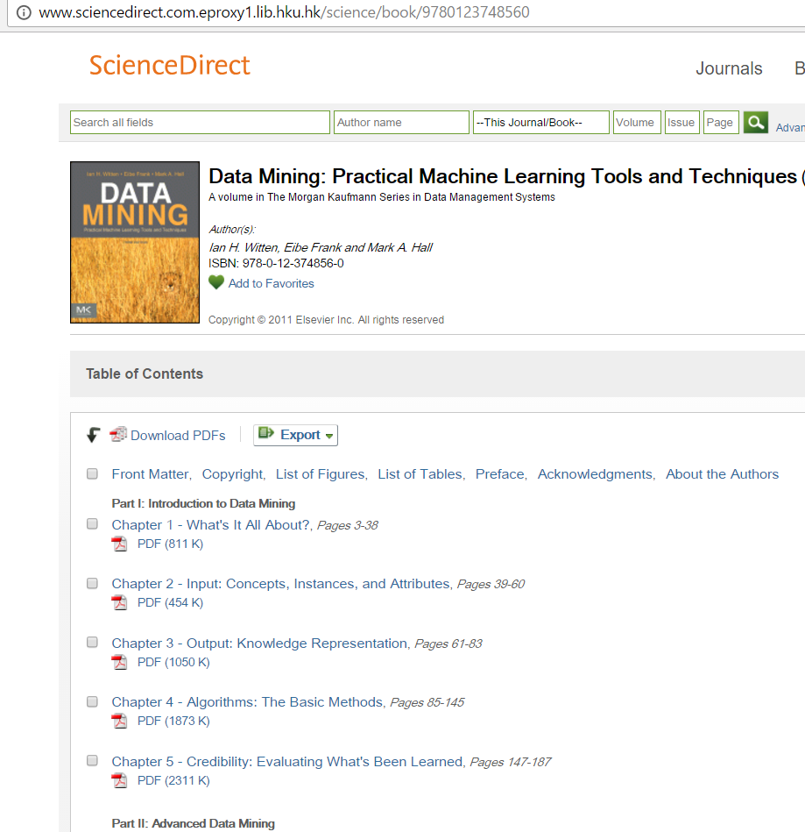
The Book
Witten, I. H. (2011). Data Mining: Practical Machine Learning Tools and Techniques. Morgan Kaufmann
ebook in HKU Lib

Slide 6
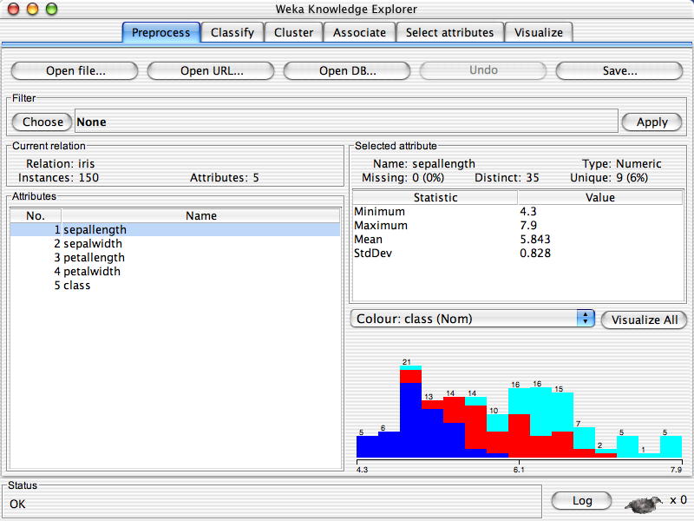

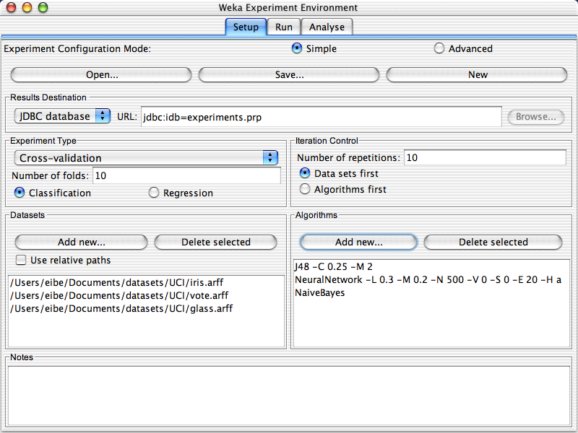
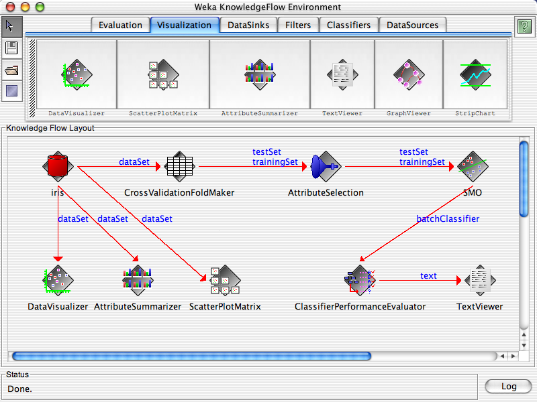

Slide 7
Clustering
Example: The Iris dataset

Slide 8
Unsupervised Learning: Clustering
A clustering is a set of clusters
Finding groups of objects such that the objects in a group will be similar to one another and different from the objects in other groups
Intra-cluster distances are minimized
Inter-cluster distances are maximized

Slide 9
Unsupervised Learning: Clustering
Two major kinds of methods
hierarchical and partitional sets of clusters
Partitional Clustering
A division of data objects into non-overlapping subsets (clusters) such that each data object is in exactly one subset
K-Means
Hierarchical clustering
A set of nested clusters organized as a hierarchical tree

Slide 10
Clustering in WEKA
WEKA contains multiple common clustering schemes:
k-Means, EM, Hierarchical clustering
Visualization of results
Clusters can be visualized and compared to “true” clusters (if given)
First step: load in data

Slide 11
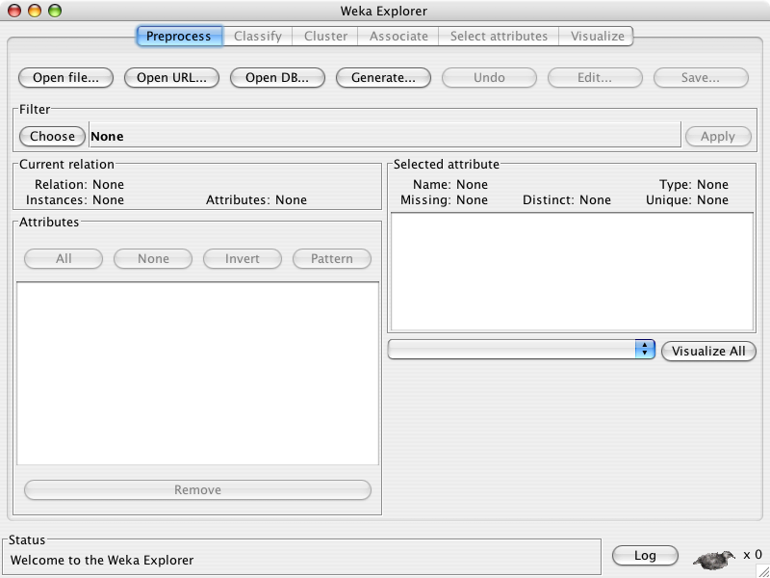

Slide 12
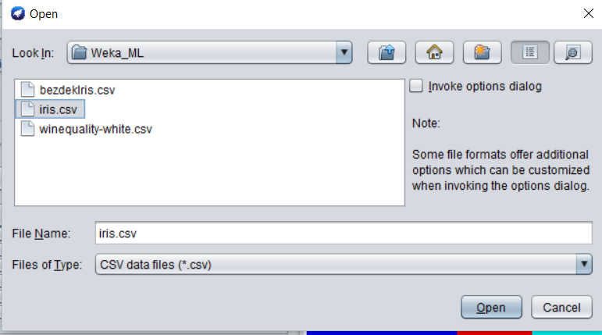

Slide 13
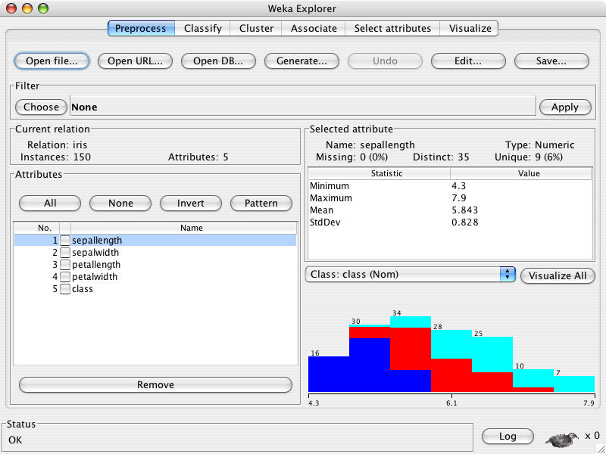

Slide 15
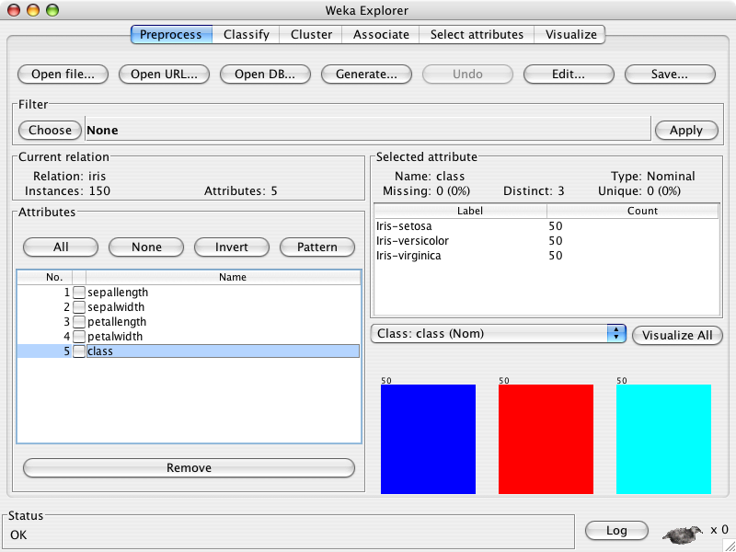

Slide 17
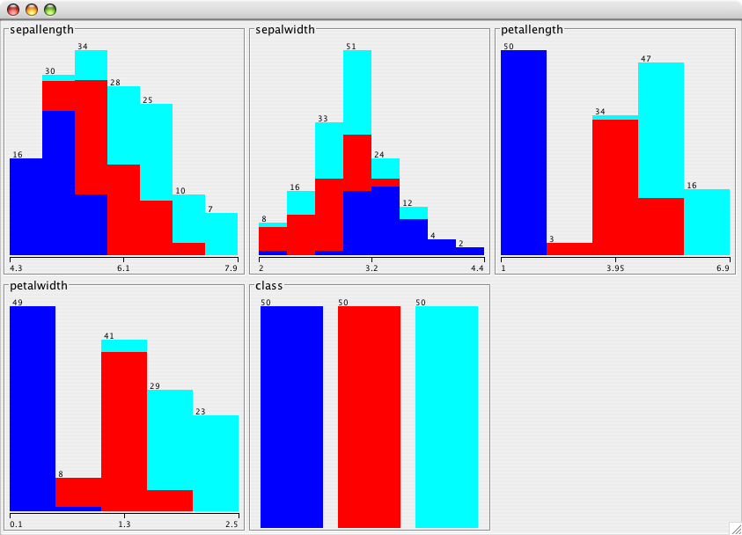

Slide 18
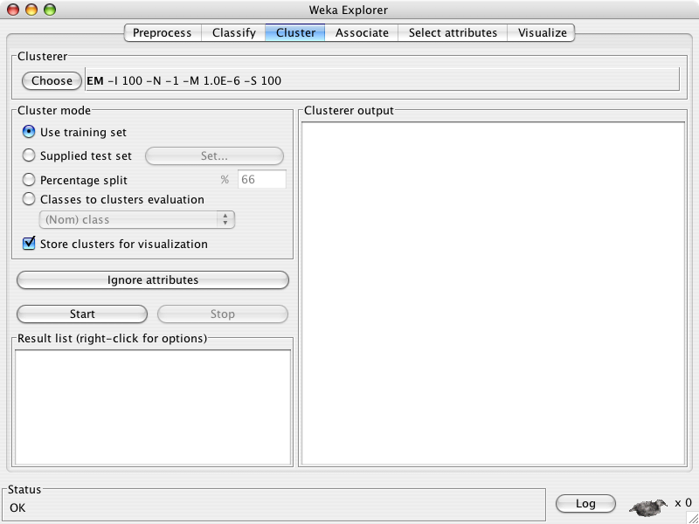

Slide 19
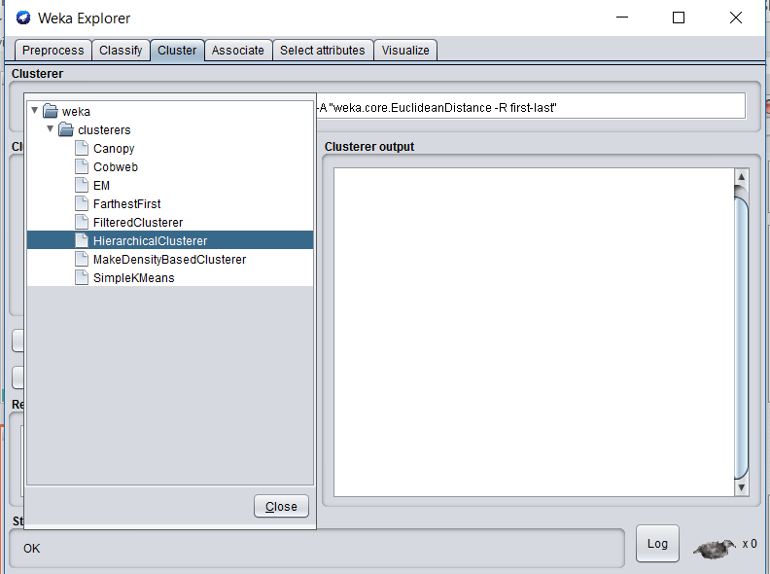

Slide 20
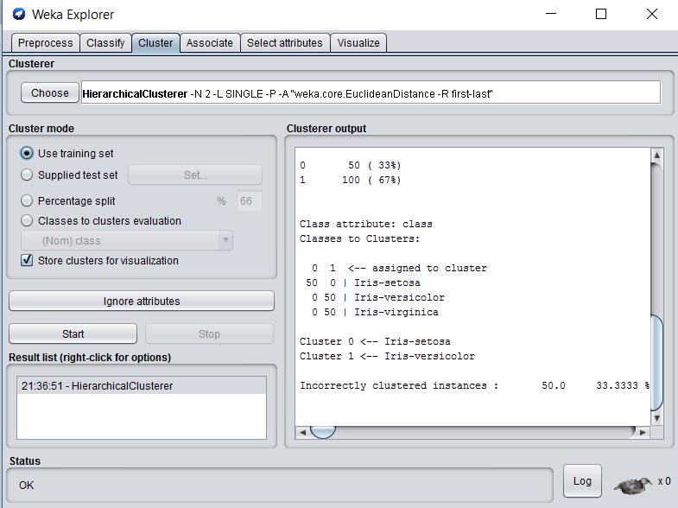

Slide 21
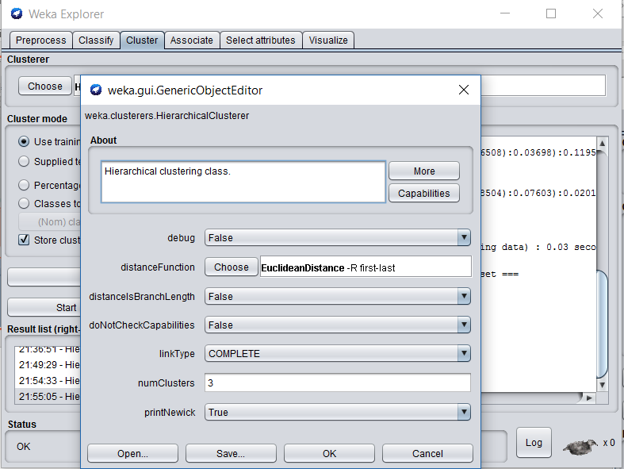

Slide 22


Link Type in Hierarchical Clustering
How to define inter-cluster distance?
Single-linkage
Complete-linkage
Average-linkage
Distance

Slide 24
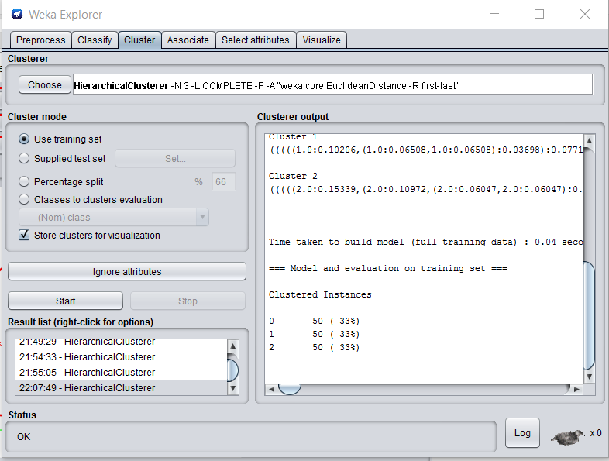
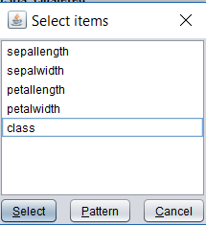

Slide 25
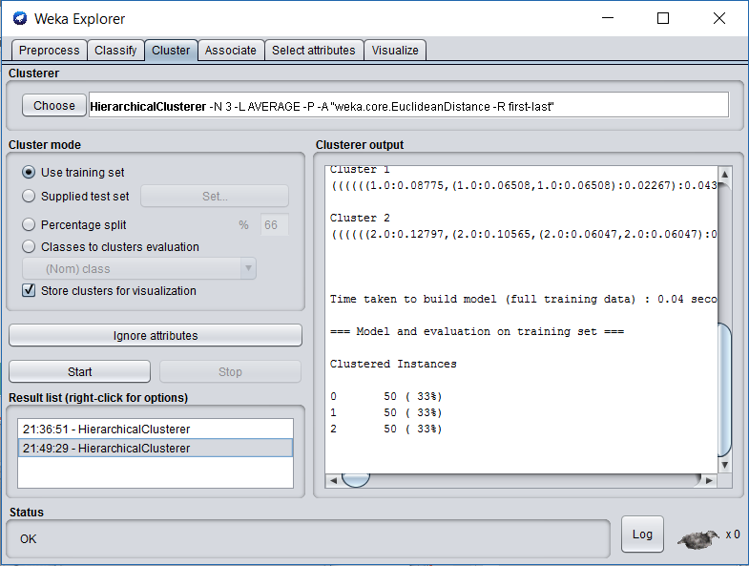

Slide 26
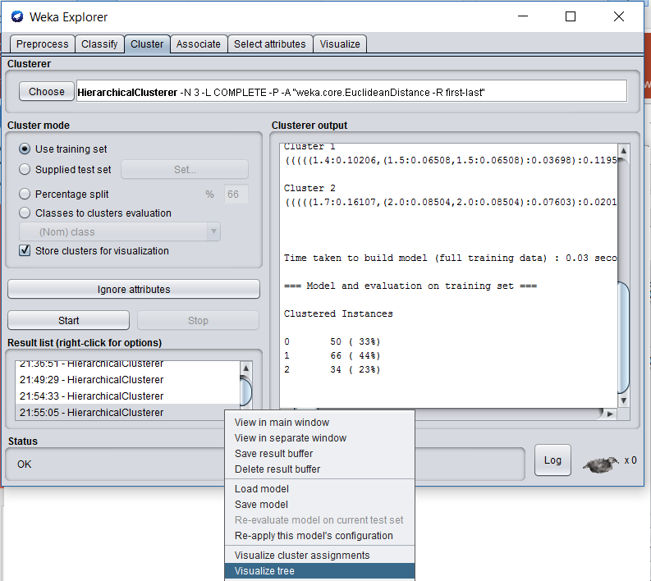

Slide 27
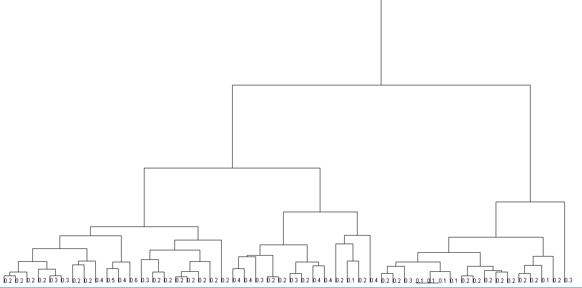

Slide 28
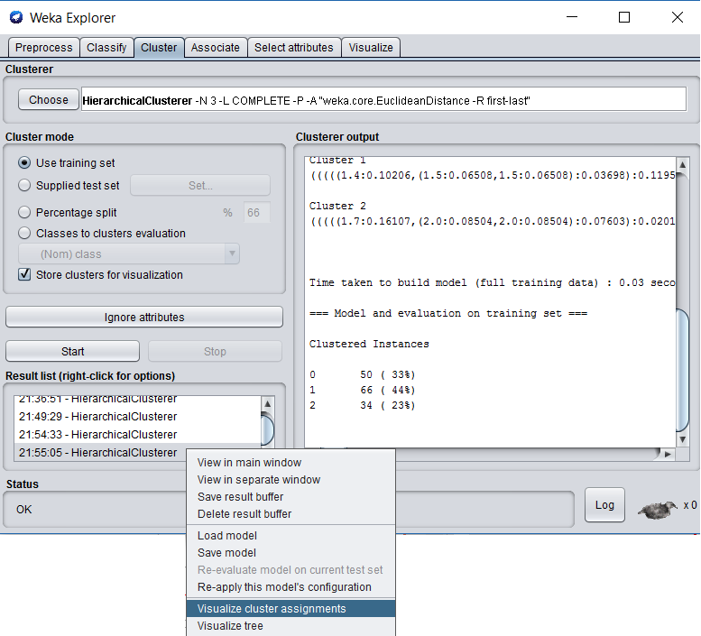

Slide 29
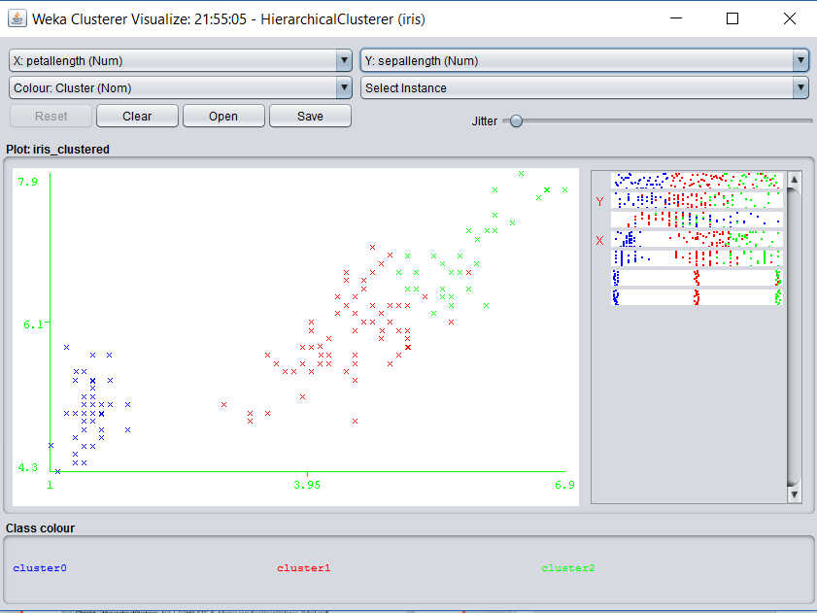

Slide 30
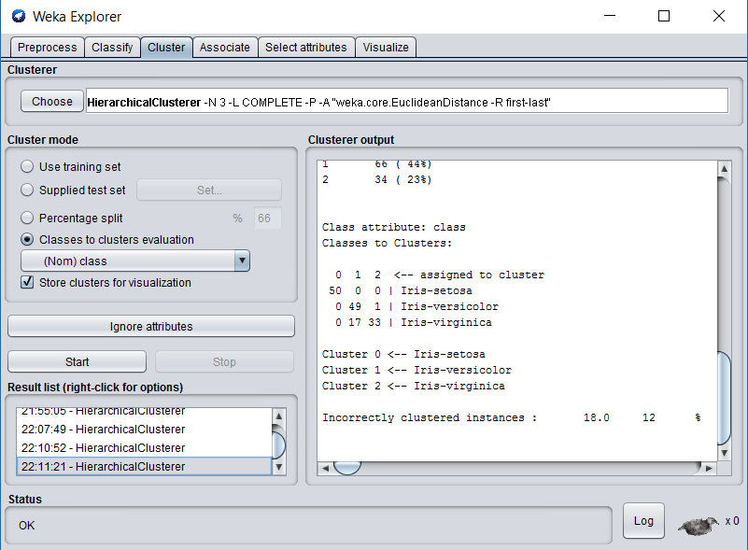
Notes:
Confusion matrix
18 samples got wrong

Slide 31
Agenda
What is WEKA?
Clustering
Classification
Wrap Up and Discussion

Slide 32
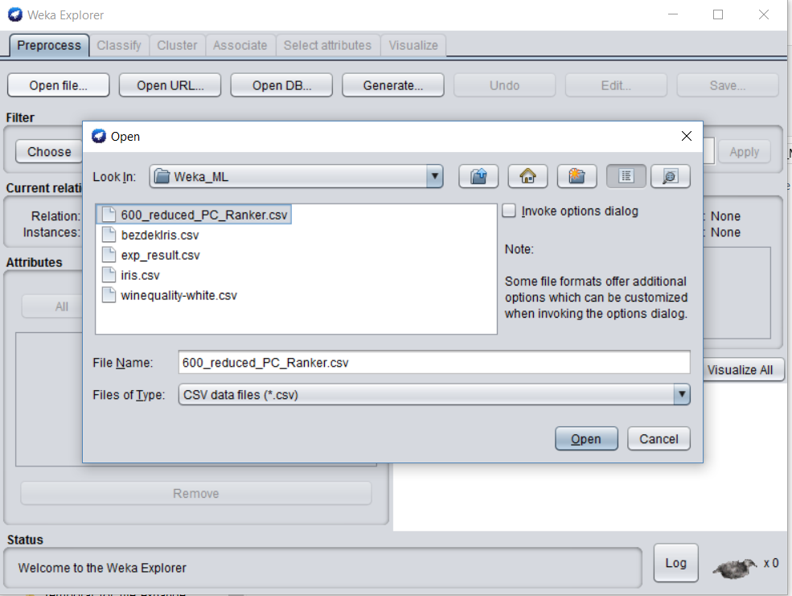

Slide 33
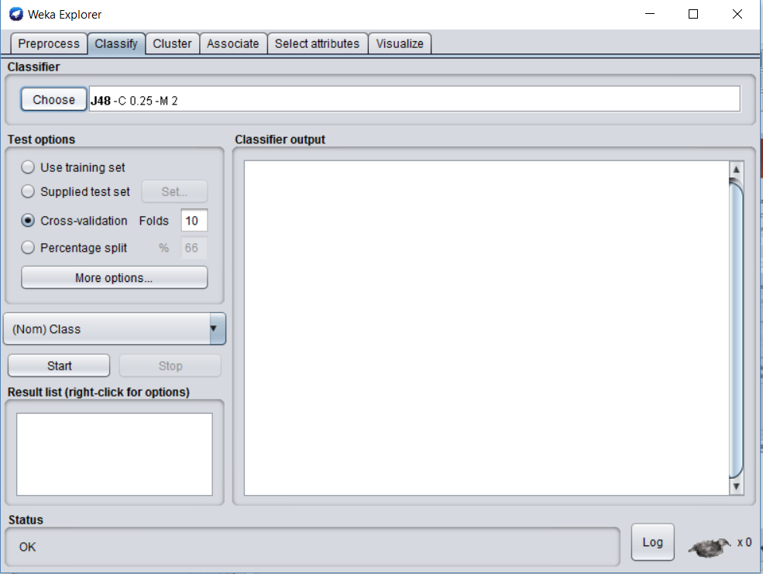

Slide 34
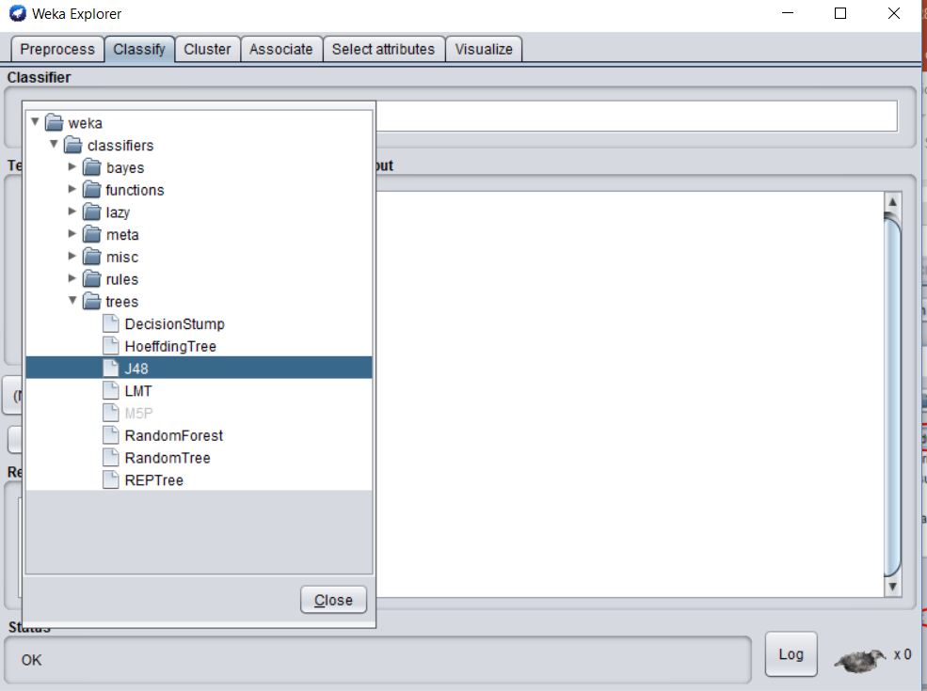

Slide 35
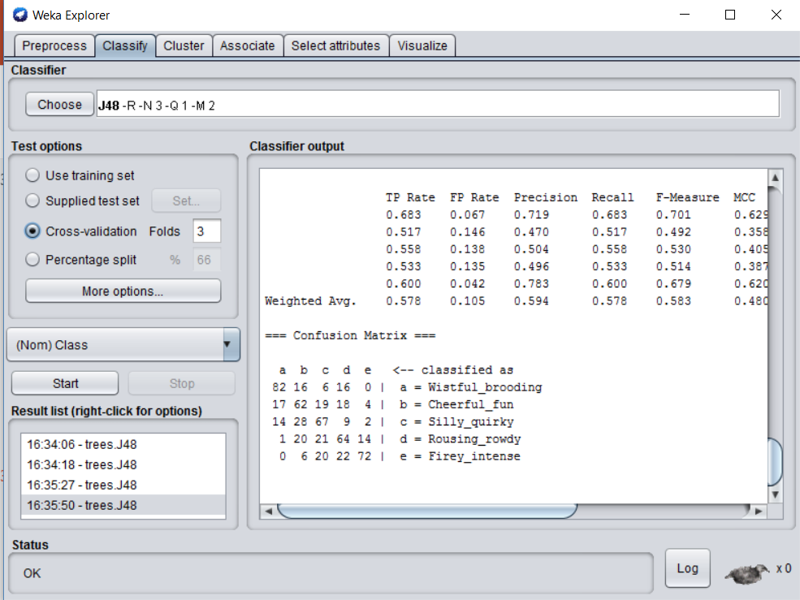

Slide 36
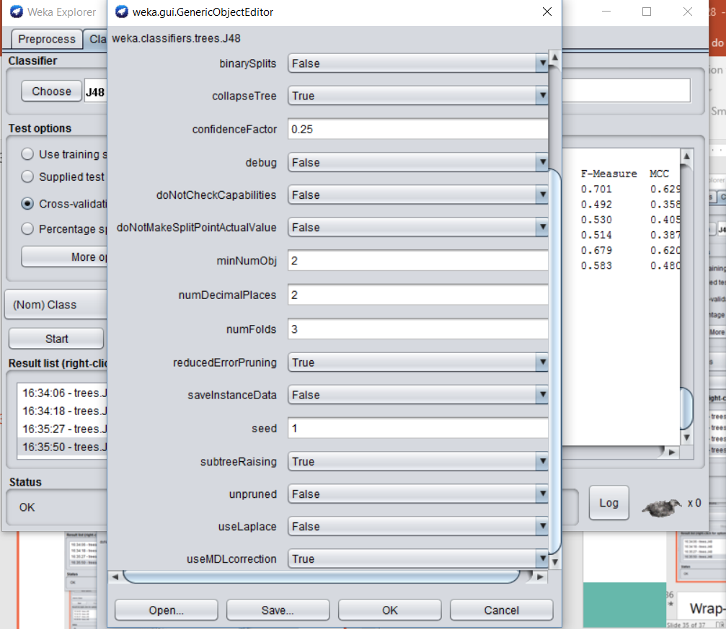

Slide 37
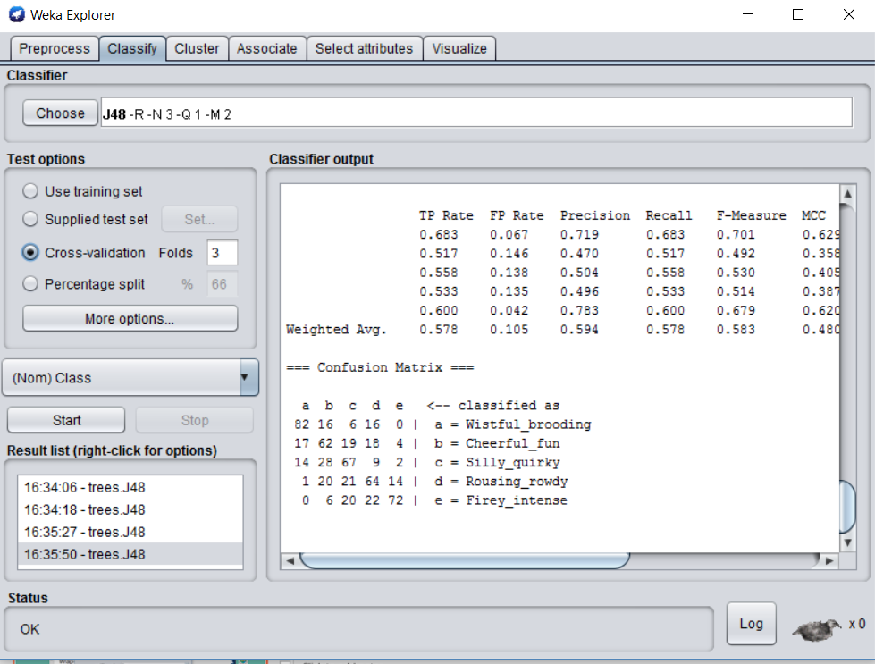

Slide 38
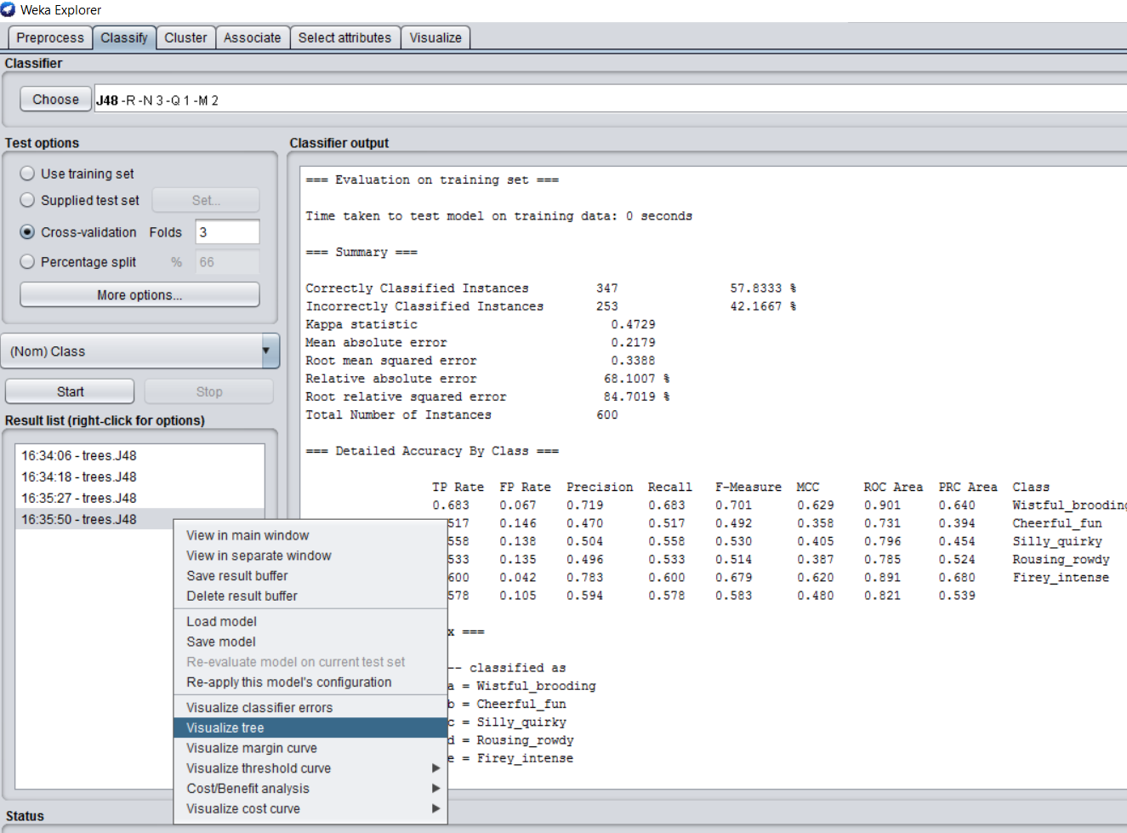

Slide 39
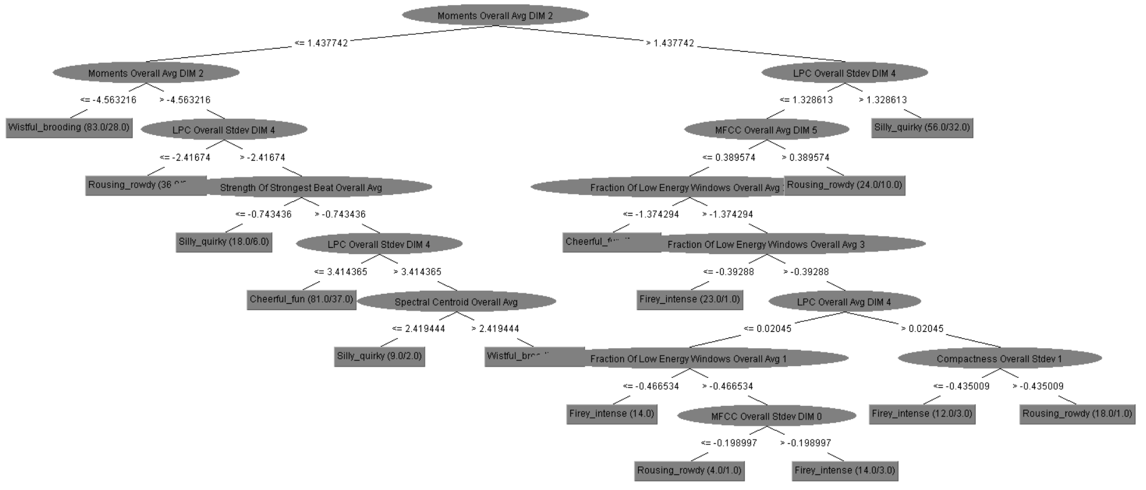

Slide 40
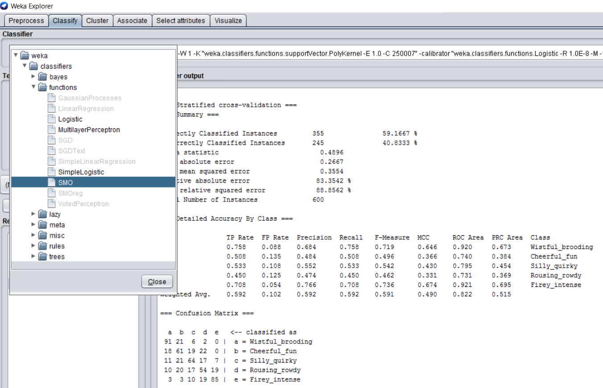
Using SVM to Classify

Slide 41
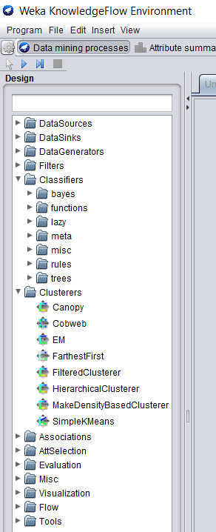
Wrap-up
WEKA is a well-known open source, free tool for ML
Very powerful
A lot more functions
Many ML tools Incorporate/wrap WEKA
RapidMiner has a WEKA extension
Many Extensions of WEKA
BioWeka - extension library for knowledge discovery in biology
WekaMetal - meta learning extension to WEKA
Weka-Parallel - parallel processing for WEKA
Grid Weka - grid computing using WEKA
Weka-CG - computational genetics tool library

Slide 42
Questions?

