Slide 1
The Library’s Role in Reviewing Data Management Plans
Eleanor Dickson
The University of Illinois at Urbana-Champaign
Slides borrowed from: Elise Dunham, The University of Illinois at Urbana-Champaign

Slide 2
Data Management Plans

Slide 3
Interest in Data
Funders
Researchers
Publishers

Slide 4
Funders’ requirements
U.S. and U.K. funders often now require data management plans in applications
Example: U.S. Office of Science and Technology Policy directs federal funding agencies to see that research outputs be made publicly accessible
http://www.whitehouse.gov/blog/2013/02/22/expanding-public-access-results-federally-funded-research
Funders responded by implementing Data Management Plan (DMP) requirements for grant proposals

Slide 5
Local requirements
Some universities implement data deposit and management policies
Example: HKU’s Policy on the Management of Research Data and Records
http://www.rss.hku.hk/integrity/research-data-records-management
Researchers are responsible for:
managing research data and records in accordance with [the policy]
developing and documenting clear procedures for the collection, storage, use, re-use, access and retention or destruction of the research data and records associated with their research. This shall include, where appropriate, defining protocols and responsibilities in a joint or multi-institution collaborative research project. This information should be incorporated, where appropriate, in a research data management plan.
planning for the ongoing custodianship (at the University or using third-party services) of their data after the completion of the research or, in the event of their departure or retirement from the University, reaching agreement with the head of department/faculty (or his/her nominee) as to where such data will be located and how this will be stored
And ensuring that any requirements in relation to research data and records management placed on their research by funding bodies or regulatory agencies or under the terms of a research contract with the University are also met.

Slide 6
What must DMPs cover?
**Specifics vary depending on individual requirements**
Data types and formats
Plans for documenting data
Plans for securing data
Plans for sharing and preserving data
Roles responsible for implementing DMP

Slide 7
The DMPTool
DataManagementPlanTool
Created by the California Digital Library
Web interface for crafting a DMP
Drafter has choice to tailor plan on requirements
Set by funder
Set by local policy
https://dmp.cdlib.org/

Slide 8
Illinois Research Data Service
A case study

Slide 9
Illinois Research Data Service (RDS)
Mission:
Provide the Illinois research community with the expertise, tools, and infrastructure necessary to manage and steward research data.

Slide 10
Illinois RDS Timeline
ARL eScience Institute
RDS Proposal
RDS in Campus Strategic Plan
Yr of Data Stewardship
RDS Hiring Initiated
2011
2012
2013
2014
2015
2016
Director hired
Developer and
Curators hired
Illinois Data Bank
launched

Slide 11
Illinois RDS Staff
Four Full-Time Staff
1 Director (Heidi Imker)
2 Data Curators (Elise Dunham and Elizabeth Wickes)
1 Repository Developer (Colleen Fallaw)
Part Time/Voluntary
Postdoc (with School of Information Science)
Information Design Specialist (Technology Services)
Graduate Students
Lots of interaction within the Library!

Slide 12
The funny thing about DMPs
For many researchers, this is about compliance
For the RDS, this is about wanting researchers to manage their data

Slide 13
Role of the RDS in DMP reviews
Provides in-depth review and feedback
Coordinates wider review with other campus experts
Note: Reviewing Data Management Plans is one of many services provided by the Research Data Service
Notes:
which means we must maintain overarching knowledge of DMP trends and funder requirements AND maintain and tighten on-campus network of expertise

Slide 14
Illinois RDS DMP review guiding principles
FAST
CONFIDENTIAL
BALANCED

Slide 15
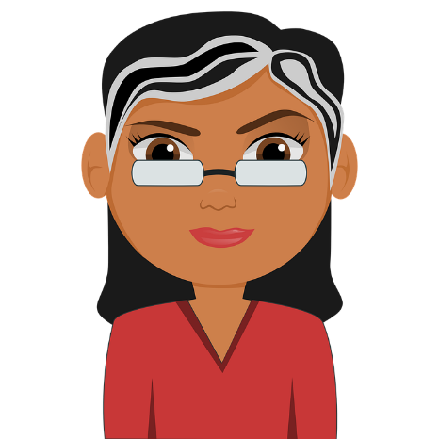



Receive a DMP to review
etc.

Slide 16
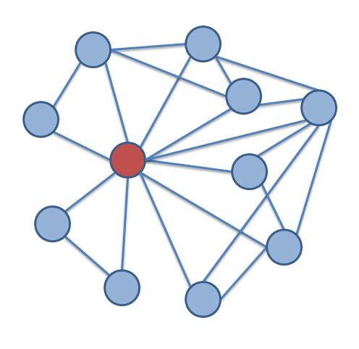
Seek input from campus network
Privacy and Information Security, Technology Services
Librarians/specialists
CONFIDENTIALITY
Office for the Protection of Research Subjects

Slide 17
Send feedback to researcher

Slide 18
Loop process as needed
Review DMP
Coordinate with experts
Send feedback to researcher

Slide 19
Example #1
Program officer told researcher that the DMP needed work
Researcher requested in-person meeting with us
RDS invited Library subject specialist to the meeting
RDS read DMP, the funding announcement, and agency guidelines
RDS talked through program officer’s feedback and made recommendations
RDS sent follow-up email detailing our recommendations
RDS reviewed subsequent drafts until completion

Slide 20
Example #2
Received input from a Library specialist in human subject research
Discussed the situation with a contact in the Division of Management Information
Sought guidance from internal contact who has great depth of knowledge of funding agency
Researcher sought out DMP assistance from the Scholarly Commons
Scholarly Commons routed question to RDS
RDS reviewed the researcher’s specific question and draft plan
Since the researcher was proposing to use FERPA-protected data RDS…
RDS spoke with researcher on the phone to clarify questions and discuss DMP
RDS provided comments and suggestions on the researcher’s DMP, incorporating feedback
Researcher implemented RDS’s suggestions and expressed gratitude for our attention to detail

Slide 21
Extremes
Turnaround
Hours
Weeks
Length
10 pages max
Amount of data sections expected in proposal
1 data planning section
6 data planning sections
1 paragraph max

Slide 22
Before & after
Draft | Revised
[no information about roles and responsibilities] | The PI and co PIs have the primary responsibility for implementing the data management plan. Postdoctoral researchers and graduate students will assist in data management activities. We will utilize resources created by the Research Data Service to train graduate student assistants in basic data management practices (http://researchdataservice.illinois.edu/workshops/)

Slide 23
Before & after
Draft | Revised
This digital material will be kept in the author’s computer. | The text and audiovisual files will be retained in the PI’s laptop computer, which will be password protected. They will be backed up to an external hard drive and to the remote U of I Box to achieve the recommended three copies.

Slide 24
Before & after
Draft | Revised
Our data files will be relatively small, so they will be permanently archived on our servers (which are automatically backed up on a regular basis). | After three years, the data will be made publicly available in perpetuity via an online data repository (to be chosen with the assistance of the University Library's Research Data Service).

Slide 25
Staying organized
DMP received via email
DMP Review Lead corresponds with DMP review contact to obtain draft DMP, funding announcement, and due date to campus OSP
DMP received via DMPTool
RDS Director and Curators receives DMPTool email notification about requested review
DMP Review Lead moves draft DMP content from DMPTool to a Word document
DMP Review Lead moves draft DMP document and funding announcement, if available, to DMP Review Commentary folder for current FY in the Box folder for DMP Reviews
DMP Review Lead shares Box document(s) with collaborators and collaborates on feedback in Box and/or via email
DMP Review Lead synthesizes feedback
DMP Review Lead enters feedback as comment on the DMP being reviewed within the DMPTool, referring to DMPTool Review Response Template for intro and outro text. Clicks "Add Comment", add comment, then click "Submit". The DMPTool owner receives an email notifying them that their DMP has been reviewed.
DMP Review Lead moves draft DMP document and funding announcement to DMP Review Commentary folder for current FY in the Box folder for DMP Reviews.
DMP Review Lead shares Box document(s) with collaborators and collaborates on feedback in Box and/or via email
DMP Review Lead reviews and synthesizes feedback
DMP Review Lead sends feedback to DMP review contact
DMPTool Lead clicks "Plan Reviewed" in the DMPTool to remove the DMP from the Review queue
Notes:
(the purpose here is not for them to read it, but for

Slide 26
Staying courteous
INCLUDING everyone who has the expertise and desire to contribute
RESPECTING the time of every individual we ask to contribute
Notes:
Including everyone who has the expertise and desire to contribute
Respecting the time of every individual we ask to contribute

Slide 27
Questions/Discussion
Notes:
Have you found out about a promise a researcher made in a DMP that surprised you?

