Slide 1

AI Text Generator using Markov Chain
Avadhoot Virkar - 22107064
Chinmay Pawaskar - 22107066
Soham Shigvan - 22107001
Monish Mudaliar - 22107024
Project Guide
Prof. Ujjwala Pagare

Slide 2
Contents
Abstract
Introduction
Motivation
Objectives
Research Gap
Problem Definition
Scope
Technological Stack
Implementation
Conclusion

Slide 3
Abstract
This project presents the development of an AI-based Text Generator using a Markov Chain model, designed to automatically generate meaningful and contextually relevant text from user input. The system applies Natural Language Processing (NLP) techniques along with a trigram-based Markov model to learn word patterns and predict the next word in a sequence, enabling coherent text generation. It includes key stages such as data preprocessing, model training, and real-time text generation through a user-friendly interface. The results demonstrate improved coherence (up to ~82%) and efficient performance, making the system useful for applications like content creation, report writing, and chat-based interactions. Overall, the project highlights a simple yet effective approach to automated text generation with potential for future enhancements using advanced AI models

Slide 4
Introduction
This project focuses on developing an AI-based Text Generator using a Markov Chain model to automatically produce meaningful and coherent text from user input. It uses Natural Language Processing (NLP) techniques to learn patterns from textual data and generate context-aware sentences. The system aims to reduce manual effort in content creation and improve efficiency through a simple, fast, and user-friendly approach.
Motivation :
Reduce the time and effort required for manual content creation by automating text generation using AI techniques.
Develop an intelligent system that can generate coherent and meaningful text, improving productivity in tasks like report writing and communication.

Slide 5
Objectives
To design and develop an AI-based text generator using Markov Chain techniques.
To implement NLP preprocessing methods like tokenization and cleaning for better data quality.
To generate coherent, meaningful, and context-aware text based on user input.
To build a simple and user-friendly interface for real-time text generation.

Slide 6
Research Gap(Limitations of existing systems)
Existing text generation systems often produce repetitive or less meaningful outputs due to limited contextual understanding.
Many models require large datasets and high computational power, making them difficult to implement for small-scale projects.
Traditional approaches like N-gram or basic Markov models lack long-range context awareness.
Lack of simple, lightweight systems that balance performance and efficiency for real-time applications.
Limited customization and user control in existing systems for generating specific types of content.

Slide 7
Problem Definition
Manual text generation is time-consuming and requires strong language skills and creativity.
Users often struggle to create meaningful and well-structured content efficiently.
Existing systems generate generic, repetitive, or contextually irrelevant text.
Lack of proper understanding of user input leads to poor quality outputs.
Need for an intelligent system that can generate accurate, coherent, and context-aware text automatically.

Slide 8
Scope
Can be used for automated content creation such as reports, articles, and emails.
Applicable in chatbots and virtual assistants for generating human-like responses.
Useful in education for assisting students in writing and learning tasks.
Can be extended with advanced AI models for improved accuracy and contextual understanding.
Has potential for integration with web applications for real-time text generation services.

Slide 9
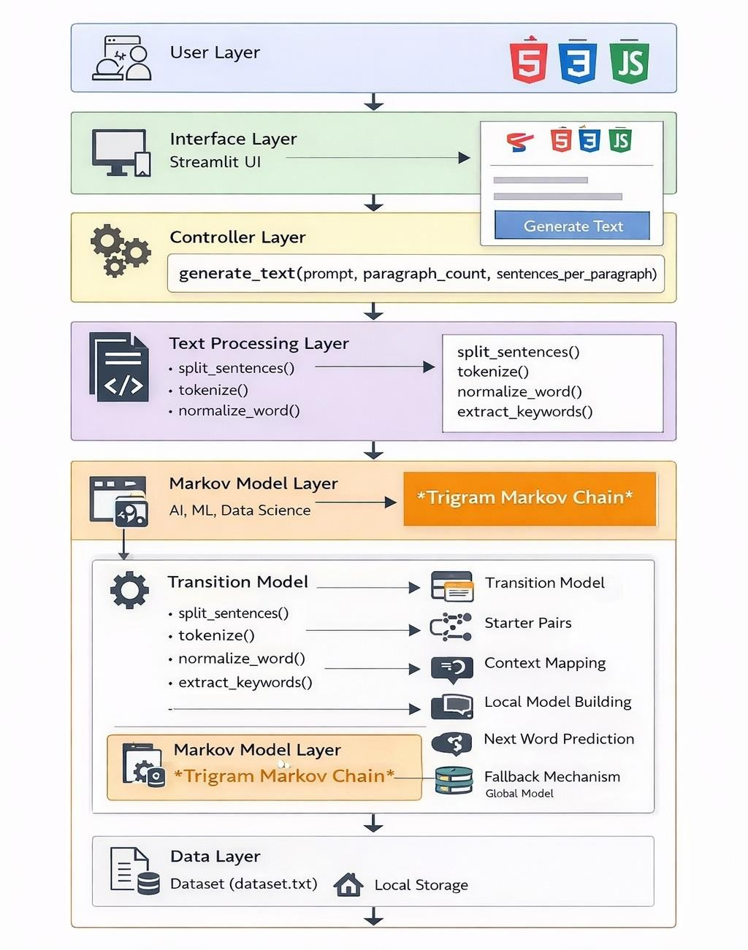
Proposed System Architecture
*

Slide 10
Technological Stack
Frontend: HTML, CSS, JavaScript (for user interface and interaction)
Backend: Python, Flask (for handling requests and text generation logic)
Machine Learning Model: Markov Chain Model
NLP Techniques: Tokenization, Text Cleaning, Normalization
Text Processing Libraries: NLTK / re (Regular Expressions)
Data Processing: Python standard libraries (lists, dictionaries)
Model Storage: Serialized model using Pickle (.pkl)
API Communication: REST API using Flask and Fetch API (JavaScript)

Slide 11
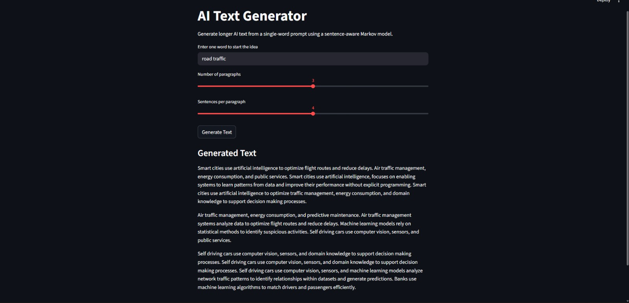
Implementation
Figure 1. AI Text Generator User Interface with Generated Output

Slide 12
Conclusion
The AI-based Text Generator using a Markov Chain model successfully demonstrates how simple machine learning and NLP techniques can be used to generate coherent and meaningful text automatically. The system effectively learns word patterns from the dataset and produces contextually relevant outputs with good efficiency and speed. Although it has some limitations in handling long-range context, it provides a strong foundation for automated content generation. Overall, the project highlights the practical application of AI in reducing manual effort and can be further enhanced using advanced models for better accuracy and performance.

Slide 13
Thank You...!!

