Slide 1

Movie Recommendation System
Group No.
Avadhoot Virkar - 22107064
Chinmay Pawaskar - 22107066
Soham Shigvan - 22107001
Monish Mudaliar - 22107024
Project Guide
Prof. Richa Singh

Slide 2
Contents
Abstract
Introduction
Motivation
Objectives
Research Gap
Problem Definition
Scope
Technological Stack
Implementation
Conclusion

Slide 3
Abstract
The rapid growth of digital entertainment platforms has made it challenging for users to find relevant movies from vast content libraries. This project presents a Content-Based Movie Recommendation System that suggests movies based on user input using metadata from the TMDB 5000 dataset, including genres, keywords, cast, crew, and overviews. It applies NLP techniques like tokenization and stemming, followed by Count Vectorization to convert text into numerical form. Cosine Similarity is used to identify and recommend similar movies. The system is deployed using Streamlit, offering a simple and interactive interface where users can quickly get personalized recommendations. It ensures fast performance through efficient computation and can be further enhanced using hybrid recommendation techniques.

Slide 4
Introduction
In the modern digital era, the rapid growth of online streaming platforms has led to a vast collection of movies, making it difficult for users to find relevant content. To address this problem, a Content-Based Movie Recommendation System is developed that suggests movies based on their features such as genres, keywords, cast, and overview. The system uses Natural Language Processing (NLP) and machine learning techniques like vectorization and cosine similarity to analyze movie data and provide accurate, fast, and personalized recommendations through an interactive interface
Motivation :
Overcome information overload and help users quickly find relevant movies.
Reduce dependency on user history and solve the cold-start problem.
Provide fast, accurate, and personalized recommendations using content-based filtering

Slide 5
Objectives
To preprocess textual movie data using NLP techniques like tokenization and stemming, and perform feature engineering on the TMDB dataset for accurate analysis.
To convert movie text data into numerical feature vectors using Count Vectorization and measure similarity between movies using Cosine Similarity for generating recommendations.
To develop an interactive web application using Streamlit that provides real-time movie recommendations based on user input.

Slide 6
Research Gap(Limitations of existing systems)
Many existing movie platforms rely mainly on keyword-based search, requiring users to know the exact movie name instead of suggesting similar movies automatically.
Several systems do not effectively use machine learning or NLP techniques, leading to less accurate and less meaningful recommendations.
Some recommendation systems depend on user ratings or history, causing the cold-start problem for new users or new movies.
Existing systems often fail to properly analyze movie content features like genres, cast, and overview, reducing recommendation quality.
Many platforms lack a simple and interactive interface for quick search and real-time movie recommendations.

Slide 7
Problem Definition
Many users struggle to decide which movie to watch due to the vast availability of content across different platforms.
Traditional search systems require users to know the exact movie name, making it difficult to discover similar or relevant movies.
Existing systems often lack intelligent mechanisms to analyze movie content such as genres, cast, and overview for better recommendations.
Some systems depend heavily on user ratings or history, leading to the cold-start problem for new users or newly added movies.
Therefore, this project aims to develop a content-based movie recommendation system that suggests similar movies using NLP techniques and similarity-based algorithms.

Slide 8
Scope
The system can recommend movies based on user input using machine learning and NLP techniques.
It can be integrated with web or mobile applications to provide real-time movie suggestions.
The model can be extended by using larger datasets and additional features such as ratings, reviews, and posters.
Future improvements may include personalized recommendations based on user preferences and viewing history.
The system can be further enhanced using advanced AI models and deep learning techniques for better accuracy.

Slide 9
Technological Stack
Frontend: Streamlit (Python-based UI)
Backend: Python
Machine Learning: Count Vectorization (Bag of Words)
Recommendation Method: Content-Based Filtering
Similarity Algorithm: Cosine Similarity
NLP Techniques: Tokenization, Stemming (Porter Stemmer)
Data Processing: Pandas, NumPy
Dataset: TMDB 5000 Movie Dataset

Slide 10
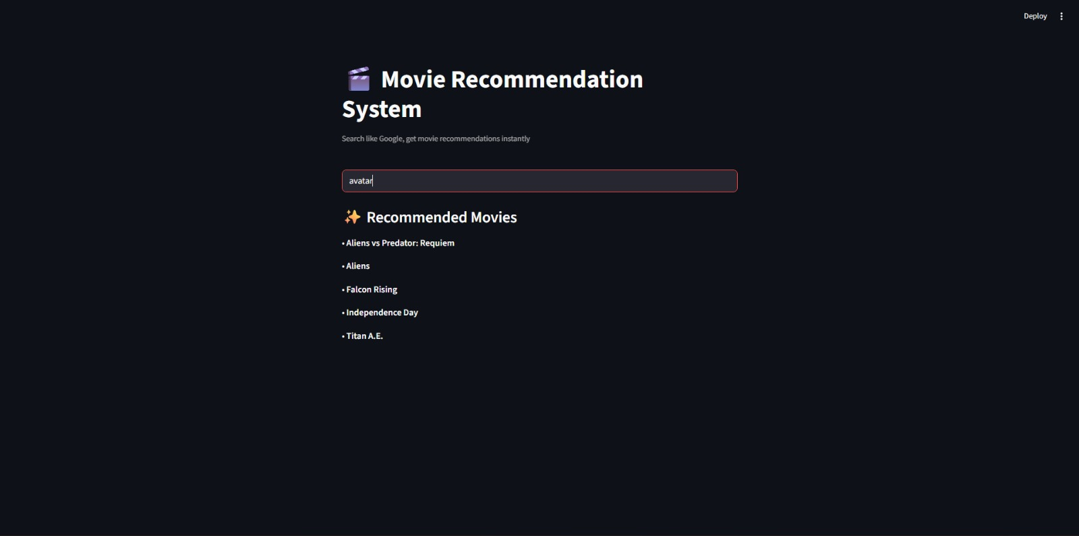
Implementation
Figure 1. Movie Recommendation Interface

Slide 11
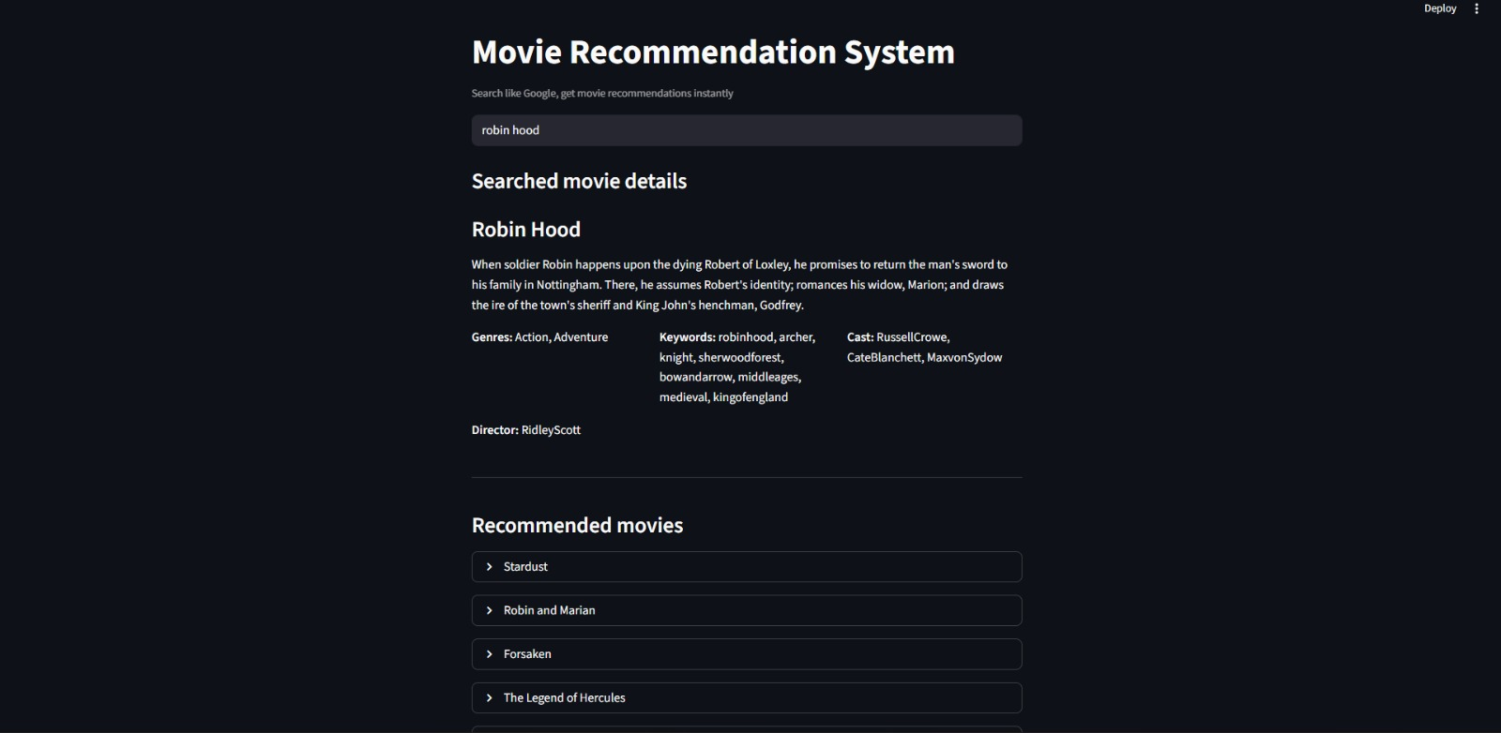
Implementation
Figure 2. Movie Details & Recommendations View

Slide 12
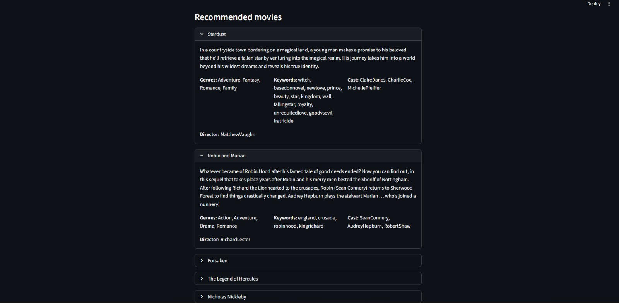
Implementation
Figure 3. Expanded Recommendation Results

Slide 13
Conclusion
The Movie Recommendation System successfully demonstrates the use of content-based filtering techniques to provide accurate and relevant movie suggestions based on user input. By utilizing movie metadata such as genres, keywords, cast, and overview along with NLP techniques and cosine similarity, the system efficiently identifies similar movies and delivers fast recommendations through an interactive interface. It effectively solves the problem of information overload and does not rely on user history, making it suitable even for new users. Overall, the project highlights the practical application of machine learning in real-world scenarios and provides a strong foundation for future enhancements like hybrid models and personalized recommendations.

Slide 14
Thank You...!!

