Slide 1

QuickMeds with Medical Assistance
Group members :
Rishi Mane(22107063)
Avadhoot Virkar(22107064)
Sharayu Mahajan(22107051)
Kalpana Mohanty(22107059)
Project Guide
Prof.Vaibhav Yavalkar

Slide 2
Outline
Introduction
Objectives
Literature Survey of the existing systems
Limitations of the existing systems
Problem statement
System Design
Technologies and methodologies
Implementation
Conclusion
References

Slide 3
Introduction
Introducing QuickMeds, your go-to solution for seamless healthcare management and medication access. Our mission is simple: to make your health journey easier, more reliable, and innovative.
QuickMeds is your virtual pharmacy, bringing a comprehensive range of genuine medications and healthcare products right to your fingertips. Whether you're dealing with a chronic condition or simply need over-the-counter remedies, our intuitive app streamlines the entire process, saving you valuable time and effort.
Say goodbye to the frustration of long queues and the uncertainty surrounding medication authenticity. With QuickMeds, you can trust that every order is genuine and delivered with peace of mind.
Join us on a journey towards better health and wellness. Welcome to QuickMeds – where your health is our top priority
MOTIVATION: To empower individuals with convenient access to genuine medications, personalized health management tools, and reliable healthcare information, ultimately enhancing their overall well-being and quality of life.

Slide 4
Objectives
Develop QuickMeds, a user-friendly healthcare app, providing access to genuine medications, personalized health tools, and reliable information, aiming to improve users' well-being.
Implementation Plan:
Use Tkinter in Python for an easy-to-use interface.
Utilize MySQL for secure data storage and Python for database interaction.
Enable users to order medications securely through the app.
Incorporate tools for tracking medication schedules and health metrics.
Provide trustworthy healthcare information within the app.

Slide 5
Literature Survey of the existing system
Sr.no | Title | Author | Year | Introduction | Methods | Conclusion
1. | [1] Evaluation of patient and doctor perception toward the use of telemedicine in Apollo Tele Health Services, India | Rajesh V | Oct- Dec, 2016 | Telemedicine connects healthcare through vast distances which would benefit both patients and doctors. The aim of this questionnaire study was to evaluate the effects of telemedicine on patients and medical specialists. | A study looked at 122 people, including 71 patients and 51 doctors, to see how satisfied they were with Apollo Tele Health Services in Hyderabad, India. They checked things like service quality, cost-effectiveness, and any issues they faced. Then they compared the data between the patient and doctor groups. | The results showed that telemedicine in healthcare could prove to be useful to patients in distant regions and to rural doctors in India. In the near future, telemedicine can be considered as an alternate to face to face patient care.

Slide 6
Literature Survey of the existing system
Sr.no | Title | Author | Year | Introduction | Methods | Conclusion
2. | [2] Safety concerns with consumer: a scoping review | Enrico Coiera | 10 Oct, 2019 | Exploring the realm of health apps from January 2013 to May 2019, our review delves into safety concerns and consequences. Leveraging databases like PubMed and Scopus, we meticulously classify descriptive data. Adhering to PRISMA-ScR guidelines, our study offers a structured analysis of this vital area." | Big libraries like PubMed and Scopus are used,from 2013 to 2019 for articles about health apps. Found out about safety worries and what might happen if they're not safe. Then, sorted this information into groups. | Apps can be risky for users' health. Involving consumers, regulators, and healthcare pros in app development can make them safer. We need to report safety issues to make things better.

Slide 7
Literature Survey of the existing system
Sr.no | Title | Author | Year | Introduction | Methods | Conclusion
3. | [3] Pharmacy management software | Madhavi Mali, Sandhya Alibade, Rajdeep Parbhane, Aparna Awade, Aruna Yadav | December-2021 | Streamlines operations, ensuring accurate tracking of drug expiry dates, stock movements, and sales transactions, thereby improving efficiency and reducing errors. By automating tasks and generating timely reports, it enhances cost management, safety, and security in the pharmacy, alleviating the burden on pharmacists from manual monitoring. | The Pharmacy Management System development starts with extensive research to understand user needs, focusing on data models. It emphasizes functions like prescription preparation, real-time inventory updates, and secure storage of patient transaction records in an SQL database. This ensures efficient sales management for pharmacists, enhancing operational effectiveness and customer service. | This Pharmacy Management System simplifies operations, saving time and improving efficiency by automating tasks like customer records and medicine stock management. It eliminates complexity, enhancing the overall management process.

Slide 8
Limitations of existing systems
Using a small sample size might not represent the entire population's views accurately.
Also, the study might not capture the full range of experiences or perspectives.
Additionally, biases could arise from factors like self-reporting or the specific context of Apollo Tele Health Services in Hyderabad, which might not apply universally.
The sorting process could introduce bias depending on the criteria used, potentially overlooking certain perspectives or findings.

Slide 9
Problem statement
Our project addresses the challenge of patients struggling to get their essential medicines by providing an online platform accessible from anywhere. This eliminates the need to travel to pharmacies, overcoming geographical barriers and mobility issues.
With our system, patients can avoid long queues and waiting times at pharmacies. They can simply place their medication orders online making the process more convenient and efficient.

Slide 10

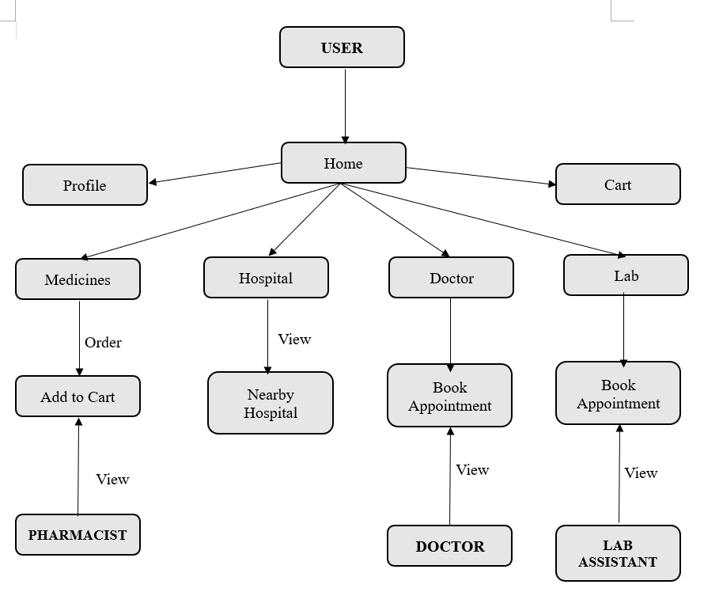









System Design

Slide 11
Technologies and methodologies
Front-End
Tkinter (version 8.6.14)
Python (version 3.12.2)
Back-End:
MySQL (version 8.1.0)
Python (version 3.12.2)

Slide 12
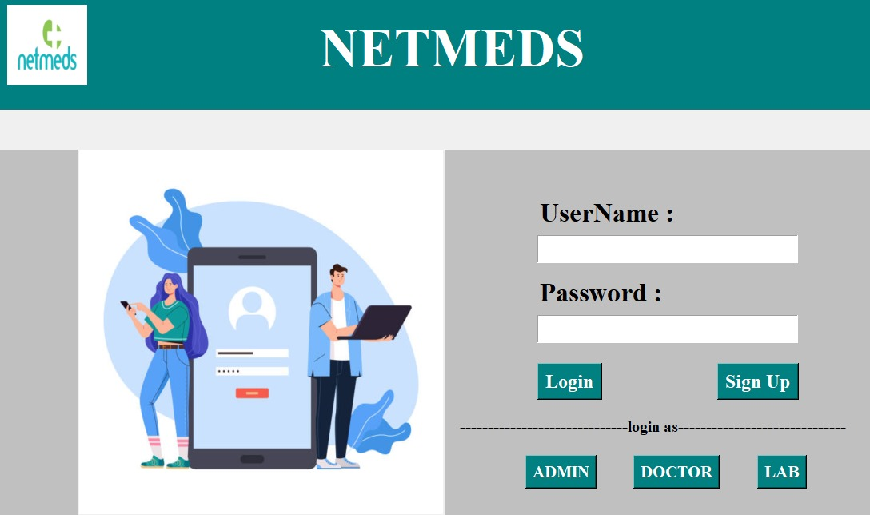
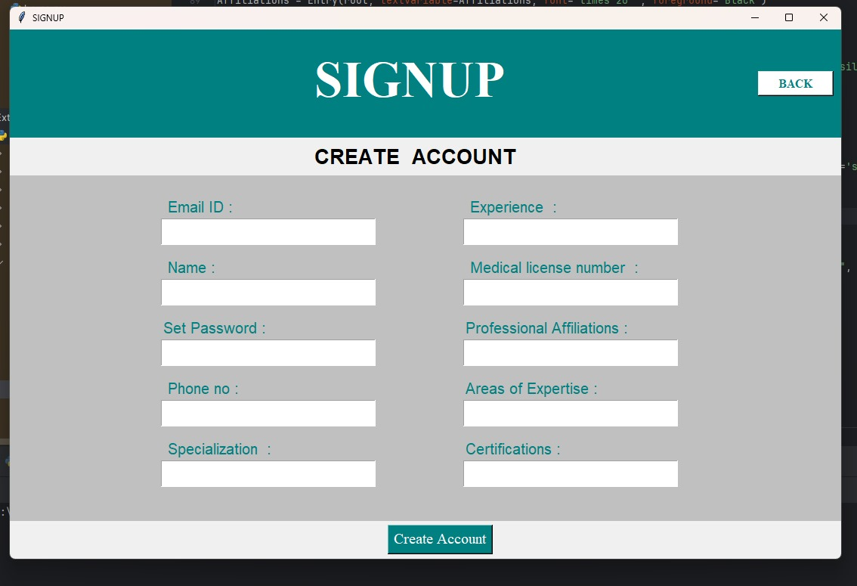
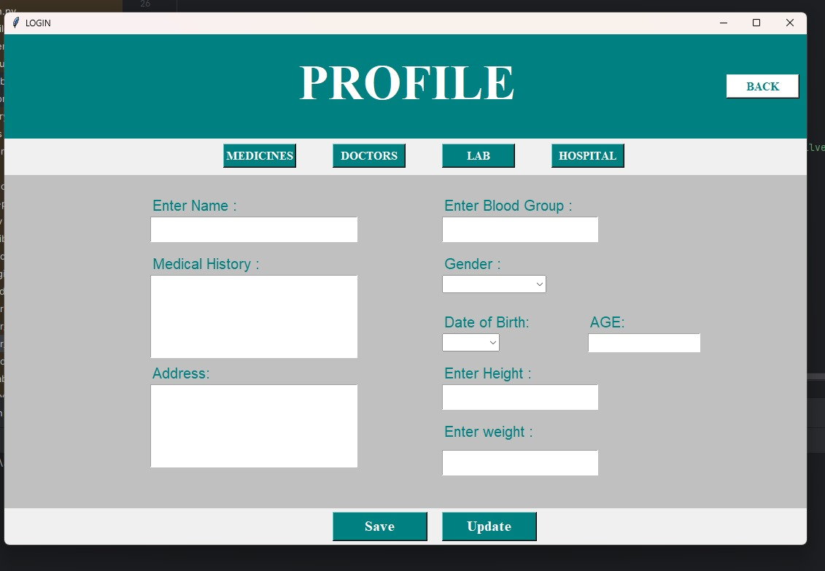
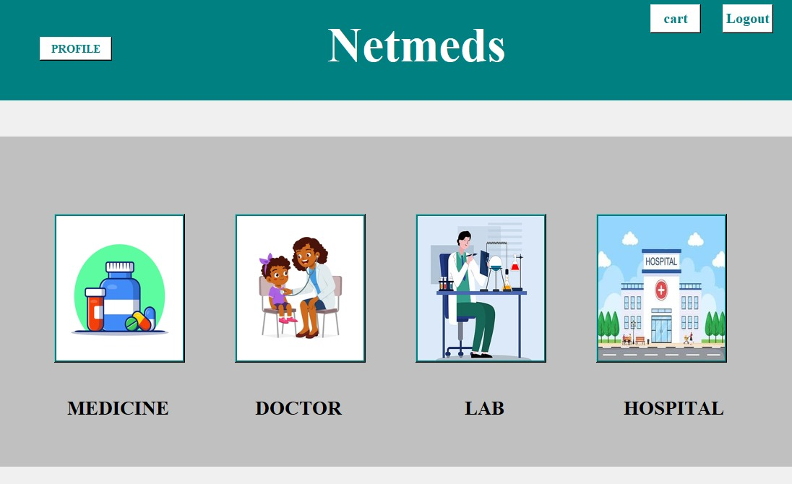
Implementation
a) Login - User
b) Signup - User
c) Profile - User
d) Home - User

Slide 13
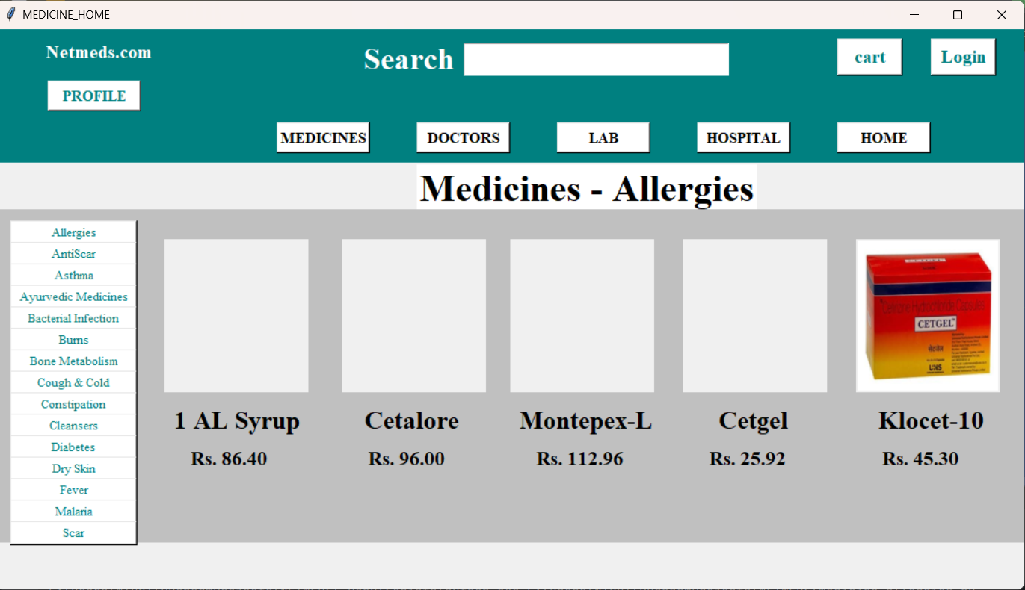
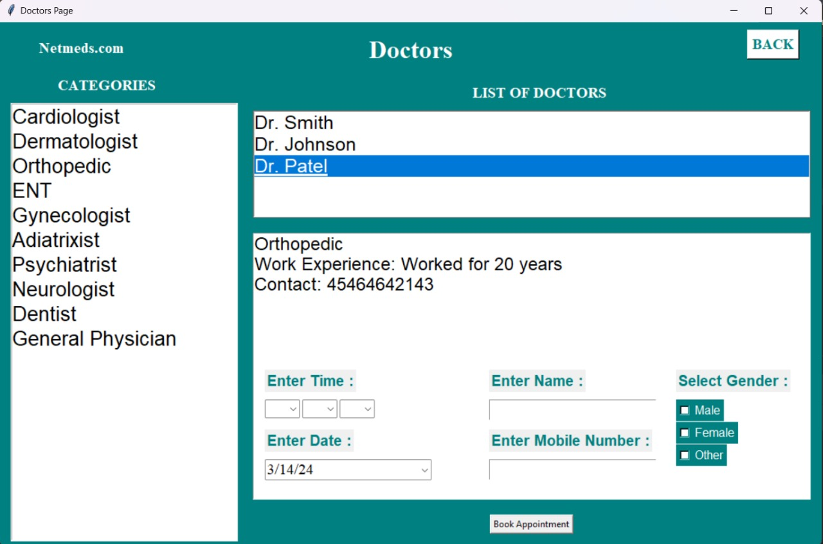
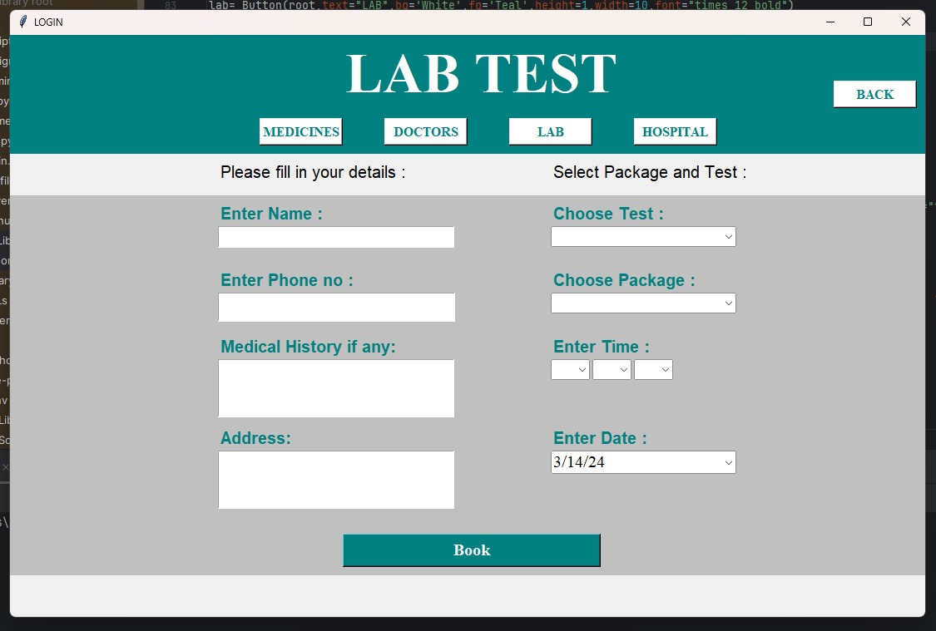
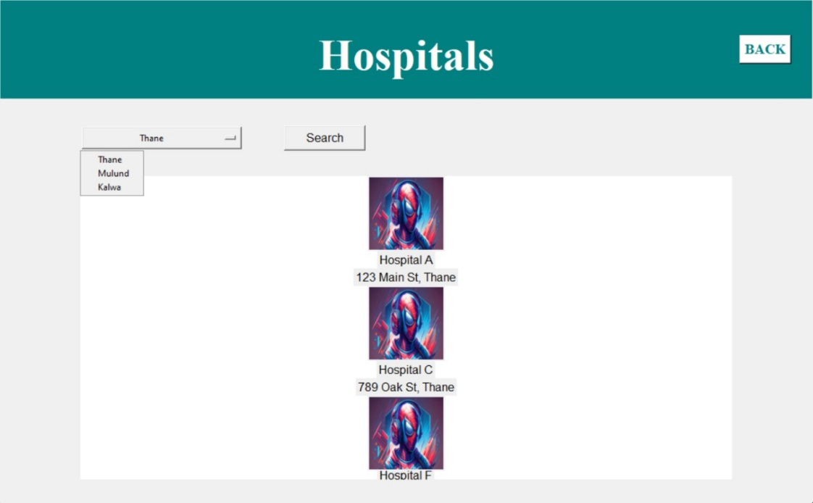
e) Medicine - User
f) Doctors Appointment - User
g) Lab Test - User
h) Hospital Search - User

Slide 14
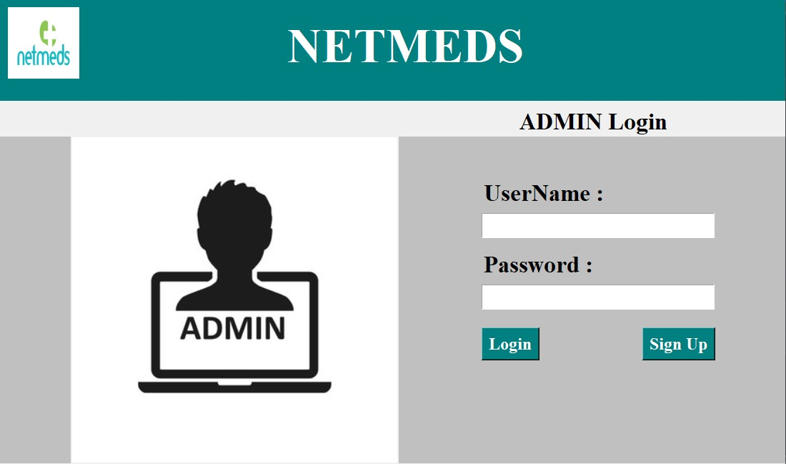
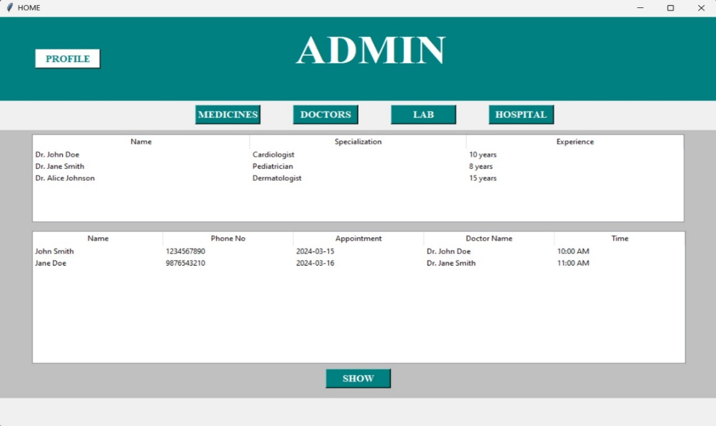
i) Admin - Login
j) View User - Admin

Slide 15
Conclusion
In conclusion, the QuickMeds with medical assistance app represents a significant advancement in healthcare accessibility and convenience.
Through its user-friendly interface and extensive range of features, including medication ordering and health monitoring, the app has the potential to revolutionize the way individuals manage their health.
However, challenges such as ensuring user privacy and security, as well as addressing regulatory compliance, must be carefully addressed to maximize the app's impact.
Overall, the NetMeds Medicine App stands as a promising tool in improving healthcare delivery and enhancing patient outcomes.

Slide 16
References
[1] Rajesh V, “Evaluation of patient and doctor perception toward the use of telemedicine in Apollo Tele Health Services, India” in lately year Oct-Dec of 2016 by IEEE.
[2] Enrico Coiera, “Safety concerns with consumers: a scoping review by PRIMSCAR Informatics,France” on 10 Oct 2019 by IEEE.
[3] Madhavi Mali, Sandhya Alibade, Rajdeep Parbhane, Aparna Awade, Aruna Yadav, “Pharmacy management software” in year Dec of 2021 by IEEE.

Slide 17
Thank You...!!

