Slide 1

DATATHON
SCOR 2023
TEAM 07:
Salim Abdou Daoura
Aymane El Firdoussi
Ahmed Amine Msik

Slide 2
Contents
Strategy
Data Preparation
Modeling
Business Analysis
Conclusion and perspectives
1

Slide 3

Strategy
Feature Selection
Optimizing Parameters
Data Preparation
Model
Testing
Final Submission
2

Slide 4
Data Preparation
3

Slide 5

Step 1: Dropping unnecessary columns
Dropping columns that:
Are Not so meaningful: Website, CompanyName,...
Are Single valued: ClimateEmissionFiscalYear (2020)
No extra information: EUR and USD,...
Cannot be used for testing: ESGRatingTransparencyLevel,...
4

Slide 6
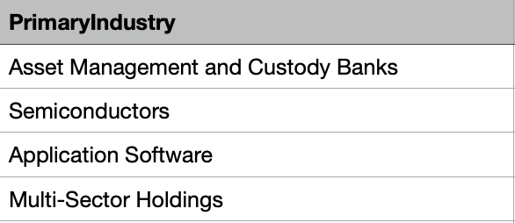
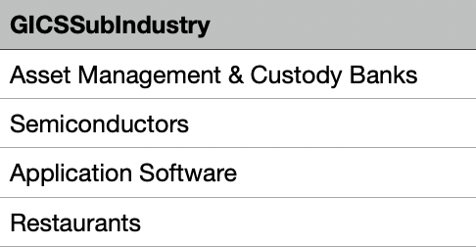
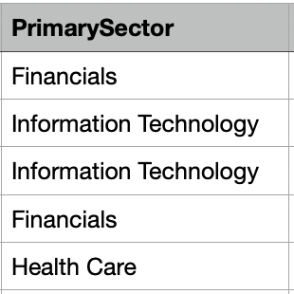
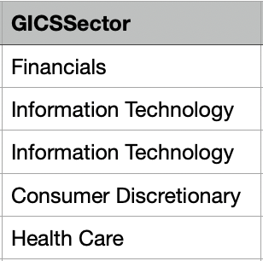
Step 2: Completing categorical missing values
Completing GICSSubIndustry using PrimaryIndustry
👉 from 592 to 20 NaN
Completing GICSSector using PrimarySector
👉 from 592 to 21 NaN
5

Slide 7
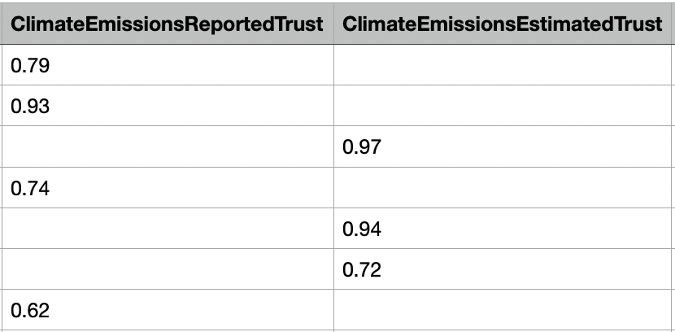
Step 3: Creating new features
6

Slide 8
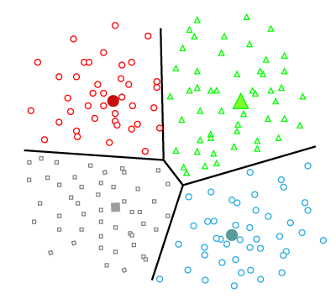
Step 4: Filling real missing values
Cluster according to: GICSSubIndustry & GICSSector
👉 Filling with means for each cluster
7

Slide 9
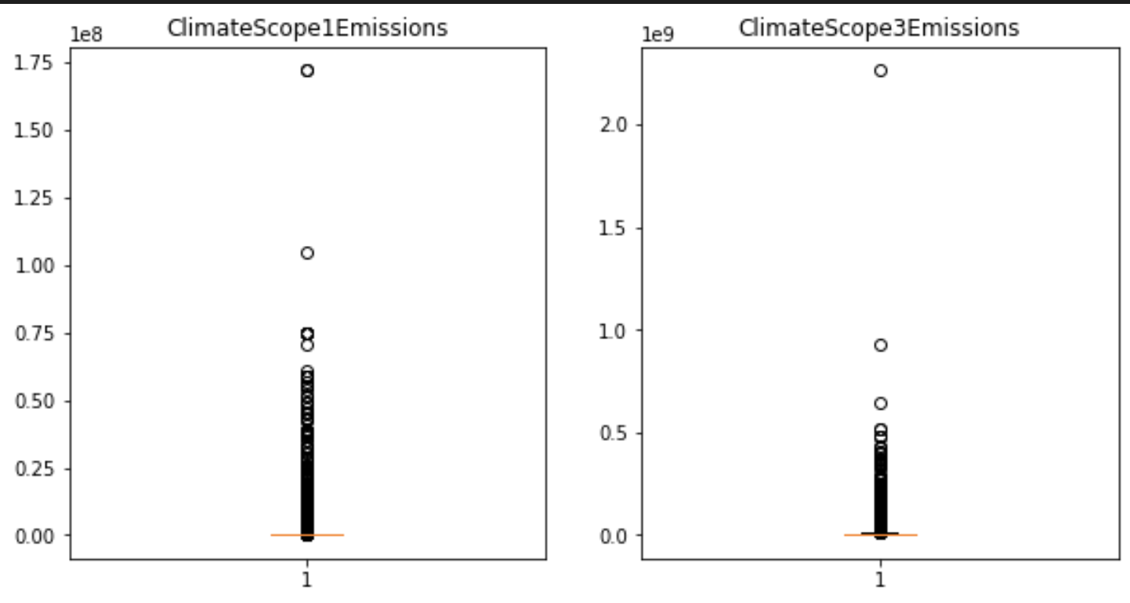
Final step: Data visualization
Existence of outliers
8

Slide 10
Modeling
9

Slide 11
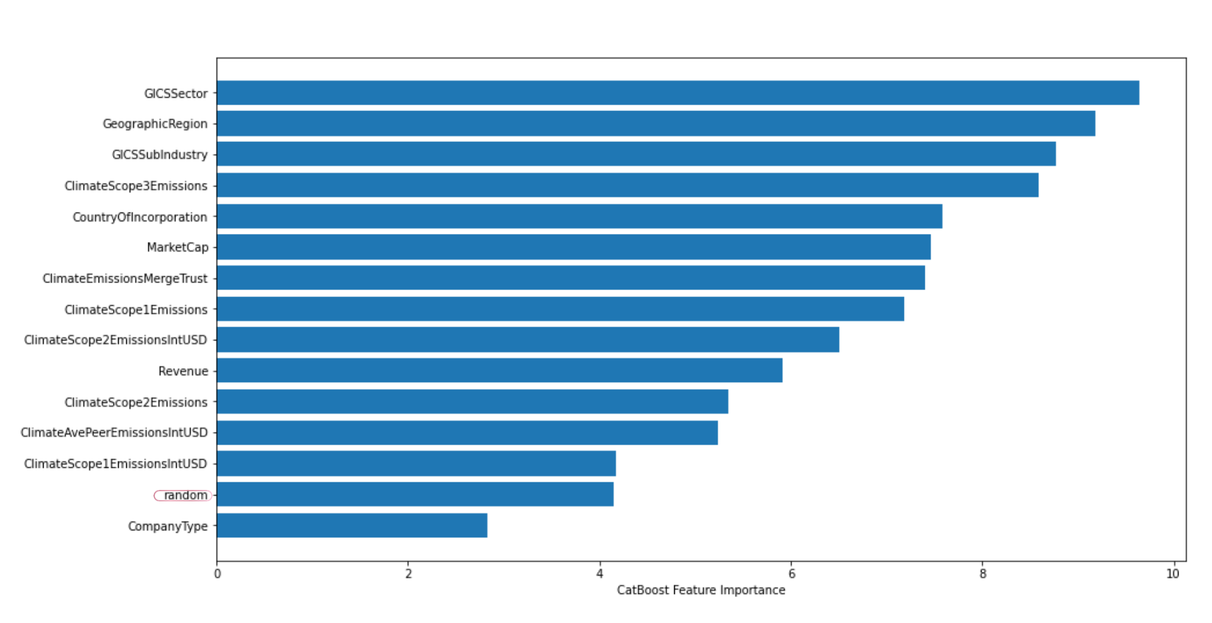
Modeling
CatBoost regressor
Well balanced feature importance
Determination of the parameters that minimize the error
10

Slide 12
Business Analysis
11

Slide 13

The possible benefits and the importance of ESG-related risk
Very valuable information for future investors
Improve risk management and financial performance
12

Slide 14
Conclusion and perspectives
👉 Automate the process of completing missing values using web scraping or existing APIs like ChatGPT.
👉 Gathering additional information about the companies (factories, energy sources, subcontracting,...)
13

Slide 15



Thank you from Team 07
Salim abdou Daoura
Aymane El Firdoussi
Ahmed Amine Msik

