Slide 1

The “Shiva runtime environment”
Advancing the programmability of the Linux process address space
Ryan “elfmaster” O’Neill: ryan@bitlackeys.org

Slide 2
What is Shiva exactly?
A weird machine for loading modules into the address space
A custom runtime linker
Fast In-process debugging and instrumentation
A rich API for program transformation, tracing, and debugging.
Think “LKM’s (Loadable kernel modules) but for userland processes”.
A programmable debugging engine that does NOT require the ptrace system call

Slide 3
What can Shiva be used for?
Building debuggers and tracers
Designing process Security modules
  Anti-exploitation, Sandboxing, Process hardening
In-memory fuzzing harnesses
Software profiling
Hot-patching code and data
Extremely fast instrumentation, hooking, and process injection of all types (Without the use of SYS_ptrace).

Slide 4
From a blackhat perspective
Shiva can be used to crack software
Design in-process rootkits
Modular virus infection

Slide 5
How does Shiva run?
Shiva is a weird machine
Shiva loads the module (ET_REL) from the “/opt/shiva/modules” directory
1. Shiva can be invoked directly as an executable
  Shiva works as a userland-exec to load and map the target executable into its own process address space (See grugqs work on ul_exec: https://grugq.github.io/docs/ul_exec.txt)
  i.e. ./shiva /bin/test_prog
2. Shiva can be invoked indirectly as a runtime interpreter (i.e. the program declares shiva as its dynamic linker)
  The kernel loads the target executable and loads Shiva as the interpreter
  Good for writing modules that are linked at every single execution
  i.e. /bin/test_prog

Slide 6
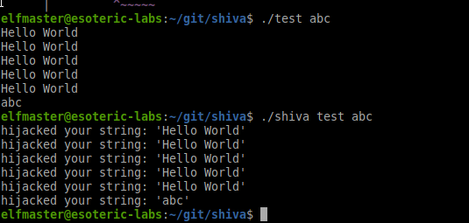
Shiva ran directly on program ./test
Shiva is loading a module: pltgot_hook.o
This module hooks the PLT function ‘puts’ and modifies the string output

Slide 7
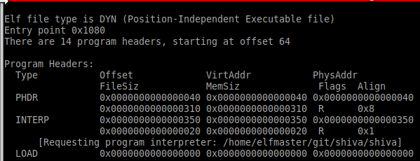
Shiva interpreter path
The INTERP segment contains the path to ‘shiva’ instead of “ld-linux.so”.

Slide 8
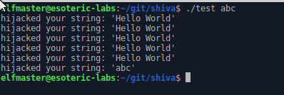
Shiva running as the interpreter for ./test

Slide 9
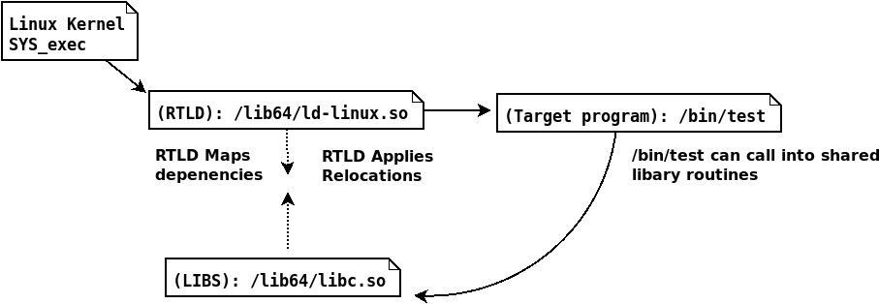
Process execution flow of a normal dynamically linked ELF

Slide 10
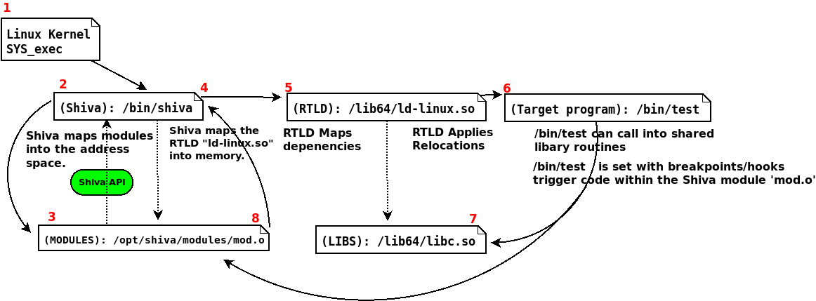
Process execution flow with Shiva as an interpreter.

Slide 12
Understanding Shiva modules
Shiva modules are loaded from “/opt/shiva/modules”
Similar to LKM (Loadable kernel module):
  Shiva modules are ELF relocatable object
  Shiva modules must have an initialization routine
  int shakti_main(shiva_ctx_t *ctx)

Slide 13
Understanding Shiva modules pt.2
The context struct “shiva_ctx_t”
Passed into the modules init function
Contains:
  Register state
  Process-state
  Thread-state
  Control flow data
  Signal data
  Shiva-Trace API specific data structures
  Full access to elfobj_t of target executable

Slide 14
Understanding Shiva modules p.3
Modules have access to the Shiva API functions
Modules have access to several libraries which are statically linked into the Shiva executable
  musl-libc
  libelfmaster
  Libudis86
  Shiva-Trace API
The module loader resolves module symbols
Shiva loader is handles loading and linking of modules
The module is an ELF relocatable object
Sections are mapped appropriately into memory segments

Slide 15
Understanding Shiva modules p4.
Shiva modules are executed in-process, and therefore do not require the PTRACE system call
Instrumentation and hooking is extremely fast
Typically a module contains an init function and one or more handler functions
The init function will set hooks/breakpoints and modify data structures etc.
The handler functions are invoked by the various hooks and breakpoints

Slide 16
Understanding Shiva modules p5.
Shiva modules are currently compiled with GCC and must be compiled with a large code model (i.e.
gcc -c -mcmodel=large)
A large code model is necessary to handle module relocation offsets that exceed 4GB
On 64bit system: The Shiva executable, the Shiva module, and the target executable will be mapped to addresses that are vastly far apart
In some instances we can and must use a small code model for modules (More on this later)

Slide 17
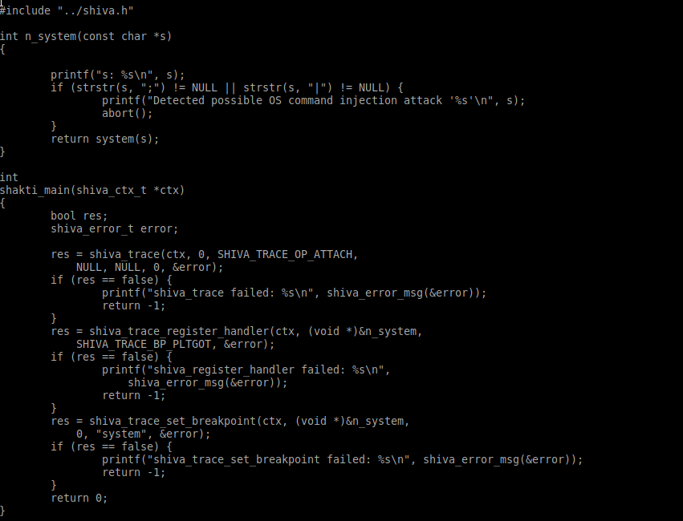
A security module. Prevent command injection via system function

Slide 18
The Shiva API (shiva_trace)
Shiva modules are written in C
Shiva modules use Shiva-Trace to access, read, transform, and instrument the process image
Rich API for process transformation
Excellent for writing debuggers, tracers, security modules, etc.
In very early development phase

Slide 19
Shiva debugging model
The Shiva program (The debugging engine and module linker)
The target program (The debuggee)
The loaded module (The debugger)
The Shiva API (The API used by the debugging module)
The debugger and the debugee are merged into a single program in memory.

Slide 20
Shiva-Trace vs. PTRACE
The Shiva-Trace API does not rely on the PTRACE system call
Shiva-Trace is effective against hardened binaries and anti-debugging
Shiva-Trace is implemented as an “in-process” programmable runtime engine.
PTRACE on the other hand, executes from a separate process context.
PTRACE: Slow. And is useless against many Linux anti-debugging techniques.
PTRACE operations send a SIGSTOP to the target process.
PTRACE is a system call and requires a context switch, whereas Shiva_trace is implemented purely in userland and less expensive.

Slide 21
Shiva Trace p3.
shiva_trace can cleverly instrument the target program at runtime
shiva_trace uses the terminology “Hooks” and “Breakpoints” interchangeably.
Many breakpoints are really just various types of hooks
shiva_trace based debugging can defeat anti-dynamic-analysis techniques.
Powerful for debugging hostile binaries

Slide 22
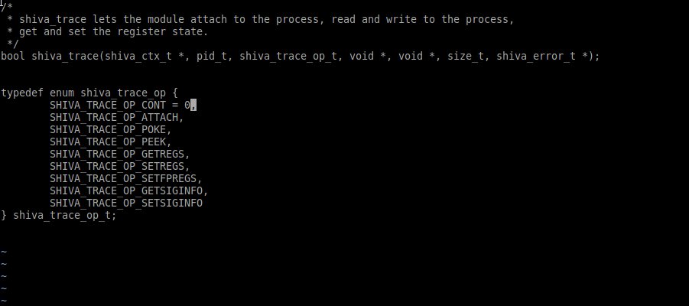
Shiva API basics: shiva_trace()

Slide 23
Shiva-Trace API - Breakpoints
Breakpoints are registered to a handler function
Similar to Linux Kprobes, but for userland
Multiple breakpoints can be set for a single handler
Some breakpoints are hooks
Some breakpoints are signal driven
A complex series of trampolines in-process trampolines

Slide 24
Shiva breakpoints and signals
We do not use PTRACE to catch signals
Our debugging module exists within the same PID as the program it’s debugging
An int3 breakpoint sets up the breakpoint-handler by creating a SIGTRAP handler with sigaction
Shiva internally hooks signal() and sigaction() in the target program to prevent the target from overwriting debugging signal handlers

Slide 25
A look at all Shiva breakpoint types
typedef enum shiva_trace_bp_type {
SHIVA_TRACE_BP_JMP = 0,
SHIVA_TRACE_BP_CALL,
SHIVA_TRACE_BP_INT3,
SHIVA_TRACE_BP_SEGV,
SHIVA_TRACE_BP_SIGILL,
SHIVA_TRACE_BP_TRAMPOLINE,
SHIVA_TRACE_BP_PLTGOT
} shiva_trace_bp_type_t;

Slide 26
Breakpoint struct
Every breakpoint set is registered to a handler function within the module

Slide 27
SHIVA_TRACE_BP_JMP
Breakpoint type: Control flow hook
Set on 5 byte jmp instructions
The jmp offset is replaced by an offset to your registered handler function
When done, the handler jumps back to the original target.
SHIVA_TRACE_LONGJMP_RETURN macro: rewinds the stack and jmp’s to the original offset
Defeats breakpoint detection with anti-debugging

Slide 28
SHIVA_TRACE_BP_CALL
Breakpoint type: Control flow hook
Set on 5 byte immediate call instructions
Original call target is replaced with offset to registered handler
The registered handler returns after calling the original function (If desired)
Extremely fast way to build a function tracer: (See modules/examples/func_tracer.c)
Only works when executing Shiva directly (Not as an interpreter) due to required small-code model.
Defeats breakpoint detection

Slide 29
SHIVA_TRACE_BP_TRAMPOLINE
Breakpoint type: Control flow hook
This type of breakpoint inserts a trampoline on the entry point of the function
  movq $target_addr, %rax
  jmp *%rax
Excellent for hooking any function locally or globally within the address space
Trampoline function restores the original code bytes before calling the original function
Not currently thread-safe. Memcpy’s that place and restore hooks are not atomic operations
Works well in a large code model whereas call hooks do not.

Slide 30
SHIVA_TRACE_BP_PLTGOT
Hook any shared library function within the PLT/GOT
Modifies the .got.plt[entry] of the given symbol
Was tricky to implement. The RTLD wants to patch over our GOT patch. (i.e. with DT_BINDNOW)
Very low overhead, and thread safe
Handler is usually a hook-replacement function for the function being hooked
A single handler can also be used for multiple PLTGOT hooks. (i.e. Any PLT call triggers the same handler)

Slide 31
SHIVA_TRACE_BP_INT3
Breakpoint type: Signal driven
Traditional int3 breakpoint uses 0xcc opcode
Causes kernel to deliver SIGTRAP
The breakpoint handler is essentially a signal handler
Uses struct ucontext to get register state in this case, as any signal handler would
If the target program already had a SIGTRAP handler: ours replaces it, and optionally can invoke the original handler

Slide 32
SHIVA_TRACE_BP_SIGILL
Breakpoint type: Signal driven
This breakpoint inserts a two byte ud2 (undefined instruction) to trigger SIGILL. “\x0f\x0b\”
Breakpoint is registered to your signal handler function
Can be helpful against hardened binaries that perform anti-debugging on standard breakpoints

Slide 33
SHIVA_TRACE_BP_SEGV
Breakpoint type: Signal driven
Breakpoint code:
  push <invalid_offset>(%rip)
Shiva_trace API inserts an instruction with an invalid offset or address
Causes an invalid memory dereference, and thus a SIGSEGV
The handler function is a signal handler that catches the SEGV, and executes your custom code

Slide 34
Reading and writing to process memory
The shiva_trace() API call
SHIVA_TRACE_OP_PEEK
  Allows the module to read anywhere in process memory
SHIVA_TRACE_OP_POKE
  Allows the module to write anywhere in process memory (Except to the Shiva code itself)

Slide 35
Getting and setting register state
The shiva_trace API call
SHIVA_TRACE_OP_GETREGS
  Get the current register values
SHIVA_TRACE_OP_SETREGS
  Set the register values

Slide 36
In-process debugging tools with Shiva
When running Shiva directly it can be used for creating powerful debugging tools
“In-process” debugging technology is extremely fast
Less context switching, more in-process trampolines
modules/examples/func_tracer.c is a module for function tracing
Sets a SHIVA_TRACE_BP_CALL hook on every immediate call
Registered handler function simply prints each function name being called

Slide 37
Shiva module: func_tracer.o
func_tracer.c
Only 84 lines of code
Much faster than tracers that are written using PTRACE
Benchmarks demonstrating performance:
Command ./test:
  Real 0m0.052s
Tracing ./test with Shiva:
  Real 0m0.155s
Tracing ./test with /bin/ltrace
  Real 0m2.582

Slide 38
Control flow integrity: ret2PLT protection
modules/examples/plt_cfi.c
Only 109 lines of code
Forward edge / Backward edge CFI
Sets a SHIVA_TRACE_BP_PLTGOT hook on every PLT call
shiva_trace_set_breakpoint() installs hooks/breakpoints and stores CFI data in breakpoint struct
Every PLT call is redirected to our modules handler:
int plt_handler(void *arg)

Slide 39
ret2plt protection p2.
int plt_handler(void *arg)
Checks the return address
Prevents arbitrary calls to the PLT
A standard ret2PLT attack will fail against this
Bypass: Attacker can craft the stack with a proper return address, so it appears a proper PLT call

Slide 40
Mitigate OS command injection
modules/examples/os_inject.o
Only 48 lines of code
SHIVA_TRACE_BP_PLTGOT hook on system() function
Replaced with secure function n_system()
n_system() sanitizes the command string

