Slide 1

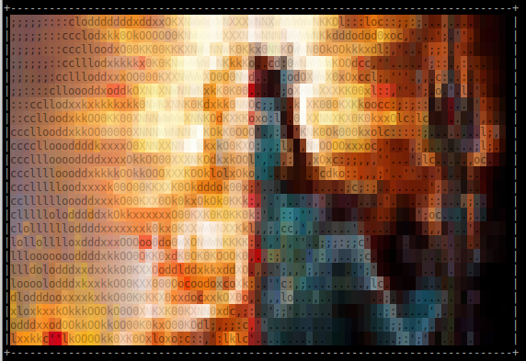
Demonstrating Shiva v0.13 Alpha
By Ryan O’Neill

Slide 2
State of the art ELF patching solution
A practical approach to patching native software in Linux
  Natural patch development in C code
  ELF symbol and relocation driven patching operations
An ELF runtime transformation technology
  Loads and links relocatable ELF patches at runtime
  Introduces new linking concepts for program transformation

Slide 3
Shiva design goals for phase-2
Flexible and modular micropatching system
  Specialized ELF interpreter “/lib/shiva”
  Program transformation at runtime with relocatable objects and ELF ABI extensions (i.e. transformations, linker chaining, etc.)
Versatile patching capabilities
  Relink any part of a programs code or data symbolically
  Splice operations: Insert symbolically rich C code anywhere
  Transformation operations with C macros
The ability to install many patches successively

Slide 4
ELF ABI compatibility
Shiva fits into the ELF ABI toolchain
  Compiler: gcc/clang
  ELF Linker: “/bin/ld”
  ELF Dynamic linker: “/lib64/ld-linux.so”
  Shiva (Custom dynamic linker): “/lib/shiva”

Slide 5
ELF ABI extensions
Shiva extrapolates on existing ELF ABI
  ELF Transforms
  Chained dynamic linkers (aka ELF interpreter chaining)
  Cross ELF Relocations
  Delayed ELF relocations
  LDSO ELF meta-data programming
  Shiva patch prelinking
    Updates dynamic segment with patch-file meta-data
    Updates PT_INTERP segment with path to “/lib/shiva”
    Adds an extra PT_LOAD segment
    Generates control flow and XREF data
    Creates custom ELF sections .shiva.xref, .shiva.branch, .shiva.strtab

Slide 6
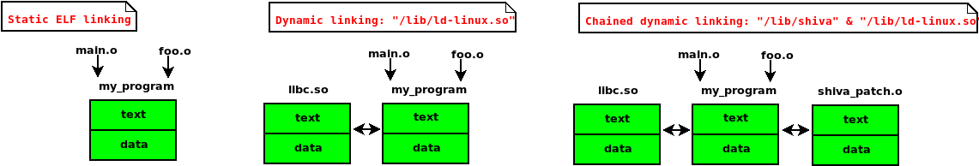
Shiva ELF linking workflow

