Slide 1
Electronic Warehouse Management
Elgin Li and William Trantan

Slide 2
Description
Database system to manage a electronics warehouse
Manages customers, orders, products, inventory, suppliers, and staff.
Focus on tracking the order lifecycle, from customer purchase to product shipment.
Designed using UML and ER diagrams for process and database structure.

Slide 3
Usage
Customer can view products
Customer can purchase products and view its shipping information
Staff can update the inventory
Staff can manage shipping of products
Supplier can send product to warehouse for staff to update inventory

Slide 4
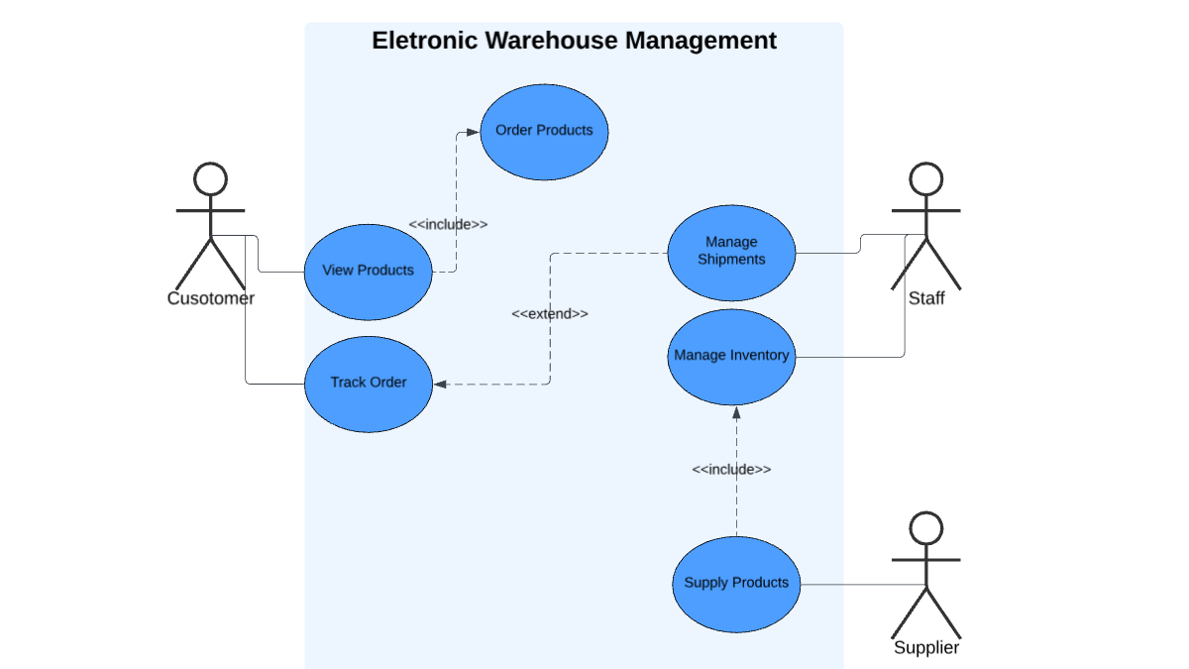
UML Use Case Diagram

Slide 5
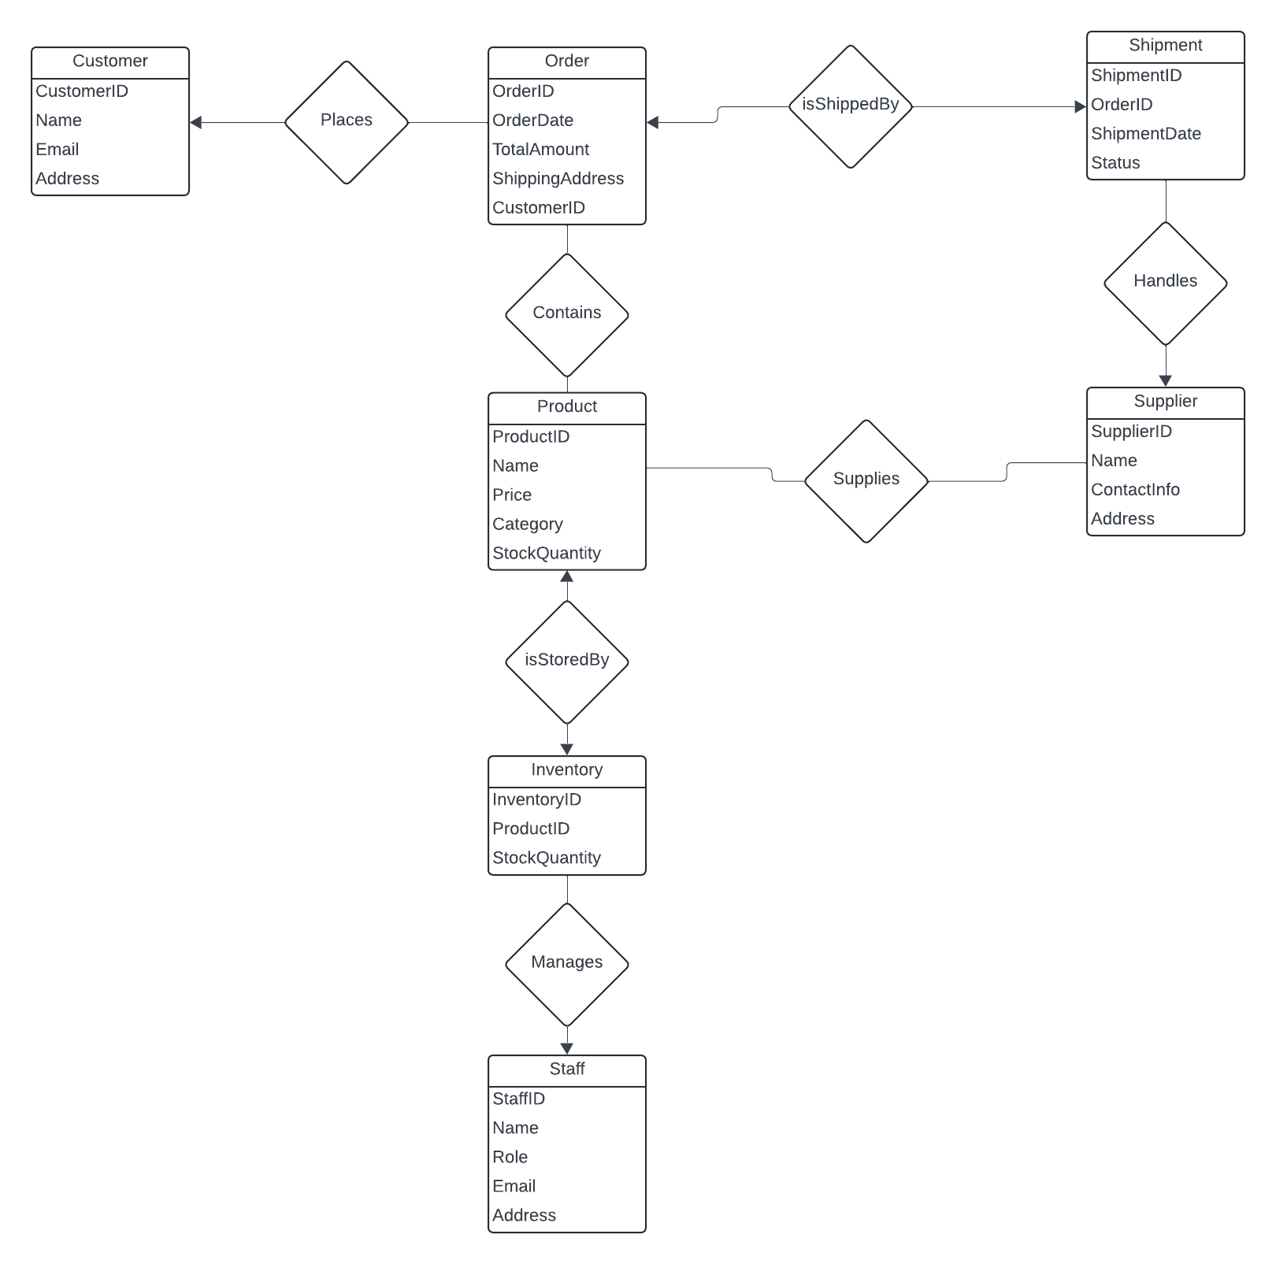
E/R Diagram

Slide 6
Implementation Details
Used Flask for backend, Html/CSS for frontend to display/process all data
Connected sqlite3 database made in checkpoint 2 to Flask backend
Wrote routes in python using sql statements written in checkpoint 2 to display and process data in the frontend
Created customer, staff, and supplier pages to demonstrate usage from diagram

