Slide 1
Electronic Warehouse Management
By Elgin Li and William Trantan

Slide 2
Description
Database system to manage a electronics warehouse
Manages customers, orders, products, inventory, suppliers, and staff.
Focus on the process of customer placing order to staff managing products, and supplier supplying products.

Slide 3
Usage
Customer can view products
Customer can order products and view its shipping information
Staff can update and delete the inventory
Staff can manage shipping and orders
Supplier can add new products to warehouse for staff to update inventory

Slide 4
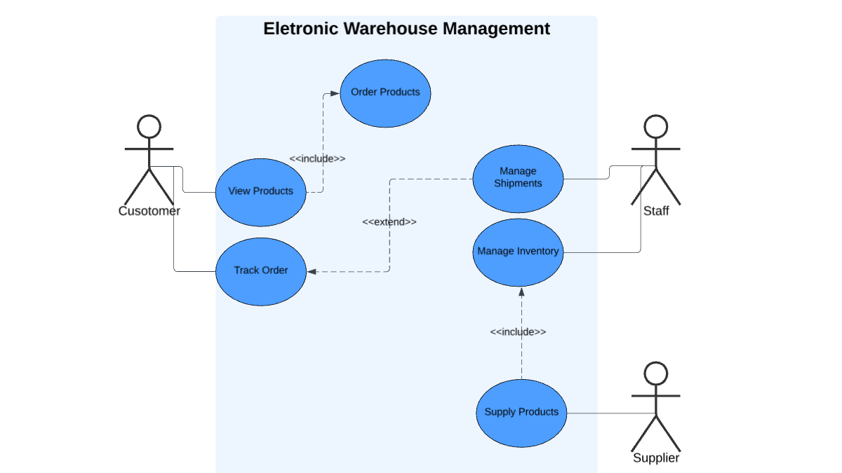
UML Use Case Diagram

Slide 5
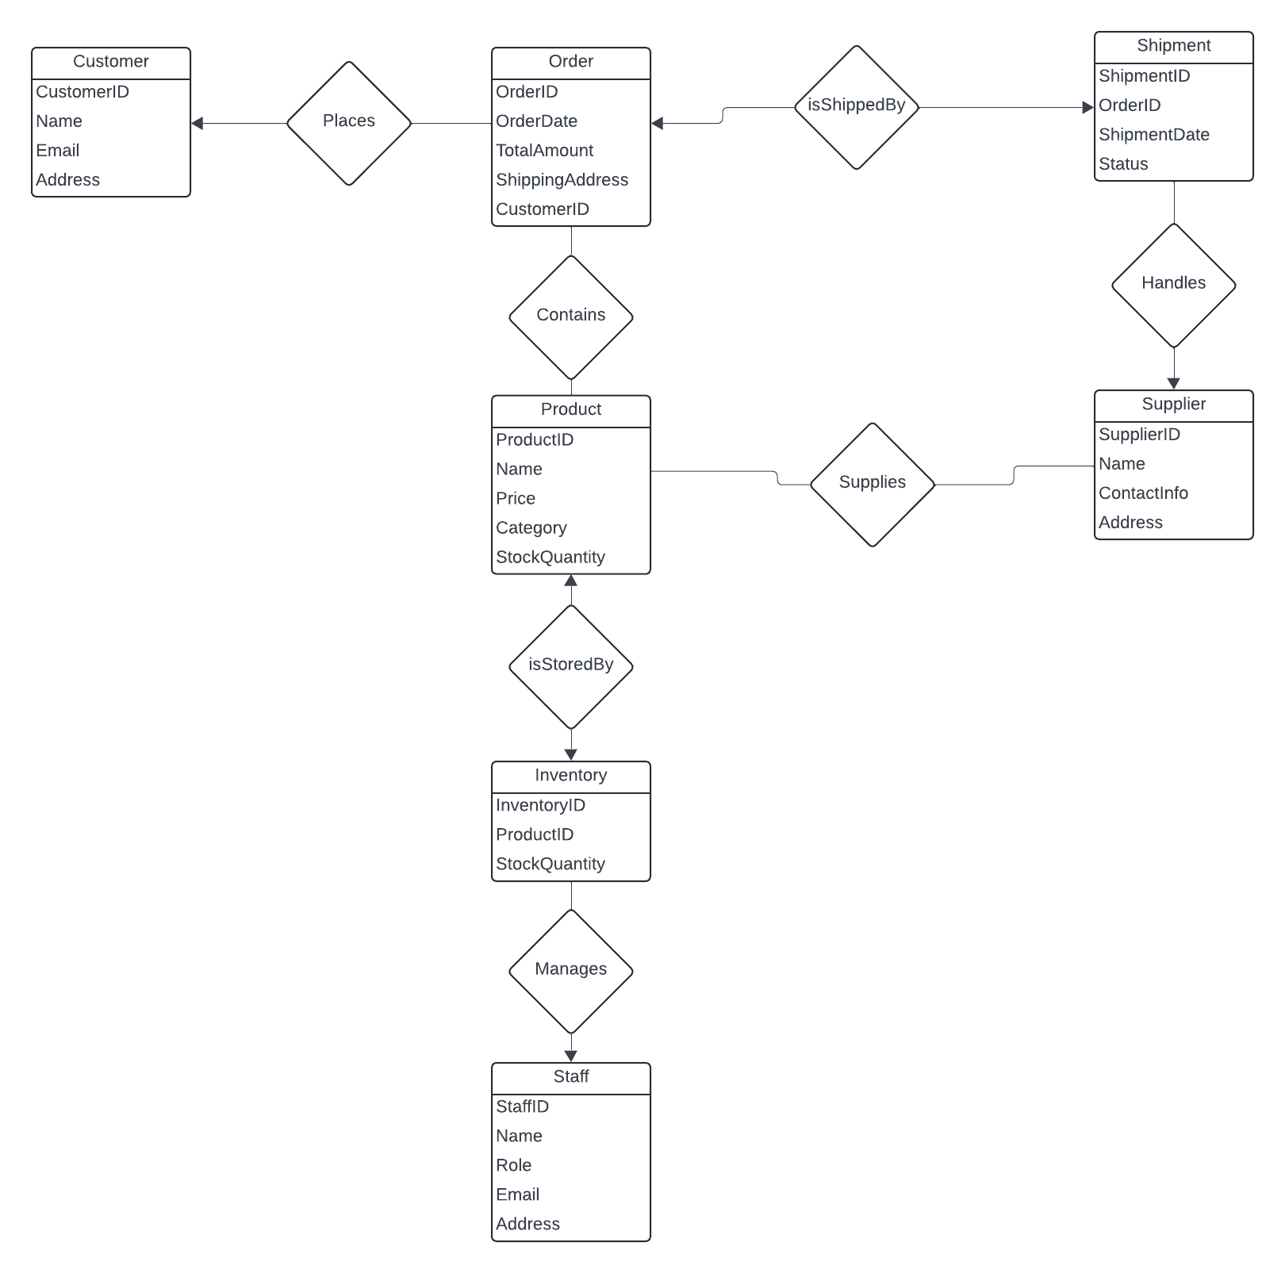
E/R Diagram

Slide 6
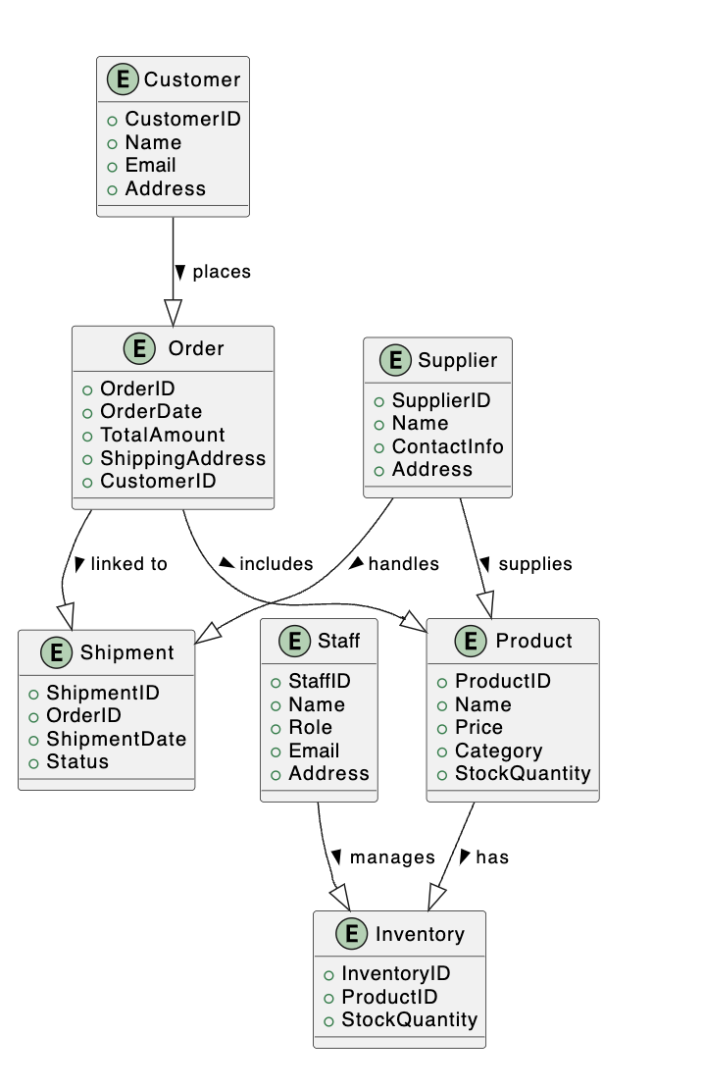
Relational Schema

Slide 7
Implementation Details
Used Flask for backend, HTML/CSS for frontend to display/process all data.
Connected the sqlite3 database to Flask backend.
Wrote routes in python using sql statements to display and process data in the frontend.
Created customer, staff, and supplier pages to demonstrate usage from diagram.

