Slide 1
Electronic Warehouse Management
Elgin Li and William Trantan

Slide 2
Description
Database system to manage a electronics warehouse
Manages customers, orders, products, inventory, suppliers, and staff.
Focus on tracking the order lifecycle, from customer purchase to product shipment.
Designed using UML and ER diagrams for process and database structure.

Slide 3
Usage
Customer can view products
Customer can purchase products and view its shipping information
Staff can update the inventory
Staff can manage shipping of products
Supplier can send product to warehouse for staff to update inventory

Slide 4
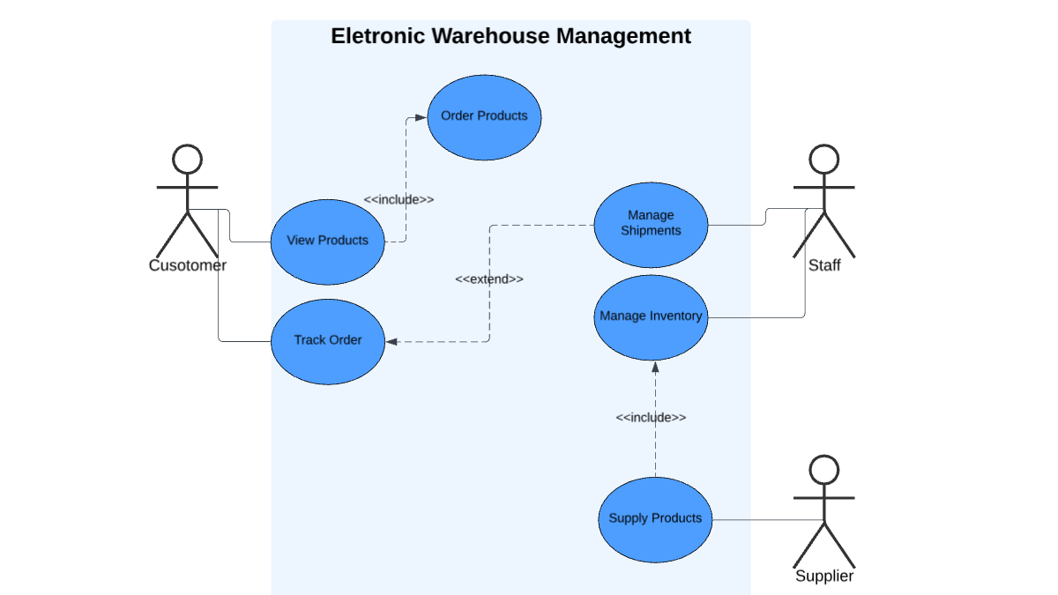
UML Use Case Diagram

Slide 5
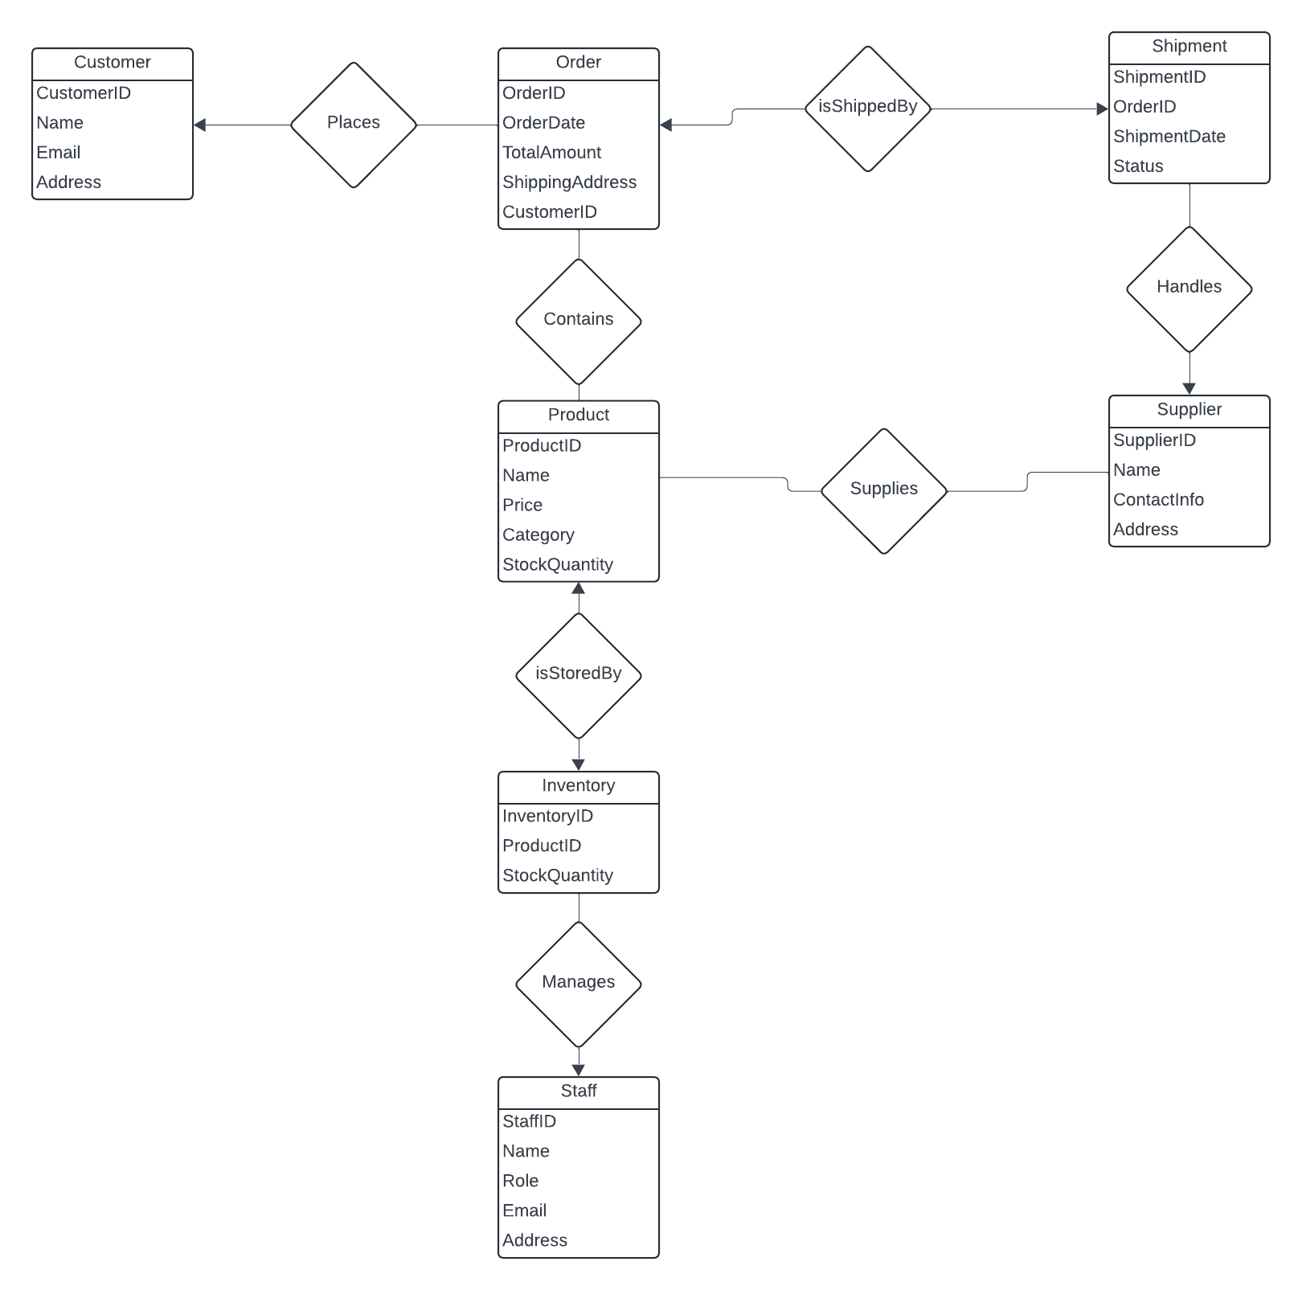
E/R Diagram

