Slide 1

Kubernetes (k8s) Introduction Helm By: Priyakant Patel

Slide 2
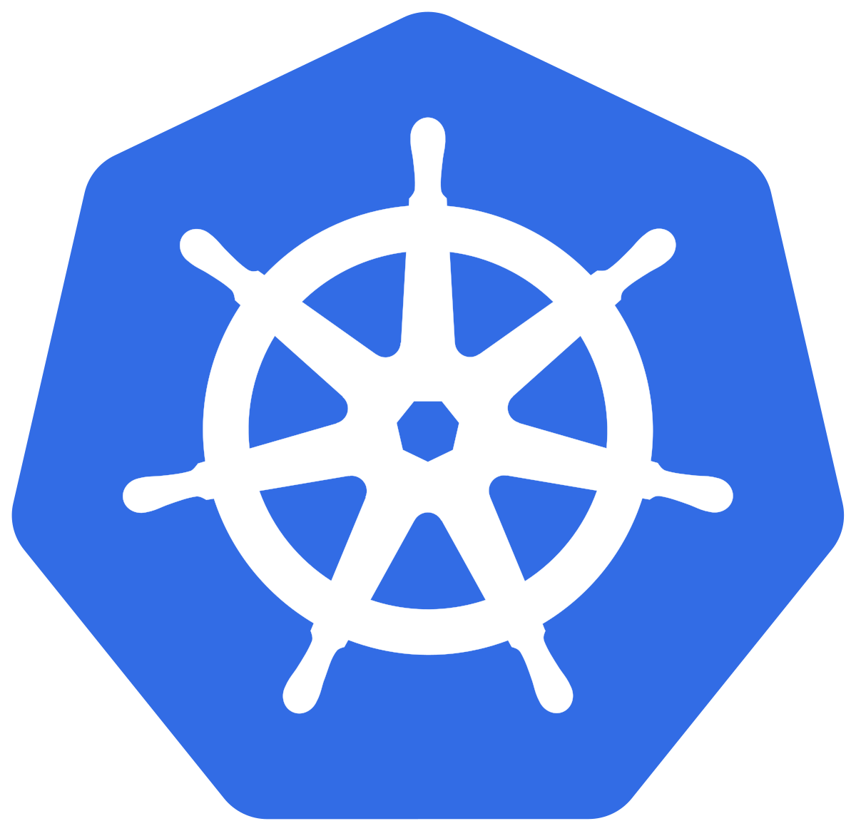
Previous session
k8s Introduction
What is Kubernetes and what can it do
Kubernetes Components
Deployment
Service
Ingress
ConfigMap

Slide 3
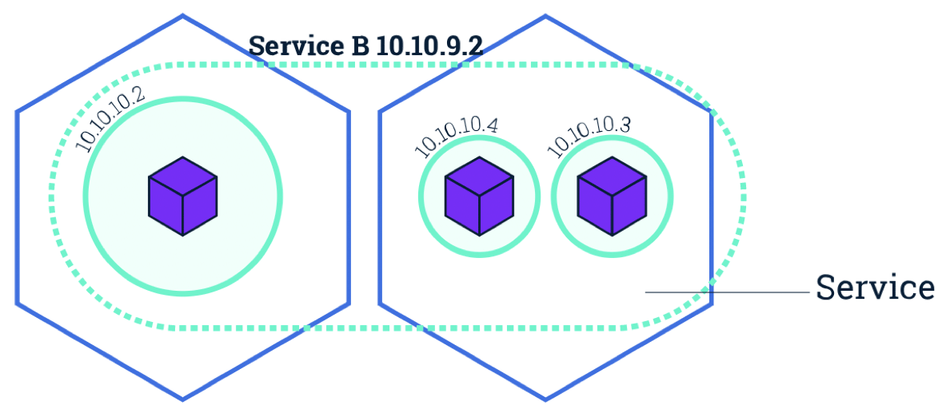


Kubernetes Components
k8s Introduction
Node
Ingress
POD
HTTP
Request

Slide 4
Deployment
k8s Introduction
Deploying applications to Kubernetes can be complex. Setting up a single application can involve creating multiple interdependent Kubernetes resources such as Deployments, Services, Ingress , ConfigMap, etc.
Typical MicroService:
1-Pod
1-Service
1-Ingress
Some Configuration
Resource requirements (CPU, Memory)
Etc.
Each requiring you to write a detailed YAML manifest file.
Notes:
Different env, different values

Slide 5

HELM to the rescue
k8s Introduction
Helm is a package manager for Kubernetes that allows developers and operators to more easily package, configure, and deploy applications onto Kubernetes clusters.
HELM Client
Command line Interface
Interacts with tiller
Local chart
Tiller Server
Cluster component
Listens to HELM Client
Interacts with K8S API
Manages lifecycle
Notes:
Version needs to match, new version do not have tiller. What we are saying

Slide 6

HELM Chart
k8s Introduction
Deploy to K8S
Packaged
Kubernetes Components
Notes:
Demo

Slide 7
HELM Commands
k8s Introduction
helm create my-chart-name
helm ls
helm install --debug --dry-run –name my-chart-name .
helm install --name my-chart-name .
helm upgrade my-chart-name .
helm upgrade my-chart-name . --set replicaCount=1
Notes:
Different env, different values

Slide 8
Templates
k8s Introduction
{{ template “chart.fullname” . }} # values from Chart.yaml
{{ .Release.Name }} # built in Release object
{{ .Values.replicaCount }} # value from values.yaml
https://helm.sh/docs/chart_template_guide/#built-in-objects
The Go Template language
Notes:
Different env, different values

Slide 9
Showcase & Reference
k8s Introduction
https://hub.helm.sh/
https://helm.sh/
Notes:
Different env, different values

Slide 10
Questions?

