Slide 1
PPT Template
Emanuel Regnath
14.01.15

Slide 2
Overview
Motivation – Why do we care?
Interconnect Power Dissipation
Concepts of Low Power Interconnects
Conclusion

Slide 3
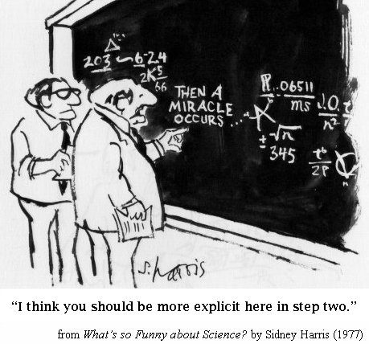
Questions

