Slide 1
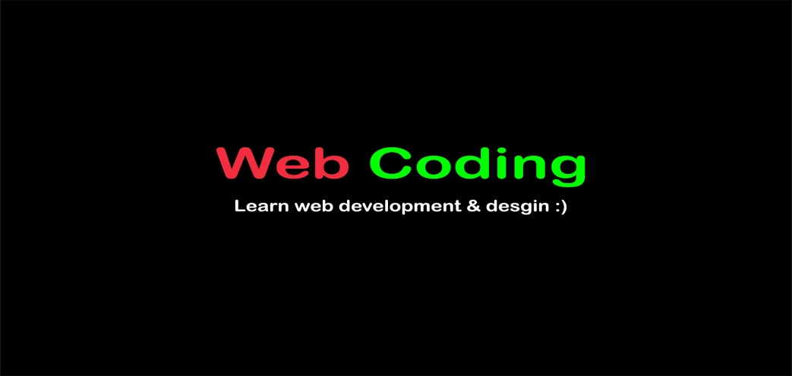
PHP for Beginners 2021: PHP Crash Course
Welcome ☺

Slide 2
What exactly is PHP?
Server-side, scripting, General purpose programming language suited for web development
PHP is an acronym for "PHP: Hypertext Preprocessor“ or Personal Home Page
Interpreted Backend language “runs on a server”
Created by ”Rasmus Lerdorf ” in 1994

Slide 3
Why Learn PHP?
PHP runs on various platforms (Windows, Linux, Unix, Mac OS X, etc.)
Adapted by tech giants like(Facebook, Wikipedia) “WORDPRESS built on top of it”
PHP supports a wide range of databases
PHP is free and open source
PHP is easy to learn and runs efficiently on the server side

Slide 4
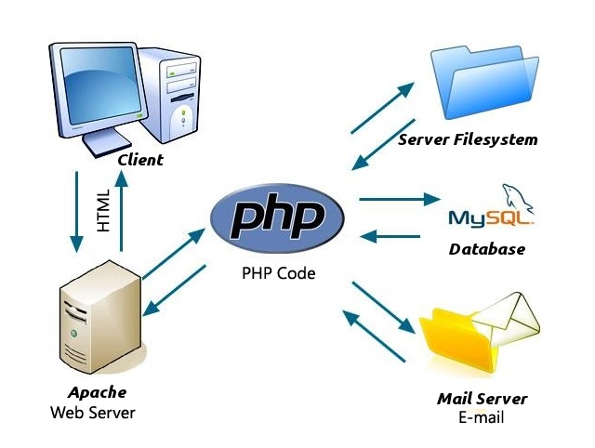
How basically the Web Works?

Slide 5
Our Tools
Server (Apache)
Database (Mysql)
Text Editor (Sublime)
Web Browser (Chrome)

Slide 6
Let’s get going see you inside ☺
If you have any questions, DON’T HESSTAIATE TO ASK ME
“My Social Media are on my Profile”
“ I LOVE ALL YOUR Questions”

