Slide 1
Attendance Register

Slide 2
Our Team
Kamalpreet Singh (Face Detection)
Jarman Singh (Face Detection)
Ishaan Chawla (Training Model)
Amandeep Singh (Face Recognition)

Slide 3
OUTLINE
Acknowledgement
Introduction to Machine Learning
Applications
Scope
What we used ?
Project Approach
Live Demonstration

Slide 4
Acknowledgement
We have taken efforts in this project. However, it would not have been possible without the kind support and help of many individuals and organizations. We would like to extend my sincere thanks to all of them.
We are highly indebted to Dr. Sunny Behal for their guidance and constant supervision as well as for providing necessary information regarding the project & also for their support in completing the project.
We would like to express my gratitude towards our parents & teachers of Shaheed Bhagat Singh State Technical Campus, Ferozepur for their kind co-operation and encouragement which helped us in completion of this project.
We would like to express our special gratitude and thanks to industry persons for giving us such attention and time.
Our thanks and appreciations also go to our colleague in developing the project and people who have willingly helped us out with their abilities.

Slide 5
Introduction
In our college lecturers still use a traditional way to record students’ attendance either through calling out students’ names or through a passing attendance sheet among students to sign beside their names.
Both ways are time consuming and associated with high error scales. In this project.
We attempt to reduce wasted time, eliminate buddy clocking, and automate the process. Our system uses facial recognition technology to record the attendance through a high resolution digital camera that detects and recognizes faces and compare the recognize faces with students’ faces images stored in faces database.

Slide 6
Machine Learning
When machine learns
Machine learning is the scientific study of algorithms and statistical models that computer systems use to effectively perform a specific task without using explicit instructions, relying on patterns and inference instead. It is seen as a subset of artificial intelligence.
When machine takes decisions without explicitly programming.

Slide 7
Applications
Virtual Personal Assistants
Weather Forecasting
Systems like Siri, Alexa & Google Assistant
Social Media Services
Email Spam and Malware Filtering
Chabot's
Object & Face Detection
Self Driving Cars

Slide 8
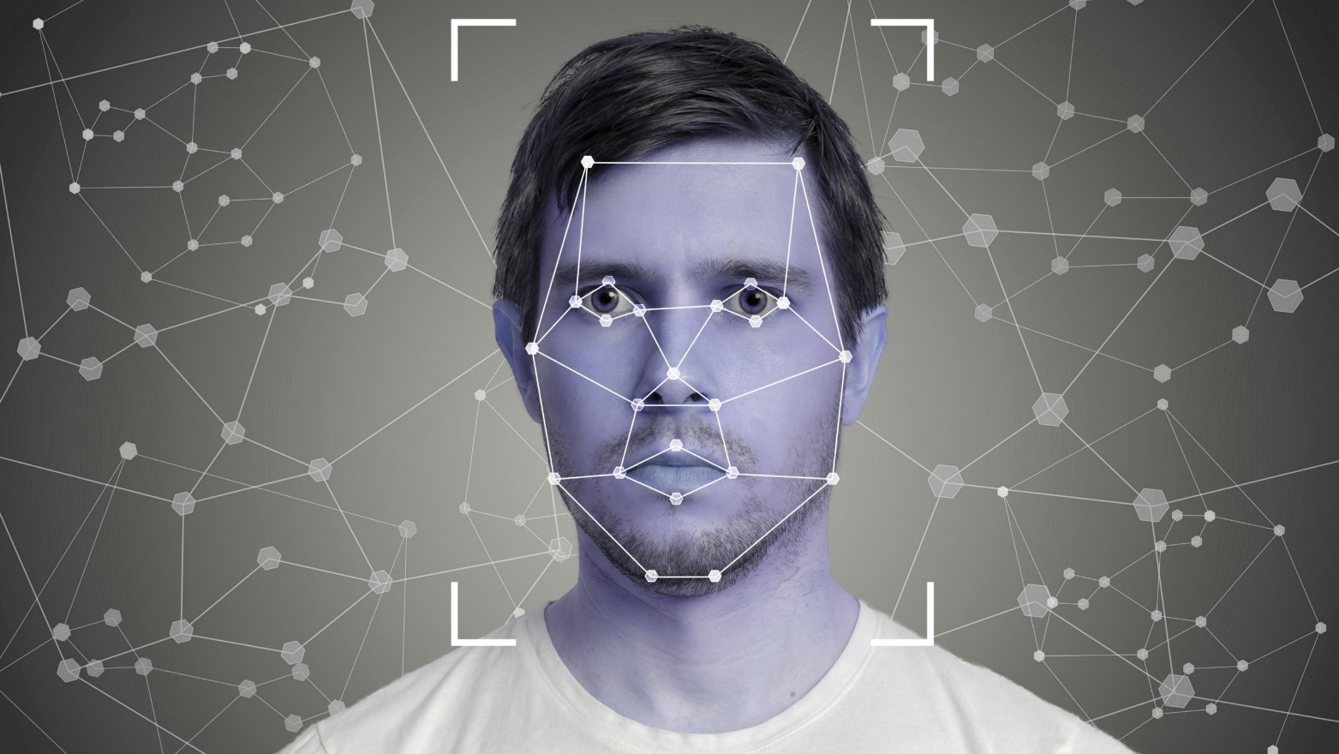
Facial Recognition System

Slide 9
Scope Of Project
Create and train a model of machine learning.
To create a program which detects faces.
Add new users by training new model .
Recognizes them using that learned model.
Marks Attendance with Face Id.

Slide 10
What We Used ?
Tensorflow Keras Model for training.
For Face Detection Faces.xml
CV2(Python)
SkLearn(Python)
Numpy(Python)
Os (python)
PyMongo for database.
Pandas for csv file generation.

Slide 11
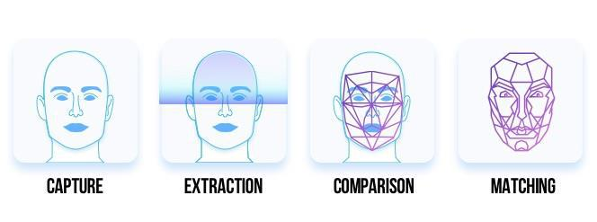
Project Approach
Capture
Extraction
Comparison
Matching

Slide 12
PHASE 1
Capture and Extraction

Slide 13
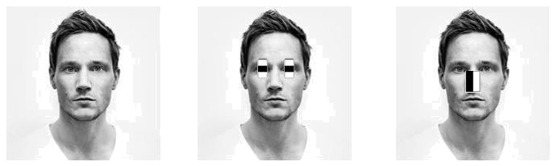
Face Detection (Minor Project)
Detect faces using faces.xml
Trained model by extracting the features of face like eyes, nose, lips etc.
The model was trained using the Tensorflow.
Feature Extraction

Slide 14
Generating Data for Training
Using Python’s cv2 library capture frames.
Generate 50 pictures by detecting faces using model.
For each person 50 pictures will be generated.
Each person is equivalent to a class.
Folder name is used as label for the image
Source code: Generating_training_data.py

Slide 15
PHASE 2
Training Model

Slide 16
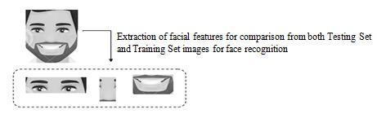
Training Classes for Recognition
Tensorflow's Keras model used to train last 2 layers of the model.
Split data into train and test data.
For each class (Person) it generates 128D unique array.
Train data(0.9)
Test data(0.1)
Source code: training.py
Output Model: face_reco1.MODEL

Slide 17
PHASE 3
Comparison and Matching

Slide 18
Recognizer
Capture faces using cv2 and face.xml model.
Convert frame to vector to feed to the recognizer model.
Using trained model face_reco1.MODEL recognize faces.
Mark attendance using the pandas.
Give the output as csv file for attendance.
Source code: recognizer.py

Slide 19
References
https://www.coursera.org/learn/image-processing
https://en.wikipedia.org/wiki/Facial_recognition_system
https://stackoverflow.com/questions/tagged/face-recognition
https://www.quora.com/topic/Face-Detection

Slide 20
Ready for Live Demo ?

