Slide 1

Automatic Provisioning of IT Resources
Scalable Web Application Deployment Architecture

Slide 2

The Challenge
Complex Deployment
Deploying and scaling complex microservices applications across physical infrastructure requires sophisticated automation and intelligent resource management.
Manual Limitations
Traditional manual provisioning cannot handle dynamic scaling demands, resource optimization, and fault tolerance requirements of high-load web applications.

Slide 3


Physical Infrastructure Foundation
8 Physical Nodes
High-Performance
Proxmox cluster providing the hardware backbone for virtualized workloads
Dedicated hardware resources with redundant power and network connectivity
Virtualization
Proxmox virtualization layer enables flexible VM management and resource allocation

Slide 4

Virtual Network Architecture
Software-defined network built on Proxmox cluster using virtual router (OPNsense)
1
2
Hospital VLAN
Ministry VLAN
Isolated network segment hosting healthcare application services and patient data systems
Separate network for government services and administrative applications with enhanced security
3
Monitoring VLAN
Dedicated infrastructure for observability stack: Prometheus, Loki, Grafana + Alertmanager

Slide 5

Monitoring Infrastructure
PLG Stack
Prometheus for metrics collection and time-series data
Loki for log aggregation across all VMs
Grafana for visualization and dashboards
Alertmanager for automated notifications
Two dedicated VMs in Monitoring VLAN observe all VMs across Hospital and Ministry VLANs, providing centralized visibility.

Slide 6

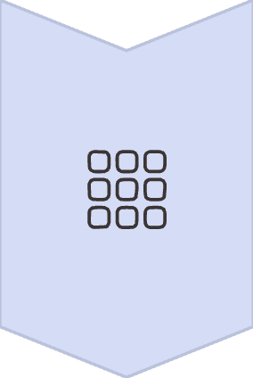


VM Cluster Segmentation Strategy
Logical Grouping
VM cluster divided into k mini-clusters based on workload relationships
Reduced Complexity
Provisioning algorithm complexity drops from O(n) to O(n/k)
Better Distribution
Improved resource distribution and scaling behavior across nodes

Slide 7
VM Provisioning Algorithm
Hybrid metaheuristic approach combining Differential Evolution and Whale Optimization Algorithm
Sample PMs
Randomly select m physical nodes from available pool
Map VMs
Assign virtual machines to sampled physical nodes
Evaluate Fitness
Calculate fitness function for current VM-to-PM mapping
Iterate Remappings
Apply optimization techniques to find better placement
Merge Results
Combine multiple samples for optimal final mapping

Slide 8

Fitness Function
Weighted Euclidean distance over normalized metrics
CPU Usage
Memory (RAM)
Processing power utilization across all cores
Available and used memory resources
I/O Operations
Energy
Disk and network throughput metrics
Power consumption and efficiency
Formula: fitness = √(w₁·ΔC² + w₂·ΔR² + w₃·ΔI/O² + w₄·ΔE²)
All metrics z-score normalized with weights summing to 1, defined by application designer

Slide 9

VM Scaling Policies
Horizontal Scaling
Automatic VM duplication triggered by HTTP 5xx error rates or packet loss detection
Vertical Scaling
Resource increases (vCPU, RAM, disk) triggered by sustained usage thresholds
Migration Logic
If physical node lacks resources, VM is automatically migrated using provisioning algorithm

Slide 10
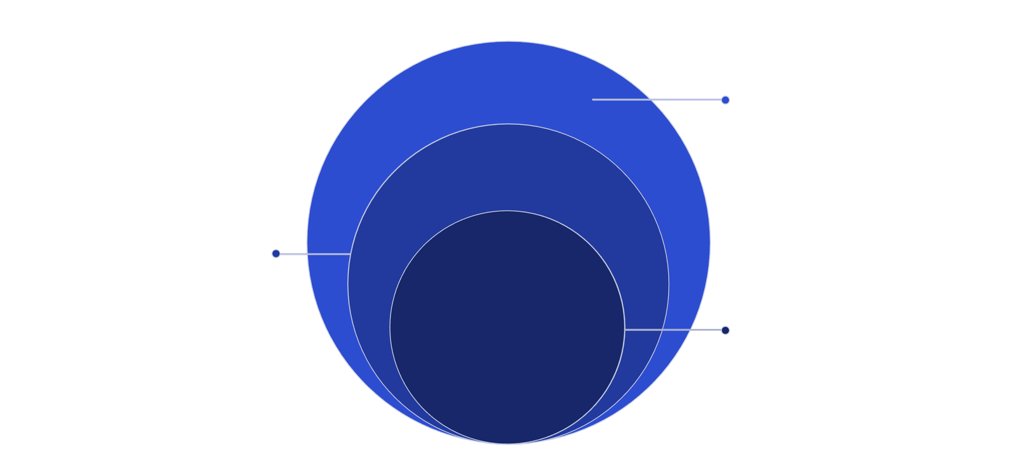
Complete Architecture Overview
Container Layer
Kubernetes pods with Best Fit distribution
VM Layer
k mini-clusters and monitoring VLAN
Physical Layer
8 Proxmox nodes forming the base
Physical Layer
VM Layer
8-node Proxmox cluster with virtualized infrastructure
Mini-clusters with intelligent provisioning and scaling
Container Layer
Monitoring
Kubernetes-managed pods distributed via Best Fit algorithm
PLG stack observing all VMs across VLANs

