Slide 1
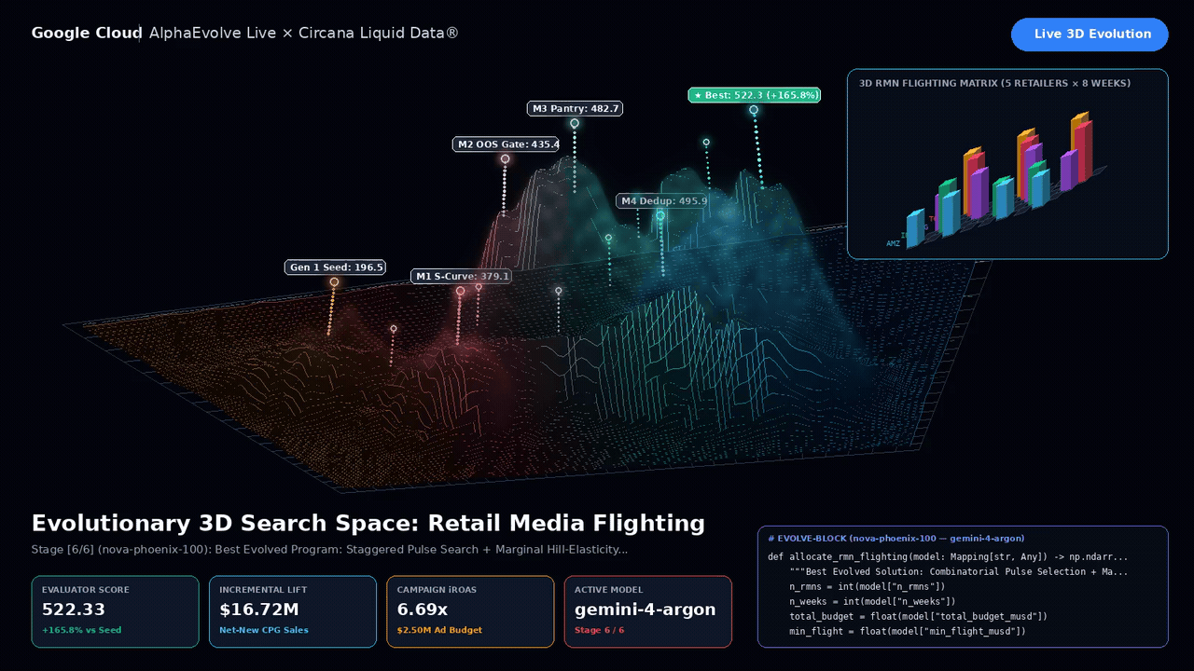
Notes:
Circana Liquid Data x AlphaEvolve 3D Search Space & Flighting Matrix. Frame 0 is the climax state (Score 522.33, +165.8 0mprovement) for static PDF exports, while Google Slides Live and PPTX play the looping 3D evolution.

