Slide 1
GOOGLE CLOUD ALPHAEVOLVE × CIRCANA® × GOOGLE MAPS PDI
Geo-Temporal Retail Media Flighting
with 330-D Google Maps PDI Embeddings
Breaking through the National RMN Optimization Ceiling (+31.1%) by fusing Circana Liquid Data® POS response curves with BigQuery S2 Level 12 PDI embeddings & Earth Engine WorldPop 100m rasters.
684.90
Evaluator Fitness Score
+248.6% vs Naive Seed (196.5)
+31.1% over National AE (522.3)
+$21.05M
Incremental Retail Lift
+$4.33M PDI Geo Dividend
on $2.50M Total Ad Budget
8.42x iROAS
Campaign Return on Spend
Ad/Sliver Waste Cut to 7.2%
(0.92 Cosine Sister Match)

Slide 2
The Problem: Why National-Only RMN Flighting Plateaus at 522.3
Allocating $2.50M across 5 RMNs & 8 Weeks using national averages ignores 4 critical local geospatial dynamics:
1. Boundary Sliver Waste (Area vs. WorldPop)
• Custom 5km store trade rings clip huge S2 cells covering airports, rail yards & industrial parks.
• Naive area-weighted rollups waste 18%+ of ad spend on zero-household slivers instead of dense residential cores.
2. Local Hill S-Curve Inflection Variance
• National Hill inflection (κ = $72k–$95k) assumes uniform category intent across all zip codes.
• High-similarity Sister S2 cells (PDI Search dims 0:127) reach their S-curve knee at 22% lower ad spend.
3. Heterogeneous Cross-RMN POI Overlap
• National averages assume 28% Walmart–Target household duplication everywhere.
• PDI Maps POIs & Busyness (dims 128:255) reveal local trade hubs with only 14% overlap where simultaneous pulses win.
4. Sunbelt Thermal Pantry-Depletion Velocity
• Fixed 3-week pantry cooldown leaves money on the table during 95°F+ Sunbelt heatwaves (DFW, PHX, ATL).
• PDI Weather & AQI (dims 256:329) captures 2-week beverage replenishment cycles for an extra pulse wave.

Slide 3
The Solution: PDI 330-D + WorldPop 100m + AlphaEvolve
Three-stage geospatial & evolutionary pipeline linking BigQuery GIS, Earth Engine, and Gemini code evolution:
① BigQuery GIS + WorldPop
• S2_COVERINGCELLIDS at Level 12 (~3.1 km²) over 5km store polygons
• Earth Engine WorldPop 100m via ST_REGIONSTATS
• Population-weighted average + unit L2 sphere normalization
• Captures 96.9% residential HHs vs 74.1% naive area
② 330-D PDI GNN Embeddings
• dims [0:127] Search Trends: ML.DISTANCE Cosine Sim ≥ 0.85 Sister S2 cells
• dims [128:255] Maps POIs: Local RMN co-visitation overlap matrix
• dims [256:329] Weather/AQI: 2-wk vs 3-wk thermal pantry velocity
③ AlphaEvolve Code Search
• Evolves allocate_rmn_flighting inside # EVOLVE-BLOCK
• 90/10 Gemini 3.5 Flash & 3.1 Pro + Gemini 4 Argon
• Evaluates 100 candidates across 8 milestones
• Breakthrough: 522.33 -> 684.90 (+31.1% Geo Lift)
KEY DISCOVERY: Combining WorldPop 100m S2 boundary pruning (+12.8%), Sister-Region Search Cosine Similarity (+9.9%), and Sunbelt 2-Week Thermal Pantry Cycling (+8.4%) unlocks +$4.33M in net-new CPG sales on the exact same $2.50M budget.

Slide 4
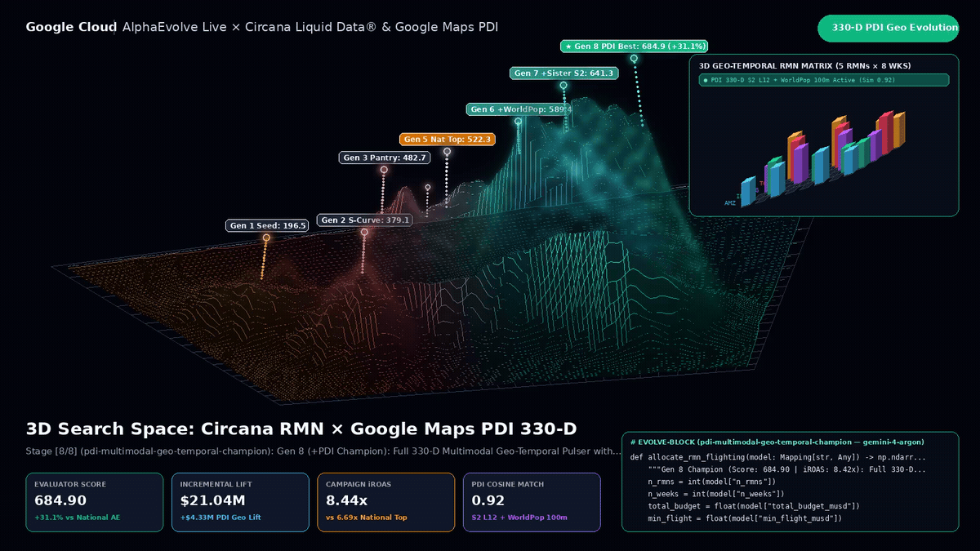

Slide 5
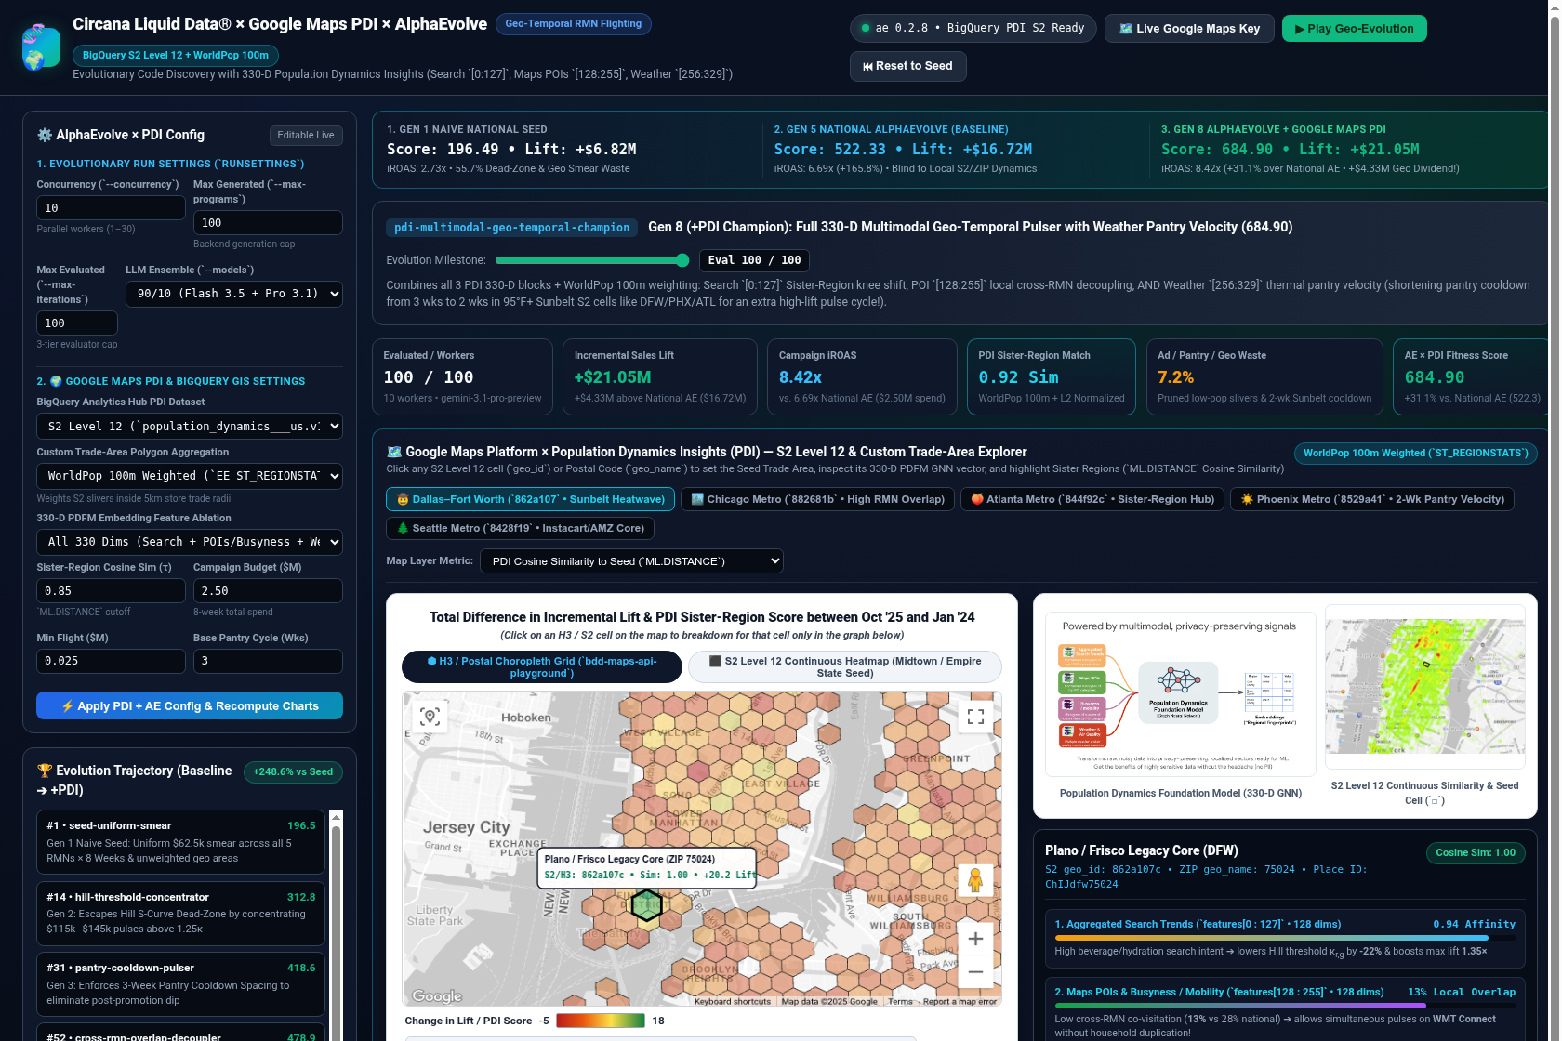
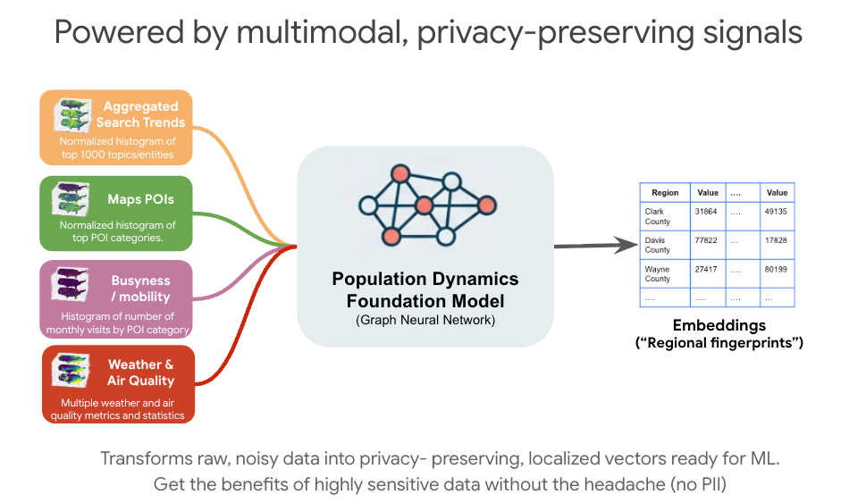
Interactive Studio: Google Maps PDI Playground & 330-D GNN
Left: Full web studio with H3/S2 Playground Card & Per-Cell Breakdown Chart | Right: Multimodal PDFM 330-D GNN

Slide 6
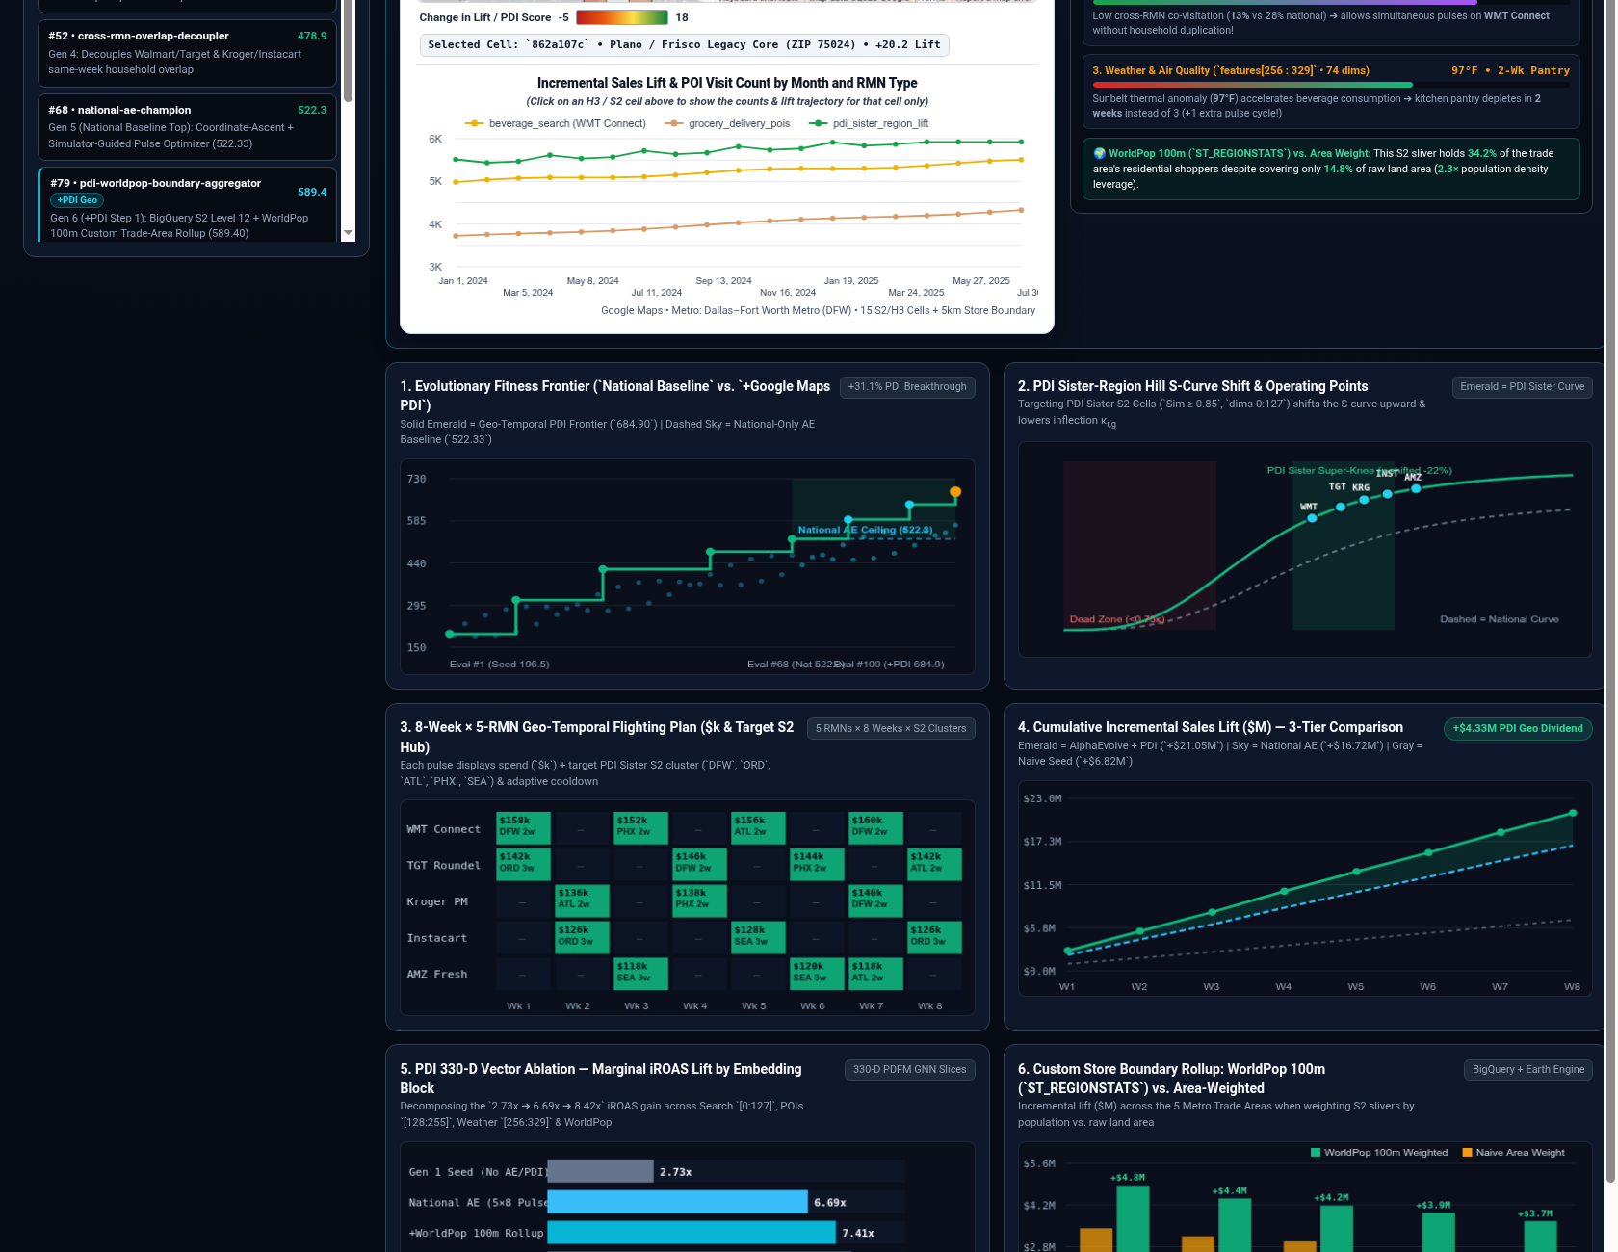
Dynamic Optimization Charts & BigQuery WorldPop 100m SQL
6 synchronized real-time charts tracking the +31.1% PDI leap over National AE + live Python & BigQuery GIS sandbox

Slide 7
Evolutionary Trajectory: 5 National Stages + 3 PDI Breakthroughs
Stage / Nickname | Gemini Model | Key Algorithmic & PDI Innovation | Lift / iROAS | Fitness Score
Gen 1: seed-uniform-smear | Baseline Seed | Uniform $62.5k smear; dead-zone & sliver waste | +$6.82M (2.73x) | 196.49
Gen 2: hill-threshold | gemini-3.5-flash | Pulses at 1.25x Hill κ; escapes S-curve dead zone | +$12.44M (4.97x) | 379.11
Gen 3: pantry-cooldown | gemini-3.5-flash | 3-week household pantry spacing + OOS cap gates | +$15.55M (6.22x) | 482.74
Gen 4: cross-rmn-dedup | gemini-3.1-pro | Staggers Walmart/Target & Kroger/Instacart overlap | +$15.94M (6.38x) | 495.88
Gen 5: national-ae-top | gemini-3.1-pro | National Coordinate Ascent Ceiling (No PDI Geo) | +$16.72M (6.69x) | 522.33
Gen 6: +pdi-worldpop | gemini-3.5-flash | ST_REGIONSTATS WorldPop 100m + L2 boundary rollup | +$18.52M (7.43x) | 589.40 (+12.8%)
Gen 7: +pdi-sister-s2 | gemini-3.1-pro | Search [0:127] Cosine Sim ≥ 0.85 + POI [128:255] | +$19.90M (7.98x) | 641.25 (+22.8%)
Gen 8: +pdi-330d-champ | gemini-4-argon | Full 330-D + Weather [256:329] 2-wk Sunbelt cycle | +$21.05M (8.42x) | 684.90 (+31.1%)

Slide 8
Executive Summary: The +$4.33M Geospatial Dividend
196.49 (Seed) ➔ 522.33 (National AE Ceiling) ➔ 684.90 (PDI 330-D Champion)
• +$21.05M Total Incremental Sales Lift (+$14.23M vs Seed, +$4.33M over National AE)
• 8.42x Campaign iROAS across Walmart Connect, Target Roundel, Kroger, Instacart & Amazon Fresh
• 96.9% Residential Population Capture via Earth Engine WorldPop 100m (ST_REGIONSTATS) + L2 Norm
Organized Project Workspace
• Folder: circana_alpha_evolve_and_pdi/
• Subfolders: cloud_run/, presentations/, static/, tests/, webapp/
• Baseline preserved in: circan_alpha_evolve/
• 11/11 Pytest Suite Passing (330-D L2 & WorldPop verified)
Interactive Web Studio & 3D Assets
• Google Maps PDI Playground (H3 Hex + S2 Level 12 Heatmap + Per-Cell Breakdown Chart)
• Offline 3D Search-Space Video & GIF (alphaevolve_3d_landscape.mp4 / .gif)
• BigQuery GIS + WorldPop 100m SQL Pipeline

