Slide 1
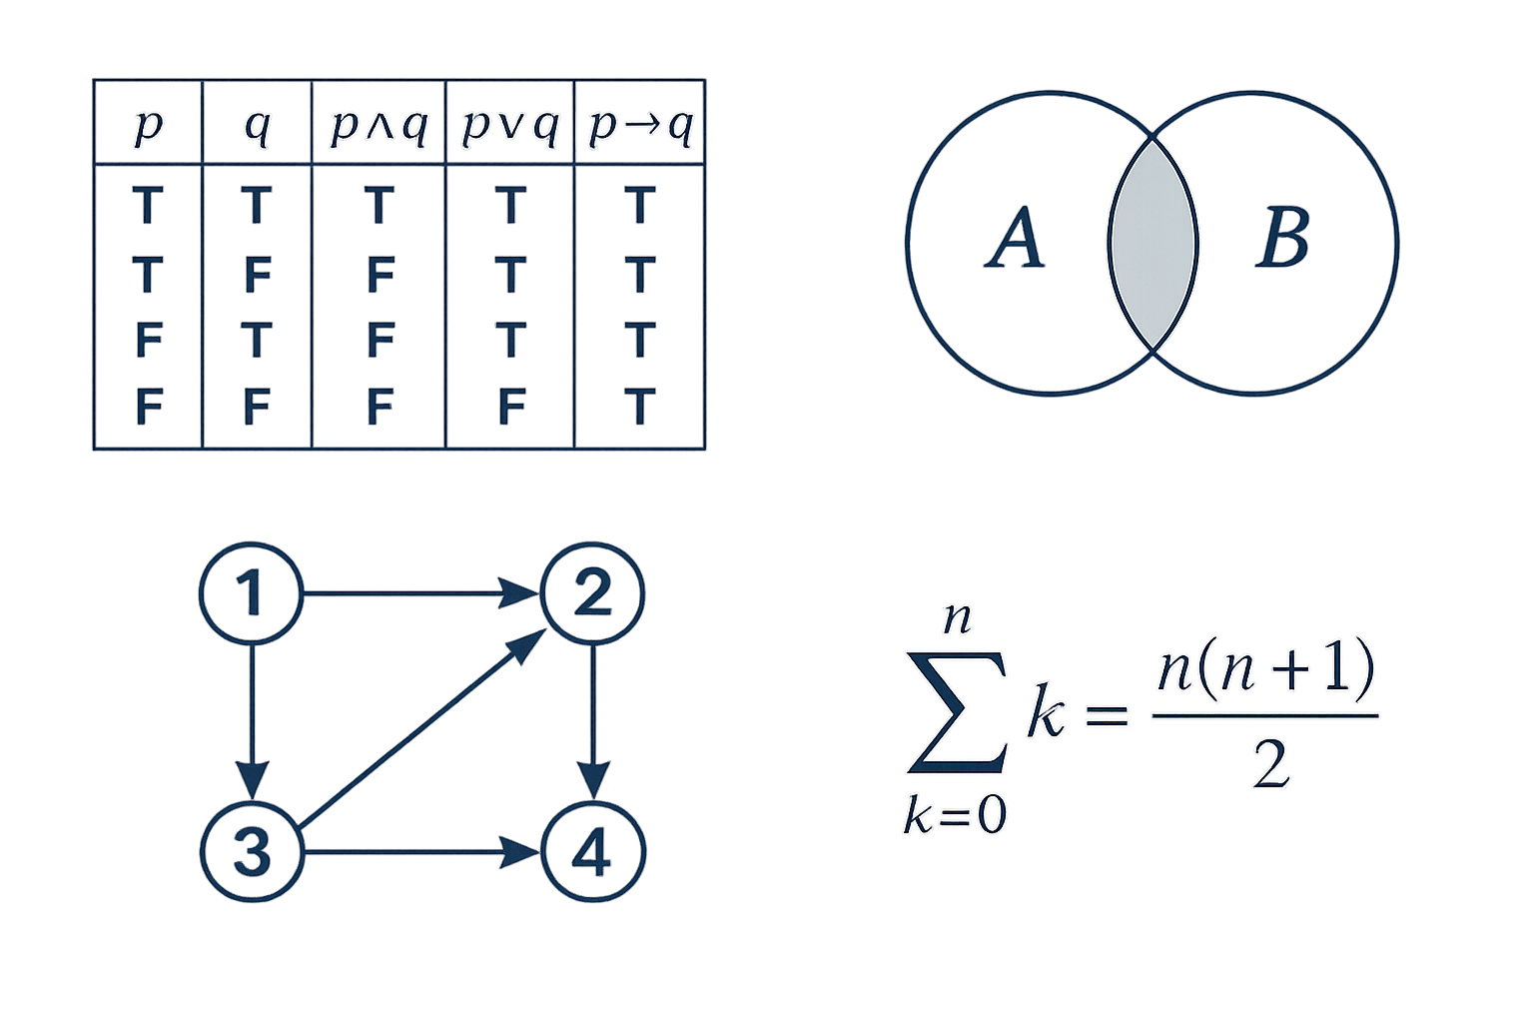
FIRST-MEETING ORIENTATION
Discrete Mathematics
Foundations for Computer Science
Taught by
Pr. Ismail Bouishak & Pr. Zouhair El Hadiq
Professors of Mathematics & Computer Science
Welcome — let's set the stage for the semester.

Slide 2
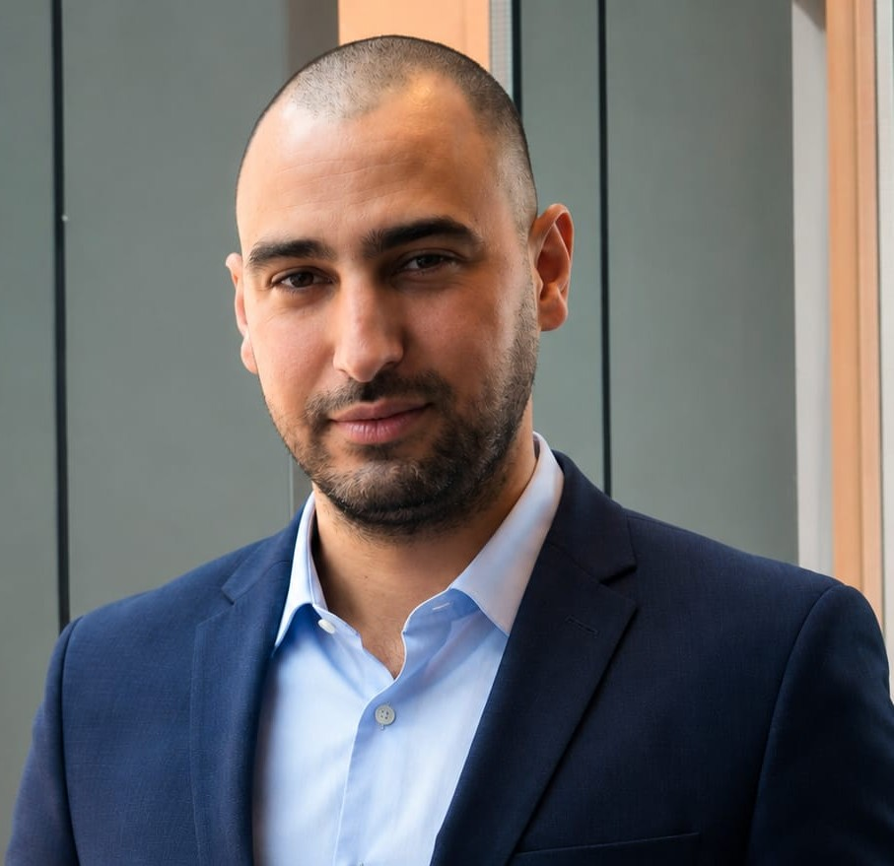

WHO WE ARE
Meet your professors
Ismail Bouishak
El Hadiq Zouhair
Professor — Discrete Math
Professor — CS & Discrete Math
Professor Agrégé In Mathematics
Process Engineer of ENIM
Experiences in Mathematics teaching @ CPGE
Ismail.BOUISHAK@um6p.ma
Professor Agrégé In Computer Science
Modeling And Scientific computer engineer of EMI.
Experiences in computer science teaching @ CPGE
zouhairelhadiq@cpgeacademy.org
Two instructors, one shared course — feel free to reach out to either of us.
Discrete Mathematics · DMath· ACSP
2 / 7

Slide 3
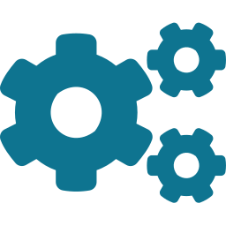



WHY THIS MATTERS
Why discrete math is the language of CS
Computers are discrete machines: bits, states, and steps. Discrete mathematics gives you the vocabulary and tools to reason about them rigorously — before you write a single line of code.
Algorithms & Complexity
Logic & Verification
Analyze correctness and efficiency. Big-O, recursion, induction.
Boolean logic powers circuits and proofs.
Graphs & Networks
Cryptography & Security
Model the web, social graphs, routing, and dependencies.
Modular arithmetic, number theory and combinatorics under the hood.
Discrete Mathematics · DMath · ACSP
3 / 7

Slide 4
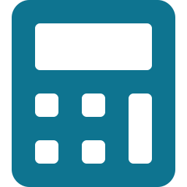
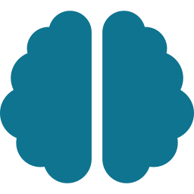



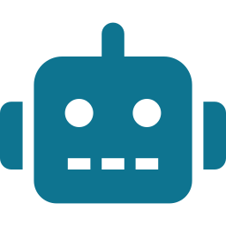
MODULE ROADMAP — DMath
Seven sequences across the module
S1
S2
S3
S4
Foundations of Logic — Part 1
Foundations of Logic — Part 2
Discrete Structures
Proofs & Recursion
Propositions, logical connectives and equivalences.
Predicate logic, quantifiers and rules of inference.
Sets, relations, functions, sequences and series.
Proof techniques, induction, recursive definitions.
S5
S6
S7
Counting
Graphs — Part 1
Graphs — Part 2
Permutations, combinations, binomial identities.
Vertices, edges, special graphs and properties.
Isomorphism, shortest paths, TSP & Chinese Postman.
Discrete Mathematics · DMath · ACSP
4 / 7

Slide 5



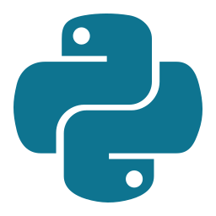

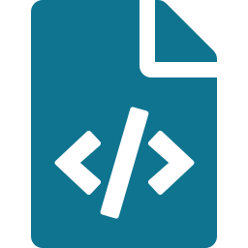

TOOLS WE WILL USE
From theory to working code
We will move between blackboard math and live code. Every concept we prove, we will also try to compute, simulate, or visualize.
Python
SymPy
Jupyter Notebooks
A clean, readable language used everywhere in modern computing — our default playground.
Symbolic math in Python: simplification, equations, modular arithmetic, combinatorics.
Mix code, math (LaTeX), and explanations in a single document — perfect for our exercises.
Why this combo?
It mirrors how a modern engineer or researcher actually works: write the proof, run the simulation, share the notebook.
Discrete Mathematics · DMath · ACSP
5 / 7

Slide 6



HOW EACH SEQUENCE WORKS
Your weekly rhythm
Watch · Read · Practice · Apply
Every sequence follows the same four-step pattern. Lab assignments are Jupyter notebooks — you submit the .ipynb file before the deadline.
Grading at a glance
Indicative — final weighting will be confirmed.
Watch the lecture video
Lab assignments (.ipynb)
20%
Each unit opens with a short video introducing the concept.
Read the lecture notes
Miterm exam
30%
Detailed notes with examples and worked exercises.
Final exam
30%
Take the unit quiz
A quick auto-graded quiz to reinforce your understanding.
Paresentation
20%
Submit the Lab (.ipynb)
Solve the lab notebook in Python / SymPy and upload before the deadline.
Discrete Mathematics · DMath · ACSP
6 / 7

Slide 7




Ready when you are.
Bring your curiosity. We'll bring the rest.
Think rigorously
Build with code
Then choose: Data or Cyber
Zouhair El Hadiq· Ismail Bouishakk
Discrete Mathematics · DMath · ACSP

