Slide 1
ACSP · 2026
FIRST-MEETING ORIENTATION
Discrete Mathematics
Foundations for Computer Science
Taught by
Zouhair El Hadiq · Ismail Bouisha
Professors of Mathematics & Computer Science
Welcome — let's set the stage for the semester.

Slide 2


WHO WE ARE
Meet your professors
Zouhair El Hadiq
Ismail Bouisha
Professor — Discrete Math & CS
Professor — Discrete Math & CS
Teaching foundations of computing
Interests: logic, combinatorics, algorithms
Email: zouhairelhadiq@gmail.com
Teaching foundations of computing
Interests: graph theory, formal methods
Co-instructor for this module
Two instructors, one shared course — feel free to reach out to either of us.
Discrete Mathematics · ACSP · 2026
2 / 7

Slide 3




WHY THIS MATTERS
Why discrete math is the language of CS
Computers are discrete machines: bits, states, and steps. Discrete mathematics gives you the vocabulary and tools to reason about them rigorously — before you write a single line of code.
Algorithms & Complexity
Logic & Verification
Analyze correctness and efficiency. Big-O, recursion, induction.
Boolean logic powers circuits, proofs, and program correctness.
Graphs & Networks
Cryptography & Security
Model the web, social graphs, routing, and dependencies.
Modular arithmetic, number theory and combinatorics under the hood.
Discrete Mathematics · ACSP · 2026
3 / 7

Slide 4
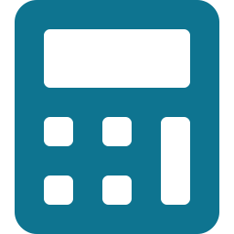




MODULE ROADMAP
What we will see this semester
01
02
03
Logic & Proofs
Sets & Functions
Number Theory
Propositions, predicates, quantifiers, proof techniques, induction.
Sets, relations, equivalence, functions, cardinality.
Divisibility, modular arithmetic, GCD, primes, applications.
04
05
06
Combinatorics
Graph Theory
Algorithms & Recursion
Counting, permutations, combinations, binomial identities.
Graphs, trees, traversals, shortest paths, applications.
Recursion, recurrences, complexity, algorithmic thinking.
Discrete Mathematics · ACSP · 2026
4 / 7

Slide 5



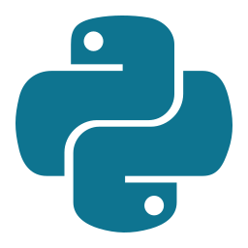

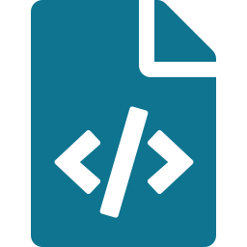

TOOLS WE WILL USE
From theory to working code
We will move between blackboard math and live code. Every concept we prove, we will also try to compute, simulate, or visualize.
Python
SymPy
Jupyter Notebooks
A clean, readable language used everywhere in modern computing — our default playground.
Symbolic math in Python: simplification, equations, modular arithmetic, combinatorics.
Mix code, math (LaTeX), and explanations in a single document — perfect for our exercises.
Why this combo?
It mirrors how a modern engineer or researcher actually works: write the proof, run the simulation, share the notebook.
Discrete Mathematics · ACSP · 2026
5 / 7

Slide 6



HOW IT WORKS
Evaluation & submissions
Notebook-based workflow
Each assignment is a Jupyter notebook. You complete the cells, run them, and submit the .ipynb file.
Grading at a glance
Indicative — final weighting will be confirmed.
Read the notebook
Notebook assignments
40%
Definitions, examples, and exercises in one document.
Code the solution
Midterm exam
25%
Use Python and SymPy to answer or verify each exercise.
Final exam
30%
Run all cells
Make sure every cell executes without error before submitting.
Participation
5%
Submit the .ipynb
Upload your notebook before the deadline. Late = penalty.
Notebooks are not just for grading — they are how you keep a personal log of what you've learned.
Discrete Mathematics · ACSP · 2026
6 / 7

Slide 7




Ready when you are.
Bring your curiosity. We'll bring the rest.
Think rigorously
Build with code
Learn together
zouhairelhadiq@gmail.com · Ismail Bouisha
Discrete Mathematics · ACSP · 2026

