Slide 1
Artificial Intelligence Neural network
Abu Shetayyah Elham
9-nov-2021
Instructor: Dr.Rami AlOuran

Slide 2
Neural Networks
Neural Network: Algorithms that simulate the way the human brain works by identifying relationships in the data set from the inputs and giving accurate outputs.
The main components of a neural network
several layers (think ‘neurons’)
Inputs
The Neuron

Slide 3
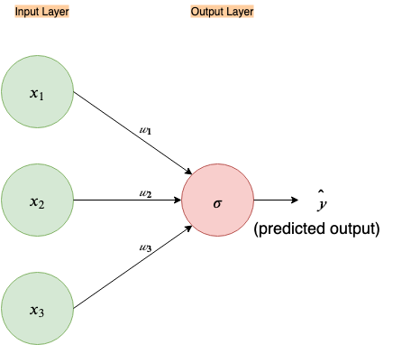
Two-layer neural network

