Slide 1

Entity-FrameWork Core
Eng : yousif mohamed

Slide 2
Table of Content
1- Intro to Programming
2- C# History
3- Development Environment
4- The Basics of everything with C#
Variables and DataTypes
Types Conversion
Errors Type
Operators
Conditions
Loops
Functions
1- Introduction to entity Framework
2- Packages to be Installed
3- OnConfiguring the ApplicationDbContext
4-your First Migrations

Slide 3
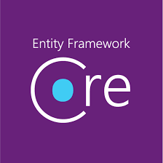
Entity Framework
Entity Framework is an object-relational mapping (ORM) framework developed by Microsoft. It is a popular tool for working with databases in .NET applications. The framework allows developers to work with data using domain-specific objects, rather than directly interacting with the underlying database

Slide 4
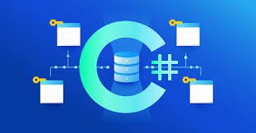
Entity-Framework Core As (ORM)
Entity Framework bridges the gap between the relational database and the application's object model. It allows developers to work with database entities as regular .NET objects, providing a higher level of abstraction.

Slide 5
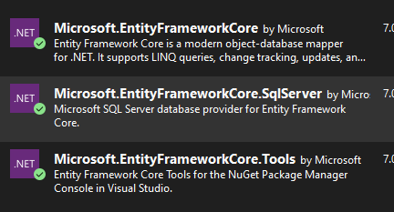
Getting Started with Entity FrameWork Core
To Start Working with Entity FrameWork
You have to install 3 main Packages
EntityFrameworkCore
EntityFrameworkCore.tools
The Third Package can be Changed as per your requirement , in this Course we will use SqlServer as our Dbms so out third Package will be
EntityFrameworkCore.SqlServer

Slide 6
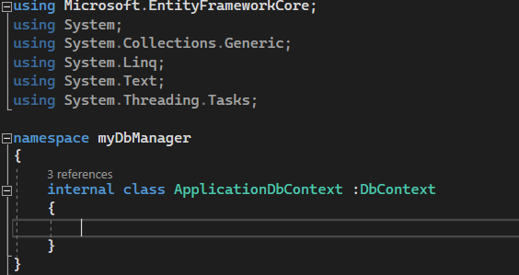
Application DbContext Class
Now you need A Controller or a bridge that you can manage your Entity Framework from
You will Create a Class that you will manage From it your Entity FrameWork ,
Soc Create a Class , their is a default name Called ApplicationDbContext ,
And to activate Entity-FrameWork Functionality you have to inherit from DbContext Class that found in Entity FrameWorkCore Package

Slide 7


Getting Started Cont
Now you need to configure your Connection and For Configuring Connection there is a virtual method that we will override on it named onConfiguring take the Connection String for the Database .
So to get the Connection String you will toggle Sql Server Object Explorer and right Click on you Server and Click On Properties , you will find the first entry Called Connection String Copy it and Past in the onConfiguring method

Slide 8
Simplifying Connection String
DataSource attribute refers that you are Connecting to local host of your Machine
Initial Catalog refers to the Targeted Database that you want to Connect To if it Found it will Connect to It if not it will Create Database with the Given Name .

Slide 9
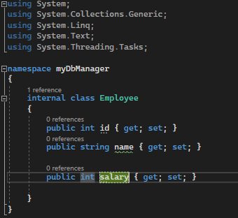
Creating Our First Table
Key Benefit for working with Entity FrameWork allow you to make Classes and it will be Converted to tables so we will create a Employee Class as our Entity , and we will give it a class Members as Attributes

Slide 10

Assigning the Class to our Database
To assign our Class to the Database We Have to go to our Manager Class which is ApplicationDbContext .
We will Create a DbSet A Class generic member as prop of type Employee , with ability of setter and getter .

Slide 11
Applying Migrations
In Entity Framework, migrations are a feature that allows you to manage and apply changes to your database schema over time. Migrations provide a way to incrementally update your database schema as your application evolves, without requiring you to drop and recreate the database each time.
Migrations Command :
To give a notice to entity Framework that there is a changes you want to be Notice you will type in Package Manager Console .
Add-migration migration-message
That Command will make you able to detect the Derived Class from DbContext to remove Last Migration made we use
remove-migration
and apply the Class to be Table then To apply the Migrations Detected
Update-Database

Slide 12
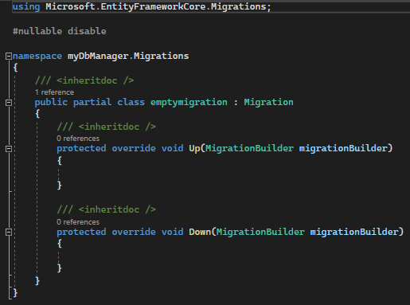
Migrations In Details
When you apply Migrations the Ef Core Automatically apply 2 steps the original Migrations to be applied and the revert of that migration as if you want to remove that migrations so when you Update DATABASE the EF-Core apply what is between up function and if you want to remove that Migrations it will apply what’s in the Down Function

Slide 13
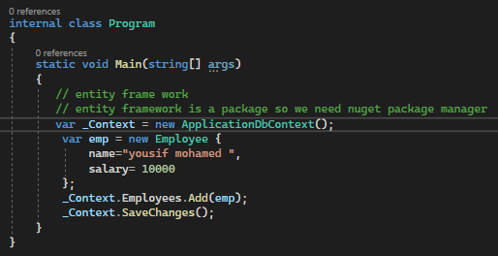

Adding into Employee Column
To add inside our Table we treat it as a normal list but with a few added Steps .
We will Create an instance of our manager Class ApplicationDbContext
Then we will Create an instance from our Targeted Table Employee and initialize it with Values
Then we will access the Employee through our Instance and we will use add(Employee )
Then we need to save changes for the application Context

Slide 14
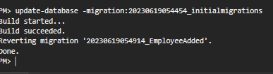
Migration RollBack
Do you Remember the Down Function to revert a Migration you may think that all what you need to make remove-migration but after the Migration updated to Database remove migration become as an applied migration so to revert it you will update-database to the Migrations you want so it will back to the step that you need .
Then you can remove-migration

Slide 15
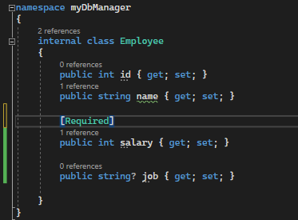
Required Attribute (Data-Annotation)
We Have To ways to set Constraints to our model attr first using Data Annotation if you remember we have talked about Data annotation that it surround our attr or function with certain Condition so we use data annotation on our Domain model .
So as our example at the side we just put the required flag on the salary attribute to make nullable false and make the attribute is required
Also if we want to change the behaviour to be nullable we can use nullish operator

Slide 16
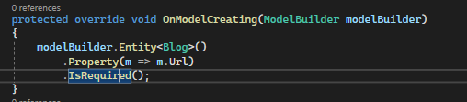
Updating using Fluent-Api
Fluent Api is a method to update in your attribute Constraint like making it Optional or make it Required it is more efficient more than the Data Annotation as we can Separate it in a separate Class or write it in our Manager Class
On model Creating is a thread that run with Each migration that allow you to Customize Constraint on your Entity .

Slide 17
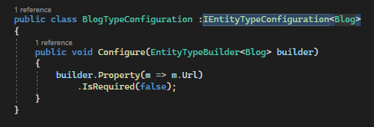
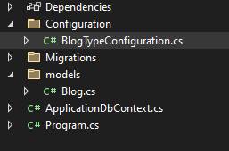
Separate Of Concern
You Can use the Fluent Api method to isolate any Customization in a separate Class as Configuration .
You will Create a Separate Class for type Configuration that inherit From IEntityTypeConfiguration<Blog> and you will Create a Configure Method that takes Parameter of Type EntityTypeBuilder<Blog>
And inside you will write the Same as you Have Written inside the Manager Class

Slide 18
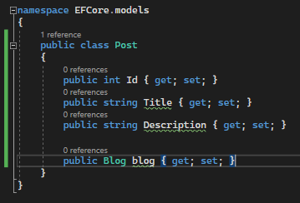
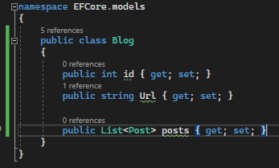
Navigation Property
Navigation Property allows you to Create a Database Table without Referencing it in the manager Class DbSet .
As you See Blog is a domain Class that exist in database and posts are not after we Done This Ef will understand that it's a relational Tables and will Create Post Class in the Database

Slide 19
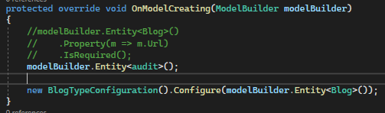
Model Builder to Create Table
You Can also add your Table using the onModelCreating .
By using instance of modelBuilder.Entity<modelname>()

Slide 20
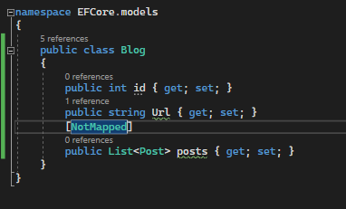

Excluding Table using Data annotation
What if i want to Exclude a table from my migrations to be an internal normal Class
We Can use Data annotation there is a attribute called NotMapped which will Prevent the Ef from mapping our class into Table
Or using FLUENT API by adding modelBuilder.Ignore();

Slide 22
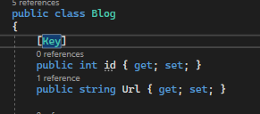

Setting Primary Key
By Default EF Set any property with name id to be primary Key not only but also if you named
Your member nameID it will be set also as Primary Key
If you set your table without id or bookid it will raise an error .
So if you want to set primaryKey you Can use Data annotation [key]
Or using Fluent api modelBuilder.Entity<model>.haskey(b=>b.bookKey)

Slide 23

Setting Default Value
You can set Default Value only using Fluent api or sql Server
That you will select it in the on Create Method
modelBuilder.entity<model>().property(b=>b.prop).hasDefaultValue(2);

Slide 24
Let’s CodeinPractice Together

Slide 25
Session Recap

Slide 26
Any Questions ?
Email : youssef.mohamed@amit-learning.com
Linked-in : https://www.linkedin.com/in/youssif-mohamed-450795157/
Thank You

