Slide 1

DSSC 18/19
Northeastern SMILE Lab
- Recognizing Faces in the Wild

Slide 2
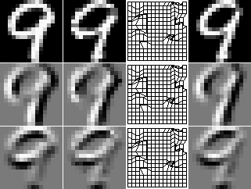
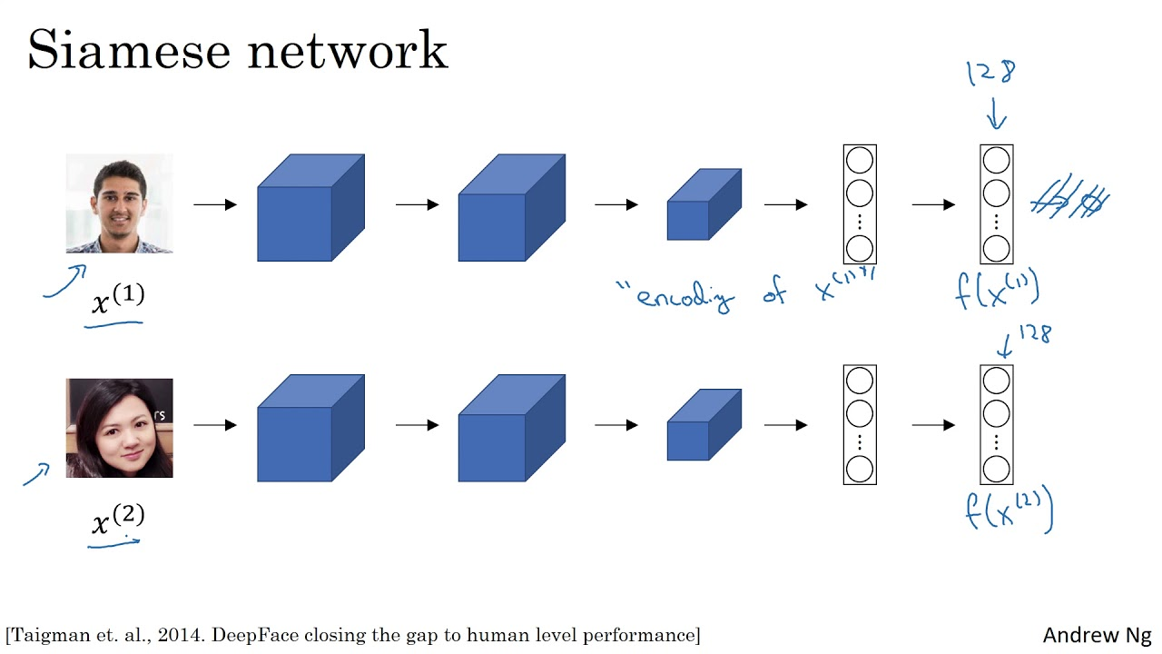
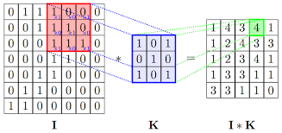
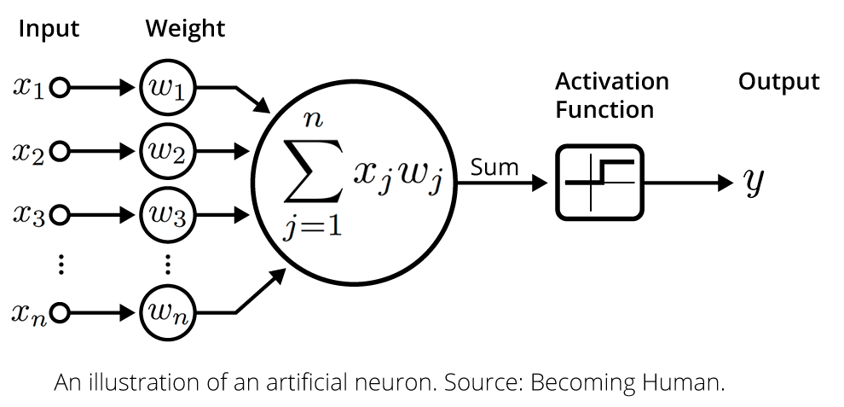
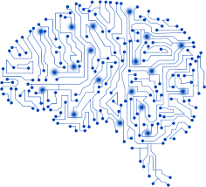
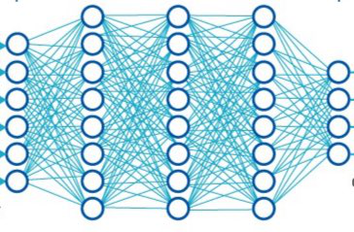
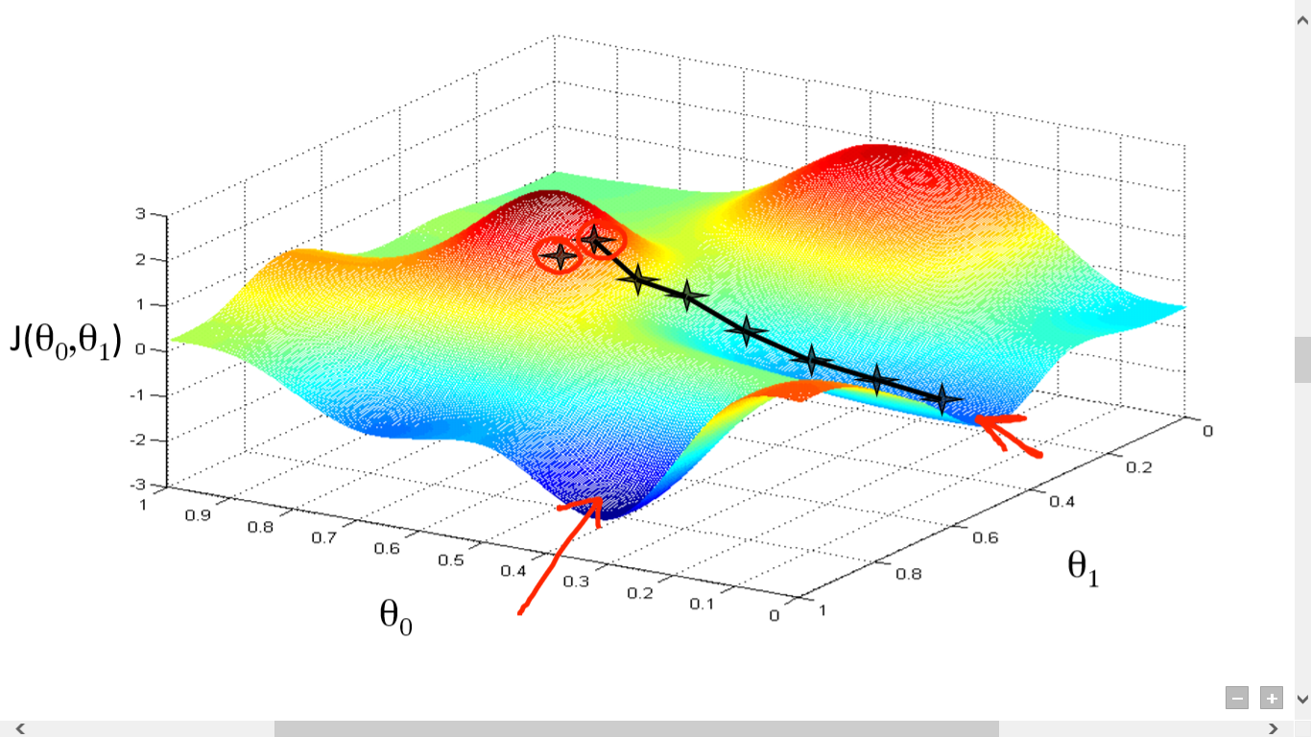
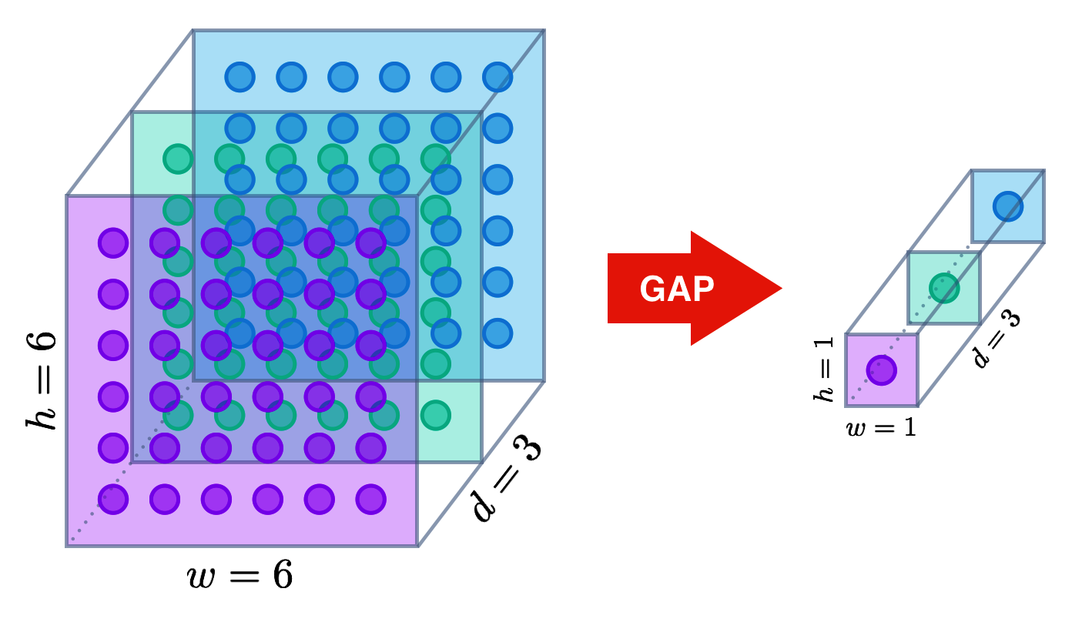
CONTENT
Data
Siamese
Activation
function
Siamese-Facenet
Global Average Pooling
Vggface-Facenet
Optimiser

Slide 3

INTRODUCTION

Slide 4
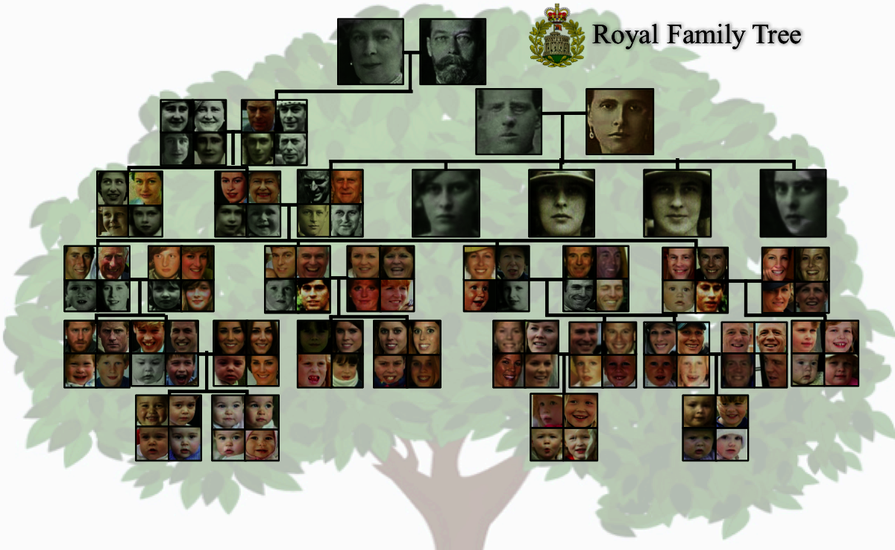

Northeastern SMILE Lab - Recognizing Faces in the Wild

Slide 5
Dataset
Families In the Wild (FIW) is the largest and most comprehensive image database for automatic kinship recognition
Two tasks:
Kinship recognition, that is predicting what kind of relation do two individuals share. Very difficult, we did not focus on it;
Kinship verification, that is determine whether a pair of facial images of different subjects are kin of a specific type. The focus of the challenge.

Slide 6
DATA
over 12379 photos
photos
4-to-38 members
members
470 families
2316 person in total.
Families
person

Slide 7
Characters are public figures
Targeted to ensure diversity in terms of ethnicity, country, occupation
In the Wild refers to variation in pose, illumination, expression, even age for member people
The original dataset included 11 kinship types; unfortunately, they have not been made available for the challenge
Different types of kin share different familial features, so pair types and modeled and evaluated independent of all others*
* J. P. Robinson, Recognizing Families in the Wild, Data Challenge Workshop in conjunction with ACM MM, 2017

Slide 8
Data description
Train-faces - the training set is divided in Families
then individuals
Images in the same individul folder belong to the same person
Images in the same family folder belong to the same family
Test-faces - the test set contains face images of unknown individuals

Slide 9
Kinship Verification
The goal of kinship verification is to determine whether a pair offacial images of different subjects are kin of a specific type
#of kineship in our data set =3598

Slide 10
Image pre-processing
Pre-processing has been tailored to the feature extractor used (more on this later)
Face detection and cropping has already been performed by the dataset curators

Slide 11
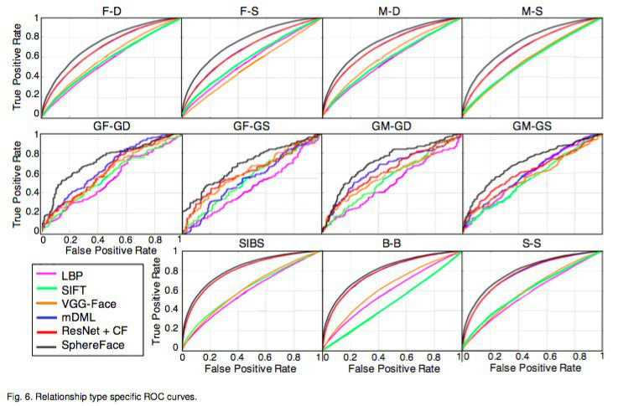
Deep Learning models have achieved superior performance on this task, compared to other approaches
Figure taken from J. P. Robinson et al., Visual Kinship Recognition of Families in the Wild, 2017

Slide 12
Existing Baseline Methods
MODEL 1
Centerface (CF)-22-layer residual convolutional neural network (CNN)
Center-loss
Face pairs were scored using cosine similarity
VGG-Face
An embedding size of 512, instead of the last fully-connected
Triplet-loss function
MODEL 2

Slide 13
Exsiting Baseline Methods
The authors proposed KinNet,
A softmax loss was added after thef c−layer to decide between the 41,856 subjects. While fine-tuning, thef c−layer was replaced with a new f c−layerof size1024D, which was followed by an L2-norm layer to normalize features to unit length
a soft triplet-loss
Since thef irst layer learns the most general representations ( lower-layerstend to learn more basic filters) the authors froze the bottommost7×7convolution layer and updated other layers to adapt the model for kinship verification.
To increase the number of training images : augmentation strategy
MODEL 3

Slide 14
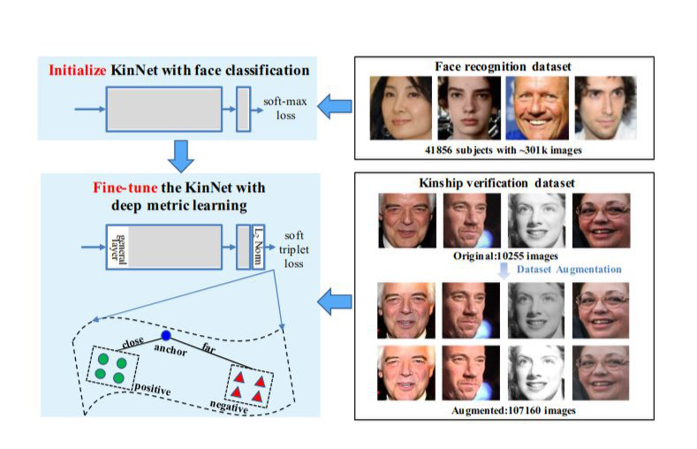
Exsiting Baseline Methods
MODEL 3

Slide 15
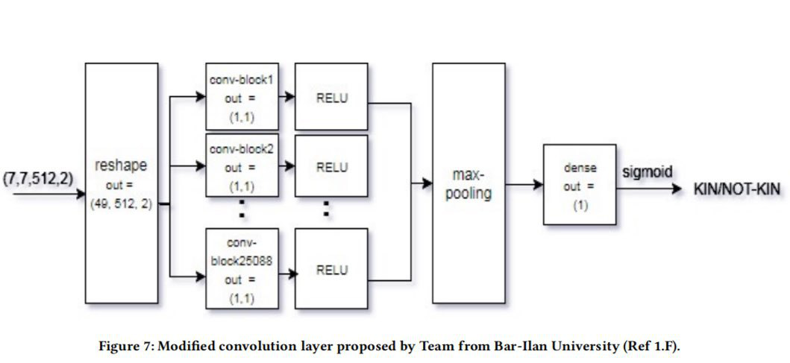
Exsiting Baseline Methods
MODEL 4

Slide 16
Human performance
According to experiments conducted by the curators of the dataset*, human performance on this task is 57.5% (accuracy)
Points to the difficulty of solving such a task
* J. P. Robinson et al., Visual Kinship Recognition of Families in the Wild, 2017

Slide 17
Vgg-Face and Facenet

Slide 18
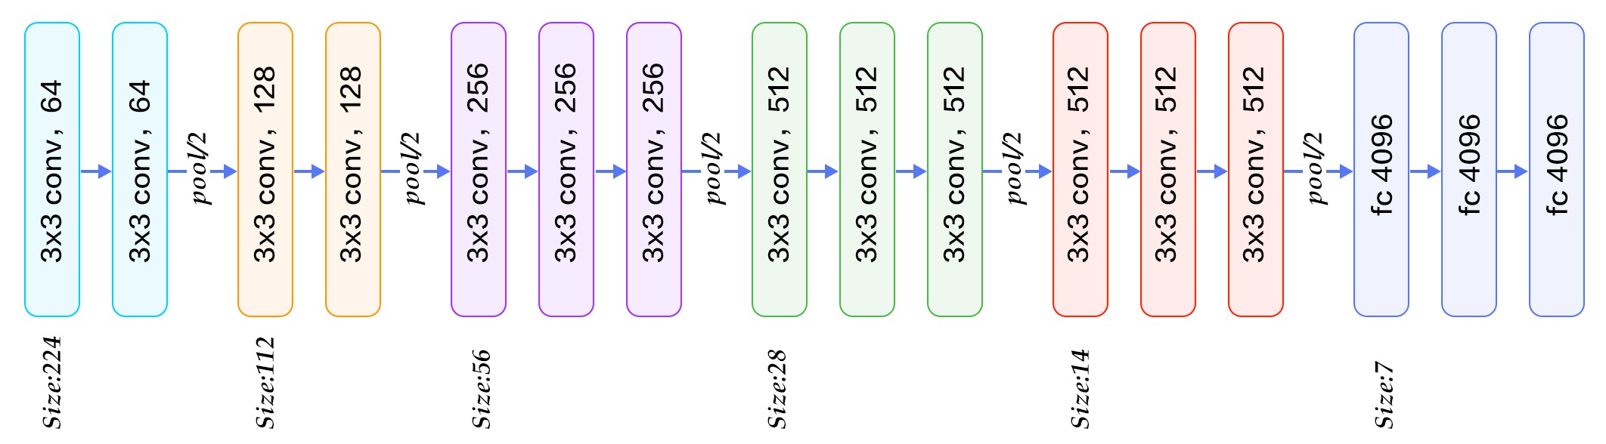
VGGFACE
The VGG-Face architecture visualizing low to high level features captured as a facial expression is propagated through-out the network, stating the dimensions produced by each layer.
It has 22 layers.

Slide 19
VGG-Face
The VGG-Face architecture has been developed by the Oxford Visual Geometry Group as an extension to existing pre-trained models
It uses one of the mainstream pre-trained architectures, usually VGG-16 or Resnet-50, trained on massive amounts of face images
The Labeled Faces in the Wild (13,233 images of 5,749 people) and the YouTube Faces (3,425 videos of 1,595 people) had been used for training*
* http://www.robots.ox.ac.uk/~vgg/software/vgg_face/

Slide 20
VGG-Face
Keras comes with a keras_vggface module to translate the original Caffe models into a Tensorflow backend
It contains everything we need, including a preprocess_vggface function
We used the Resnet-50 architecture

Slide 21
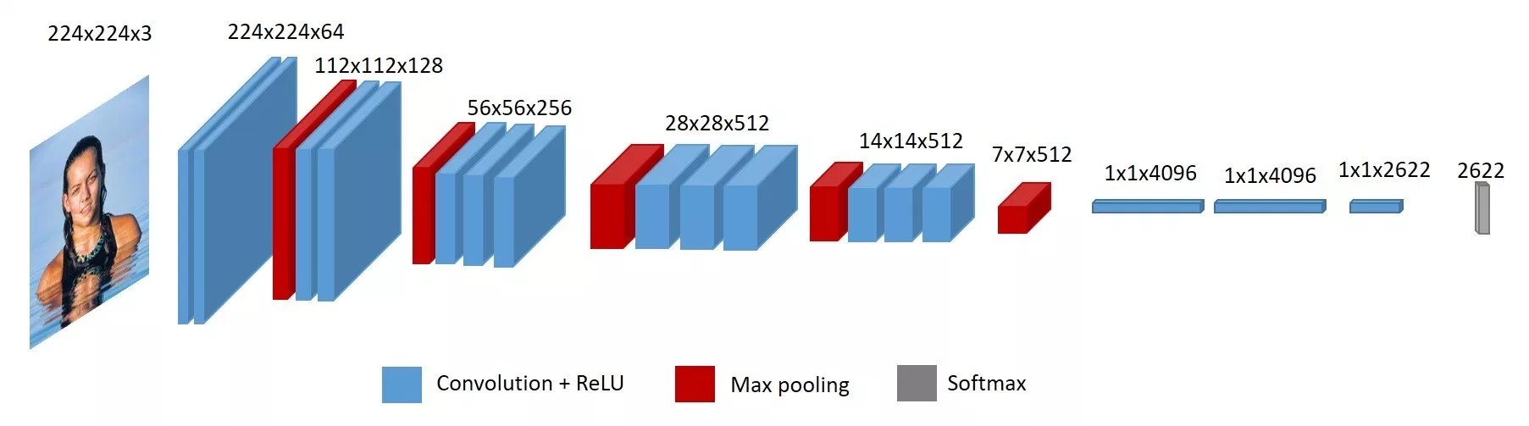
VGG-Face - full view at image level

Slide 22
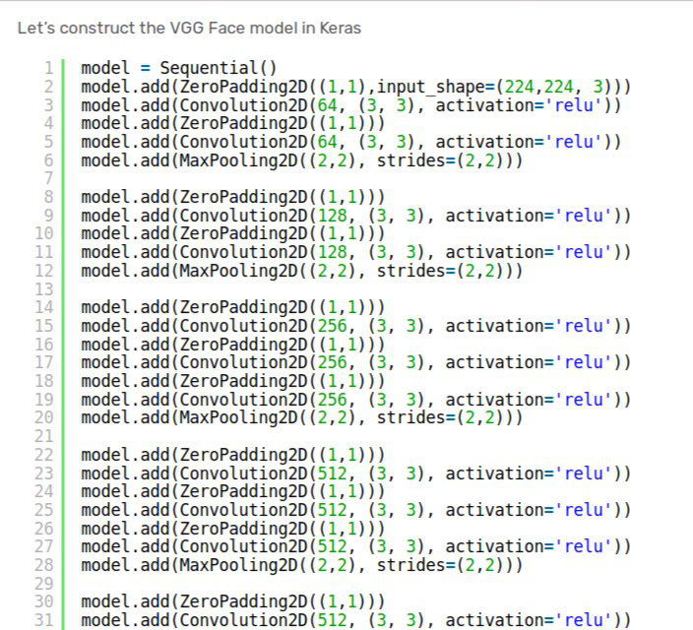
VGGFACE -CODE

Slide 23
Face-Net*
FaceNet learns a mapping from face images to a compact Euclidean Space where distances directly correspond to a measure of face similarity
Once the FaceNet model having been trained with triplet loss for different classes of faces to capture the similarities and differences between them, the 128 dimensional embedding returned by the FaceNet model can be used to clusters faces effectively
Facenet has been introduced in 2015 by Google researchers and is now the backbone of many open-source face recognition systems like OpenFace, etc.
* F. Schroff, D. Kalenichenko, J. Philbin, FaceNet: A Unified Embedding for Face Recognition and Clustering, 2015

Slide 24
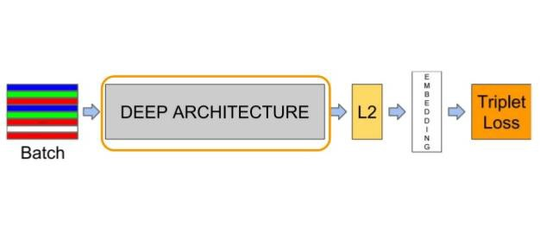
Face-Net
Input layer and a deep CNN followed by L2 normalization, which results in the face embedding. This is followed by the triplet loss during training
Image taken from the paper mentioned at previous slide

Slide 25
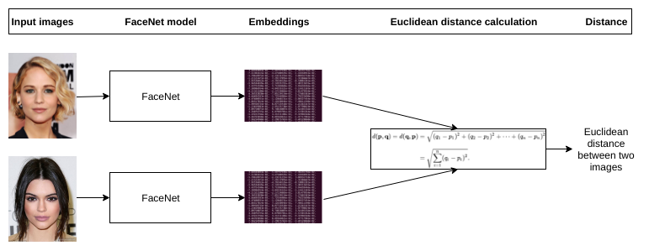
Face-Net
In order to compare two images, create the embedding for both images by feeding through the model separately. Then we can use above formula to find the distance which will be lower value for similar faces and higher value for different face.
Image taken from the paper mentioned at previous slide

Slide 26
Face-Net
We used a pre-trained Facenet model hosted at: https://github.com/nyoki-mtl/keras-facenet
Training had been performed on MS-Celeb-1M dataset, a massive collection of 6,464,018 pictures taken from 64,682 celebrities (mined from online material)
Pre-processing: we need to resize the image to (160, 160, 3) and standardize the pixels to take values in [0,1]
It employs an Inception-ResNet-v1 architecture, and includes layers such as BatchNormalization, together with an intricated topology made up of branches and blocks

Slide 27
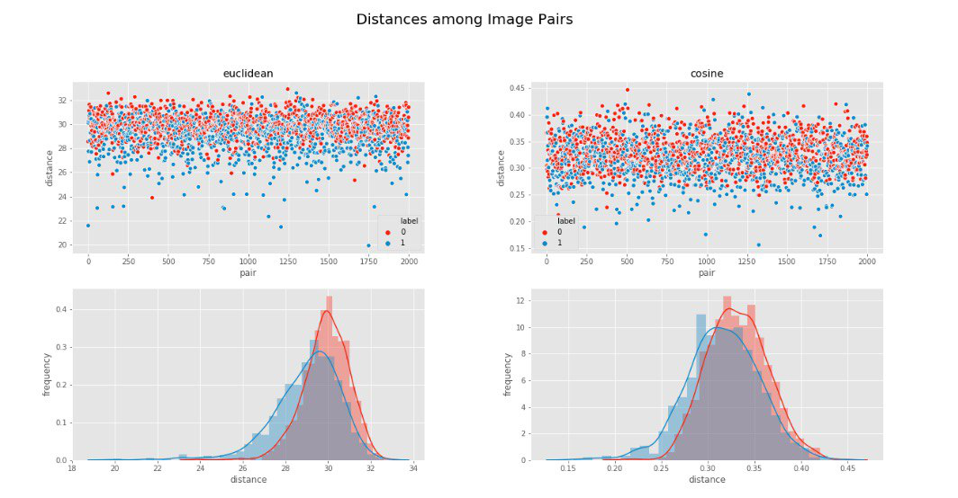
Experiment*: sample k(=2000) pairs, produce embeddings using VGG-Face, plot different distance metrics between the encoded vectors. Pairs are colored according to kin/no-kin.
Boundaries are fuzzy, pointing to the difficulty of the task. Histogram frequencies are basically overlapping
* We are reproducing the plots of Q. Duan, Adversarial Contrastive Residual Net for 1 Million Kinship Recognition, 2017 (figure 5 of page 7)

Slide 28
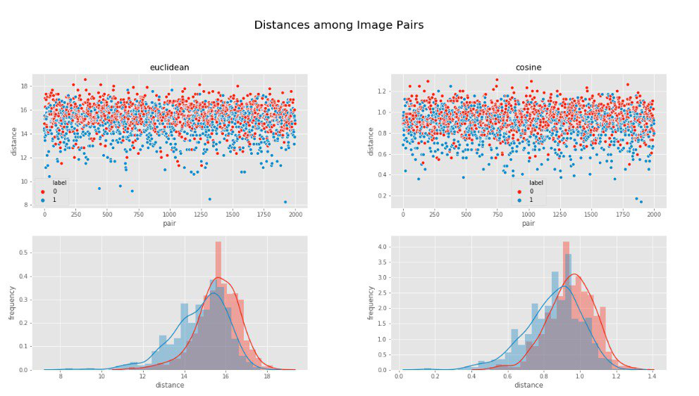
Experiment: same as before, but using Facenet as feature extractor. Results are similar

Slide 29
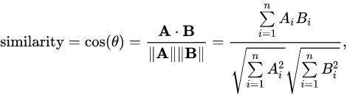
cosine similarity
cosine similarity function can be defined as follows:

Slide 30
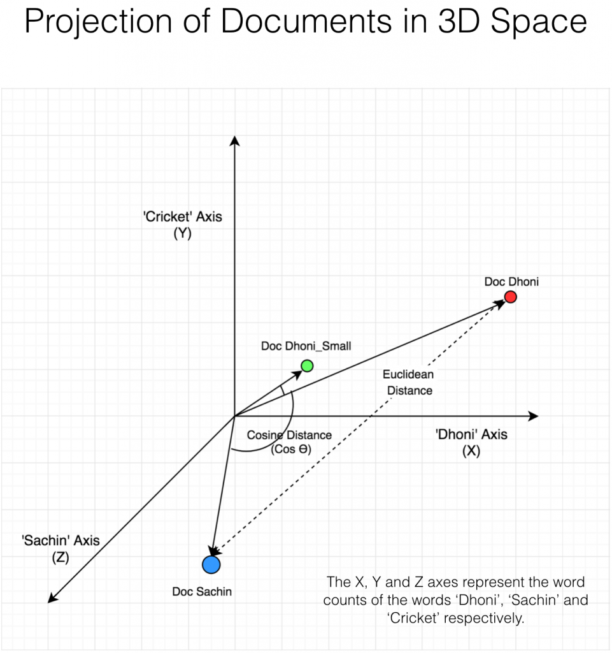
Cosine similarity

Slide 31
Siamese neural network

Slide 32
Siamese neural network
Siamese neural network are neural networks containing two or more identical sub network components.
The main idea behind siamese networks is that they can learn useful data descriptors that can be further used to compare between the inputs of the respective sub networks
Inputs can be anything from :
numerical data - image data - sequential data

Slide 33
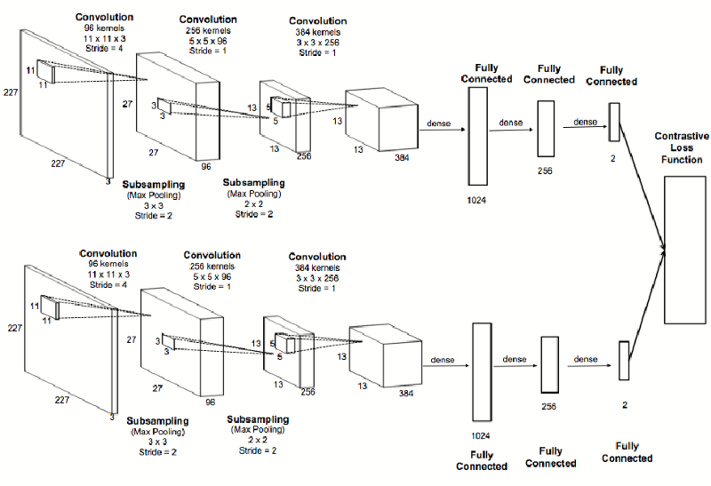
Siamese neural network

Slide 34
Siamese neural network
Usually, siamese networks perform binary classification at the output.
loss functions :
cross-entropy loss: This loss can be calculated as
where L is the loss function
y the class label (0 or 1) and p is the prediction. In order to train the network to distinguish between similar and dissimilar objects, we may feed it one positive and one negative example at a time and add up the losses:
L=+L +-L

Slide 35
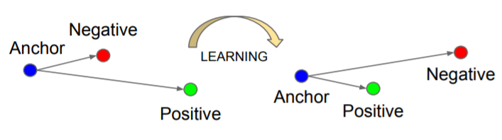
siamese networks-Triplet loss
Triplet loss :
d is a distance function
a is a sample of the data set
p is a random positive sample
n is a negative sample
m is an arbitrary margin
separation between the positive and negative scores.

Slide 36
Weight Initialization
To break symmetries in the weigth space, we start from an asymmetric point
Weights are sampled from a N(0, 0.01), biases come from a N(0.5, 0.01)
Variability is crucial; we followed the specification for siamese networks found in

Slide 37
GAP

Slide 38
Global Average Pooling*
GAP layers are used to reduce the spatial dimensions of a three-dimensional tensor.
A tensor with dimensions h×w×d is reduced in size to have dimensions 1×1×d. GAP layers reduce each h×w feature map to a single number by simply taking the average of all h*w values.
Sums out spatial information, so more robust to spatial translation (not really important here)

Slide 39
No parameter to optimize, so no risk of overfitting
No pool_size to tune (as in plain pooling)
No need to call Flatten()
In object detection, can be used to enforce correspondences between feature maps and categories
* M. Lin at al., Network in Network, 2013 (see section 3.2 especially)

Slide 41
Baseline

Slide 42
Validation Philosophy
We used a 10% hold-out validation strategy
A subset of the families, representing approx. 10% of all images was selected and set aside for validation. We made sure there was no family overlapping between training and validation sets
We used generators to feed images to the network, making use of the fit_generator functionality of Keras
For each batch, we randomly sample k = batch_size // 2 positive pairs, and the remainings will be negative. As a result, the network sees an equal amount of positive and negative examples (shuffled to make learning smoother)
We keep track of each sampled pair, so that the network is fed with all the training pairs only once. Same for validation

Slide 43
Metrics
Accuracy and AUC score were monitored during training and in validation
AUC was easily appended to the list of metrics by wrapping the roc_auc_score function of Sklearn into a Tensorflow tensor
Since the challenge required to use the AUC, we mostly focused our attentions on it
[explain AUC]

Slide 44
Feature Extractor
Both Facenet and VGG-Face have been tested as feature extractors
Since Facenet reported (slightly) superior performance in every instance, we will consider only it from now on (VGG-Face stays a valid feature extractor as well)
The reasons for this is rather intuitive: Facenet has been trained on an incredibly bigger number of images; moreover, Facenet employs an architecture that has proved superior on the ImageNet task
Fine-tuned the whole network. Freezing layers did not really help

Slide 45
Early Stopping
As a preliminary regularization technique, we applied early stopping on the model
Validation AUC score was monitored, with a patience of 5 epochs
EarlyStopping callback of Keras turned out useful

Slide 46
Loss and Optimizer
Binary cross-entropy was chosen as loss function
Adam optimizer was used
Initial learning rate was set to 0.00001
Moreover:
Batch size was set to 32. 64+ did not fit in memory and 16 showed a too erratic behavior
Number of epochs was set to 20 (without considering early stopping)

Slide 47
Learning Strategy
We first try to boost model capacity and achieve excellent training performance, then we will regularize to look after validation performance (as usually suggested)*
*See for example I. Courville, Y. Bengio, I. Goodfellow, Deep Learning, 2015

Slide 48
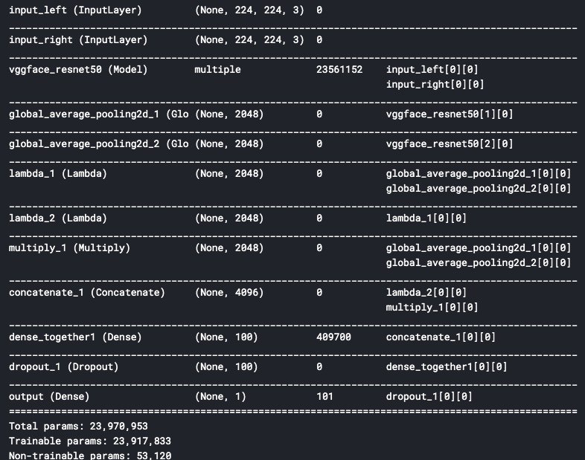

Slide 49
Baseline
We use siamese network as a baseline of our algorithm.
Batch size, 224,224,3
VGGFACE OR FACE NET
Global average pooling
Size of tensor (2048)
VGGFACE OR FACE NET
Global average pooling
Size of tensor (2048)
Batch size, 224,224,3

Slide 50
Baseline
Lambda1 : we took the absolute value of first image and then we substruct the second tensor
Lambda2: we square the lambda 1 to increase the difference
Multiply : the output of two tensors to get 1 output .
Concatenate : we put together multiply tensor with lambda 2
Add a dense layer
Add dropout layer
output: there is just one neuron with sigmoid activation function that tells the probablity (0,1) of being kin.

Slide 51
TOTAL PARAMETERS
# OF TOTAL PARAMETER
(WEIGHT AND BIAS )
            FACENET 23 561 152
23 970 953

Slide 52
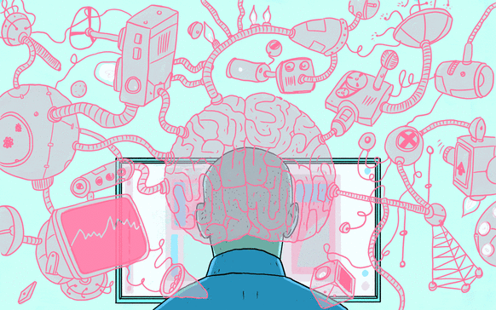
THANK YOU

