Slide 1
Web Ontology Language
Elham

Slide 2
Introduction
Web Ontology Language (OWL) is a Semantic Web language designed to represent rich and complex knowledge about things, groups of things, and relations between things.
It is a knowledge representation language, designed to formulate, exchange, and reason with knowledge about a domain of interest ( often called vocabulary).

Slide 3
How knowledge is represented in OWL?
The basic notions are:
Axioms: the basic statements that an OWL ontology expresses
Entities: elements used to refer to real-world objects
Expressions: combinations of entities to form complex descriptions from basic ones

Slide 4
Having a closer look at statements in OWL Axioms
To formulate knowledge explicitly, it is useful to assume that it consists of elementary pieces that are often referred to as statements or propositions.
Axioms are assumed to be always true.
The way ontological axioms interact can be very subtle and difficult for people to understand.
Example:
Mary is female
John and Mary are married

Slide 5
Entities
All atomic constituents of statements are called entities.
objects (John, Mary)
categories (female)
relations (married)
we denote objects as individuals, categories as classes and relations as properties.

Slide 6
Expressions
Names of entities can be combined into expressions using so-called constructors.

Slide 7
Classes and Instances
This statement talks about an individual named Mary and states that this individual is a person. Mery “is a member of” the class of all persons.
we can use the same type of statement to indicate that Mary is a woman by expressing that she is an instance of the class of women:
ClassAssertion( :Person :Mary )
ClassAssertion( :Woman :Mary )

Slide 8
Object Properties
An ontology is also meant to specify how the individuals relate to other individuals. For example: “Mary is John's wife”
The entities describing in which way the individuals are related – like hasWife in our case, are called properties.
ObjectPropertyAssertion( :hasWife :John :Mary )

Slide 9
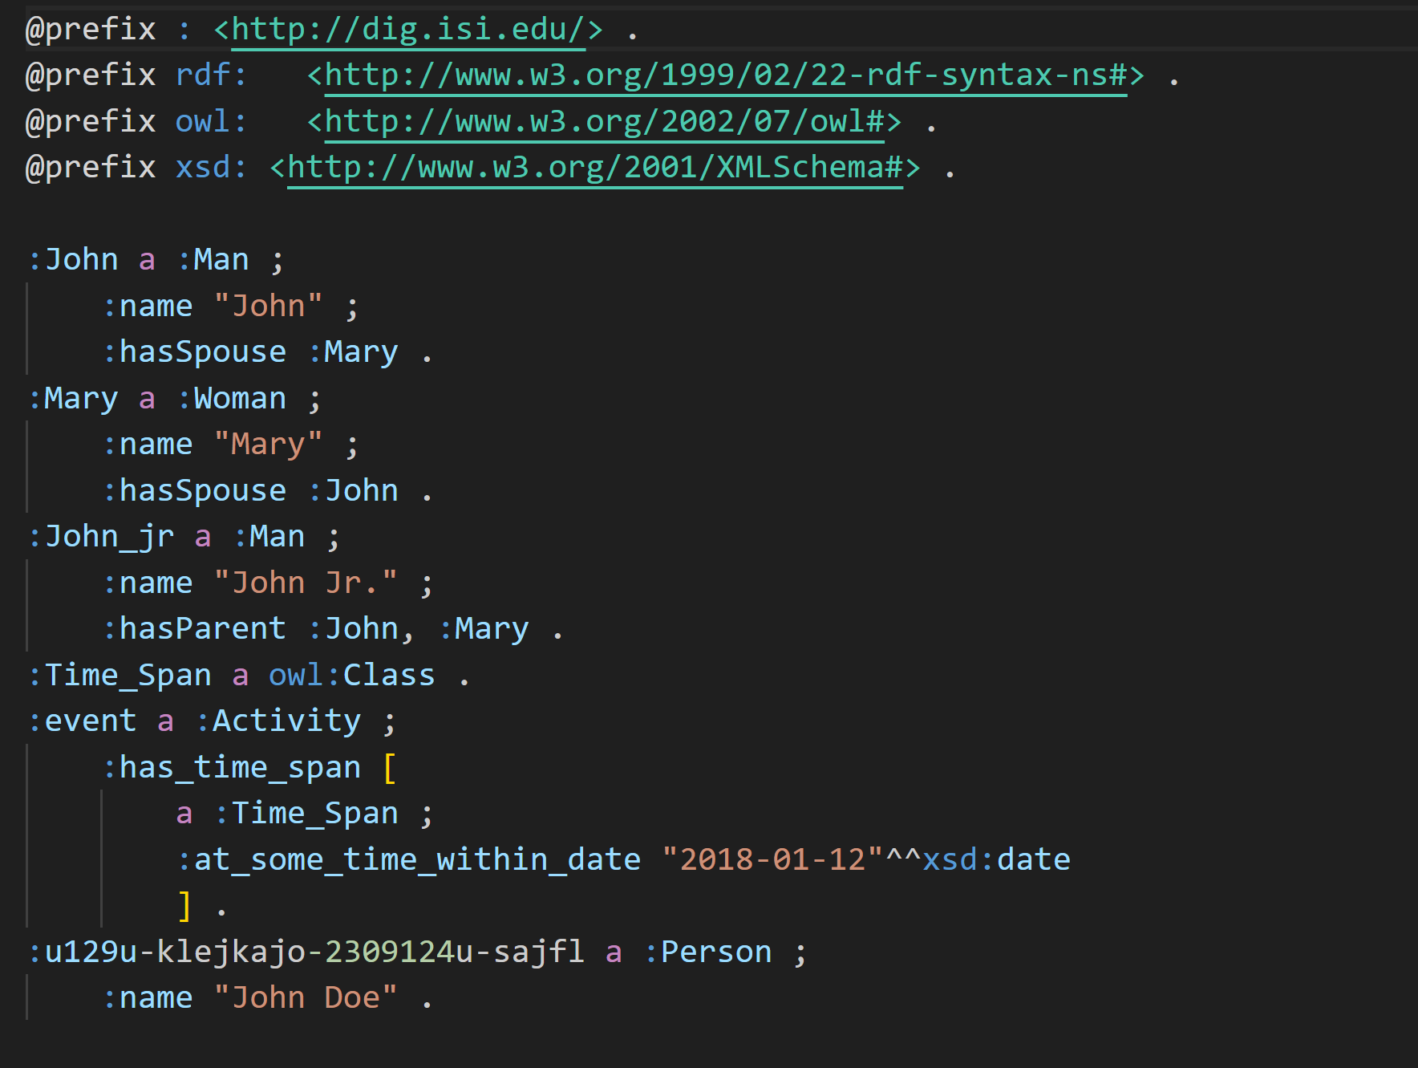

Slide 10
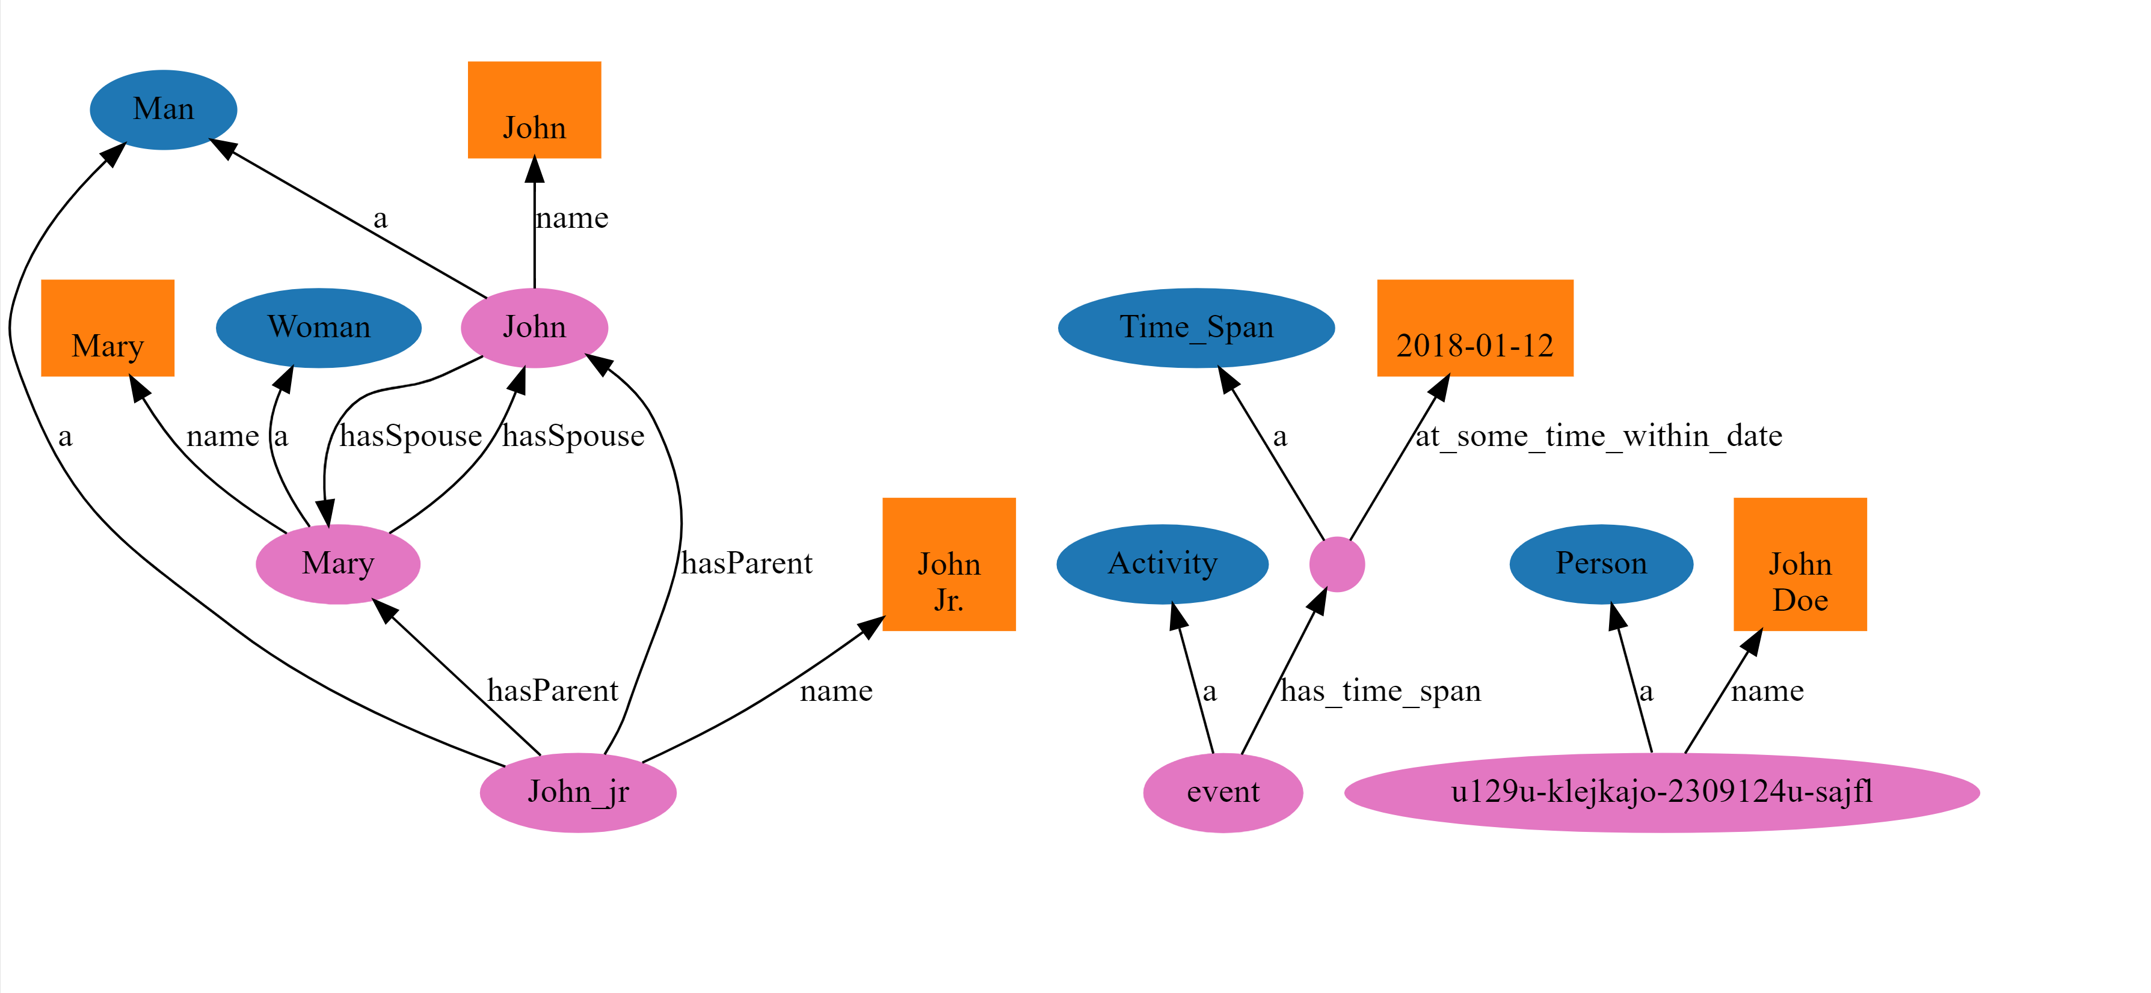

Slide 11
Understanding Linked Data Formats

Slide 12
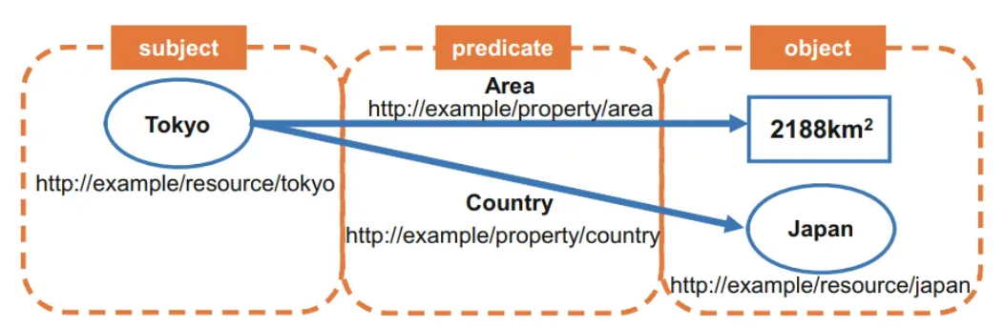
Introduction
Very simply, linked data is stored as triples that consist of a subject, predicate, and object.
These triples connect entities to other entities to create a directed knowledge graph:
RDF is commonly stored in one of four formats: N-Triples (.nt), Turtle (.ttl), JSON-LD (.json) or RDF/XML (.rdf).

Slide 13
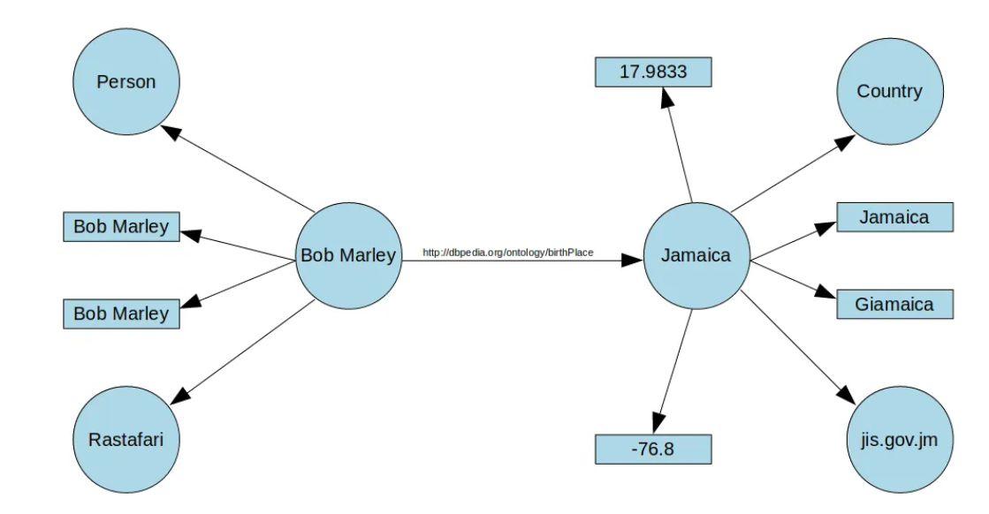
N-Triples
Storing and reading RDF as N-Triples is simple as every line of a .nt file is a single triple (<subject> <predicate> <object>) that together form a directed knowledge graph:
circles represent entities,
rectangles represent literals
arrows illustrate the predicates.

Slide 14
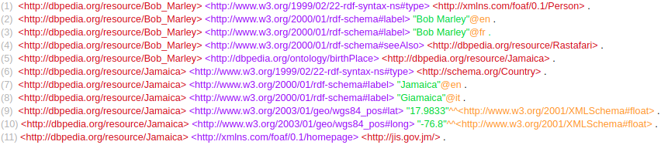
N-Triples format
Here we have 11 triples containing information about Bob Marley and Jamaica extracted from DBpedia
is of type Persois
we use the foaf (friend of a friend) ontology as the URI for this type
Literal
Literal tag
Entity
Predicate
we can see the foaf ontology used once more to connect the entity of Jamaica to its homepage URL (subset of URI).

Slide 15
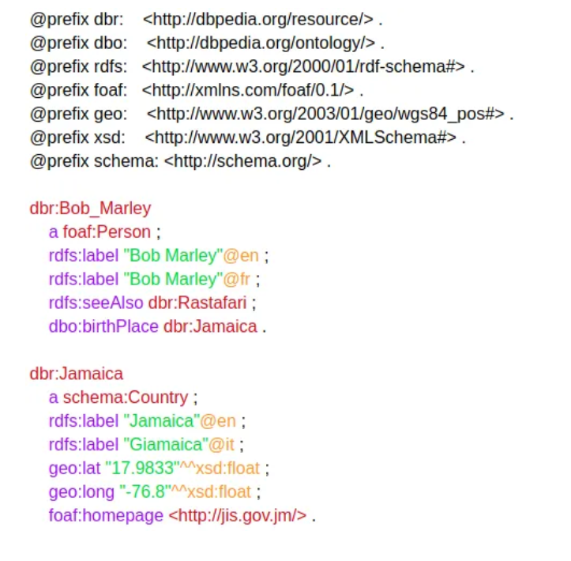
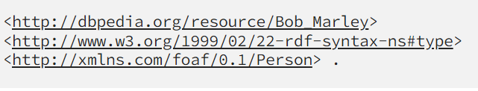

Turtle
you can define prefixes at the beginning of the .ttl file.
the long repeated sections of the URIs can be written in their short form.
This allows the subject <http://xmlns.com/foaf/0.1/Person> to be shortened to foaf:Person.
One unique shortening is the predicate <http://www.w3.org/1999/02/22-rdf-syntax-ns#type> which is so common, it is represented simply with the letter a
can be shortened in Turtle to
data about Bob Marley and Jamaica is separated into separate blocks. This grouping along with defined prefixes, makes Turtle format a lot easier to understand than N-Triples. Related information to the subject is separated with a semi-colon and finished with a full-stop and a new line to indicate a new subject.

Slide 16
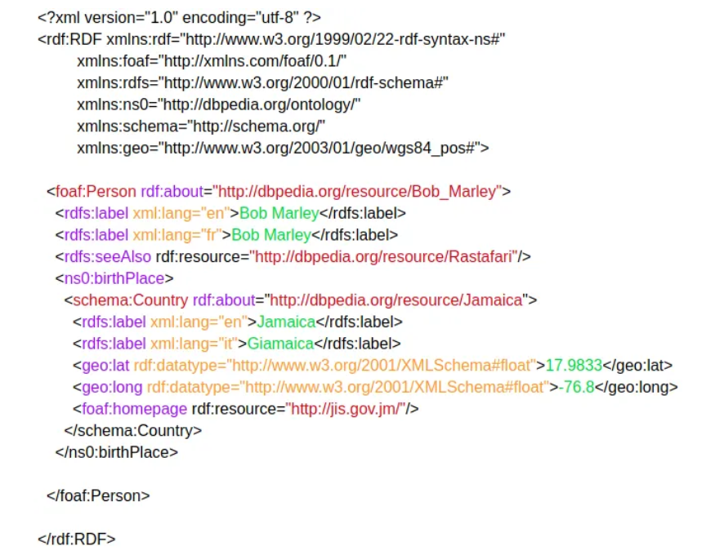
RDF/XML
prefixes can be defined at the top of RDF/XML files to avoid unnecessary repetition of URIs.
RDF format is considered the standard format.

Slide 17
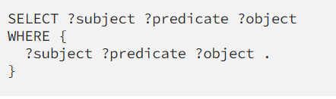
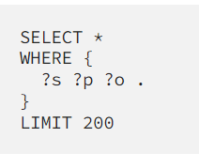
What is SPARQL?
SPARQL (SPARQL Protocol and RDF Query Language) is the query language
The following query returns every triple
The ? indicates a variable so ?example is a variable called “example”
this query only returns 200 triples.

Slide 18
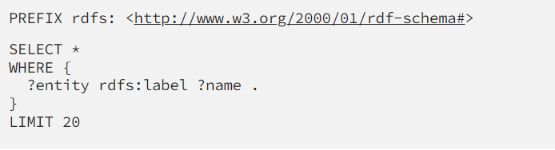
Entities are connected to their human-readable names with the predicate rdfs:label so ?entity rdfs:label ?name matches any triple with the predicate rdfs:label and returns ?entity and ?name.

Slide 19
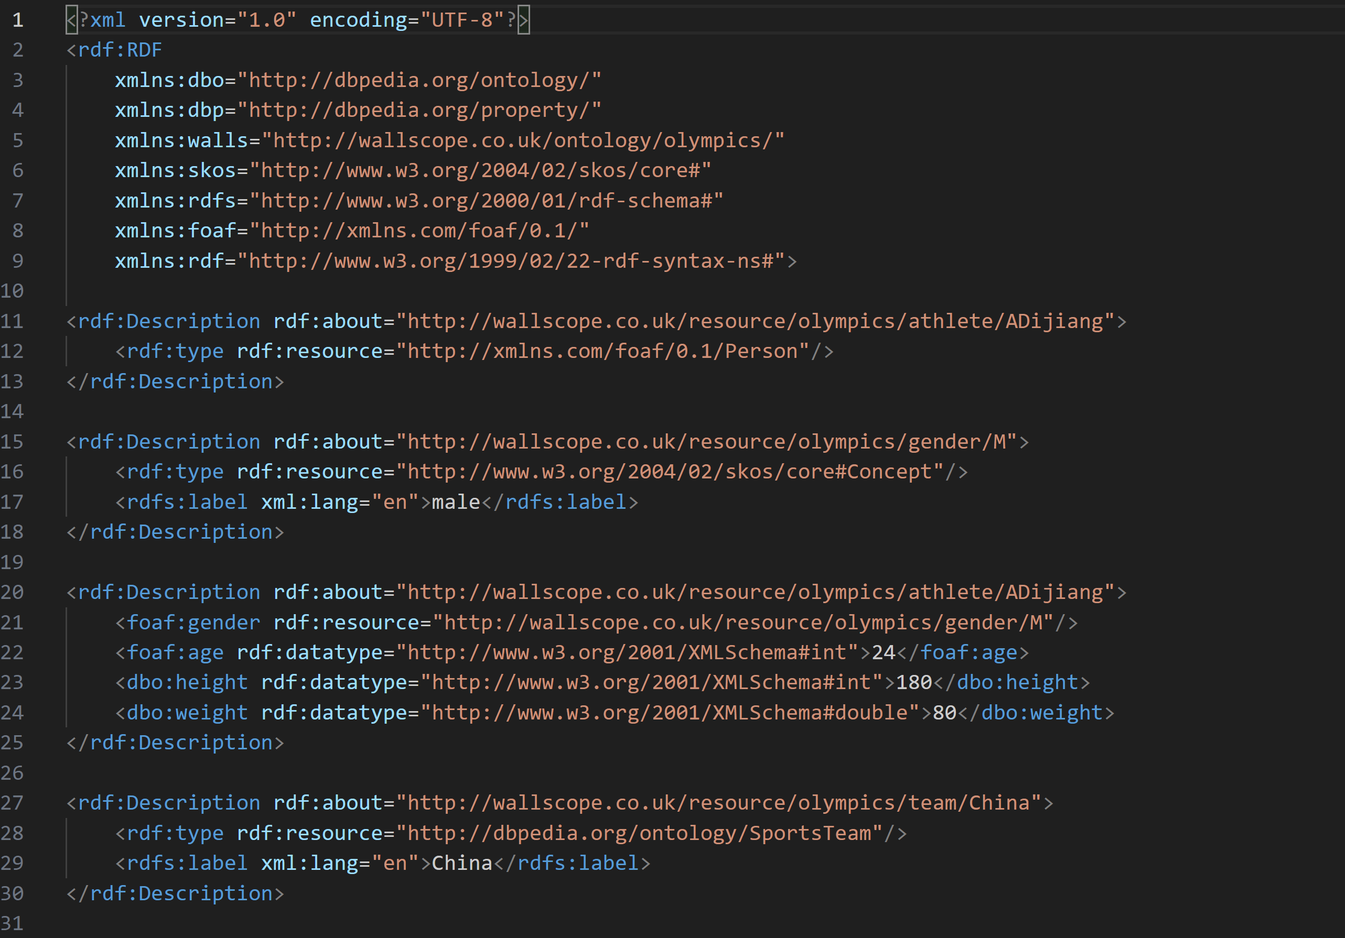
Olympics RDF data Examples:

Slide 20
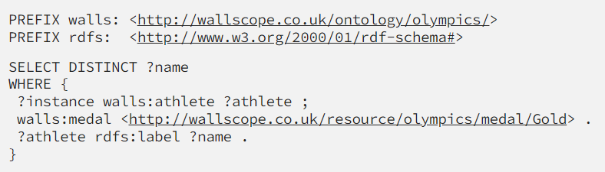
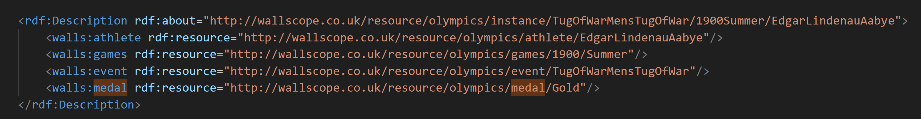

Query
Lists the names of every gold medallist (excluding duplicates):
listing the prefixes used in the query to make it more readable.
selected o return the variable called ?name
The first triple
DISTINCT clause after SELECT filters the names to remove duplicates.
athletes are linked to their medals through the instance entity
The first triple
grabs every entity with an outgoing predicate walls:athlete and the athlete entity.
connects the instance entities to their Gold medal entities.
we get their labels and assign them the variable ?name as this is what we want to return.

Slide 21
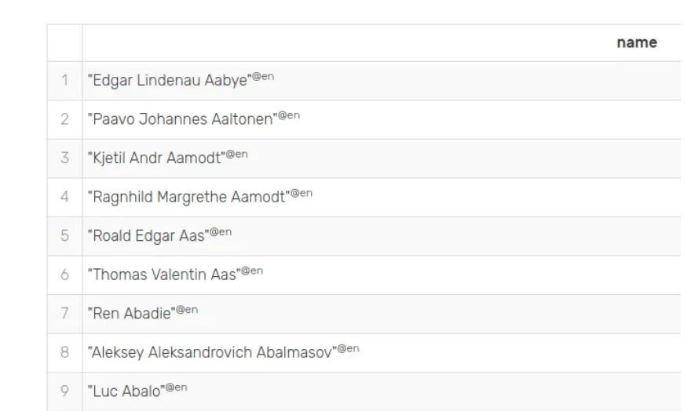
a list of human-readable names of athletes that got gold medals at the Olympics (with duplicates removed) as desired:

Slide 22
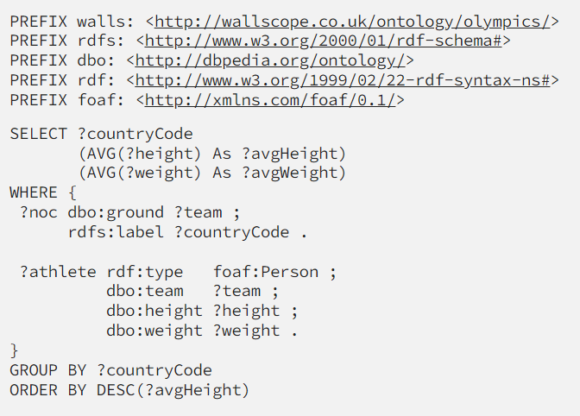
Query
lists each country alongside the average height and weight of its athletes (sorted by the average height):

Slide 23
All SPARQL prefixes
https://prefix.cc/popular/all.sparql

Slide 24
Tools
Elham

Slide 25
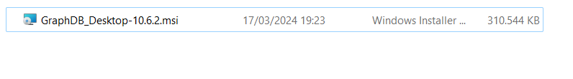

GraphDB
Download here:
https://graphdb.ontotext.com/

Slide 26
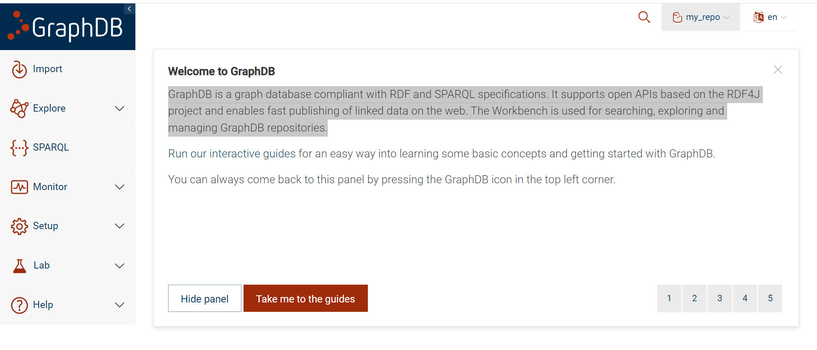
GraphDB
http://localhost:7200/.

Slide 27
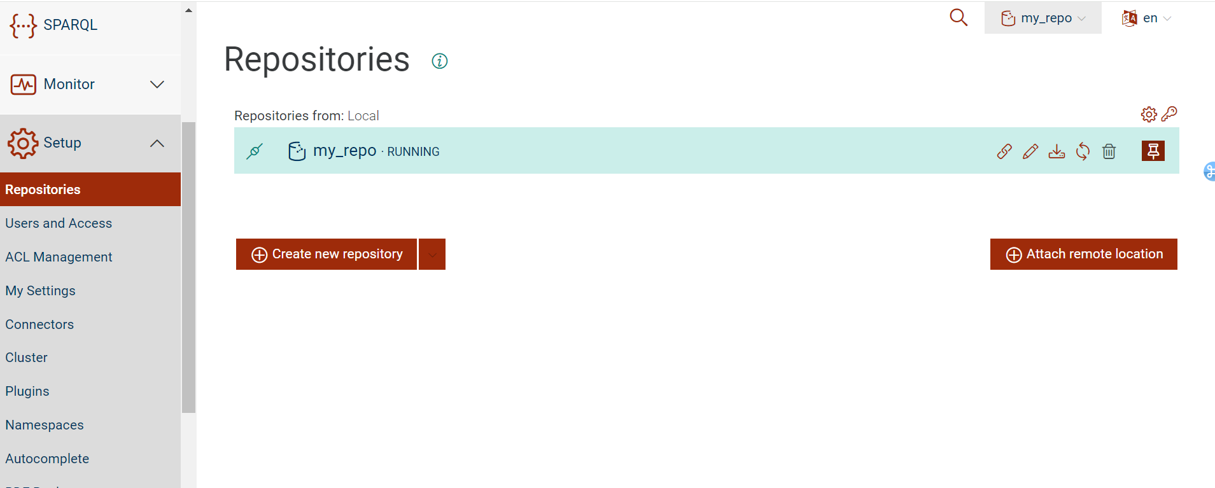
Creation of repository

Slide 28
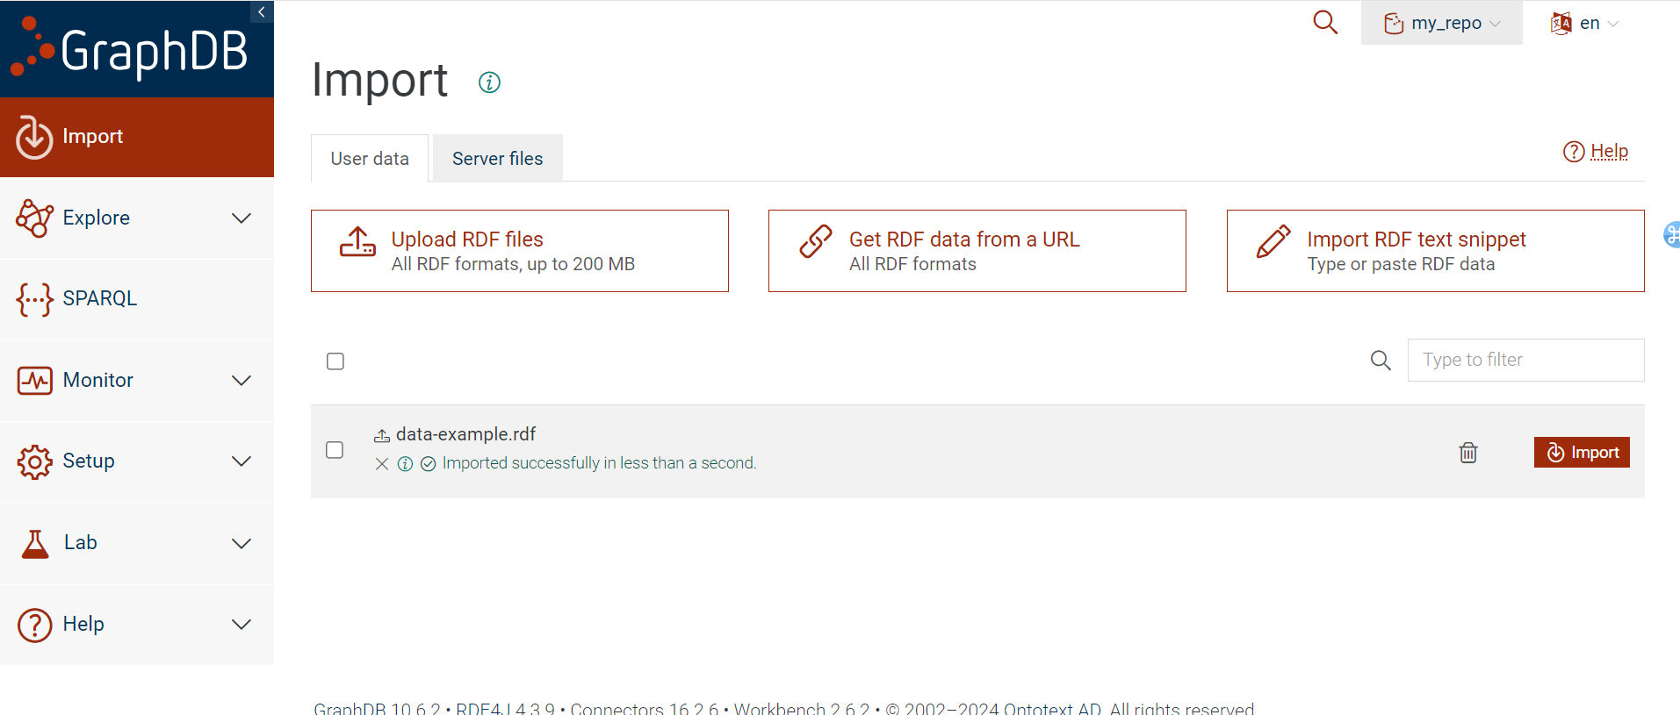
Import data

Slide 29
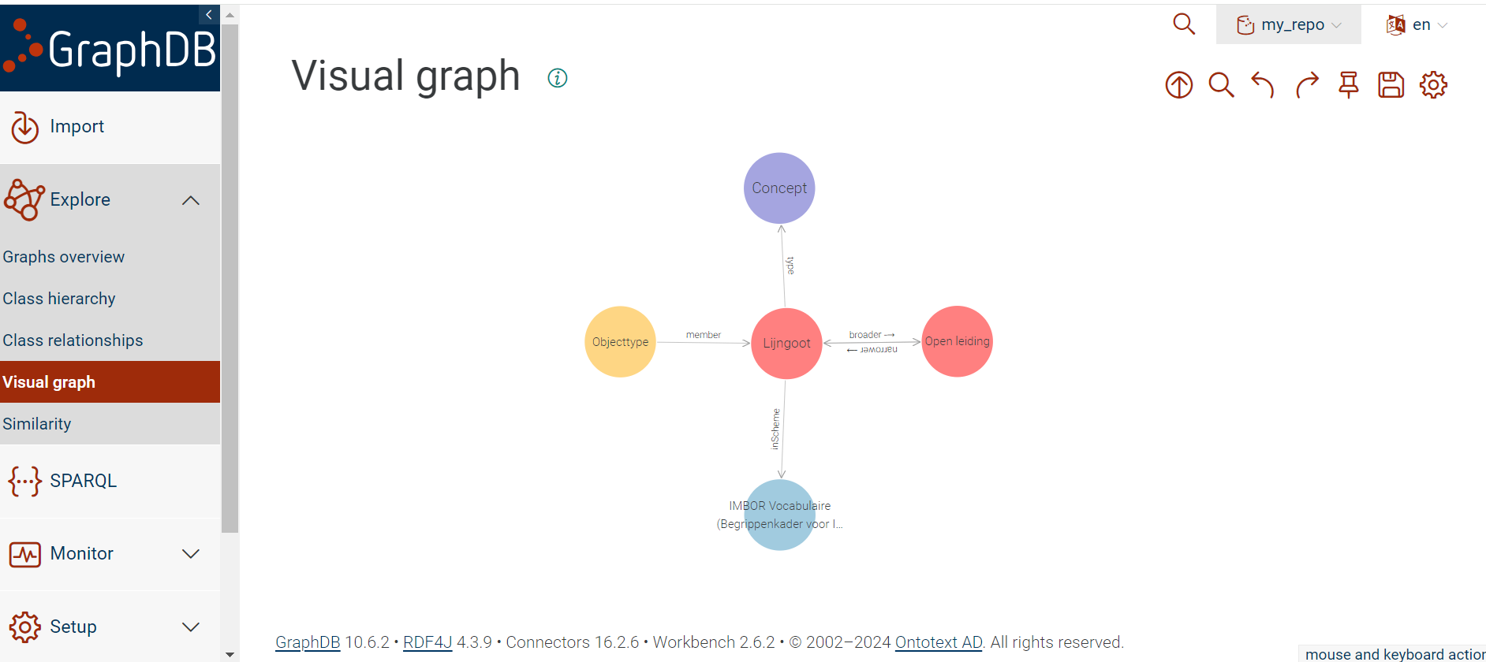

Slide 30
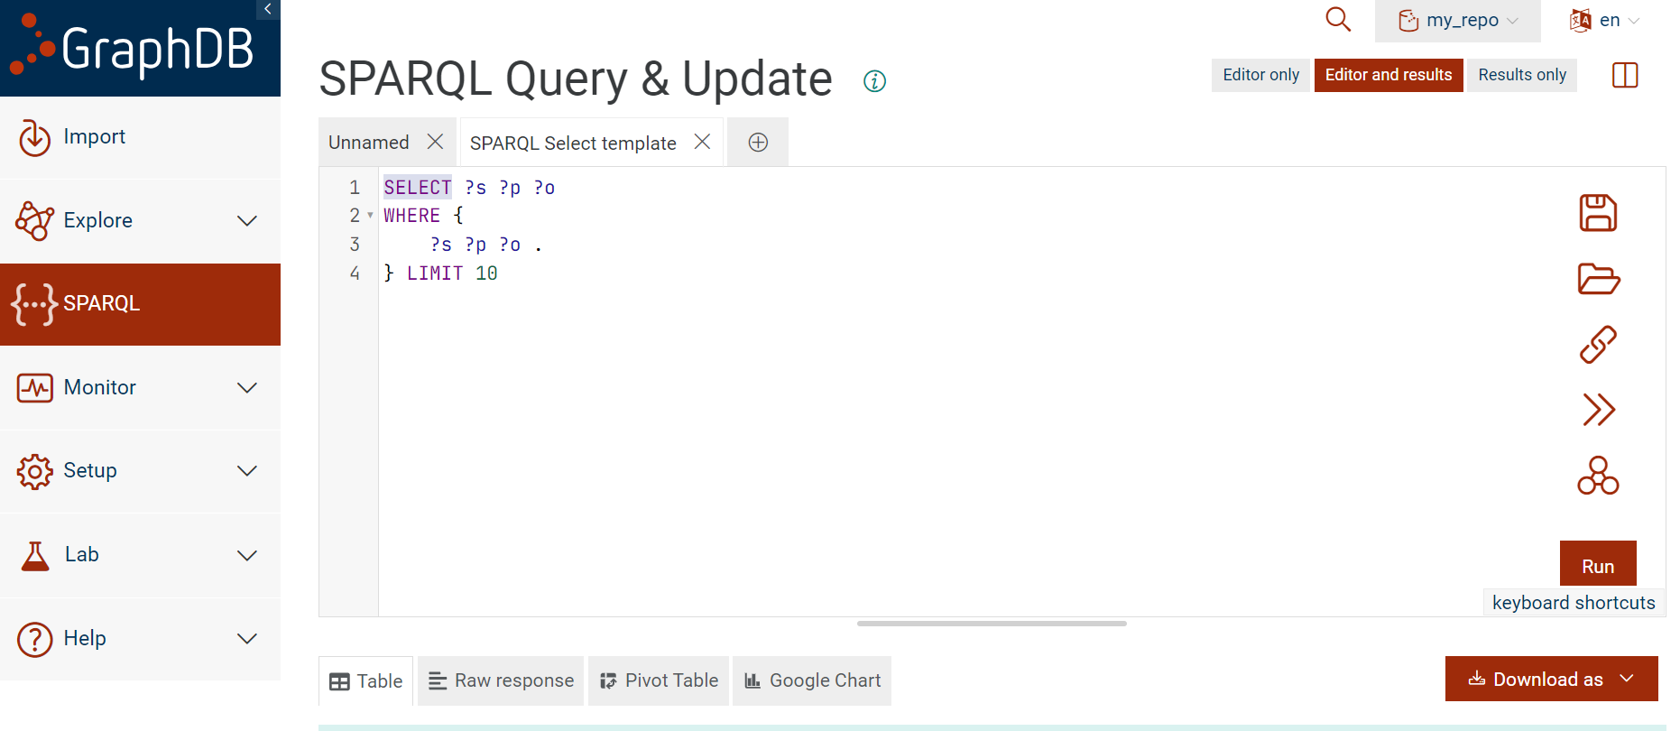

Slide 31
Blazegraph (Udemy course recommended this one)
https://blazegraph.com/ (to download and install it)
Run the command (java -server -Xmx4g -jar blazegraph.jar)
(sometimes it conflicts with vpn and gives the error on that. )
https://github.com/blazegraph/database/wiki/Quick_Start
If we want to work from a local machine just use this:
http://localhost:9999/blazegraph/
Portnumber: 9999

Slide 32
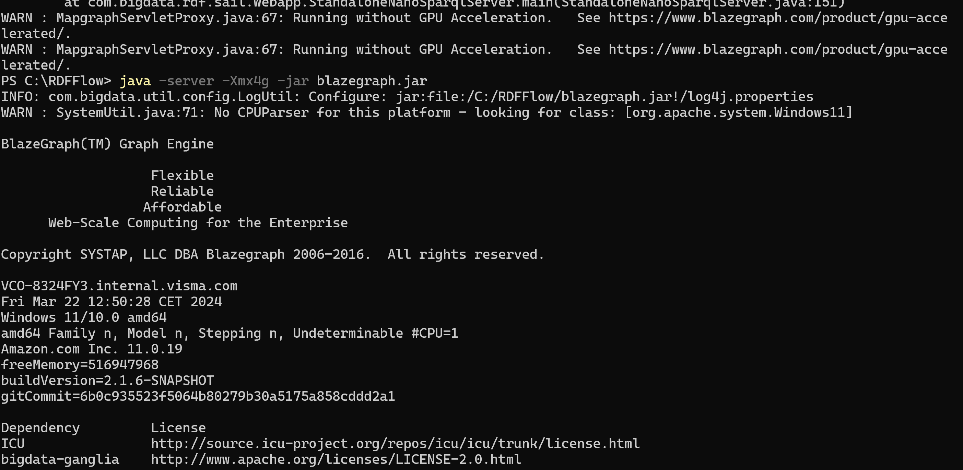
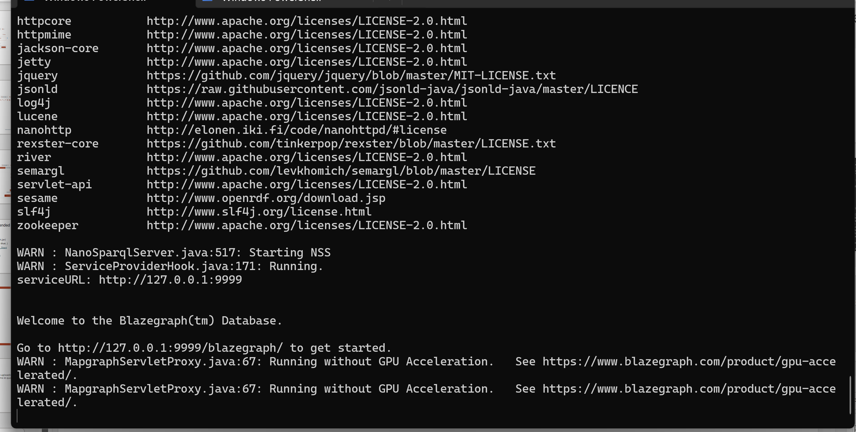
Copy this in your browser to start it

Slide 33
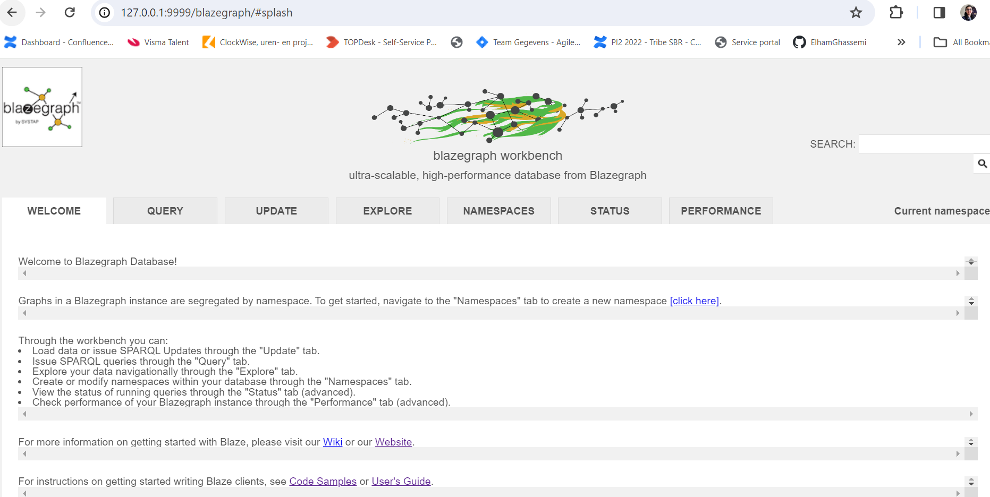

Slide 34
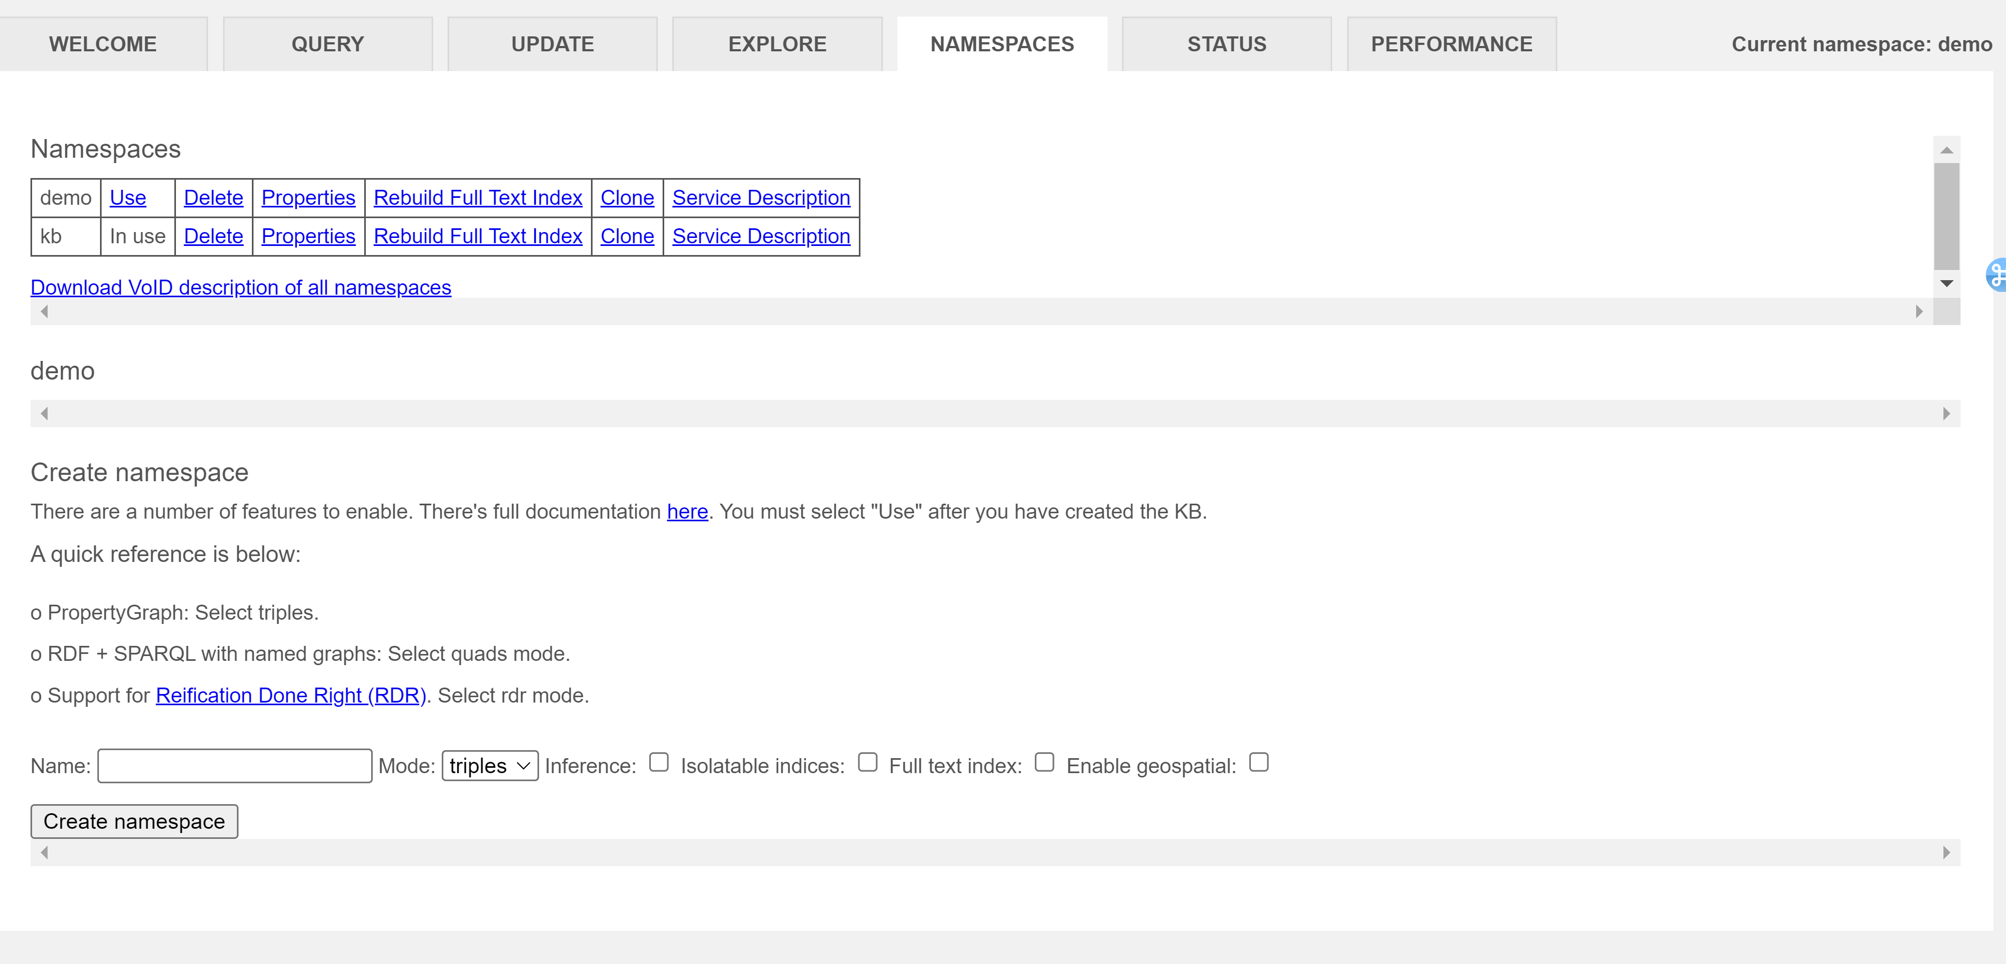
Quick start with Blazegraph
First create a new database where we are going to be uploading our dataset. We go to namespace and create our demo in quad mode.

Slide 35
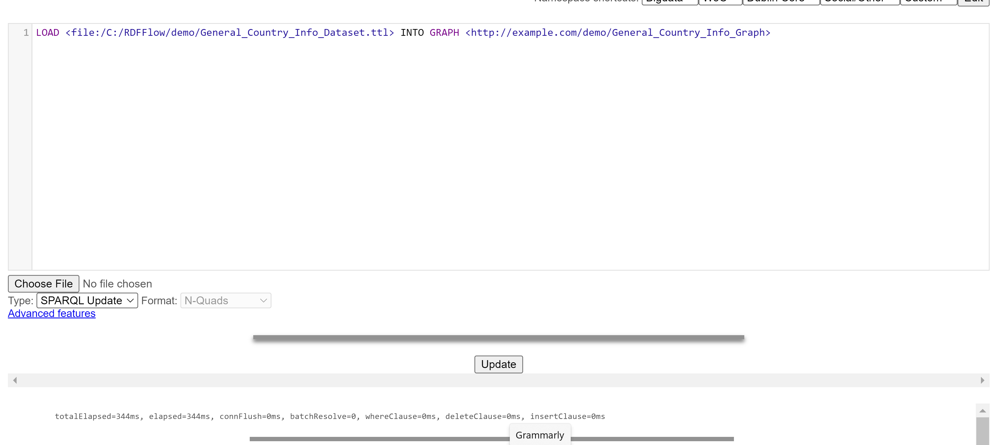
Load data
Use LOAD operation: (it is beneficial when we have multiple files to upload them)

Slide 36
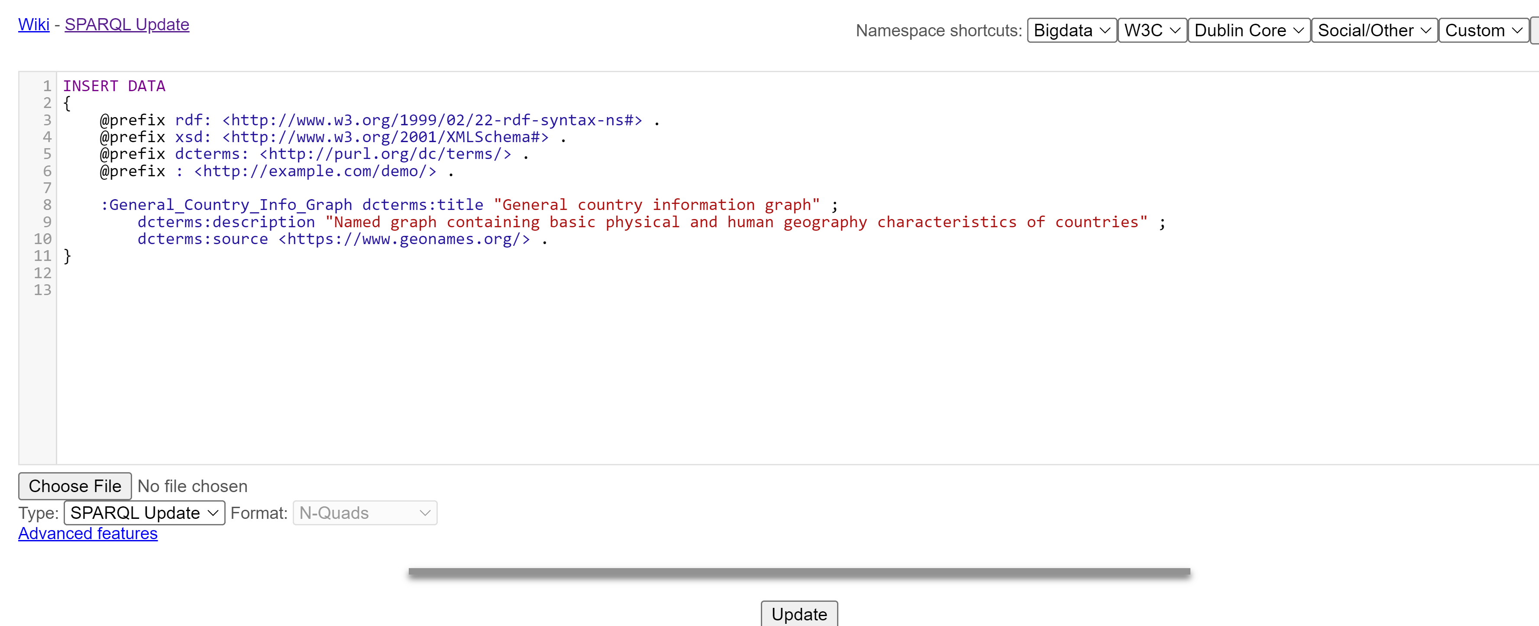
Specify the prefix for our graph
INSERT DATA operation containing statements involving the named graph: General_Country_Info_Graph

Slide 37
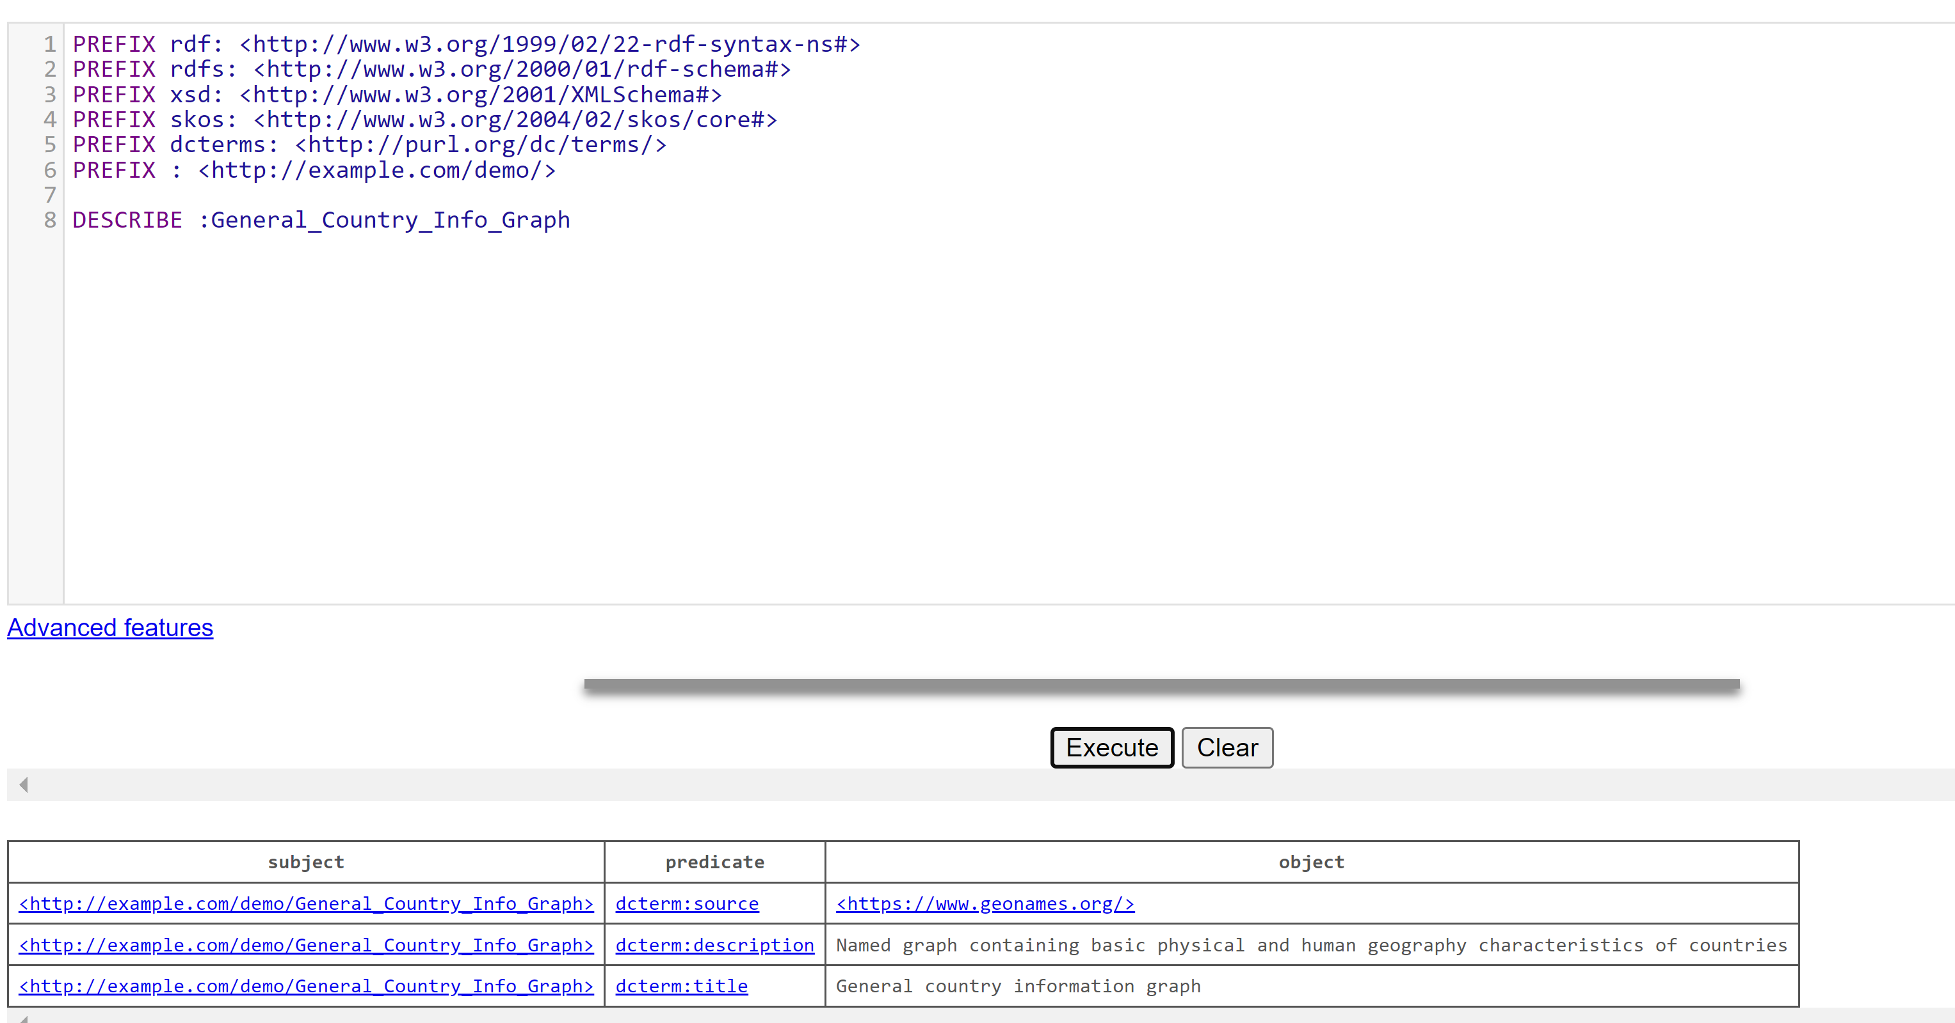
Query
Describe the named graph

Slide 38
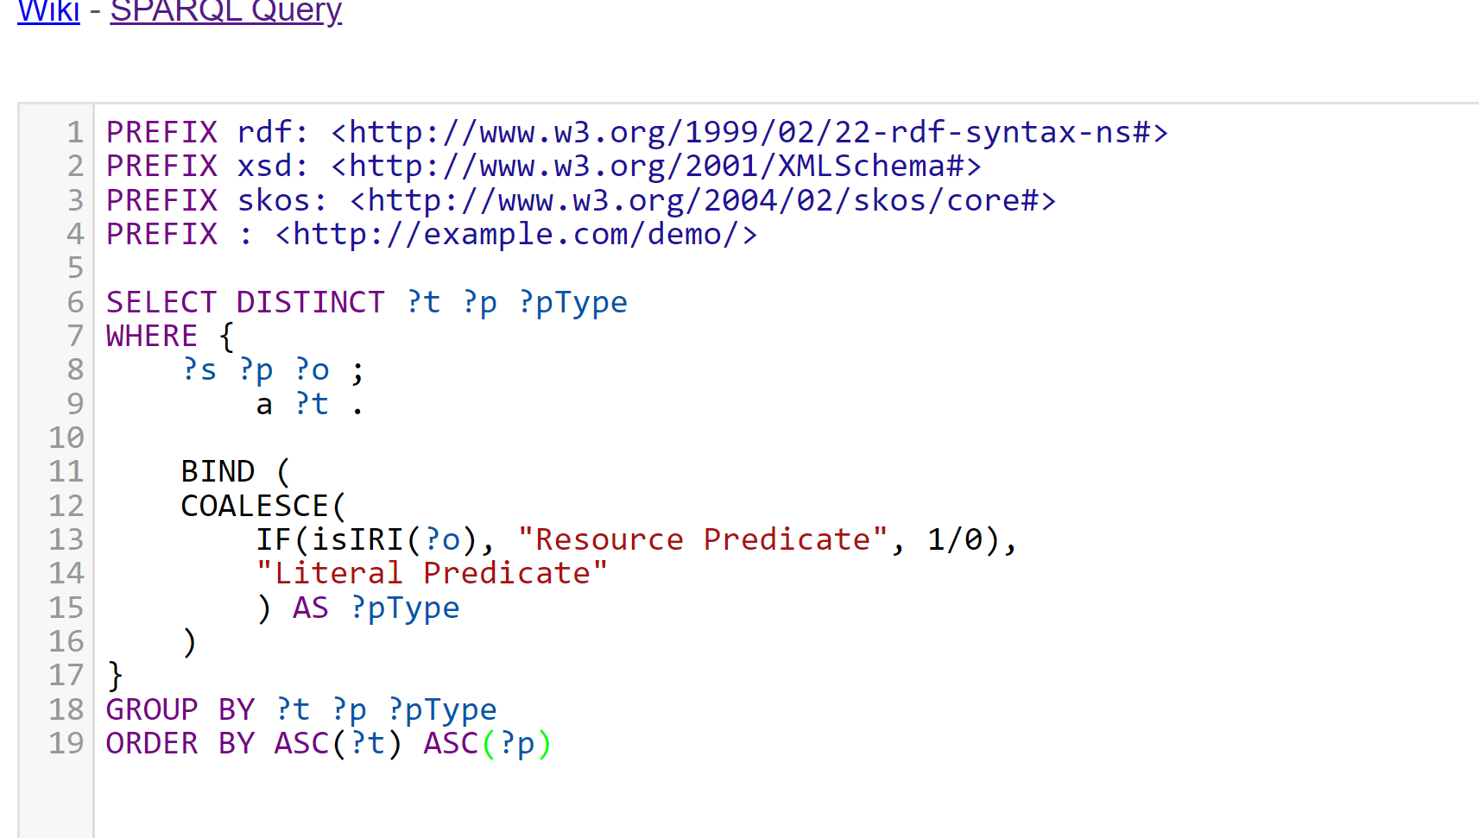
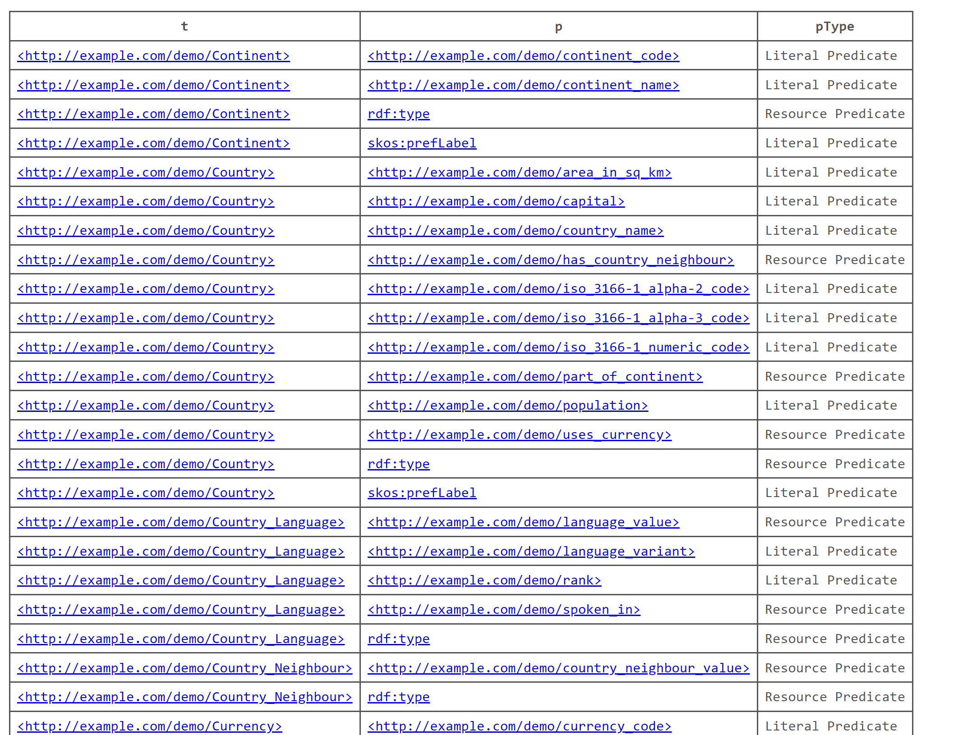
Query
Exposing the full vocabulary for the graph

Slide 39
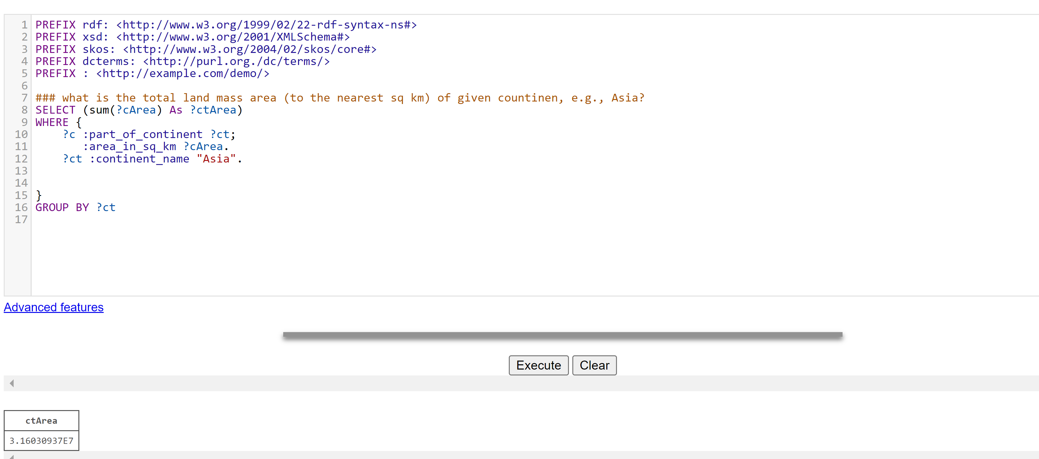
Sum in the query
Sum: Aggregate function to calculate the sum of numbers.
Round : rounds a number to the nearest integer.
CEIL: rounds up a number to the nearest integer.
FLOOR: rounds down a number to the nearest integer.
RAND: returns a random value between 0 and 1.
AVG: Aggregate function to calculate the average value from a list of numbers.
MIN,MAX: Aggregate functions to work out the minimum and maximum values, respectively. Numbers are sorted numerically.
ABS: returns the absolute value of a number.

Slide 40
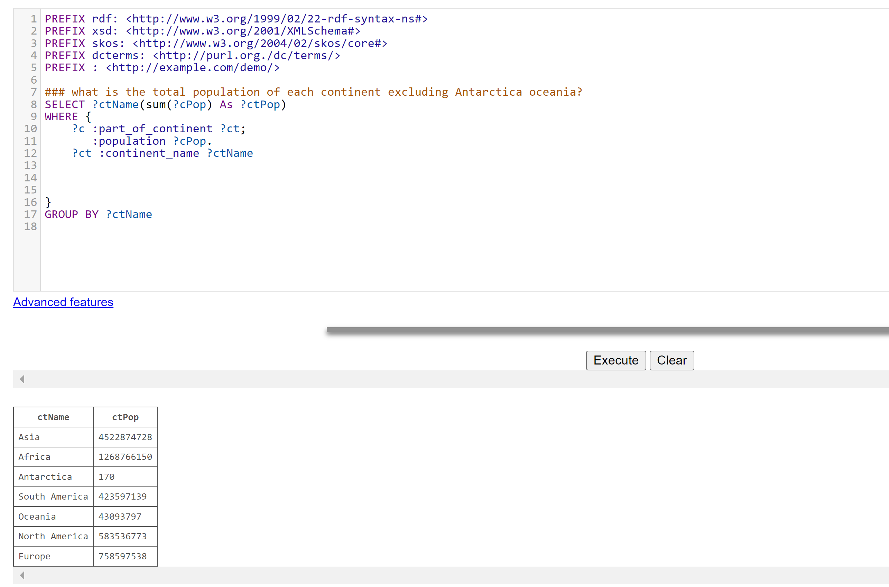
IN and NOT IN filter
We can see Antarctica and Oceania is also in the results and we want to exclude them.

Slide 41
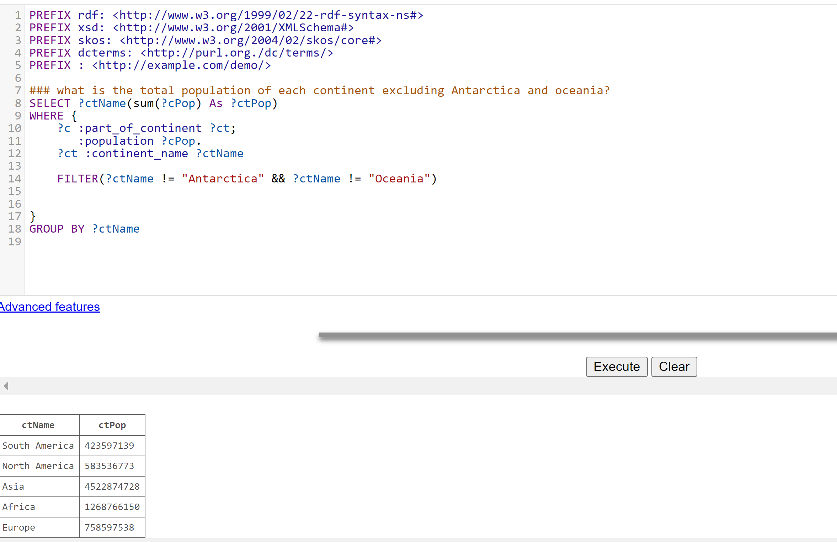
IN and NOT IN filter
We can filter two of continents

Slide 42
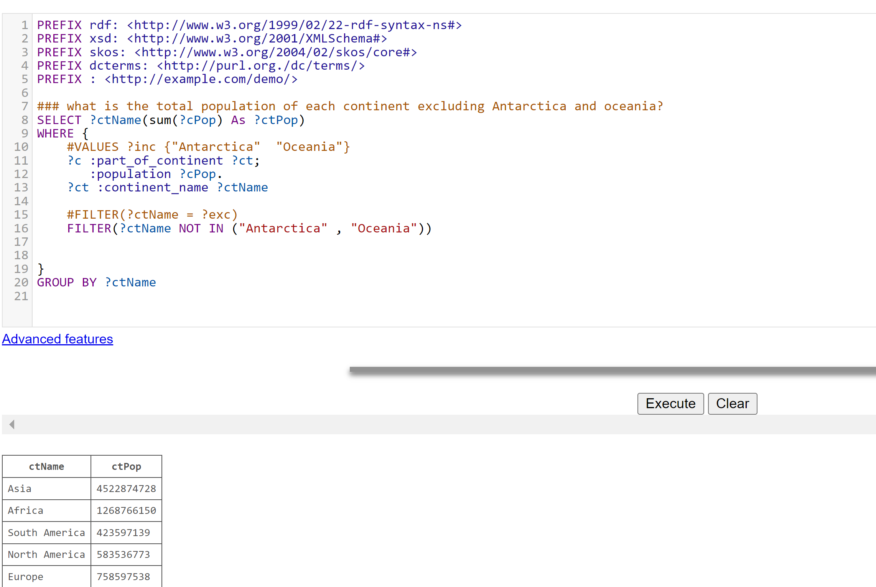
IN and NOT IN filter

Slide 43
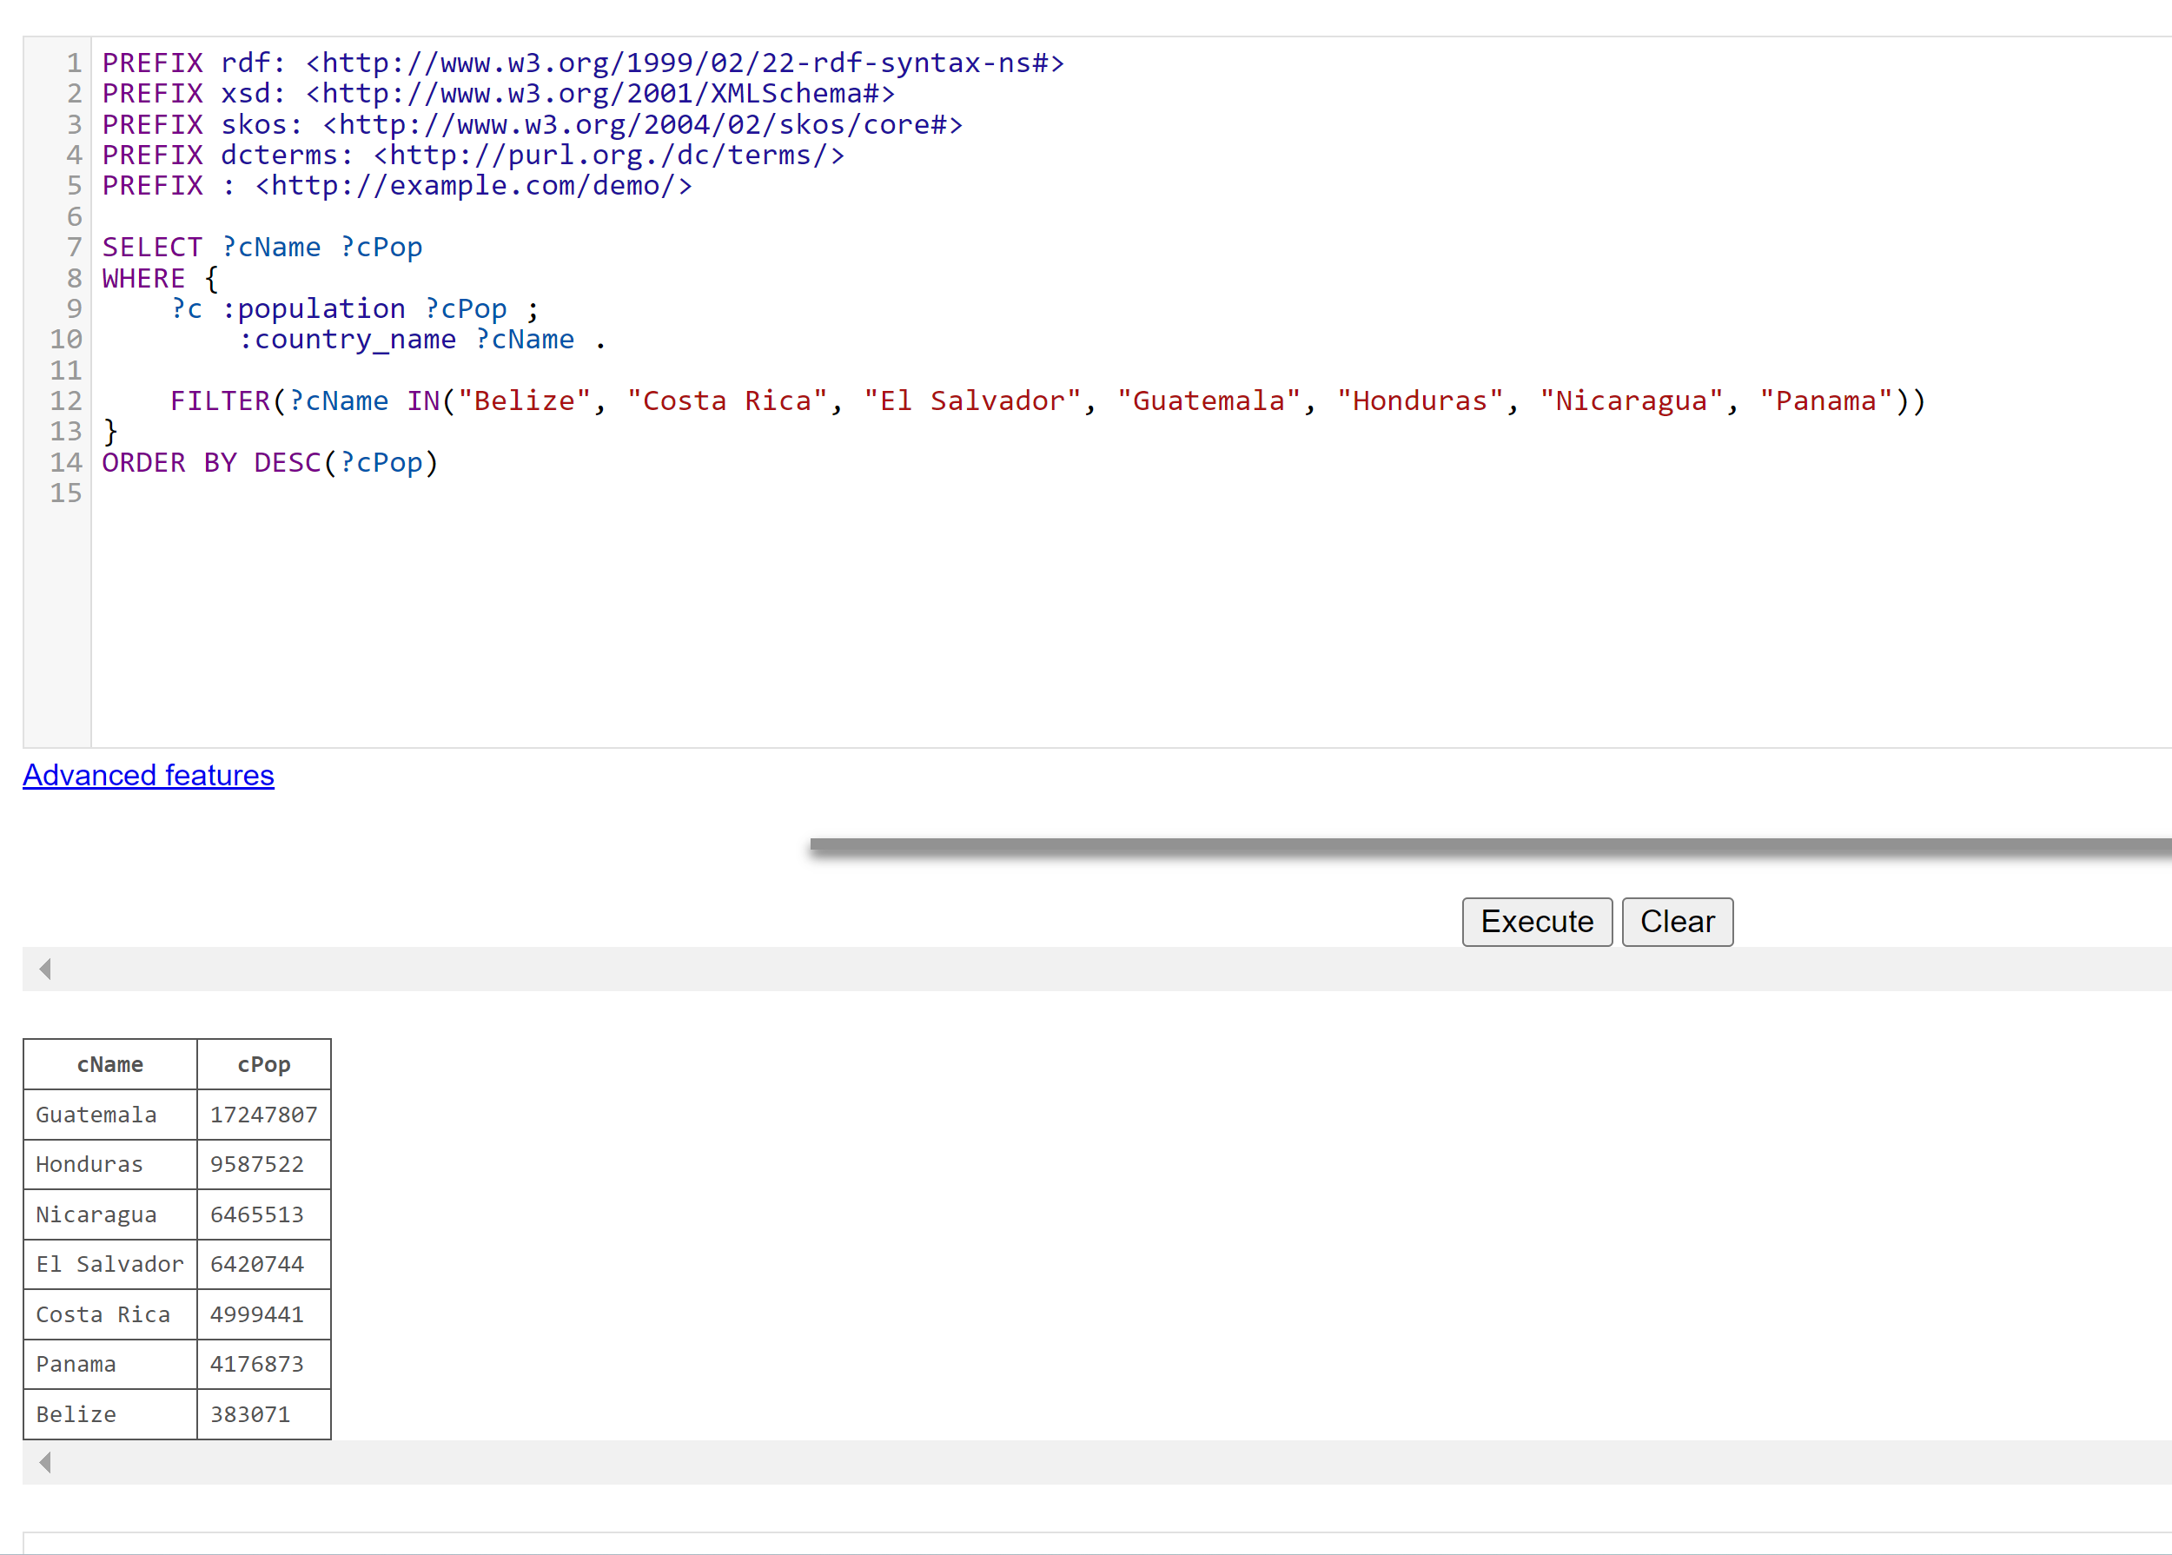
Challenge
Write a SPARQL query to find out the population of each of the countries of Central America. Central America consists of countries with the following names: "Belize", "Costa Rica", "El Salvador", "Guatemala", "Honduras", "Nicaragua" and "Panama".
In your query, use the functions FILTER and IN and order the results in descending order of population.

Slide 44
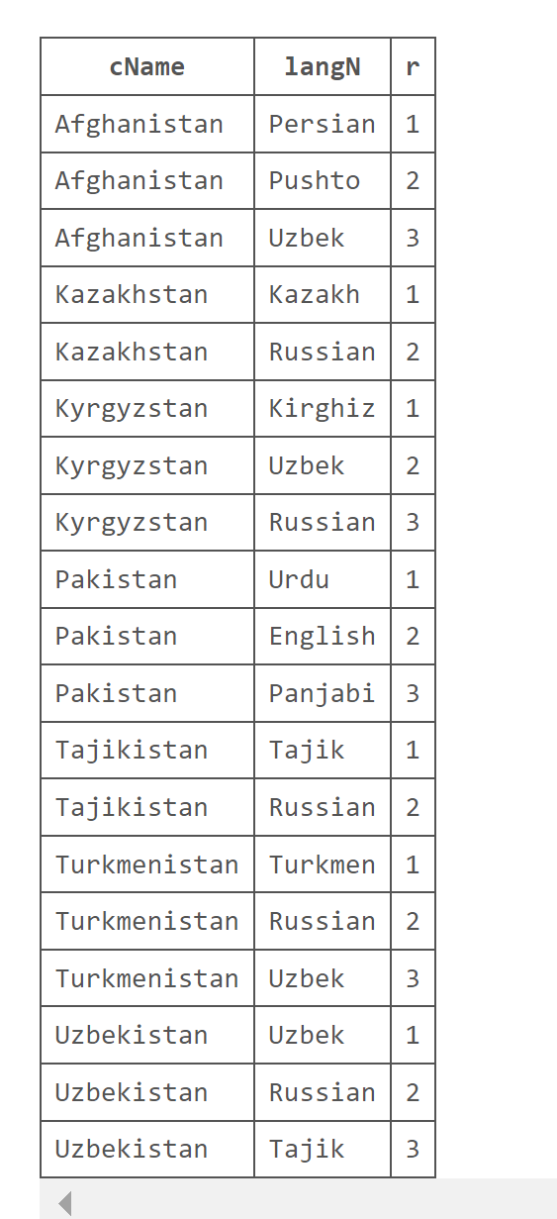
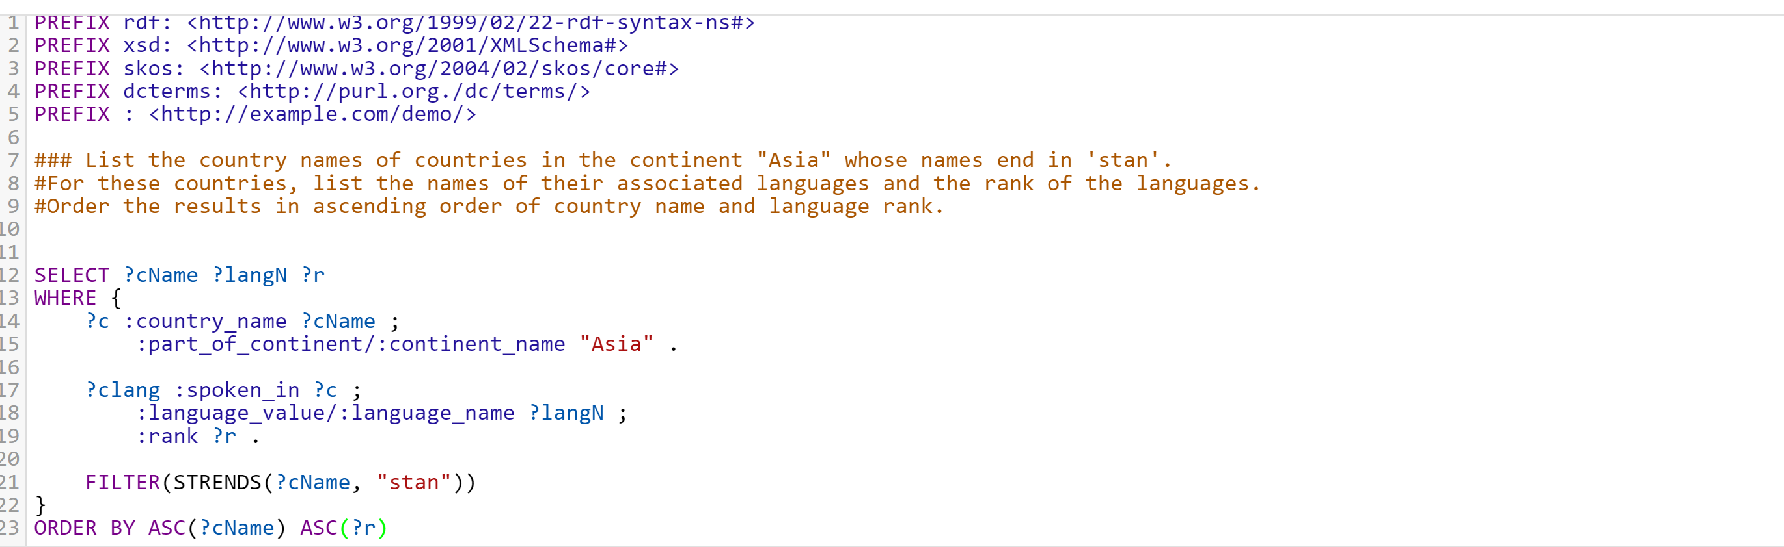
Function STRENDS, STRSTARTS

Slide 45
Functions
STRBEFORE(string, compare_string) returns the part of the string before the compare string.
Example: STRBEFORE("South Africa", "th") returns Sou. If the compare string is not found it returns empty.
STRAFTER
Purpose: STRAFTER(string, compare_string) returns the part of the string after the compare string.
Example: STRAFTER("Thailand", "ai") returns land. If the compare string is not found it returns empty.
STRLEN
Purpose: STRLEN(string) returns the length of a string.
Example: STRLEN(?country) where ?country is China will return 5.
CONTAINS
Purpose: CONTAINS(string, compare_string) checks if the string contains the compare string.
Example: CONTAINS("Madagascar", "dag") returns true, meaning the string contains dag.
SUBSTR
Purpose: SUBSTR(string, start_position, string_length) returns a substring of a string starting at the position marked by start_position, and will have the given length supplied through string_length.
Example: SUBSTR(?country, 7, 4) where ?country is Costa Rica will return Rica. Omitting the length as in SUBSTR(?country, 7) returns Rica, i.e. the remaining string from the starting position.
UCASE
Purpose: UCASE(string) returns the string in upper case.
Example: UCASE("Japan") will be returned as JAPAN.
LCASE
Purpose: LCASE(string) returns the string in lower case.
Example: LCASE("UK") will be returned as uk.
CONCAT
Purpose: CONCAT(string1, string2, ...) returns the concatenation of two or more strings.
Example: CONCAT("Republic", " of ", "Ireland") returns Republic of Ireland.
ENCODE_FOR_URI
Purpose: ENCODE_FOR_URI(string) converts any special characters in the string for use in a URL for the web.
Example: ENCODE_FOR_URI("Washington DC") returns Washington%20DC.
LANGMATCHES
Purpose: LANGMATCHES(language_tag, language_range) checks if the language tag matches the language range. See langMatches for more info.
Example: FILTER LANGMATCHES(LANG(?label), "en") filters language tags in the English language. The language tags may contain region as well, e.g. en-IE. A language range of * matches any non-empty language-tag string.
REGEX
Purpose: REGEX(string, pattern, flag) checks if the string matches the pattern. The pattern may contain different special characters. See regex for more info.
REPLACE
Purpose: REPLACE(string, pattern, replacement, flag) returns the string after replacing all occurrences of pattern in string with replacement. pattern is interpreted the same as in REGEX. flag is optional.
Example: REPLACE("United_Kingdom", "[_]", " ") removes all the underscores from the original string and replaces them with spaces.

Slide 46
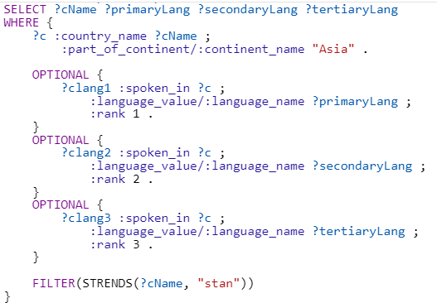
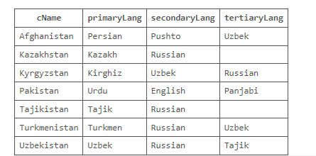

Transposing data in tables with OPTIONAL
For the countries in "Asia" whose names end in 'stan', list the names of their associated languages as data transposed in such a way that the result table displays, for each country, its rank 1 language as primary language in one column, rank 2 language as secondary language in another column, and rank 3 language as tertiary language in another column.

Slide 47
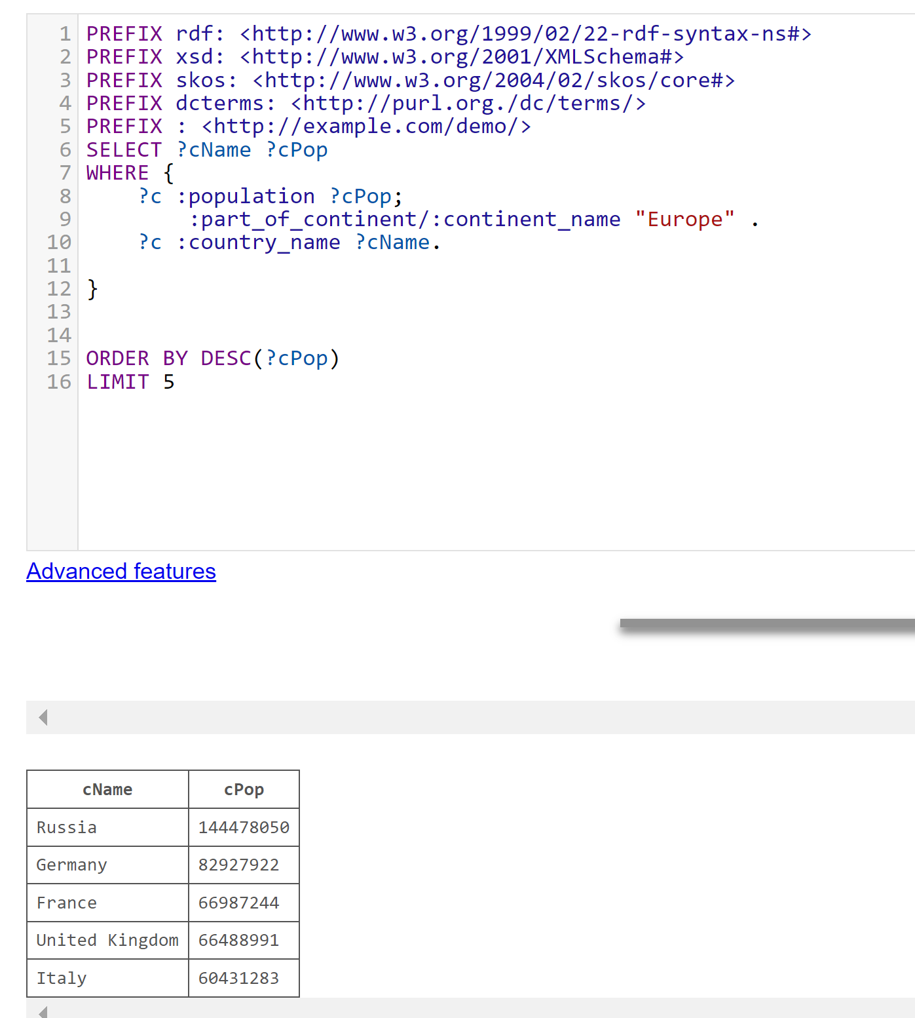
Subquery
List the names of the 5 most populated countries in the continent "Europe" and the names of their corresponding neighbours. Order the results in ascending order of the names of these 5 countries.
This query pulls the top 5 most populated countries in Europe.

Slide 48
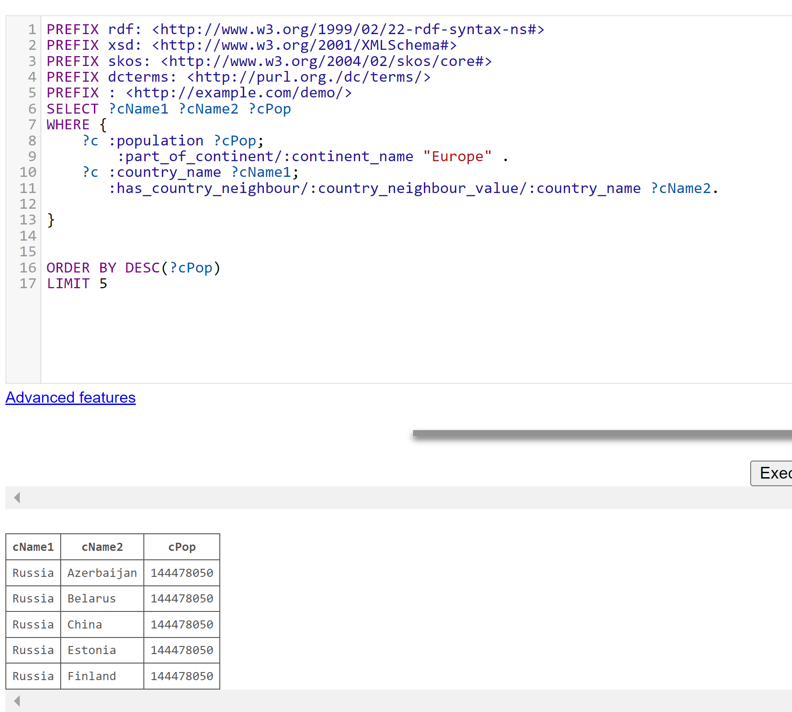
Subquery
This query gives the name of the neighboring countries but it is not correct for the request.

Slide 49
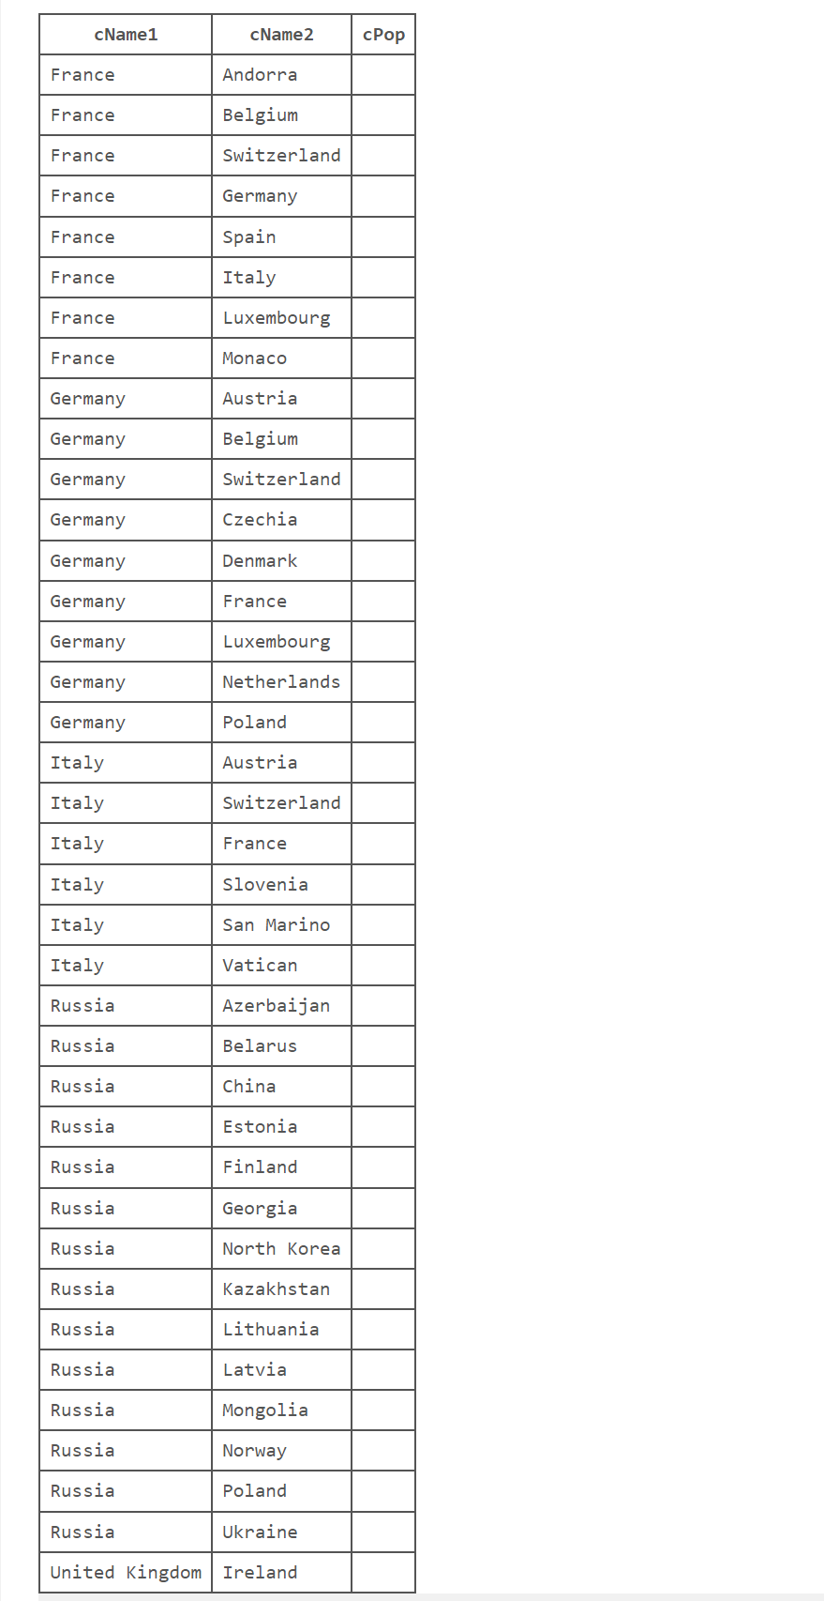
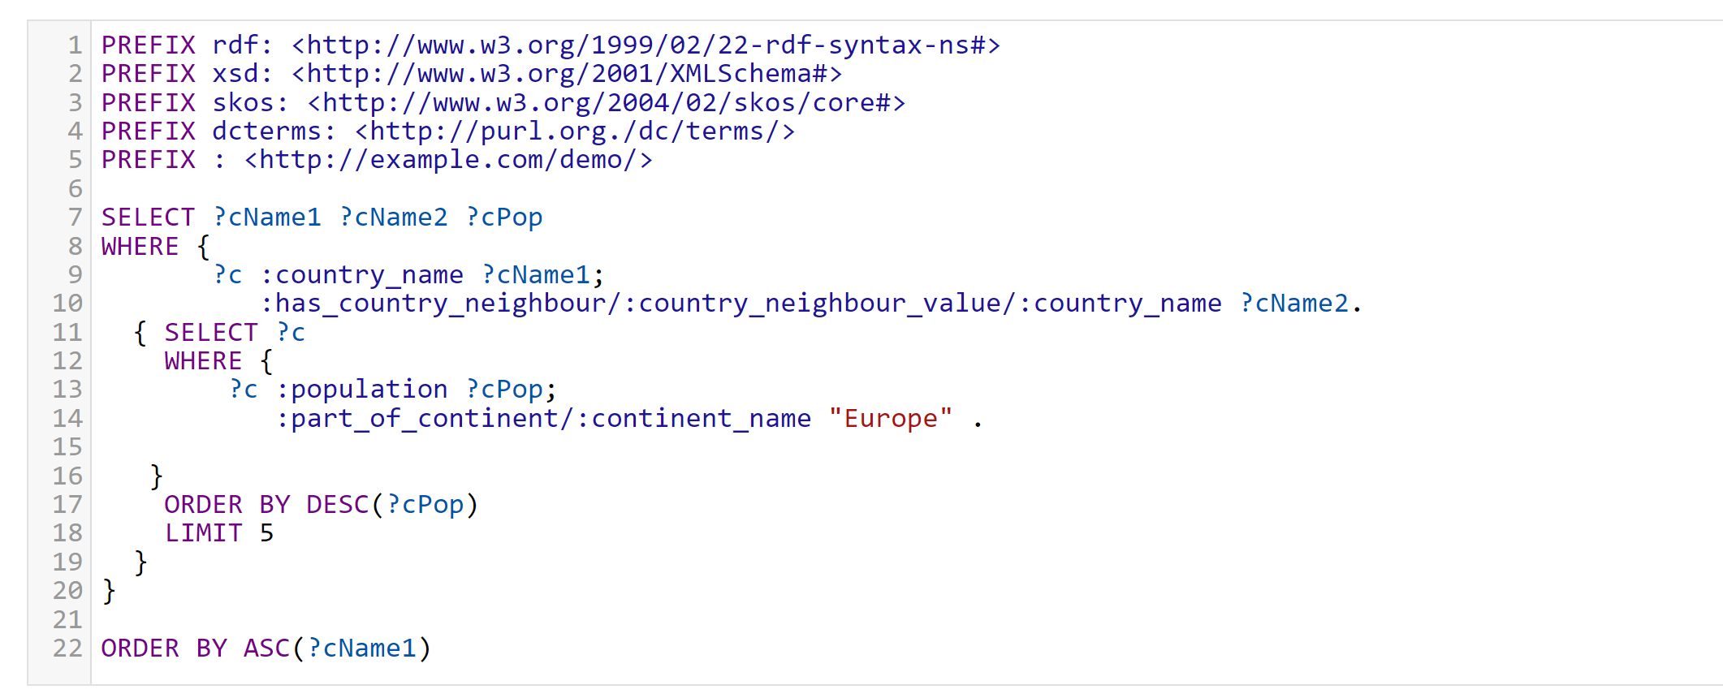
Subquery

Slide 50
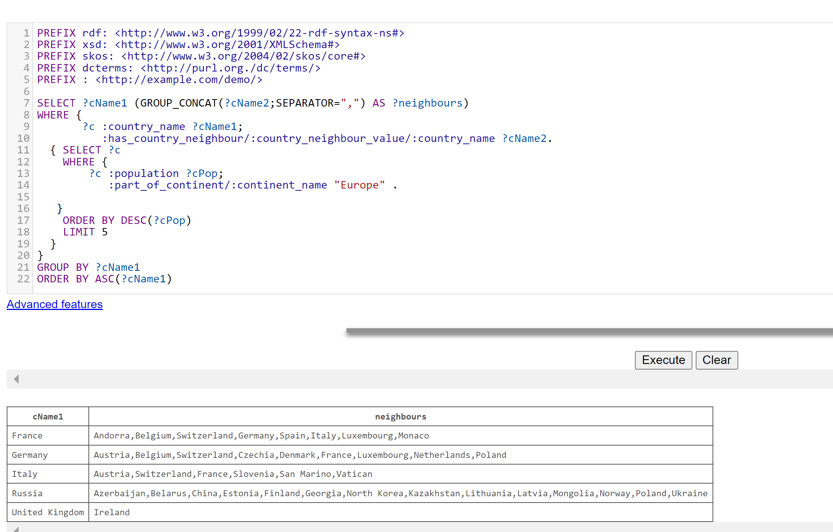
Concatenating elements with GROUP_CONCAT

Slide 51
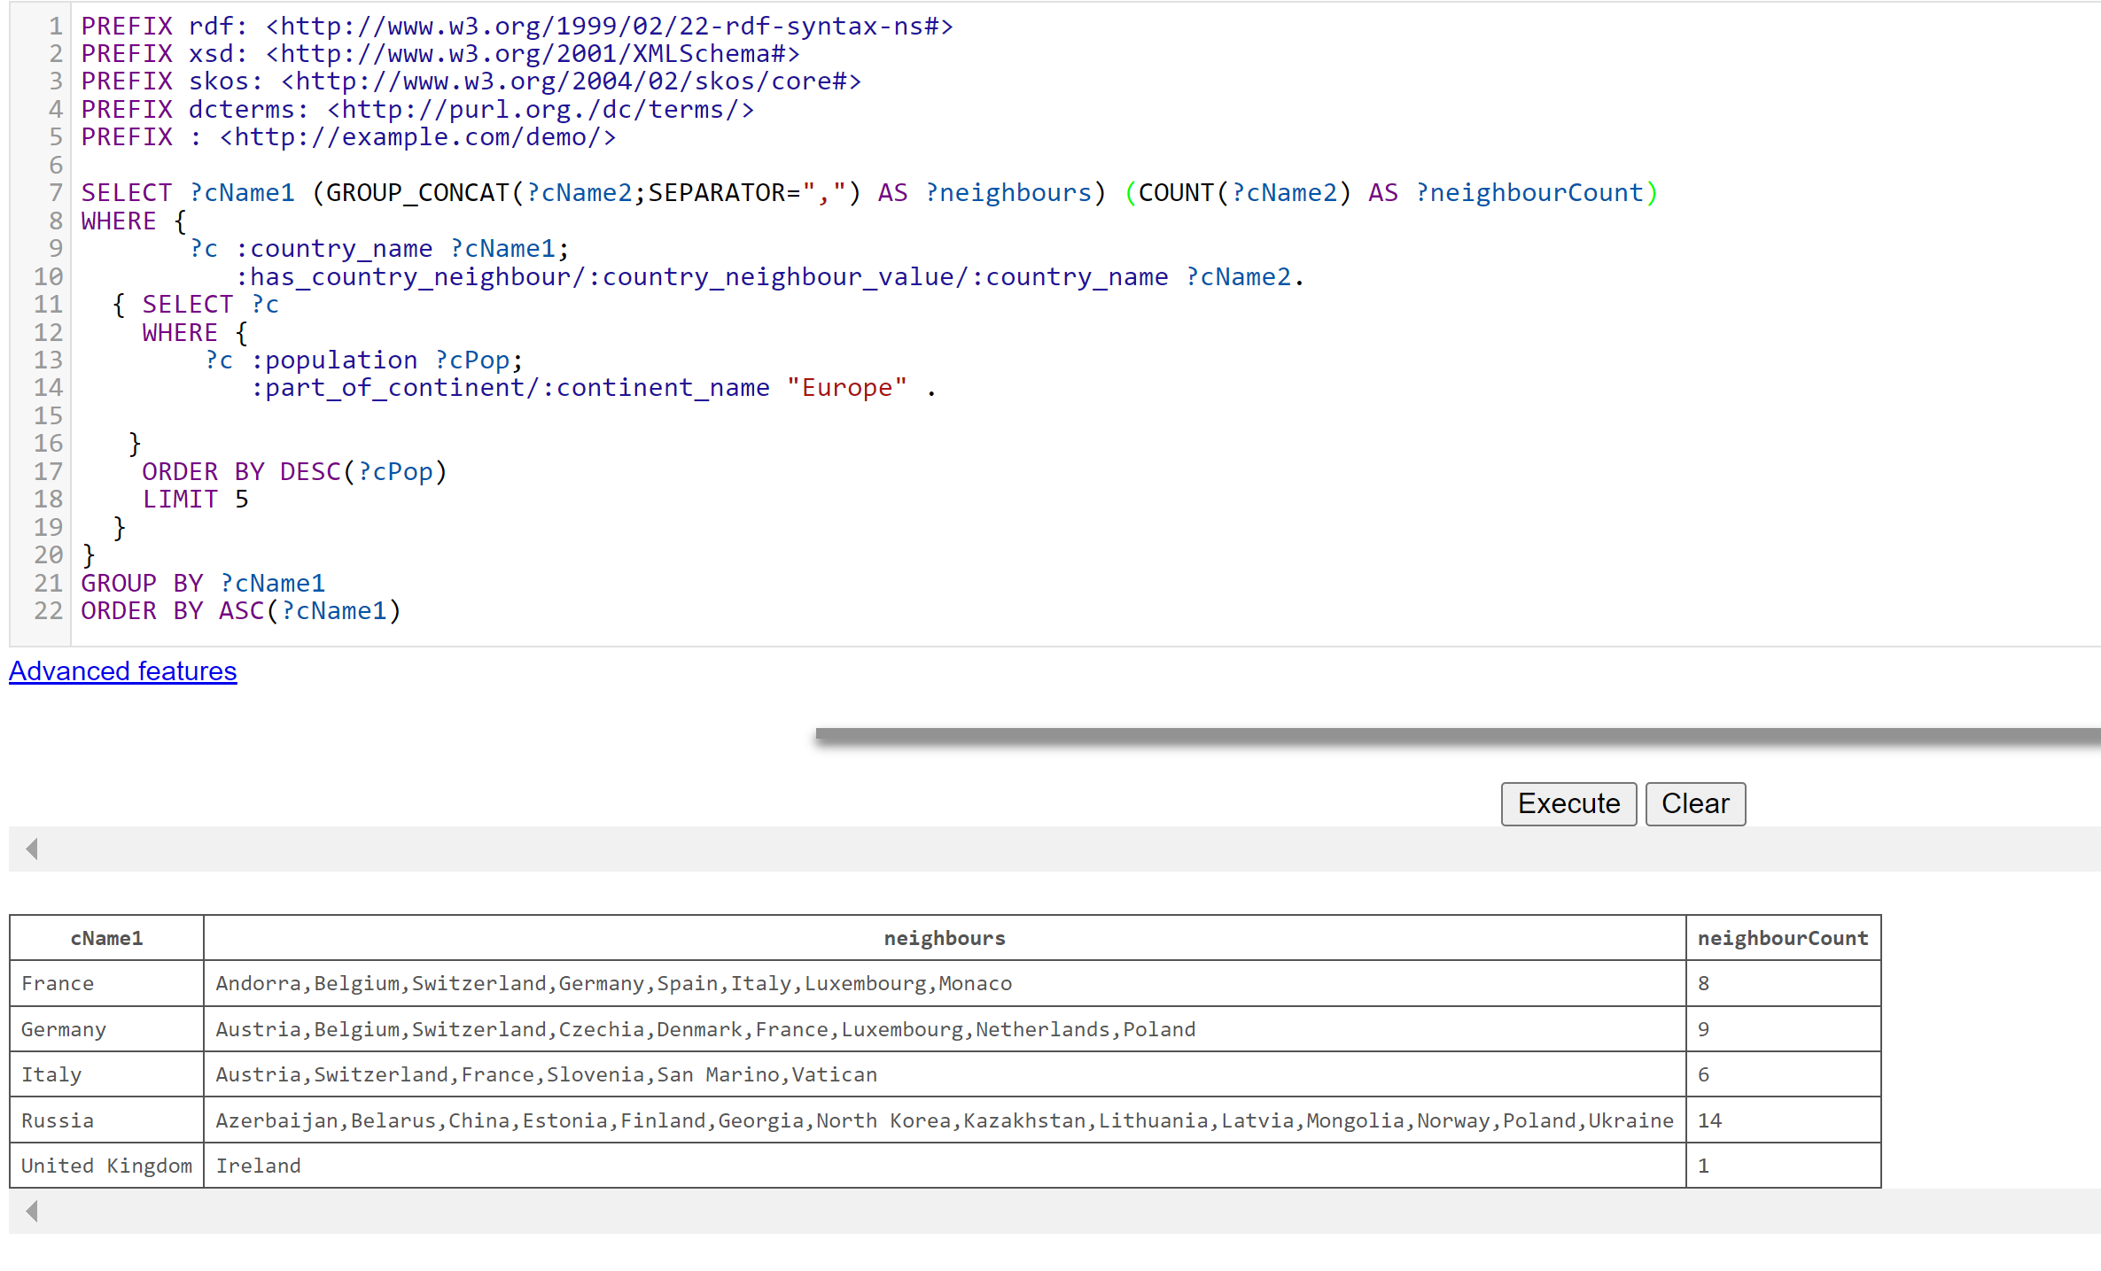

Slide 52
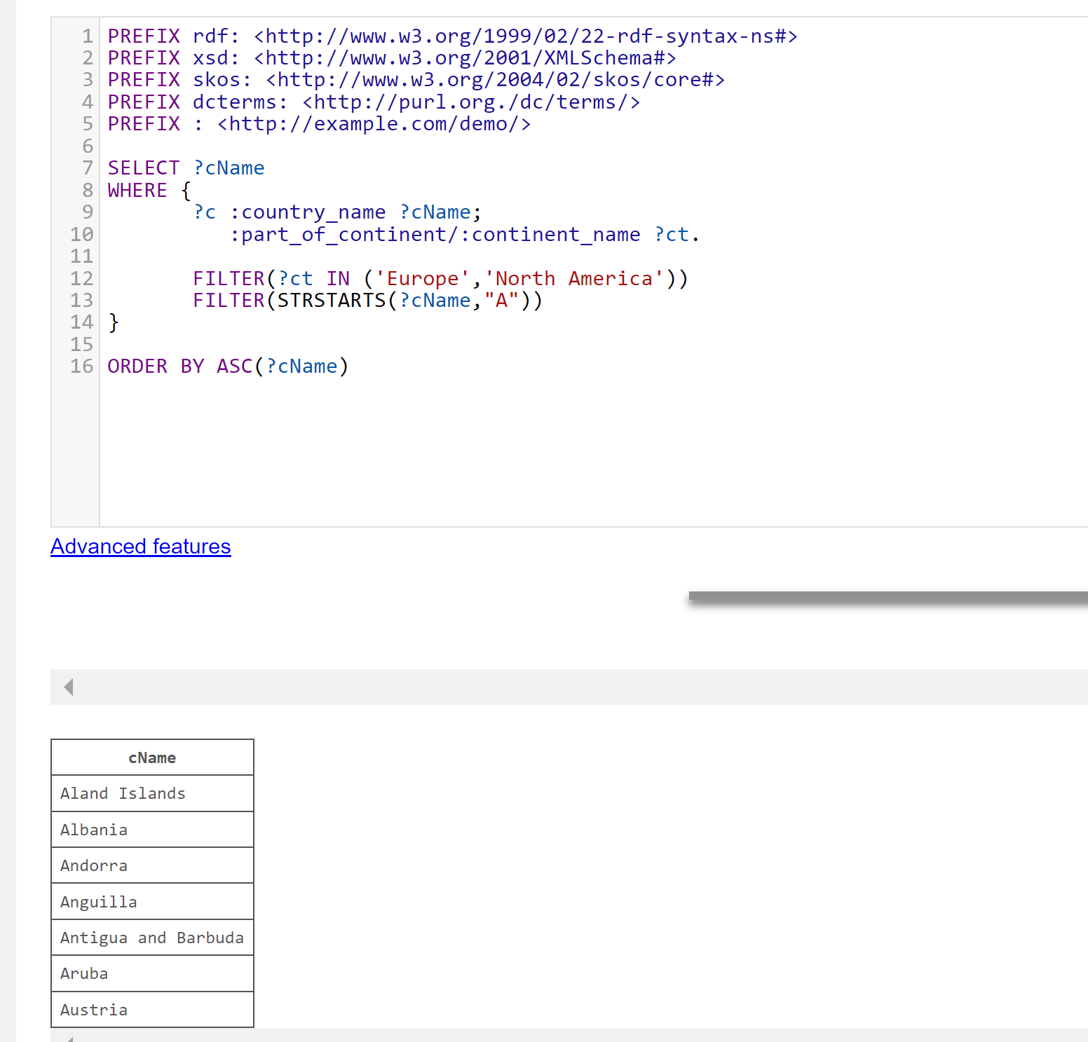
Exercises
List the names of countries that start with a capital letter "A" in the continents "Europe" and "North America", ordering the results in ascending alphabetical order.

Slide 53
Exercises
For these countries, in a second column in the result table, also list all the names of their associated languages together with any language variant that might be applicable. Each language name and variant pair should be in uppercase and multiple values should be separated by the character "|". For example, if for one of the countries, "Hungarian" was one of the languages with no language variant, and "German" was another associated language with the variant "AT" in the second column, HUNGARIAN|GERMAN(AT) should be displayed.
Write the query such that the results will be displayed in the table even though the countries might not have associated languages and language variants in the dataset.
Use the IN function for the two continents in scope, as well as the necessary string functions to tailor the results.

Slide 54
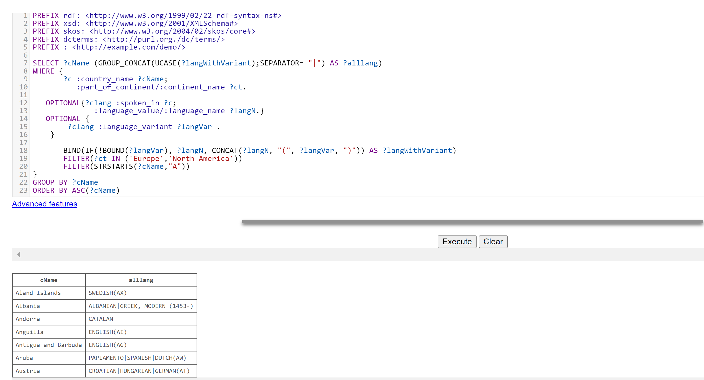
Exercises

Slide 55
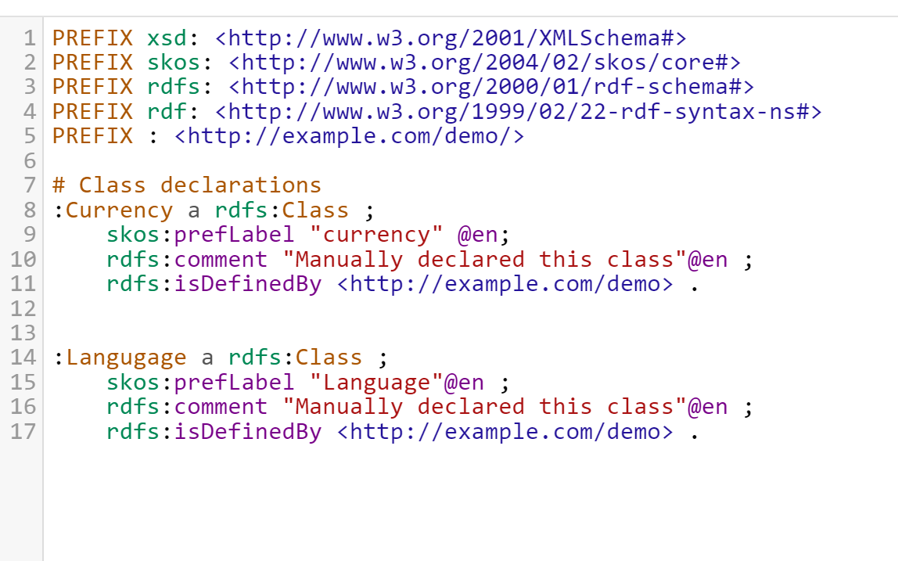
RDFS classes

Slide 56
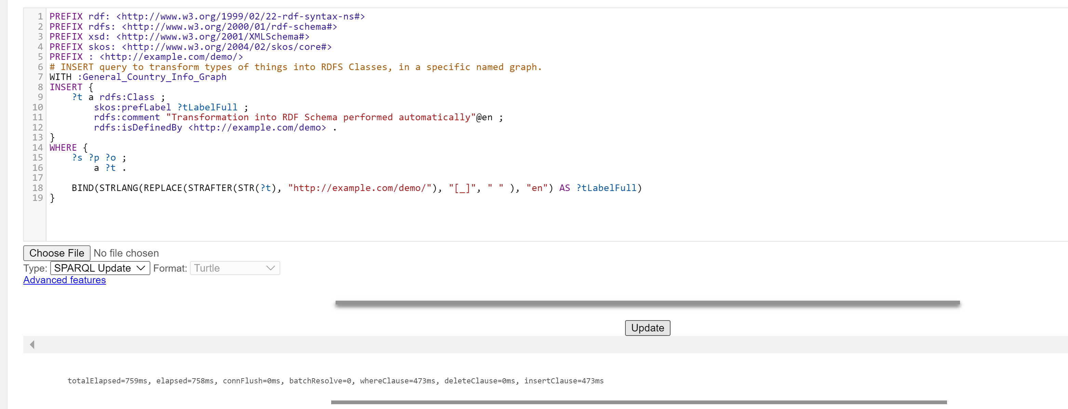
Automating class creation with SPARQL INSERT

Slide 57


Slide 58

RDFS classes

Slide 59


Slide 60

Automating property creation with SPARQL INSERT

Slide 61

Construct
A more general CONSTRUCT query can be created to surface the graph schema (ontology) as a sub-graph. This query can, for example, be used when you don't have a proper schema and want to see what's under-the-hood in terms of the graph vocabulary.

Slide 62


Slide 63

Visualize the subgraph, that is our graph schema, i.e. that is our ontology. There are several outgoing and incoming predicates in country class.

Slide 65

Constructing the graph schema

Slide 66


Slide 67





Slide 68


Declaring and querying RDF Containers
load an instance of rdf:Bag and an instance of rdf:Seq in two different named graphs.

Slide 69

Compose and run a SPARQL query to retrieve from :Travel_Bucket_Lists graph and :General_Country_Info_Graph as the default graph, the names of all countries that start with an uppercase vowel in the container :My_Travel_Bucket_List
Also display in the list of results the index of the countries in the container as an xsd:integer

Slide 70
Some tutorial
https://atomgraph.github.io/SPARQL-Playground/
https://docs.data.world/tutorials/sparql/Your_First_Sparql_Query.html

Slide 71
Python packages
https://owlready2.readthedocs.io/en/latest/intro.html
RDFLib : https://rdflib.readthedocs.io/en/stable/index.html
Read: https://www.oclc.org/developer/news/2016/making-sense-of-linked-data-with-python.en.html

Slide 72
Useful to read
Database design basics:
https://support.microsoft.com/en-gb/office/database-design-basics-eb2159cf-1e30-401a-8084-bd4f9c9ca1f5
From SQL Tables To Sparql Graphs ()
RDF grapher is a web service for parsing RDF data and visualizing it as a graph: https://www.ldf.fi/service/rdf-grapher
Stardog: https://docs.stardog.com/tutorials/rdf-graph-data-model

Slide 73
https://raghavam.github.io/teaching/monsoon2018/ontmodelling/intro-owl.html#/15

