Slide 1

Comparison of Machine Learning Algorithms for the Power Consumption Prediction - Case Study of Tetouan City / Morocco
New England Institute of Technology
Mohamed El-hassnaoui
Prof. Tim Henry
December 12, 2018,
Notes:
Greating, my name , I belong to … faculty university ….. I will present my paper which is about ……

Slide 2
Outline
OBJECTIVES
INTRODUCTION
CASE STUDY
COMPARATIVE MACHINE LEARNING MODELS
METHODOLOGY
RESULTS AND EXPERIMENTS
CONCLUSION AND FUTURE WORK

Slide 3
Objectives
.
Reducing the cost of electricity for both producer and consumer
Decreasing or increasing the power production according to the consumer consumption
Selecting the most accurate machine learning models to predict the electricity power consumption for every 10 minutes, and/or every hour
Conserving the environment by reducing the Gases emitted from power plants

Slide 4
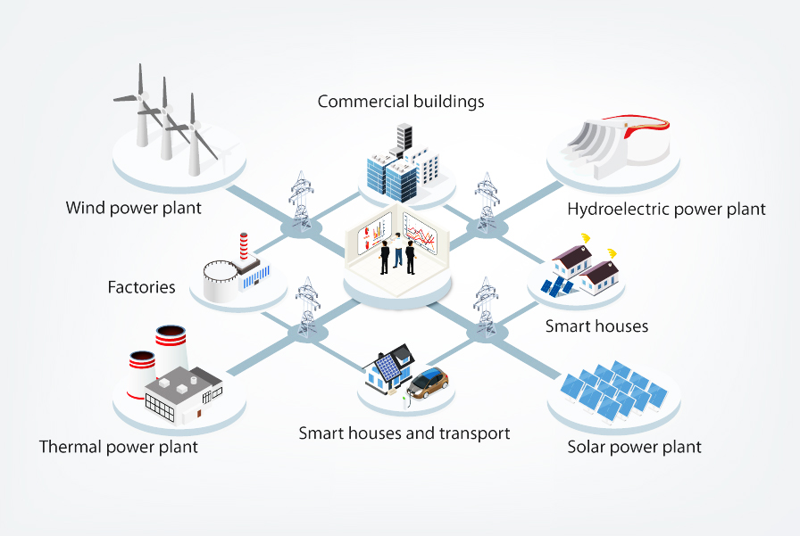
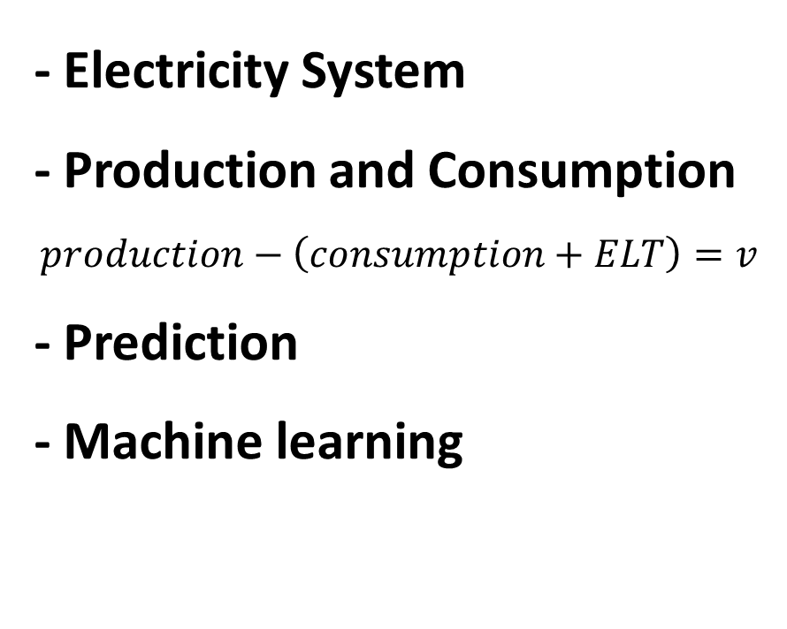
Introduction
- Electricity System - Production and Consumption - Prediction - Machine learning
http://www.focusondrives.com/disrupting-the-electricity-system/
Notes:
Power system gets more and more attention by researchers. Many resources are added and how to control and manage it became important to make the utilities work effectively. consumer becomes producer .all the system stands for what we have and what we need. We can describe the balance by the equation if the …..
ELT is the energy lost in the transportation and 𝑣 is real number. Prediction helps to know the power consumption and the power produced especially that renewable. There are many models that used in prediction and we can classified them into statistics, engineering and artificial intelligence. We use in this work machine learning which is part of AI.

Slide 5

Case Study
Tetouan
Notes:
This case study is about the power consumption of Tetouan city which is located in the north of morocco.
The power consumption data was collected from Supervisory Control and Data Acquisition System (SCADA) of Amendis which is a public service operator and in charge of the distribution of drinking water and electricity

Slide 6
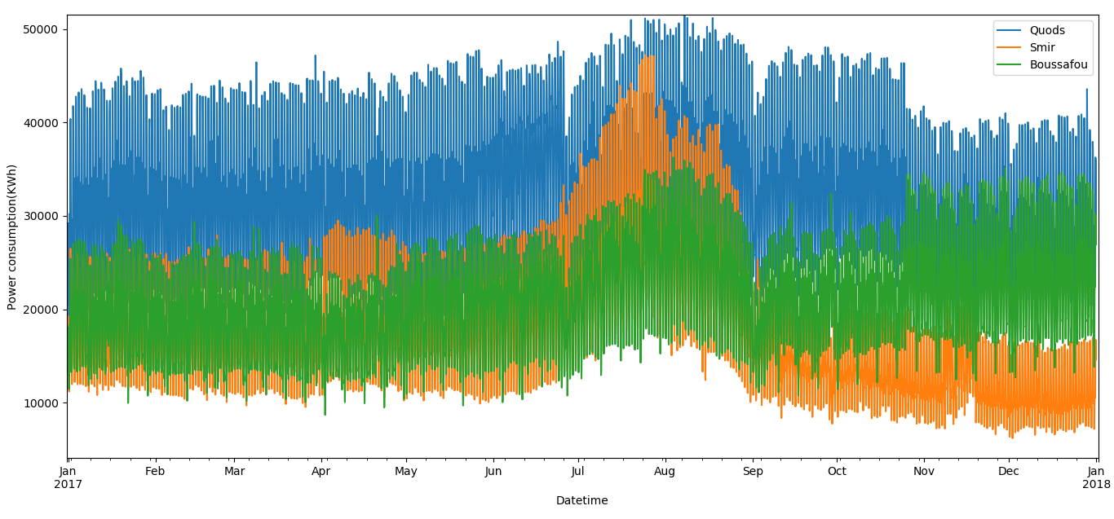
Case Study
Power consumption data
Notes:
Power consumption of three distribution networks. Period of 2017 for every 10 minutes.
There is no missing data for the three distribution.
As we can see the power consumption is increased in summer according to hot weather and vacation time

Slide 7
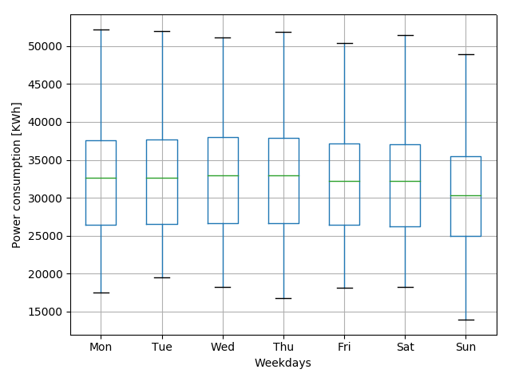
Case Study
Quads Distribution network
Weekday power consumption
Weather data
Notes:
As it is shown that the power consumption of Sunday is less than other days. many factors may affect the prediction. We use the date time variables as input and beside them we use the variables of weather such as temperature and humidity and wind speed etc.
Weather data is taken from the physic department which has sensors in the guard of collage.
This data is taken in each 5 minute and we resample it to be in the same measure of power consumption data.

Slide 8
Comparative Machine Learning Models
Linear Regression
Support vector Regression
Decision Tree
Random Forest
Feedforward Neural network
Notes:
Machine Learning is broadly classified into Supervised, Unsupervised, Semi-supervised.
Supervised is divided into regression and classification. Power prediction is continues variable and related to regression. We compare the most used models in prediction.

Slide 9



Comparative Machine Learning Models
Support vector Regression
Linear Regression
$$ξ$$
$$ε$$
$$ζ$$
Notes:
Linear regression is consider the simplest model and used as a based model. Above is figure of two variables. And find the best line to fit .
Support vector machine was used for classification problem and it achieves good result in that field then lately it used for regression. the algorithm is more complicated therefore to be taken in consideration. However, the main idea is always the same: to minimize error, individualizing the hyperplane which maximizes the margin,
Kernal: linear, Polynomial, radial basis function

Slide 10
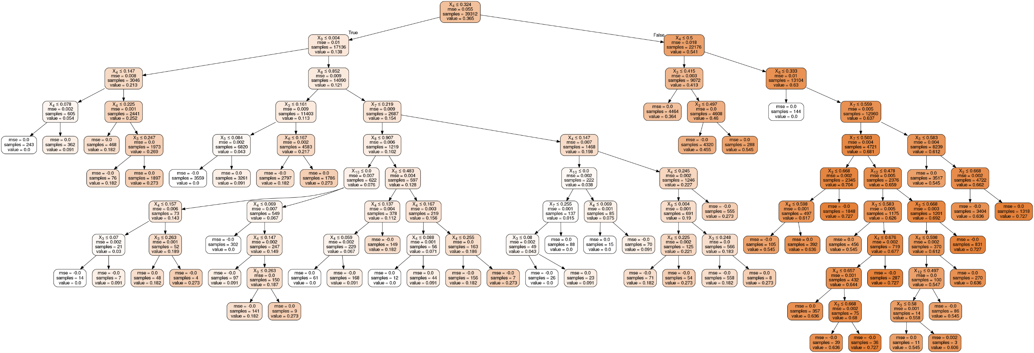
Comparative Machine Learning Models
Decision Tree
Notes:
Decision tree consider as one of the simplest algorithm.it used as if conditions with respect to input. Explanation of figure.
Types of DT: ID3,c4.5, CART(Classification and regression trees Algorithm ).
Criterion, max_depth, min_samples_split , min_samples_leaf, max_features
Problem(high variance)
Random forest:
Uncorrelated(ensamble) decision trees,
It use to reduce the high covariance of Decision tree.
Beside the parameters of decision tree we use the number of trees in random forest.

Slide 11
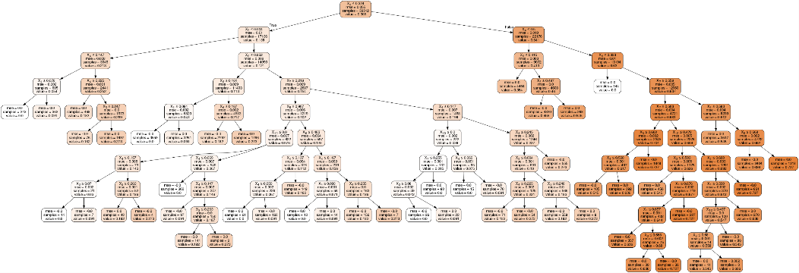
Comparative Machine Learning Models
Random Forest
Notes:
Decision tree consider as one of the simplest algorithm.it used as if conditions with respect to input. Explanation of figure.
Types of DT: ID3,c4.5, CART.
Criterion, max_depth, min_samples_split , min_samples_leaf, max_features
Problem(high variance)
Random forest:
Uncorrelated(ensamble) decision trees,
It use to reduce the high covariance of Decision tree.
Beside the parameters of decision tree we use the number of trees in random forest.

Slide 12
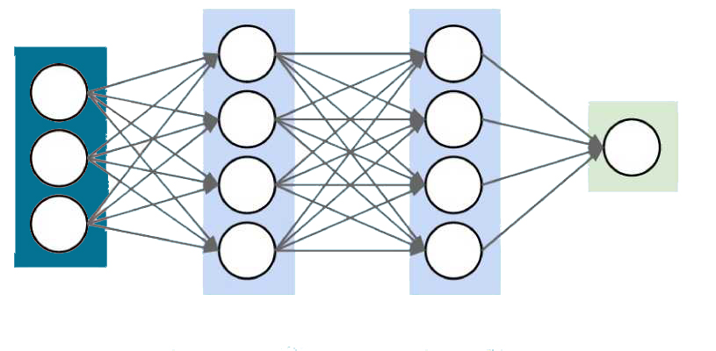

Comparative Machine Learning Models
Artificial Neural Network
$$f(\sum{\left(WX+b\right)})$$
Output layer
Input layer
Hidden layers
Notes:
Feedforward neural network or multilayer perceptron is type of ANN which consist of input layer hidden layer and output layer. For deep neural network we have more than one hidden layer. Direction- weight- backpropagation-optimizer-initial – bias.
Challenge: neurons- layers- optimizer- batch size- learning rate- activation function - epochs – momentum and so on.
We optimize all those parameter by grid search.

Slide 13
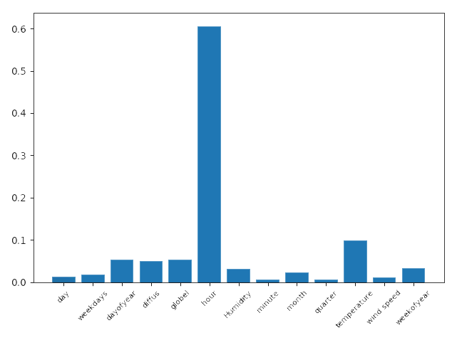
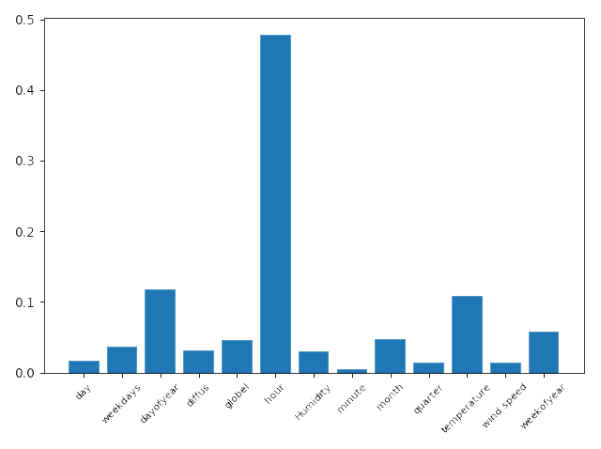
Methodology
Importance of Variables (Variable Selection)
Quads Distribution
Aggregation
Notes:
Methodology (after extract and transfer and load data from the resources) we have to study the importance of variable and their effective to prediction
We have many variables that came form data of power consumption(colander variables) and weather data but in prediction some variable may increase the accuracy of the prediction and other may not. So we check the importance of the variables for the three distribution.
Important of variable can be classified into three categories filter methods(correlation), wrapper(stepwise methods in linear regression.) and embedded(random forest)
We can see that all parameter have the affection but hour and temperature in quads distribution
Actually feather selection play another role speed up the algorithms by get red of unimportant variables and reduce the data

Slide 14
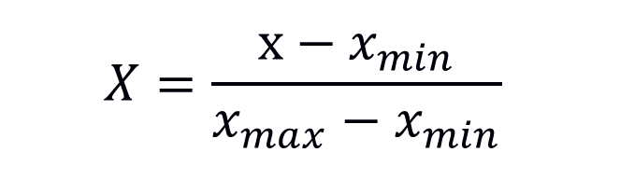
Methodology
Normalizing Data
$$X=\frac{x−x_{min}}{x_{max}−x_{min}}$$
Hyper-parameter tuning for ML (Grid Search)
0.1
0.01
0.001
0.0001
C= [1, 10, 50, 100]
gamma= [0.1, 0.01, 0.001, 0.0001]
1
10
50
n_estimators = [10, 50, 100, 200]
max_depth = [3, 10, 20, 40]
100
Notes:
We normalize the data by the equation above. The data will be in range between 0 and 1. actually some models depends on rescaling the data like the neural network . But some does not such as decision tree.
searching for the ideal model architecture is referred to as hyperparameter tuning. As we described the ML models which depend on many hyperparameters.
There are many methods used but we choose grid search which simply build a model for each possible combination of all of the hyperparameter values provided, evaluating each model, and selecting the architecture which produces the best results.

Slide 15





Methodology
Environment & Implementation

Slide 16
Results and Experiments
RMSE and MAE COMPARISON OF ALGORITHMS IN 3 DISTRIBUTIONS FOR 10 MINUTES POWER CONSUMPTION
Models | Quads Distribution |  |  |  | Smir Distribution |  |  |  | Boussafou Distribution |  |  |  | Aggregated Distribution
 | RMSE |  | MAE |  | RMSE |  | MAE |  | RMSE |  | MAE |  | RMSE |  | MAE
 | Train | Test | Train | Test | Train | Test | Train | Test | Train | Test | Train | Test | Train | Test | Train | Test
RF | 671.7 | 3174.7 | 472.8 | 2663.5 | 214.1 | 2336.9 | 135.6 | 1939.6 | 594.5 | 3227.8 | 420.5 | 2475.9 | 482.3 | 4481.1 | 318.5 | 3595.3
DT | 840.2 | 4613.9 | 550.7 | 3962.3 | 306.7 | 2849.8 | 179.3 | 2396.3 | 611.7 | 3543.7 | 405.9 | 2759.5 | 790.6 | 5957.3 | 490.0 | 4835.5
SVR | 4092.3 | 3898.7 | 3192.3 | 3046.0 | 4205.5 | 5584.3 | 3298.6 | 4680.8 | 3334.4 | 3981.3 | 2671.6 | 3066.6 | 10821.8 | 9647.2 | 8505.6 | 7692.8
FFNN | 2562.2 | 3203.6 | 1945.7 | 2601.2 | 3815.8 | 4877.8 | 2976.9 | 4007.1 | 2731.5 | 3745.6 | 2119.5 | 2965.2 | 6487.6 | 7045.9 | 4985.02 | 5583.9
LR | 4404.2 | 3925.5 | 3522.1 | 3112.2 | 4068.4 | 4949.9 | 3213.4 | 4033.4 | 3142.8 | 5785.7 | 2504.1 | 4647.2 | 10687.4 | 10152.5 | 8450.9 | 8110.3
Notes:
RMSE: Root Mean Square Error
Mean absolute error (MAE)
RMSE & MAE Evaluation use for regression methods.
Why Aggregation?
For comparing subsets.
For deducing reasons why subgroup differ.
To subset data data for analysis.

Slide 17
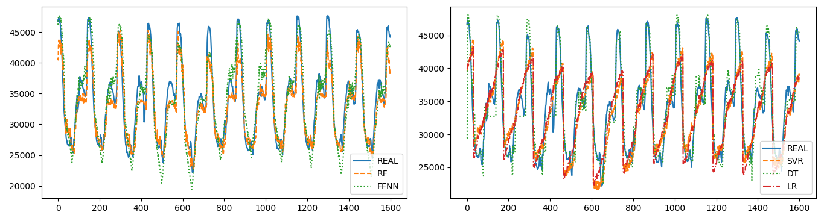
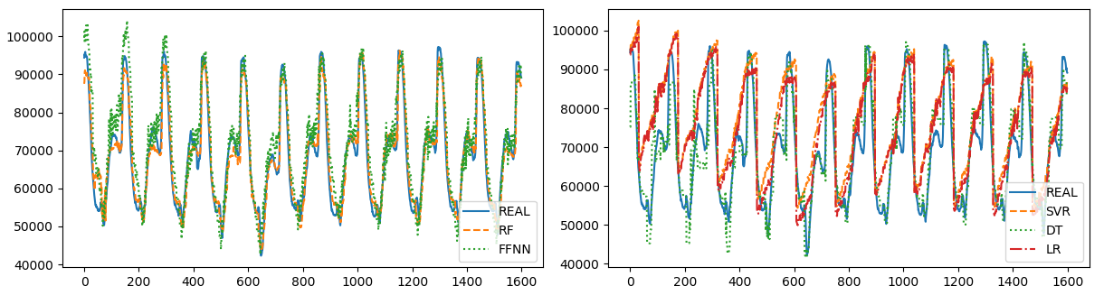
Results and Experiments
Quads Dis
Aggregation

Slide 18
Results and Experiments
RSME and MAE COMPARISON OF ALGORITHMS IN 3 DISTRIBUTIONS FOR HOURLY POWER CONSUMPTION
Model | Quads Distribution |  |  |  | Smir Distribution |  |  |  | Boussafou Distribution |  |  |  | Aggregated Distribution
 | RMSE |  | MAE |  | RMSE |  | MAE |  | RMSE |  | MAE |  | RMSE |  | MAE
 | Train | Test | Train | Test | Train | Test | Train | Test | Train | Test | Train | Test | Train | Test | Train | Test
RF | 3185.8 | 21109.7 | 2286.7 | 15442.0 | 3602.2 | 14700.9 | 2342.3 | 11955.2 | 5669.8 | 19504.1 | 4079.2 | 15777.6 | 4960.9 | 28769.3 | 3493.7 | 24033.3
DT | 8218.56 | 26706.6 | 5879.6 | 23216.4 | 7364.0 | 16301.5 | 4716.7 | 13392.9 | 5766.6 | 20272.6 | 4091.4 | 16332.3 | 7487.5 | 38016.7 | 4724.6 | 30354.9
SVR | 24954.1 | 26746.2 | 19707.4 | 21291.8 | 24094.4 | 29986.9 | 18886.2 | 24206.8 | 19320.6 | 23827.4 | 15435.9 | 18262.8 | 62601.5 | 56235.9 | 49188.3 | 44758.6
FFNN | 19166.6 | 21127.3 | 14511.1 | 15622.3 | 20115.4 | 19845.6 | 15182.1 | 15235.3 | 20679.2 | 21873.3 | 17081.5 | 17161.9 | 46393.3 | 49175.1 | 36238.2 | 38693.8
LR | 25961.7 | 23455.2 | 20798.6 | 18643.9 | 24018.5 | 29528.9 | 18985.4 | 24096.9 | 18528.9 | 34486.8 | 14767.1 | 27776.1 | 62840.1 | 59939.8 | 49712.8 | 47962.1

Slide 19
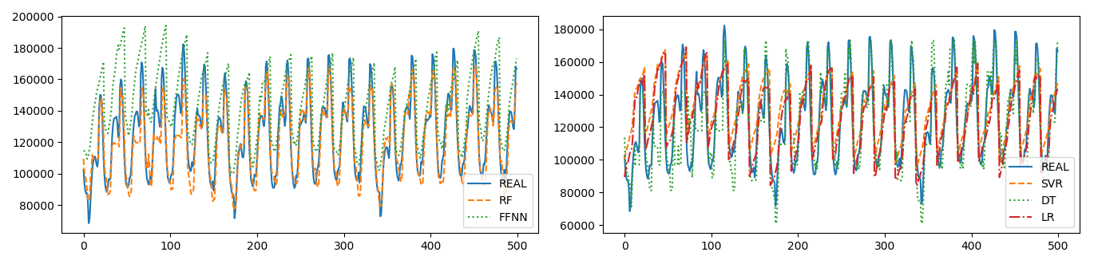
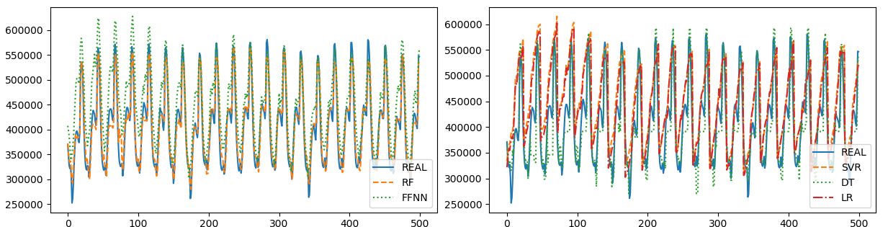
Results and Experiments
Boussafou Dis
Aggregation

Slide 20
Conclusions – Future Works
Studying the power consumption of Tetouan City
Comparing the achievement of the most accurate machine learning models to predict the power consumption
Applying the same study to different Moroccan power suppliers and distribution companies including one’s of renewable energy
Planning to give a financial study and measure the economic impacts
Finding that random forest model outperformed its counterpart in our case study

Slide 21
END
Thank you for listening.

