Slide 1
CCD Cameras with USB2.0 & Gigabit interfaces for the
Pi of The Sky Project
Grzegorz Kasprowicz
Piotr Sitek
PERG
In cooperation with Soltan Institute for Nuclear Studies and CFT PAN dr hab. Grzegorz Wrochna dr hab. Lech Mankiewicz

Slide 2
Plan of presentation
Camera specification
Prototypes (K1,K2)
Gigabit ethernet interface
Final version design (K20) and tests
Ethernet controlled power switch
Next generation of CCD cameras
Summary

Slide 3
Aim of presented work
General : Construction of CCD Cameras set for the Pi of The Sky project
Currently: development and production of K20 camera with gigabit interface

Slide 4
Camera Specification:
Sensor: STA0820 2048x2048 pixels
USB 2.0HS & Ethernet 1000T Interface
Programmable exposure and readout time
(1s-100s)
uC software and FPGA upgrade via USB/Eth
Peltier cooling of CCD
Humidity and temp. measurement inside and outside chamber (CCD, case, ambient )
Build-in mechanical shutter
Focusing motor control

Slide 5
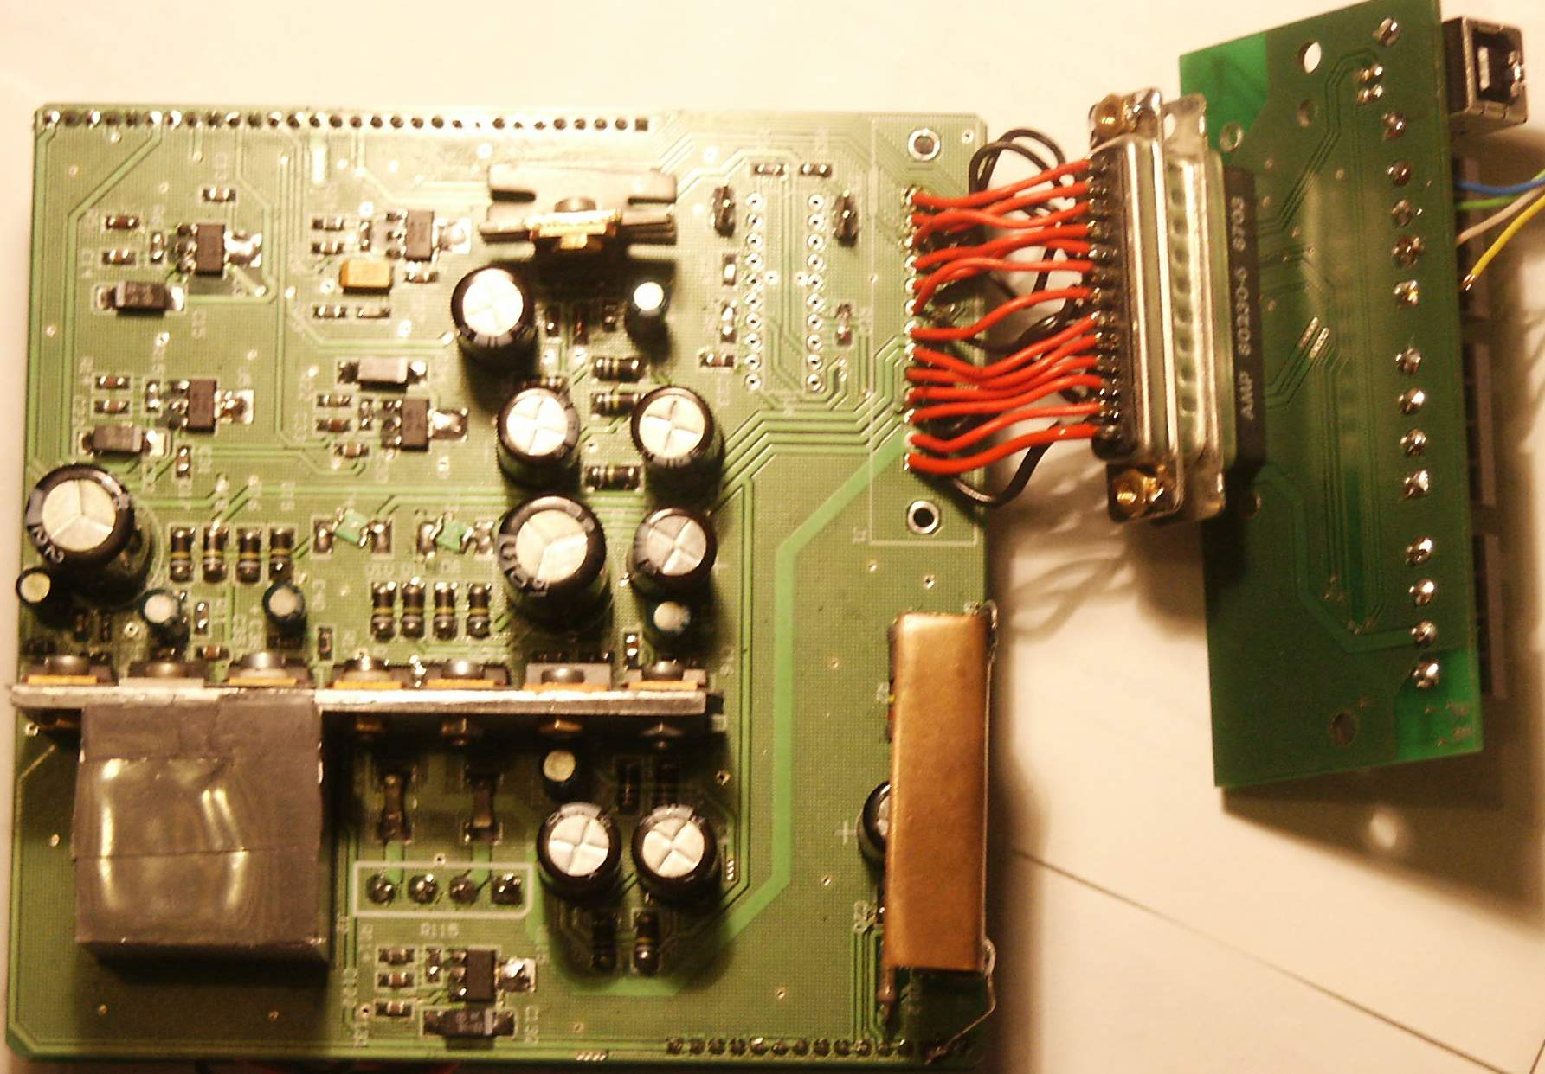
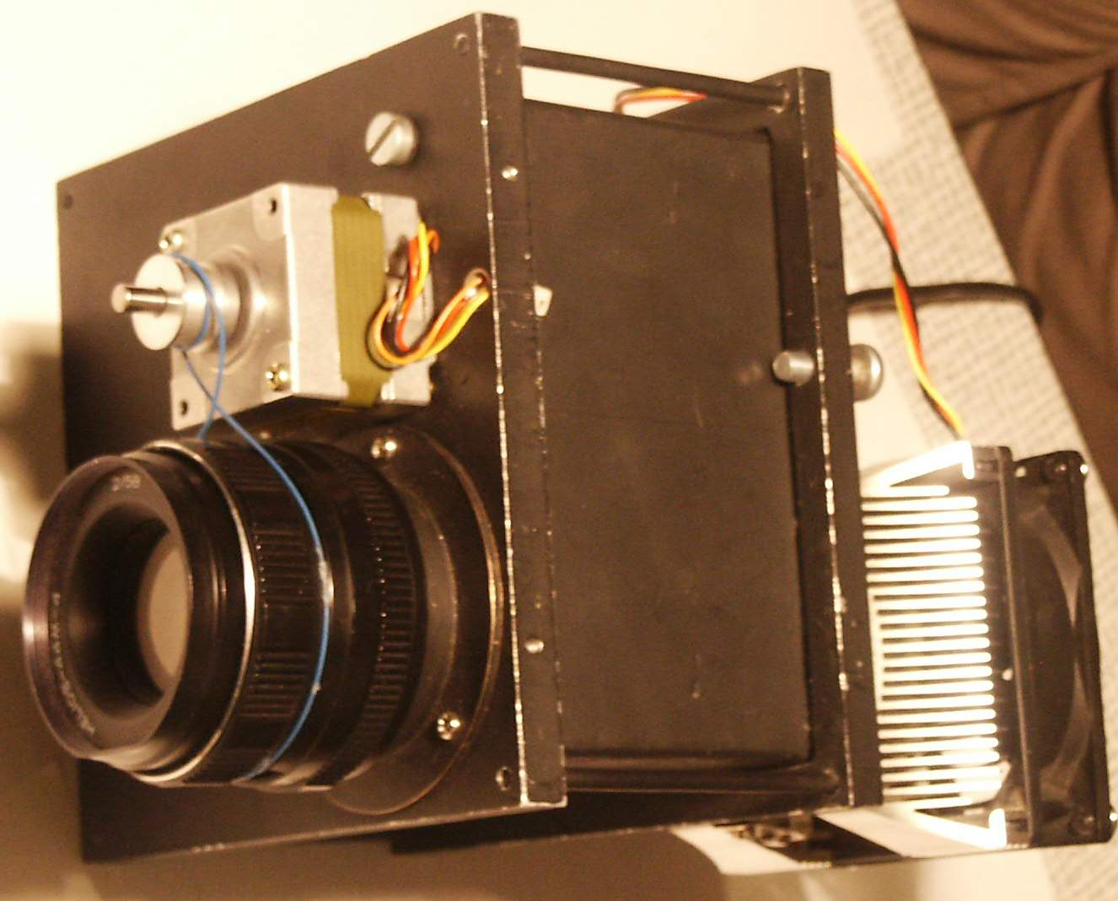
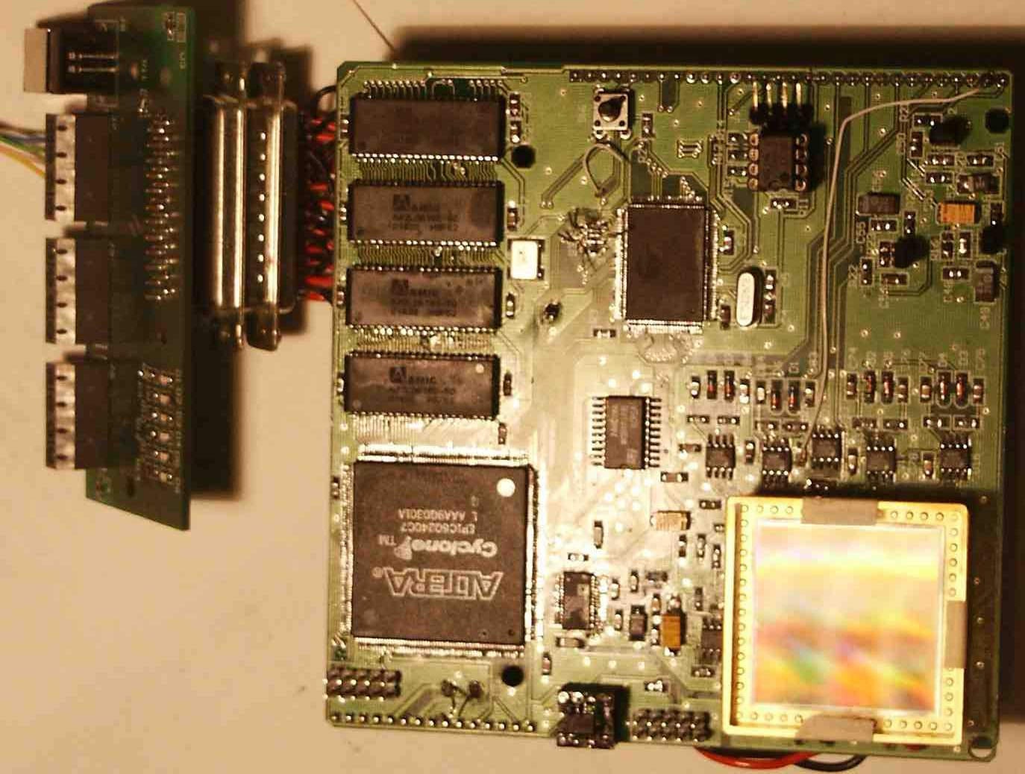
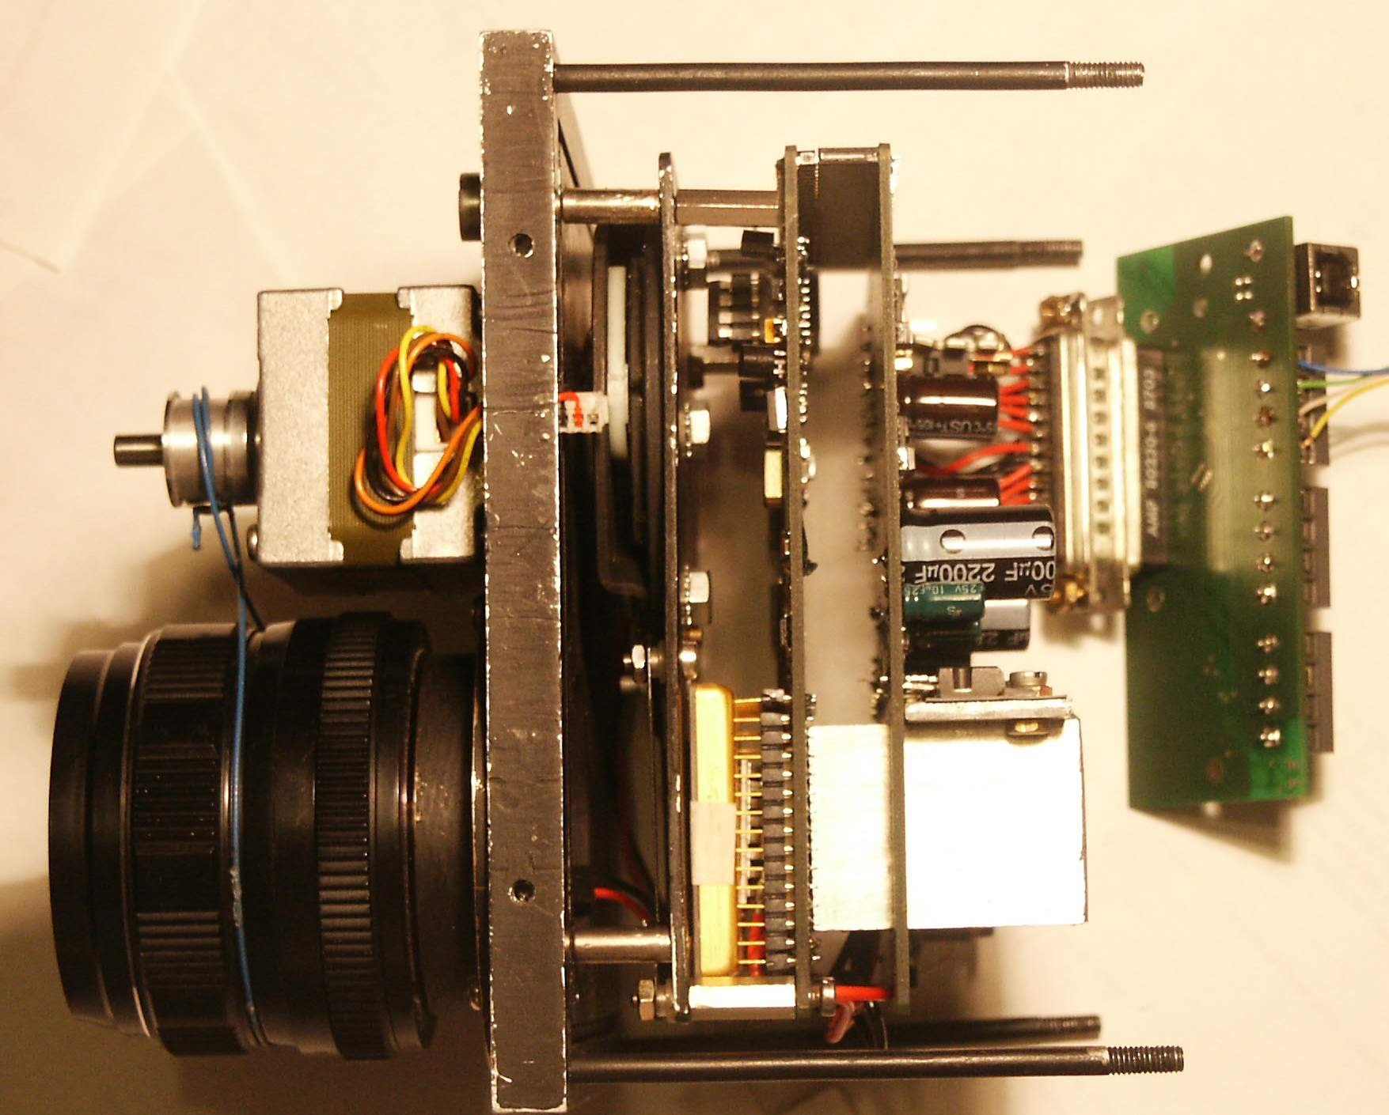
Prototype : K1 (2003)
Power supply board Top view
Main board Side view

Slide 6
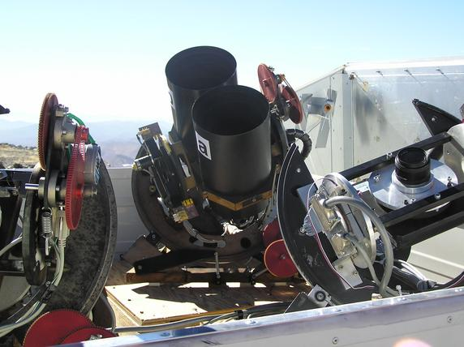
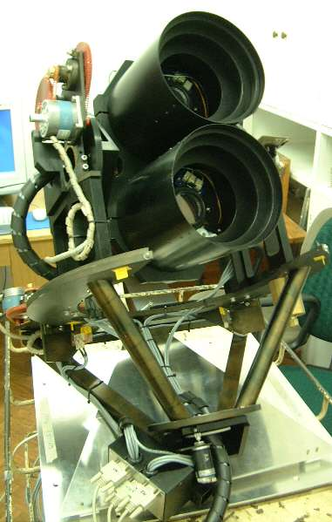
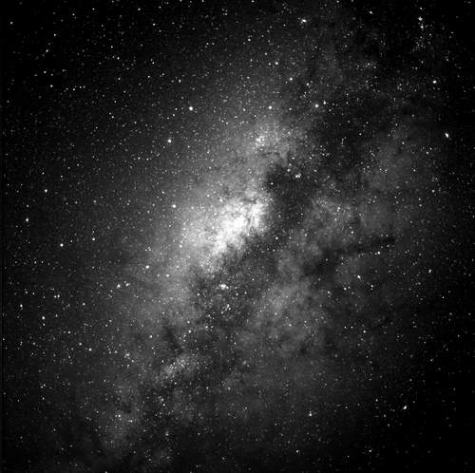
Working K2 cameras (2004)
Installed in Las Campanas in Chile

Slide 7
K2 Camera Status
2 cameras installed in Las Campanas in Chile
work since may 2004 collecting hundreds GB of data
many optical flashes and other variable objects detected
USB2.0 : Too short maximum cable length (5m)
problems with transmission reliability
problems with PC’s redundancy

Slide 8
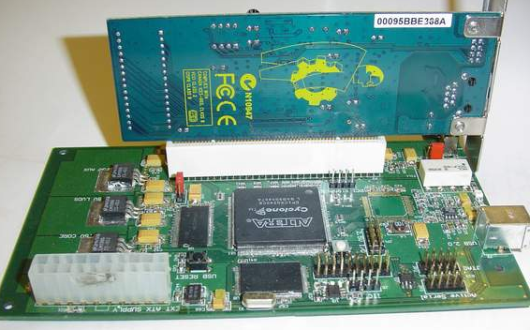
Gigabit Ethernet interface prototype
Gigabit Network adapter
PCI connector
210Ms ADC
LPF
supply
FPGA
SDRAM
ATX power connector
USB connector
USB2.0 interface

Slide 9
Gigabit interface schematic
USB 2.0
Microcontroller
PCI
Gigabit
Ethernet
Interface
Card
PLL
PCI
Master
Registers
1000T
PCI
PCI
Slave
RX/TX
Buffers
SDRAM
DATA
SDRAM
Controller
FIFO
2x 1KB
FPGA
Main
control
CCD DATA

Slide 10
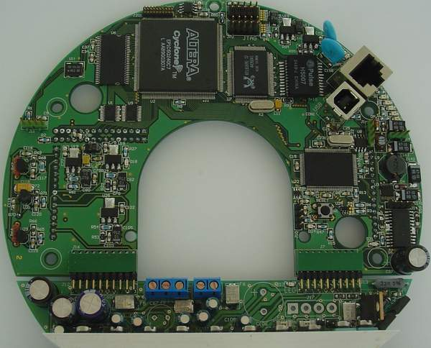
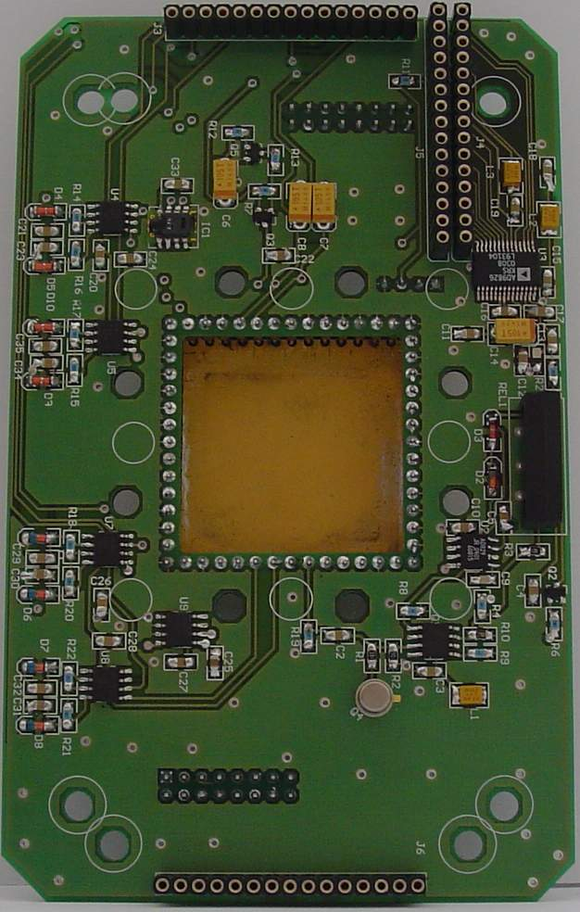
K20 camera prototype with Gigabit Ethernet & USB2.0 HS interface
FPGA
Gigabit
MAC+PHY
Ethernet trafo
SDRAM
CCD drivers
ADC
DC/DC
3.3V
Connectors
USB & Eth
CCD
USB2.0 interface
CCD supply
Motor driver
pre-amplifier
Supply
drivers
Digital & supply board Analog board

Slide 11
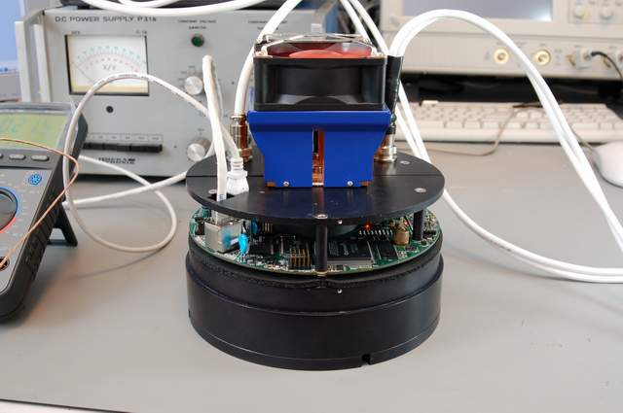
K20 during tests (without lens)

Slide 12
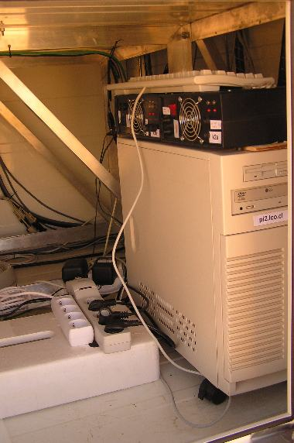
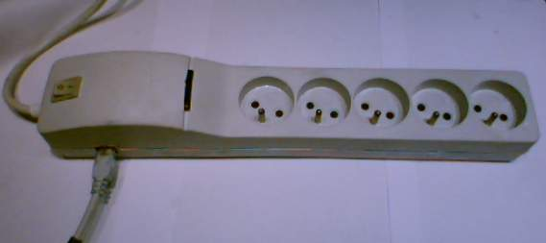
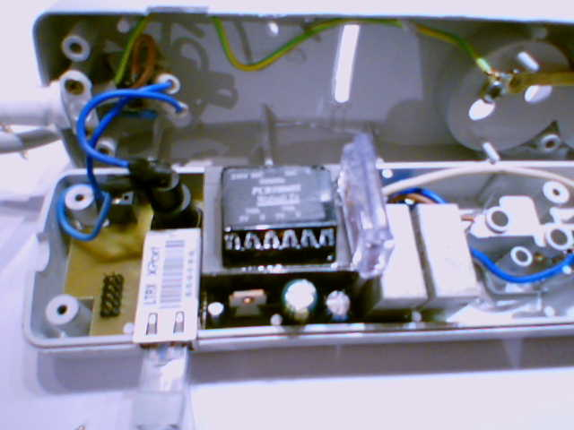
Ethernet controlled power switch
2 switched circuits: 3+2 sockets
TCP/IP/UDP protocol support
128bit encryption
Used in „Pi of the Sky” in case of emergency - hardware reboot of whole system
More functional and cheaper solution based on DM9000A + AVR is under development

Slide 13
Next generation of CCD cameras
NIOS FPGA platform + Gigabit Ethernet as control and communication unit
New analogue signal chain – analogue HS dual slope integrator - further reduction of readout noise
New shutter control circuit – capacitive pickup feedback based PD driver - further enhancement of shutter endurance

Slide 14
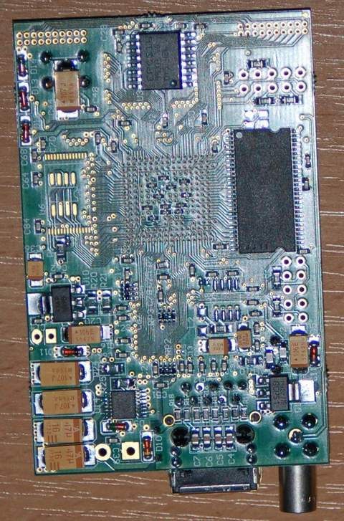
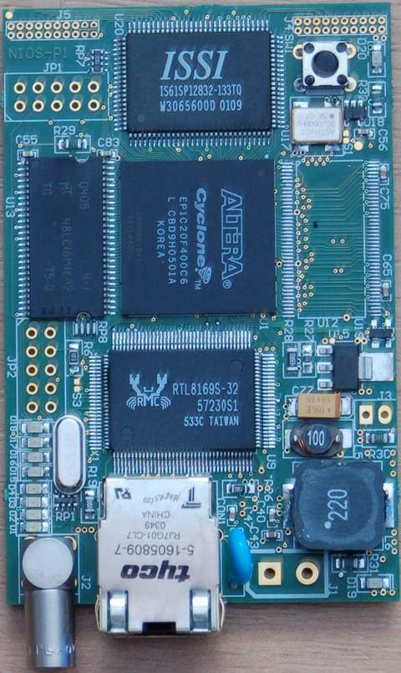
NIOS + Gb Ethernet test board
Serial FLASH (config+boot)
I/Os
SSRAM
SDRAM
SDRAM
Cyclone FPGA
Gigabit MAC+PHY
Core supply
RJ45+trafo
Clock I/O
4 layers PCB
32M+16M x16 SDRAM
4Mx32 SDRAM
32MB boot FLASH
128kx32 pipelined SRAM
Single supply 5..12V
FPGA: 20,000 LE Cyclone
40 x IO lines
RTL8169S PCI 1000T MAC+PHY
DC/DC

Slide 15
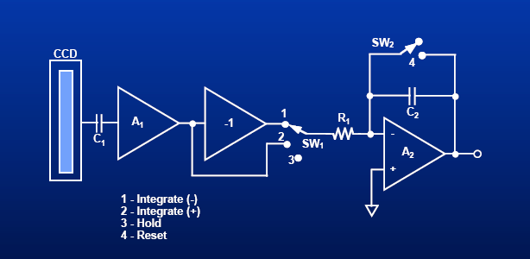
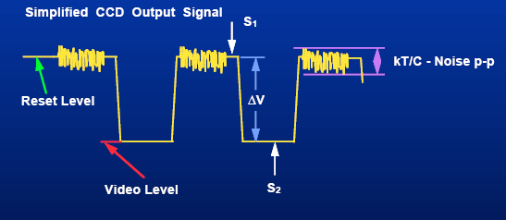
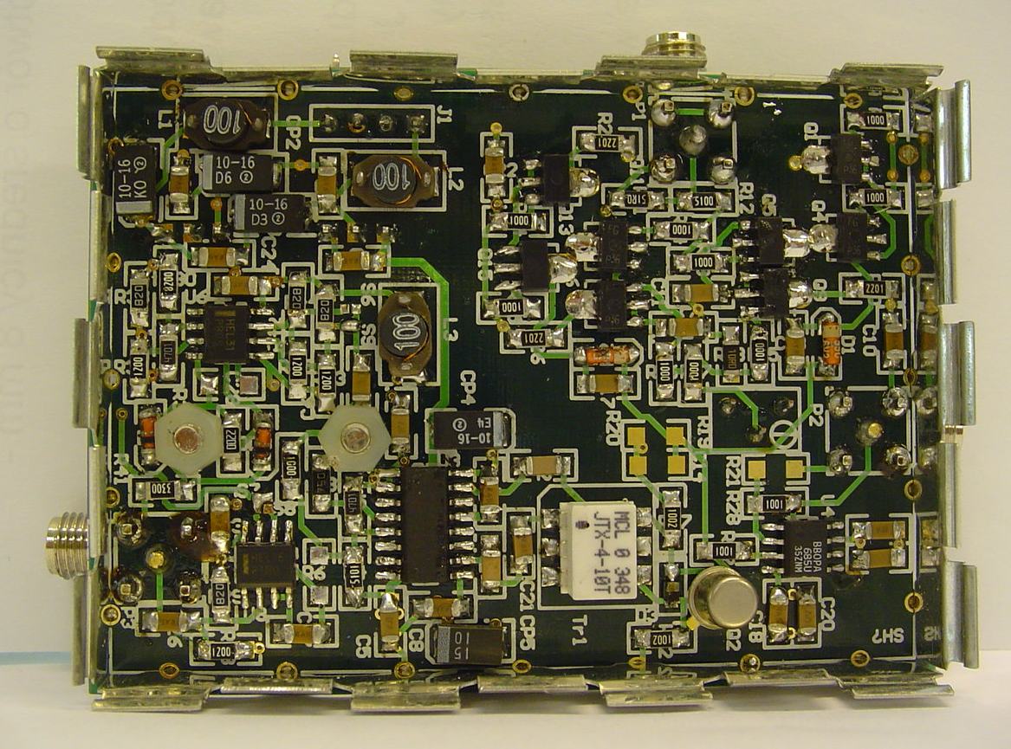
HS analogue dual slope integrator
Analogue integrator prototype
High Speed (Fclk > 40MHz)
Built using discrete components
MOSFET switches with separation
Embedded driver and ECL logics

Slide 16
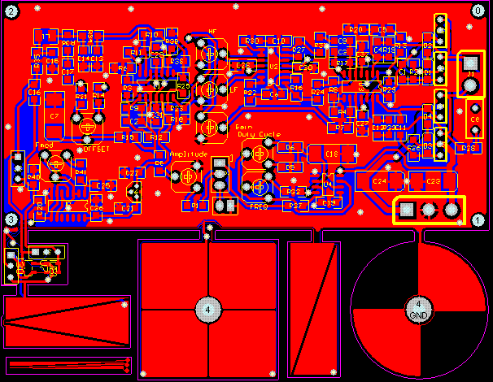
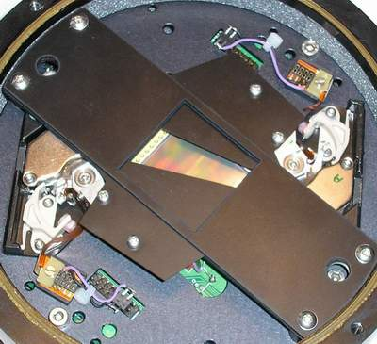
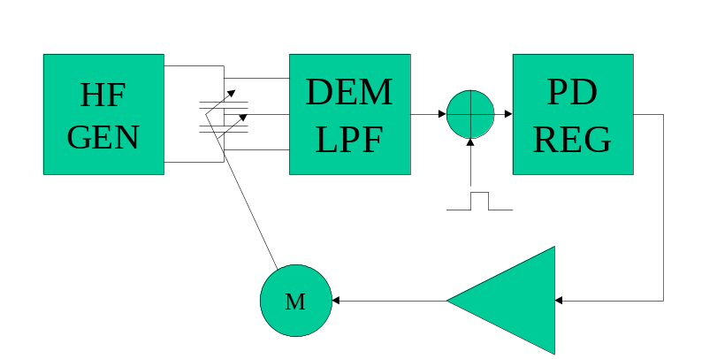
Shutter position control circuit
Controller PCB design
simple capacitive position sensor
non - contact sensor operation
no shutter modifications needed
bumper-less operation
reduced noise and vibrations
longer life-time of mechanism
Capacitive sensor
Regulator block schematic
sensor

Slide 17
Achieved results:
Generally:
Construction and tests of two K2 cameras in LCO
Recently:
Development of K20 camera prototype with Gigabit Ethernet interface
R&D of next generation CCD Cameras
Production and tests of K20 cameras (P.Sitek)

Slide 18
Plans for future:
Readout noise reduction to less than 5..7e-
Design and development of NIOS based platform for multi-CCD camera systems.
New cameras with 60mm diameter for telescope applications
Implementation of over-sampling techniques and “Zero noise CCD” concept

