Slide 1
Design Challenges and Technologies for Embedded Systems
Design challenge of Embedded Systems – optimizing design metrics
Technologies
  Processor technologies
  IC technologies
  Design technologies

Slide 2
Some common characteristics of embedded systems
Single-functioned
  Executes a single program, repeatedly
Tightly-constrained
  Low cost, low power, small, fast, etc.
Reactive and real-time
  Continually reacts to changes in the system’s environment
  Must compute certain results in real-time without delay

Slide 3

An embedded system example -- a digital camera
Digital camera chip
CCD
CCD preprocessor
Pixel coprocessor
D2A
A2D
lens
JPEG codec
Microcontroller
Multiplier/Accum
DMA controller
Display ctrl
Memory controller
ISA bus interface
UART
LCD ctrl
Single-functioned -- always a digital camera
Tightly-constrained -- Low cost, low power, small, fast
Reactive and real-time -- only to a small extent

Slide 4
Design challenge – optimizing design metrics
Obvious design goal:
  Construct an implementation with desired functionality
Key design challenge:
  Simultaneously optimize numerous design metrics
Design metric
  A measurable feature of a system’s implementation
  Optimizing design metrics is a key challenge

Slide 5
Design challenge – optimizing design metrics
Common metrics
  Unit cost: the monetary cost of manufacturing each copy of the system, excluding NRE cost
  NRE cost (Non-Recurring Engineering cost): The one-time monetary cost of designing the system
  Size: the physical space required by the system
  Performance: the execution time or throughput of the system
  Power: the amount of power consumed by the system
  Flexibility: the ability to change the functionality of the system without incurring heavy NRE cost

Slide 6
Design challenge – optimizing design metrics
Common metrics (continued)
  Time-to-prototype: the time needed to build a working version of the system
  Time-to-market: the time required to develop a system to the point that it can be released and sold to customers
  Maintainability: the ability to modify the system after its initial release
  Correctness,
  Safety,
  Testability,
  Manufacturability,
  many more

Slide 7
Design metric competition -- improving one may worsen others
Expertise with both software and hardware is needed to optimize design metrics
  Not just a hardware or software expert, as is common
  A designer must be comfortable with various technologies in order to choose the best for a given application and constraints
Power
Performance
Size
NRE cost
CCD
Digital camera chip
A2D
CCD preprocessor
Pixel coprocessor
D2A
lens
JPEG codec
Microcontroller
Multiplier/Accum
DMA controller
Display ctrl
Hardware
Software
Memory controller
ISA bus interface
UART
LCD ctrl

Slide 8
Time-to-market: a demanding design metric
Time required to develop a product to the point it can be sold to customers
Market window
  Period during which the product would have highest sales
Average time-to-market constraint is about 8 months
Delays can be costly
Revenues ($)
Time (months)

Slide 9
Losses due to delayed market entry
Simplified revenue model
  Product life = 2W, peak at W
  Time of market entry defines a triangle, representing market penetration
  Triangle area equals revenue
Loss
  The difference between the on-time and delayed triangle areas
Peak revenue
Peak revenue from delayed entry
Revenues ($)
On-time
Market rise
Market fall
Delayed
D
W
2W
On-time Delayed
entry entry
Time

Slide 10
Losses due to delayed market entry (cont.)
Area = 1/2 * base * height
  On-time = 1/2 * 2W * W
  Delayed = 1/2 * (W-D+W)*(W-D)
Percentage revenue loss = (D(3W-D)/2W²)*100%
Try some examples
Peak revenue
Peak revenue from delayed entry
Revenues ($)
On-time
Market rise
Market fall
Delayed
  Lifetime 2W=52 wks, delay D=4 wks
  (4*(3*26 –4)/2*26^2) = 22%
  Lifetime 2W=52 wks, delay D=10 wks
  (10*(3*26 –10)/2*26^2) = 50%
  Delays are costly!
D
W
2W
On-time Delayed
entry entry
Time

Slide 11
NRE and unit cost metrics
Costs:
  Unit cost: the monetary cost of manufacturing each copy of the system, excluding NRE cost
  NRE cost (Non-Recurring Engineering cost): The one-time monetary cost of designing the system
  total cost = NRE cost + unit cost * # of units
  per-product cost = total cost / # of units
  = (NRE cost / # of units) + unit cost
Example
  NRE=$2000, unit=$100
  For 10 units
    total cost = $2000 + 10*$100 = $3000
    per-product cost = $2000/10 + $100 = $300
Amortizing NRE cost over the units results in an additional $200 per unit

Slide 12
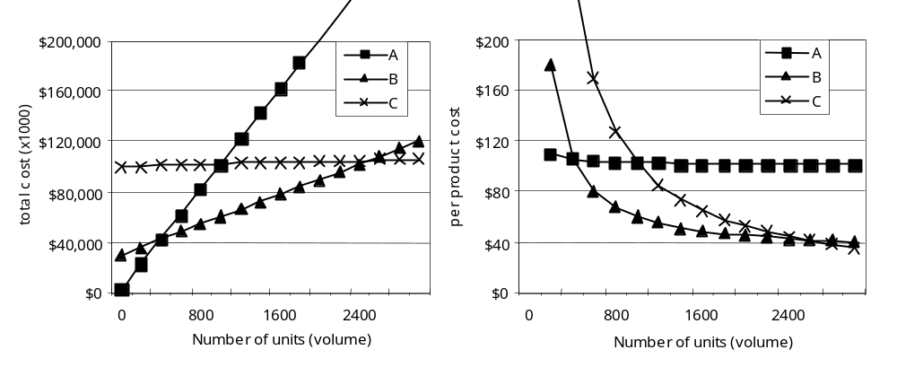
NRE and unit cost metrics
Compare technologies by costs -- best depends on quantity
  Technology A: NRE=$2,000, unit=$100
  Technology B: NRE=$30,000, unit=$30
  Technology C: NRE=$100,000, unit=$2
But, must also consider time-to-market

Slide 13
The performance design metric
Widely-used measure of system, widely-abused
  Clock frequency, instructions per second – not good measures
  Digital camera example – a user cares about how fast it processes images, not clock speed or instructions per second
Latency (response time)
  Time between task start and end
  e.g., Camera’s A and B process images in 0.25 seconds
Throughput
  Tasks per second, e.g. Camera A processes 4 images per second
  Throughput can be more than latency seems to imply due to concurrency, e.g. Camera B may process 8 images per second (by capturing a new image while previous image is being stored).
Speedup of B over S = B’s performance / A’s performance
  Throughput speedup = 8/4 = 2

Slide 14
Three key embedded system technologies
What is “Technology”?
  A manner of accomplishing a task, especially using technical processes, methods, or knowledge
Three key technologies for embedded systems
  Processor technology
  IC technology
  Design technology

Slide 15
Processor technology
Processor is the architecture of the computation engine used to implement a system’s desired functionality
Processor does not have to be programmable
  “Processor” not equal to general-purpose processor
Controller
Datapath
Controller
Datapath
Controller
Datapath
Control
logic and State register
Register
file
Control logic and State register
Registers
Control
logic
index
total
Custom
ALU
State register
+
General
ALU
IR
PC
IR
PC
Data
memory
Data
memory
Program memory
Data
memory
Program memory
Assembly code for:
total = 0
for i =1 to …
Assembly code for:
total = 0
for i =1 to …
General-purpose (“software”)
Application-specific
Single-purpose (“hardware”)

Slide 16
Processor technology
Processors vary in their customization for the problem at hand
total = 0
for i = 1 to N loop
total += M[i]
end loop
Desired functionality
General-purpose processor
Application-specific processor
Single-purpose processor

Slide 17
General-purpose processors
Programmable device used in a variety of applications
  Also known as “microprocessor”
Features
  Program memory
  General datapath with large register file and general ALU
User benefits
  Low time-to-market and NRE costs
  High flexibility
“Pentium” the most well-known, but there are hundreds of others
Controller
Datapath
Control
logic and State register
Register
file
General
ALU
IR
PC
Program memory
Data
memory
Assembly code for:
total = 0
for i =1 to …

Slide 18
Single-purpose processors
Digital circuit designed to execute exactly one program
  a.k.a. coprocessor, accelerator or peripheral
Features
  Contains only the components needed to execute a single program
  No program memory
Benefits
  Fast
  Low power
  Small size
Controller
Datapath
Control logic
index
total
State register
+
Data
memory

Slide 19
Application-specific processors
Programmable processor optimized for a particular class of applications having common characteristics
  Compromise between general-purpose and single-purpose processors
Features
  Program memory
  Optimized datapath
  Special functional units
Benefits
  Some flexibility, good performance, size and power
Controller
Datapath
Control
logic and State register
Registers
Custom
ALU
IR
PC
Data
memory
Program memory
Assembly code for:
total = 0
for i =1 to …

Slide 20
IC technology
The manner in which a digital (gate-level) implementation is mapped onto an IC
  IC: Integrated circuit, or “chip”
  IC technologies differ in their customization to a design
  IC’s consist of numerous layers (perhaps 10 or more)
    IC technologies differ with respect to who builds each layer and when
gate
IC package
IC
oxide
source
channel
drain
Silicon substrate

Slide 21
IC technology
Three types of IC technologies
  Full-custom/VLSI
  Semi-custom ASIC (gate array and standard cell)
  PLD (Programmable Logic Device)
Here PLD is a generic name that includes FPGAs, FPAAs, etc

Slide 22
Full-custom/VLSI
All layers are optimized for an embedded system’s particular digital implementation
  Placing transistors
  Sizing transistors
  Routing wires
Benefits
  Excellent performance, small size, low power
Drawbacks
  High NRE cost (e.g., $300k), long time-to-market

Slide 23
Semi-custom
Lower layers are fully or partially built
  Designers are left with routing of wires and maybe placing some blocks
Benefits
  Good performance, good size, less NRE cost than a full-custom implementation (perhaps $10k to $100k)
Drawbacks
  Still require weeks to months to develop

Slide 24
PLD (Programmable Logic Device)
All layers already exist
  Designers can purchase an IC
  Connections on the IC are either created or destroyed to implement desired functionality
  Field-Programmable Gate Array (FPGA) very popular
Benefits
  Low NRE costs, almost instant IC availability
Drawbacks
  Bigger, expensive (perhaps $30 per unit), power hungry, slower

Slide 25
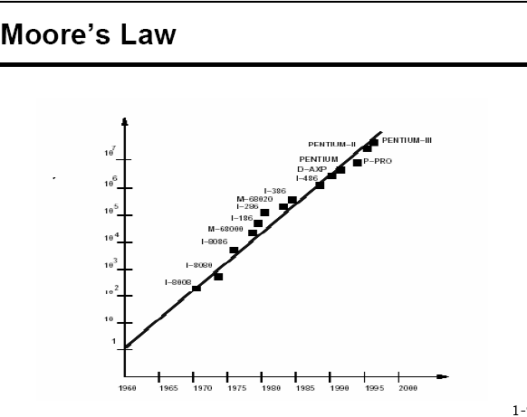
Moore’s law

Slide 26
Moore’s law
Moore’s law
The most important trend in embedded systems
  Predicted in 1965 by Intel co-founder Gordon Moore
  IC transistor capacity has doubled roughly every 18 months for the past several decades
10,000
1,000
Logic transistors per chip
(in millions)
100
10
1
Note: logarithmic scale
0.1
0.01
0.001
1981
1983
1985
1987
1989
1991
1993
1995
1997
1999
2001
2003
2005
2007
2009

Slide 27
Moore’s law
Wow
  This growth rate is hard to imagine, most people underestimate
  How many ancestors do you have from 20 generations ago
    i.e., roughly how many people alive in the 1500’s did it take to make you?
    2²⁰ ⁼ more than 1 million people
  (This underestimation is the key to pyramid schemes!)

Slide 28
Graphical illustration of Moore’s law
1981
1984
1987
1990
1993
1996
1999
2002
10,000
transistors
150,000,000
transistors
Leading edge
chip in 1981
Leading edge
chip in 2002
Something that doubles frequently grows more quickly than most people realize!
  A 2002 chip can hold about 15,000 1981 chips inside itself

Slide 29
Design Technology
The manner in which we convert our concept of desired system functionality into an implementation
Compilation/
Synthesis
Libraries/
IP
Test/
Verification
System
specification
System
synthesis
Hw/Sw/
OS
Model simulat./
checkers
Compilation/Synthesis: Automates exploration and insertion of implementation details for lower level.
Behavioral
specification
Behavior
synthesis
Cores
Hw-Sw
cosimulators
Libraries/IP: Incorporates pre-designed implementation from lower abstraction level into higher level.
RT
specification
RT
synthesis
RT
components
HDL simulators
Test/Verification: Ensures correct functionality at each level, thus reducing costly iterations between levels.
Logic
specification
Logic
synthesis
Gates/
Cells
Gate
simulators
To final implementation

Slide 30
Design productivity exponential increase
100,000
10,000
1,000
100
Productivity
(K) Trans./Staff – Mo.
10
1
0.1
0.01
1981
1983
1985
1987
1989
1991
1993
1995
1997
1999
2001
2003
2005
2007
2009
Exponential increase over the past few decades

Slide 31
The co-design ladder
In the past:
  Hardware and software design technologies were very different
  Recent maturation of synthesis enables a unified view of hardware and software
Hardware/software “codesign”
Sequential program code (e.g., C, VHDL)
Compilers
(1960's,1970's)
Behavioral synthesis
(1990's)
Register transfers
Assembly instructions
RT synthesis
(1980's, 1990's)
Assemblers, linkers
(1950's, 1960's)
Logic equations / FSM's
Logic synthesis
(1970's, 1980's)
Machine instructions
Logic gates
Implementation
Microprocessor plus program bits: “software”
VLSI, ASIC, or PLD implementation: “hardware”
The choice of hardware versus software for a particular function is simply a tradeoff among various design metrics, like performance, power, size, NRE cost, and especially flexibility; there is no fundamental difference between what hardware or software can implement.

Slide 32
Independence of processor and IC technologies
Basic tradeoff
  General vs. custom
  With respect to processor technology or IC technology
  The two technologies are independent
General-purpose
processor
ASIP
Single-
purpose
processor
General,
providing improved:
Customized,
providing improved:
Flexibility
Maintainability
NRE cost
Time- to-prototype
Time-to-market
Cost (low volume)
Power efficiency
Performance
Size
Cost (high volume)
PLD
Semi-custom
Full-custom

Slide 33
Design productivity gap
While designer productivity has grown at an impressive rate over the past decades, the rate of improvement has not kept pace with chip capacity
10,000
100,000
1,000
10,000
Logic transistors per chip
(in millions)
100
1000
10
Gap
Productivity
(K) Trans./Staff-Mo.
IC capacity
100
1
10
0.1
1
0.01
productivity
0.1
0.001
0.01
1981
1983
1985
1987
1989
1991
1993
1995
1997
1999
2001
2003
2005
2007
2009

Slide 34
Design productivity gap
1981 leading edge chip required 100 designer months
  10,000 transistors / 100 transistors/month
2002 leading edge chip requires 30,000 designer months
  150,000,000 / 5000 transistors/month
Designer cost increase from $1M to $300M
10,000
100,000
1,000
10,000
Logic transistors per chip
(in millions)
100
1000
10
Gap
Productivity
(K) Trans./Staff-Mo.
IC capacity
100
1
10
0.1
productivity
1
0.01
0.1
0.001
0.01
1981
1983
1985
1987
1989
1991
1993
1995
1997
1999
2001
2003
2005
2007
2009

Slide 35
The mythical man-month
The situation is even worse than the productivity gap indicates
In theory, adding designers to team reduces project completion time
In reality, productivity per designer decreases due to complexities of team management and communication
In the software community, known as “the mythical man-month” (Brooks 1975)
At some point, can actually lengthen project completion time! (“Too many cooks”)
15
Team
1M transistors, 1 designer=5000 trans/month
Each additional designer reduces for 100 trans/month
So 2 designers produce 4900 trans/month each
60000
16
16
50000
19
18
40000
24
23
30000
Months until completion
20000
43
10000
Individual
0
10
20
30
40
Number of designers

Slide 36
Microelectronic Circuits
General-purpose processors:
  High-volume sales.
  High performance.
Application-Specific Integrated Circuits (ASICs):
  Varying volumes and performances.
  Large market share.
Prototypes.
Special applications (e.g. space).

Slide 37
Microelectronics Design Styles
Adapt circuit design style to market requirements
Parameters:
  Cost.
  Performance.
  Volume.
Full custom
  Maximal freedom
  High performance blocks
  Slow
Semi-custom
  Standard Cells
  Gate Arrays
  Mask Programmable (MPGAs)
  Field Programmable (FPGAs)) • Silicon Compilers & Parametrizable Modules (adder, multiplier,
  memories)

Slide 38
Standard Cells
  Cell library:
    Cells are designed once.
    Cells are highly optimized.
  Layout style:
    Cells are placed in rows.
    Channels are used for wiring.
    Over the cell routing.
  Compatible with macro-cells (e.g. RAMs).
Macro-cells
  Module generators:
    Synthesized layout.
    Variable area and aspect-ratio.
  Examples:
    RAMs, ROMs, PLAs, general logic blocks.
  Features:
    Layout can be highly optimized.
    Structured-custom design.

Slide 39
Array-based design
Pre-diffused arrays:
  Personalization by metalization/contacts.
  Mask-Programmable Gate-Arrays.
Pre-wired arrays:
  Personalization on the field.
  Field-Programmable Gate-Arrays.
MPGAs & FPGAs
MPGAs:
  Array of sites:
  Each site is a set of transistors. • Batches of wafers can be pre-fabricated.
  Few masks to personalize chip.
  Lower cost than cell-based design.
FPGAs:
  Array of cells:
  Each cell performs a logic function. • Personalization:
  Soft: memory cell (e.g. Xilinx).
  Hard: Anti-fuse (e.g. Actel). • Immediate turn-around (for low volumes).
  Inferior performances and density.
  Good for prototyping.

Slide 40
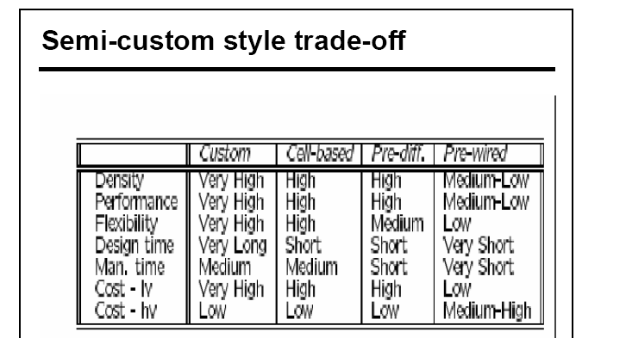
Semi-custom style trade-off

Slide 41
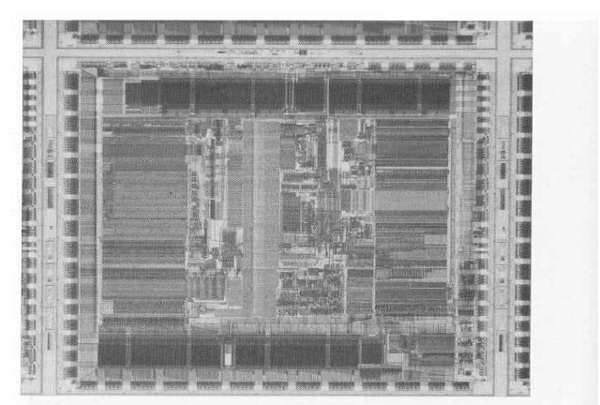
Example: DEC AXP Chip designed using Macro Cells

Slide 42
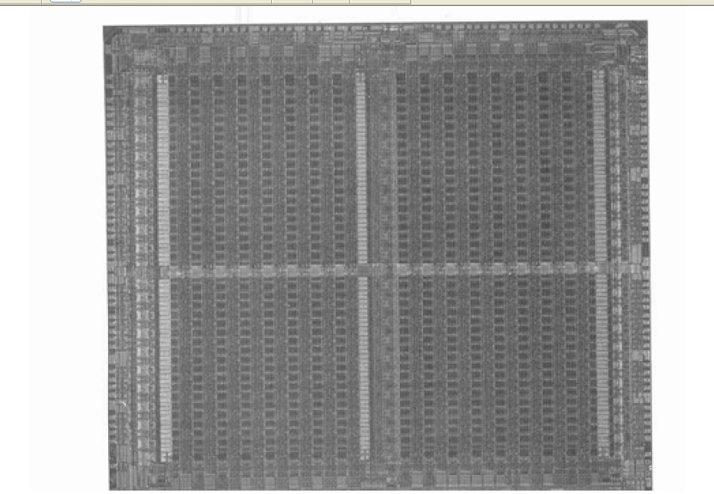
Example: Field Programmable Gate Array from Actel

Slide 43
Summary
Embedded systems are everywhere
Key challenge: optimization of design metrics
  Design metrics compete with one another
A unified view of hardware and software is necessary to improve productivity
Three key technologies
  Processor: general-purpose, application-specific, single-purpose
  IC: Full-custom, semi-custom, PLD
  Design: Compilation/synthesis, libraries/IP, test/verification

Slide 44
Sources of Slides
Vahid Givargis
Dr. Aiman H. El-Maleh
Computer Engineering Department
King Fahd University of Petroleum & Minerals
Embedded Systems Design: A Unified Hardware/Software Introduction, (c) 2000 Vahid/Givargis

