Slide 1
Comparing FPGA vs. Custom CMOS and the Impact on Processor Microarchitecture
Henry Wong
Vaughn Betz, Jonathan Rose

Slide 2
Processor Microarchitecture
Microarchitecture: How to arrange circuits to make a processor
Depends on how efficient the circuits are
Which depends on the substrate
  Custom CMOS
  Standard Cell
  FPGA

Slide 3
Goals
Make good microarchitecture design choices for bigger and faster FPGA soft processors
Much existing literature on processor design for custom CMOS implementation
  Comparisons of overall area/delay between substrates exist
  But relative building block costs vary up to two orders of magnitude on FPGA vs. Custom CMOS
This work: compares building blocks and infer microarchitectural conclusions
  Also applicable to circuits other than processors

Slide 4
What we're measuring
Focus on processors as the complete circuit
  FPGA vs. Custom: Synthesize RTL for FGPA
Compare building block circuits that are often used in processors
  SRAM, CAM, Multiplier, Adder, …
Infer how existing microarchitectures should be modified for FPGA

Slide 5
Methodology
FPGA circuits synthesized through Quartus II 10.0
  Largest, fast speed grade, 65 nm Stratix III (3LS340)
  Area calculated from FPGA tile areas
  A few results are from literature
Custom CMOS design examples found in literature
  High-performance circuit design and layout are difficult and time consuming
  Normalize to 65 nm: Ideal area scaling and ring oscillator delay scaling

Slide 6
Metrics
Area
  Still a key design constraint on FPGAs
Delay
Power or energy: Not considered here
  Data not often published and testing conditions not standard.
  FPGA users mostly spared responsibility for not melting the chip.

Slide 7
1. Processor Core Comparison
Complete circuit serves as a reference point for sub-circuit measurements later

Slide 8
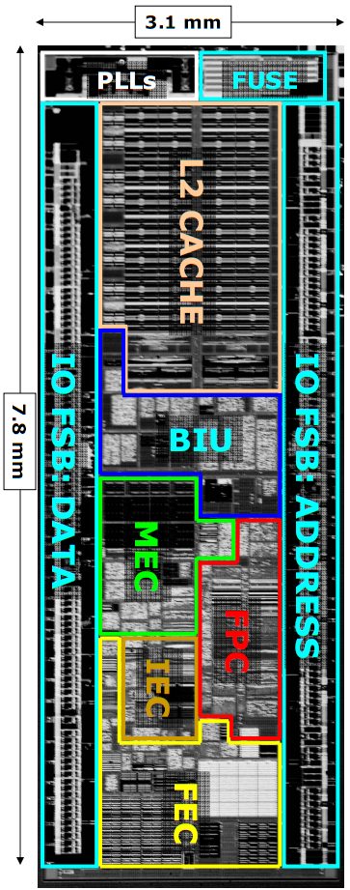
Processor Core Comparison
SPARC T1 and T2, Intel Atom and Nehalem
  Compare CMOS to FPGA implementations
  Compare just one core, excludes large caches
FPGA implementation used RTL optimized from the custom CMOS implementation
  Atom and Nehalem results cited from literature

Slide 9
Processor Cores: Area
 | Custom Area (mm²) | FPGA Area (mm²) | Area Ratio
SPARC T1 | 6.0 | 100 | 17
SPARC T2 | 11.7 | 294 | 25
Intel Atom | 12.8 | 350 | 27
Intel Nehalem | 51 | 1240 | 24
Geometric Mean |  |  | 23
Area ratio: FPGA/Custom area
  17-27x (Geomean 23x)

Slide 10
Processor Cores: Speed
 | Custom fmax (MHz) | FPGA fmax (MHz) | Speed Ratio
SPARC T1 | 1800 | 79 | 23
SPARC T2 | 1600 | 88 | 18
Intel Atom | >1300 | 50 | 26
Intel Nehalem | 3000 | 0.52 | -
Geometric Mean |  |  | 22
Speed ratio: Custom/FPGA fmax
  18-26x (Geomean 22x)

Slide 11
2. Building Block Comparisons
Compare area and delay
Will go through one example on SRAMs

Slide 12
Single-Port SRAM
Custom: A few design examples from literature and data from the CACTI area and delay models
FPGA: Four ways to build memory on Stratix III
  M144K (2k x 72-bit)
  M9K (256 x 36-bit)
  MLAB (32 x 20-bit)
  Registers and muxes
Used (n x 32-bit) memories in this section

Slide 13
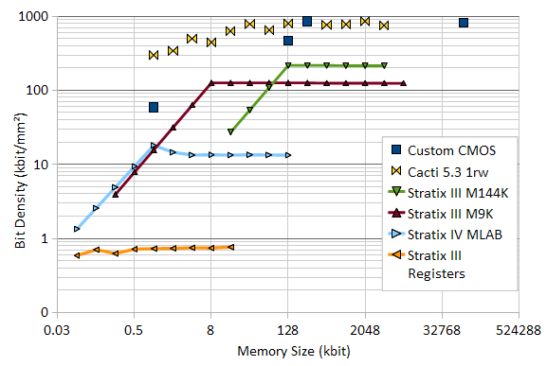
Single-Port SRAM Density
2-5x
Hard SRAM blocks save area
Single-port density ratio: 2-5x (compare to 23x)
  Partly due to FPGA's dual-ported memory blocks

Slide 14
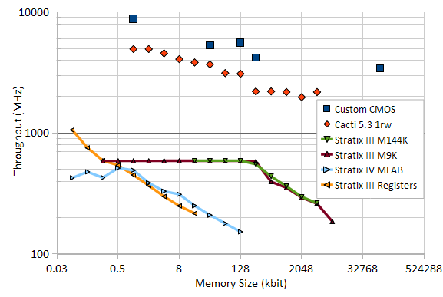
Single-Port SRAM Fmax
7-10x
SRAMs 7-10x ratio for < 256 kbit (compare to 22x)
Big arrays: stitching small blocks adds more delay

Slide 15
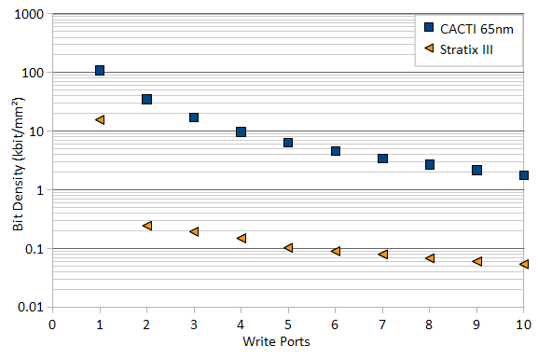
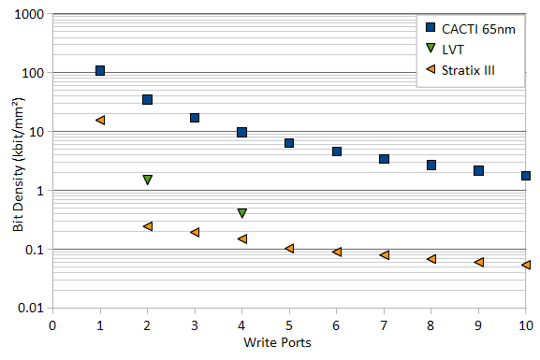
Multiported SRAM Density (2kb)
7x: Replicate RAM twice for 2r1w
143x: Registers and muxes for 4r2w
23x: Replicate RAM 8x for 4r2w
Density ratio: 7x for 2r1w, more write ports worse
Fmax ratio is 9x-15x for 2r1w through 20r10w

Slide 16
Summary: Building Blocks
Lower ratios are better for FPGA
 | Area Ratio | Delay Ratio
Processor Cores | 17 - 27 | 18 - 26
SRAM single port (1rw) | 2 - 5 | 7 - 10
SRAM 4r2w LVT 4r2w | 143 23 | 13 10
CAM | 100 - 210 | 14
Multiplexer | >100 | 20 - 75
Multiplier | 4.5 - 7.0 | 17 - 22
Adder | 4.5 - 7.0 | 15 - 20
Pipeline Latch |  | 12 - 19
Routing |  | 9 - 20
Off-Chip Memory |  | 1.3 - 2

Slide 17
Building Blocks
Area dominates the differences between block types
Multiplexers are slow
SRAM bits are cheap
  Multiported memories are expensive
CAMs and muxes are expensive
Hard adders/multipliers save area, but aren't fast
Pipeline latches slightly faster
These costs affect microarchitecture choices...

Slide 18
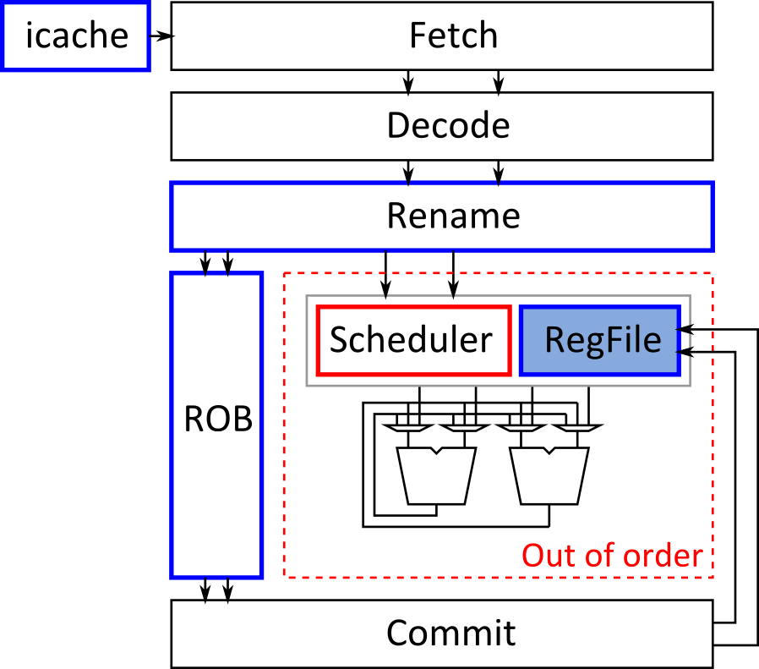
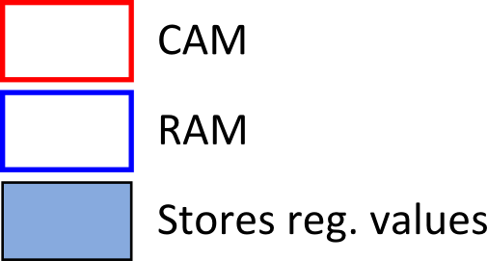
3. Processor Microarchitecture
Multiported RAM
CAM
Multiplexers

Slide 19
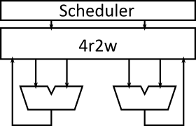
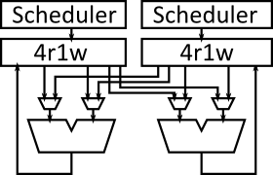
SRAM Ports: Clustered RF
Choose architecture to minimize register file ports
  Clustered register files: One write port per cluster

Slide 20
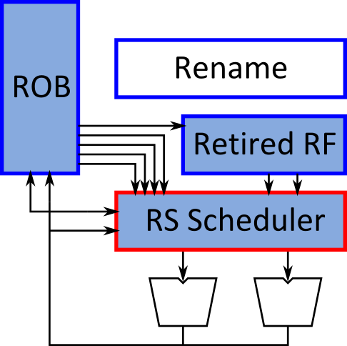
Scheduler CAM: Intel P6
P6 to Nehalem
Values stored in three places
RS is a CAM that stores values

Slide 21
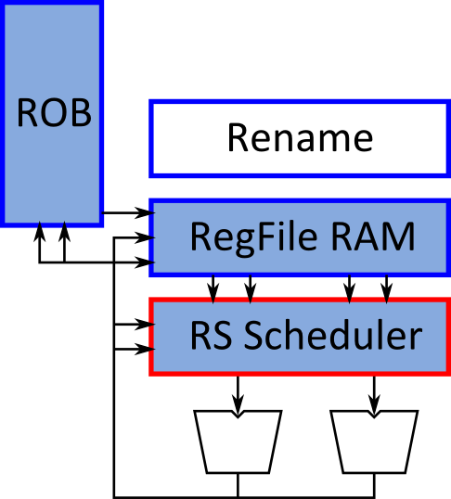
Scheduler CAM: AMD K7
AMD K7/K8/K10
Values stored in three places
RS is a CAM that stores values

Slide 22
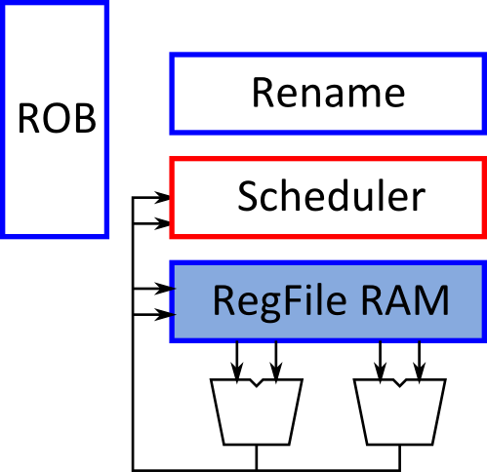
Physical Register File
MIPS R10000, Intel P4, Sandy Bridge, AMD Bobcat
Values stored in one place
Scheduler CAM stores no operands
PRF: Fewer multiported RAMs and smaller CAM

Slide 23
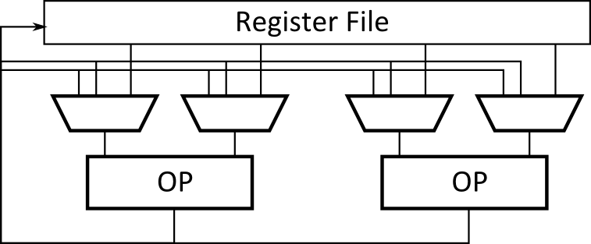
Reducing Bypass Muxes
Two sets of bypass muxes per operation
Multiple issue makes bypass muxes even bigger

Slide 24
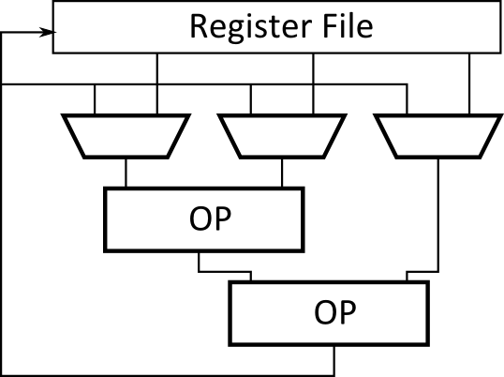
Fusing Operations
Chaining dependent operations: 3 muxes/2 ops
  Fused multiply-add works especially well because incremental cost of second operation is small
Point-to-point
saves one bypass mux

Slide 25
Summary
Need to measure cost of building block circuits to guide microarchitecture design choices
  Relative area costs span 2 orders of magnitude
Microarchitecture choices should reflect costs
  Examples: Reduce RAM port count, CAM size, and multiplexers; Take advantage of cheaper ALUs
  Use clustered physical register file, (no reservation stations); Explore fusing dependent operations together

Slide 26
Future Work
Use these results to guide the design of a larger and higher-performance soft processor
  Use existing microarchitecture literature as guidance, and adapt for FPGA substrate

Slide 27
Thank You!

