Slide 1
EduOS - Operating System Simulation
C + Python Hybrid Kernel Project | Scheduling | IPC | Threads

Slide 2
ABSTRACT
EduOS is a lightweight operating system simulation built using C and Python. It demonstrates key operating system concepts such as process creation, scheduling, threading, and inter-process communication (IPC). The system uses a custom Process Control Block (PCB) to manage process state, simulating system calls like fork, exec, wait, and exit. A Python-based scheduler evaluates multiple CPU scheduling algorithms and generates performance visualizations such as Gantt charts and comparison graphs. IPC is implemented using shared memory with security checks based on process ownership. Through this project, I learned how operating systems manage resources, enforce process isolation, and schedule tasks efficiently across multiple processes and threads. It also improved my understanding of system-level programming, synchronization issues, and hybrid system design between low-level C and high-level Python tools.

Slide 3
DESIGN DECISIONS
PCB as Struct (C)
Used Struct PCB for simplicity and Speed
Matches Real OS Kernel
Efficient Memory Layout
Array-Based Process Table
Faster lookup for small simulation
Avoids Complex dynamic allocation

Slide 4
DESIGN DECISIONS
POSIX THREADS(pthread)
Standard Linux threading model
Realistic concurrency simulation
Shared Memory IPC
Faster than message Queues
Simulates kernel-level memory sharing
Allows ownership-based security control

Slide 5
Syllabus Mapping
Syllabus Topic | EduOS Implementation | File Reference
1.Process Management | PCB creation, fork,exec,wait | Process_manager.c
2.CPU Scheduling | FCFS,SJF,RR,Priority | Scheduler_sim.py
3.Threads | Pthread worker pool | thread_manager.c
4.IPC | Shared memory + Security check | Ipc_shared.c
5.Race Condition | Counter increment demo | race_demo.c
6.Deadlock | Mutex Circular lock demo | Deadlock_demo.c

Slide 6
Scheduling Analysis
Algorithms Tested:
FCFS , SJF , Priority Scheduling , Round Robin
Observation:
SJF gave lowest average waiting time
FCFS performed worst due to long job blocking
Round Robin balanced fairness and response time
Reason:
SJF prioritizes shortest jobs
RR improves responsiveness in interactive system
When others win:
FCFS – simple batch systems
RR – time sharing systems
Priority – real-time systems

Slide 7
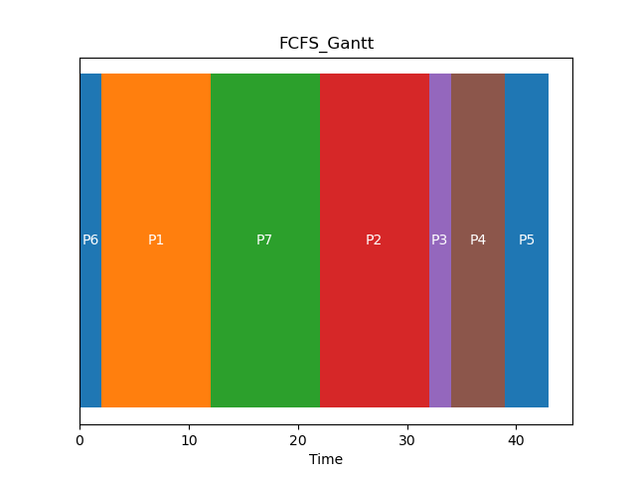
Scheduling Gantt Chart

Slide 8
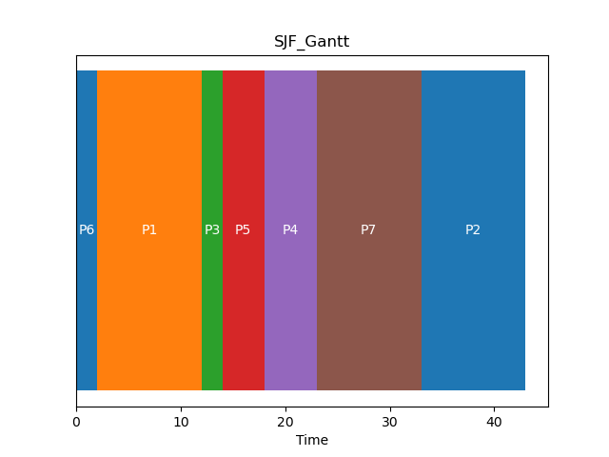
Scheduling Gantt Chart

Slide 9
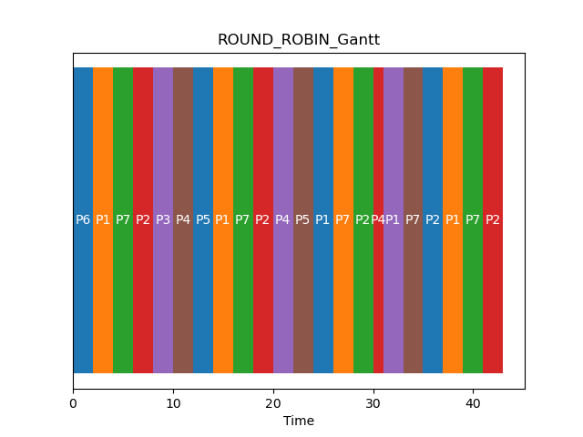
Scheduling Gantt Chart

Slide 10
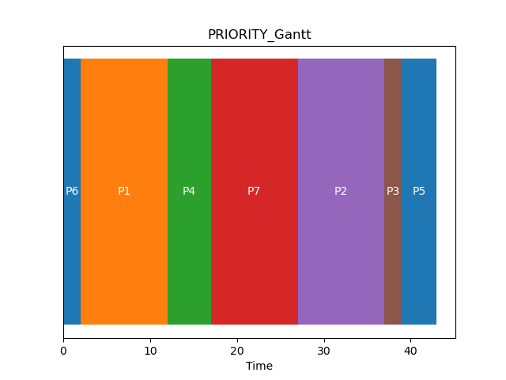
Scheduling Gantt Chart

Slide 11
Threading Issues
PROBLEM:
Race condition in shared counter
Multiple threads incrementing without sync
RESULT:
Incorrect final counter value
Non-deterministic output
FIX:
Added pthread_mutex_lock
Ensured critical section protection
LESSON:
Without synchronization --> data corruption
Mutex ensures atomic execution

Slide 12
C vs Python: Lessons Learned
C and Python were used together to simulate different layers of an operating system. In C, low-level control was used to manage processes, threads, and memory directly through structures like PCB and system-like functions such as fork, exec, wait, and exit. This made the system more realistic but also more complex, as memory management and synchronization had to be handled manually.
In contrast, Python was used for higher-level simulation tasks such as scheduling algorithms and performance analysis. Python made it easier to implement algorithms like FCFS, SJF, and Round Robin, and to generate graphs for visualization. However, it abstracts away system-level control, meaning it cannot directly represent kernel behaviour.
The main lesson learned is that C provides control and realism, while Python provides speed and clarity. Combining both allows a balance between system accuracy and usability. This reflects real operating systems where the kernel is written in low-level languages, while user-space tools are often higher-level.
Overall, the project helped me understand how operating systems separate responsibilities between low-level hardware control and high-level process management tools.

Slide 13
Challenges & Solutions
Git Rebase Conflicts
Problem: README overwritten during merge
Solution: used git reflog and restored correct commit
IPC Access Errors
Problem: Unauthorized process access
Solution: added owner_id check in PCB
Thread Race Condition
Problem: Incorrect counter output
Solution: Added mutex lock

Slide 14
GitHub Summary
Repository URL: https://github.com/elhimmisomali-art/Operating-System-Assignment
Commits : 12+ meaniful commits
Branch Strategy:
Single main branch (main)
Feature development directly commited
Recent commits:
git log –oneline -12

Slide 15
THANK YOU

