Slide 1
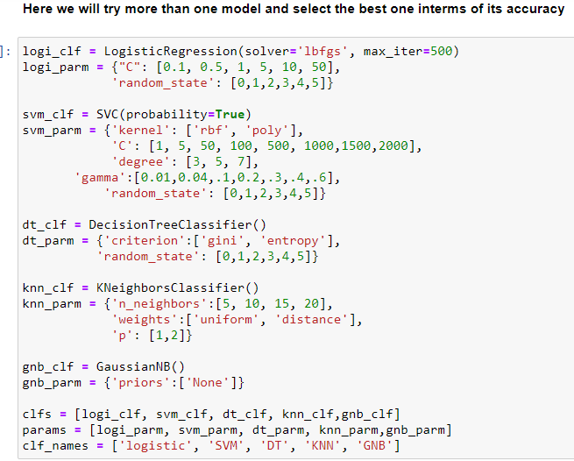

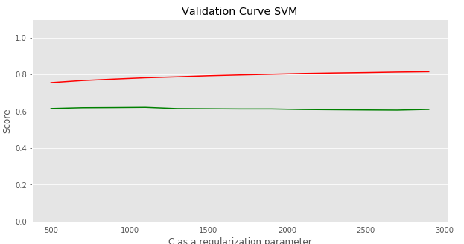
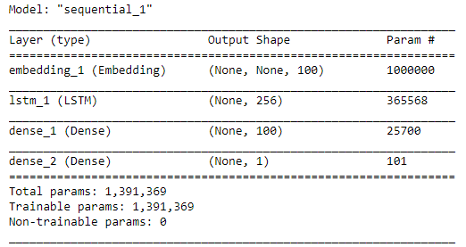
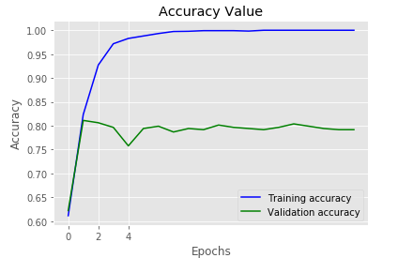
Nuwayer Algoliqah,,Hood College ,Frederick,MD
Sentiment Analysis and Classification
INTRODUCTION
Sentiment Analysis (SA) is an ongoing field of research in text mining field. SA is the computational treatment of opinions, sentiments and subjectivity of text.
It represents a large problem space. There are also many names and slightly different tasks, e.g., sentiment analysis, opinion mining, opinion extraction, sentiment mining, subjectivity analysis, affect analysis, emotion analysis, review mining, etc. the both sentiment analysis and opinion mining are frequently employed
And we found the best accuracy obtained on test data was from SVM Classifier by 61 percentage on
And the validation curve for a list of range for C as regularization parameter we here labeled the trading curve in red color and test in green color the accuracy achieved as 81 and 61 percentages for training and test data respectively.
After as we note the accuracy is low and the large distance between the trained and test on validation curve, so we have to find another method to apply to solve such problem, so we applied deep learning algorithms aim to achieve or increase the current accuracy we applied Long Short-Term Memory (LSTM) A special variation of RNN, Long Short-Term Memory (LSTM) networks is discussed. LSTM showed a striking accuracy in language modeling and speech recognition. We will be varying different forms of LSTM for our text classification purpose. A LSTM network contains LSTM units along with the input and output network layer units. [
ABSTRACT
Sentiment analysis or opinion mining is the computational study of people's opinions, sentiments, attitudes, and emotions expressed in written language. It is one of the most active research areas in natural language processing and text mining in recent years. Its popularity is mainly due to two reasons. First, it has a wide range of applications because opinions are central to almost all human activities and are key influencers of our behaviors. Whenever we need to make a decision, we want to hear others’ opinions. Second, it presents many challenging research problems.
METHODOLOGY
In this work, we will go through the steps cleaning and preprocessing for text and convert each sentence into vector we applied here TF-IDF algorithm to covert sentence in dense vector. TF-IDF stands for (term frequency-inverse document frequency) is discussed in examining the relevance of key-words to documents in corpus. TF-IDF is a numerical statistic that shows the relevance of keywords to some specific documents or it can be said that, it provides those keywords, using which some specific documents can be identified or categorized.
Keras offers an Embedding layer that can be used for neural networks on text data. Normally the embedding matrix is ​​learned during the same model learning, to adapt the best vectors for each object. [13] and we achieved 79 percentage accuracy on test data.
Data Mining Models
Our problem here is a classification problem and after applying clean and preprocessing methods in addition word embedding method and here we applied TF-IDF on our text and then we tried to train more machine learning estimator to compare its performance after applying hyper parameter tuning for each estimator (SVM, Logistic Regression, Decision Tree, KNN, Bayesian Classifier):
CONCLUSION
Here we demonstrate the motivation of studying sentiment analysis and its application in the marketing specially we also pursue through the text cleaning and processing methods towards applying machine learning algorithms and we compare the result obtained by applying deep learning LSTM model and we note there are significate improvement happened in terms of the accuracy on validation data. On this work for machine learning estimators we only applied one method in the area of word embedding TF-IDF by achieving 61 percentage accuracy with best estimators and parameters founded in support vector machine SVM this value may be increased if we applying another method in terms of text transformation or vectorizations techniques.then applied LSTM model as a deep learning estimators by achieving 80 percentage accuracy on validation data.

