Slide 1
Sentiment Analysis and Classification
Nuwayer Algoliqah
Dr.Liu
Data Mining

Slide 2
INTRODUCTION
Sentiment Analysis (SA) is an ongoing field of research in text mining field. SA is the computational treatment of opinions, sentiments and subjectivity of text.
It represents a large problem space. There are also many names and slightly different tasks, e.g., sentiment analysis, opinion mining, opinion extraction, sentiment mining, subjectivity analysis, affect analysis, emotion analysis, review mining, etc. the both sentiment analysis and opinion mining are frequently employed.
Opinion Mining extracts and analyzes people’s opinion about an entity while Sentiment Analysis identifies the sentiment expressed in a text then analyzes it. Therefore, the target of SA is to find opinions, identify the sentiments they express, and then classify their polarity.

Slide 3
ABSTRACT
Sentiment analysis or opinion mining is the computational study of people's opinions, sentiments, and emotions expressed in written language. It is one of the most active research areas in natural language processing and text mining in recent years. Its popularity is mainly due to two reasons. First, it has a wide range of applications because opinions are central to almost all human activities and are key influencers of our behaviors. Whenever we need to make a decision, we want to hear others’ opinions. Second, it presents many challenging research problems.
We applied text mining methods and algorithms and we compared the achieved accuracy for each after tuning or applying optimization methods aim to increase the validation accuracy we faced some difficulties to achieve the best accuracy on the validation curve but still there some obstacles and we know the core of text processing especially sentiment analysis is sentence transformation we need to transform our documents into vector representations such that we can apply machine learning.

Slide 4
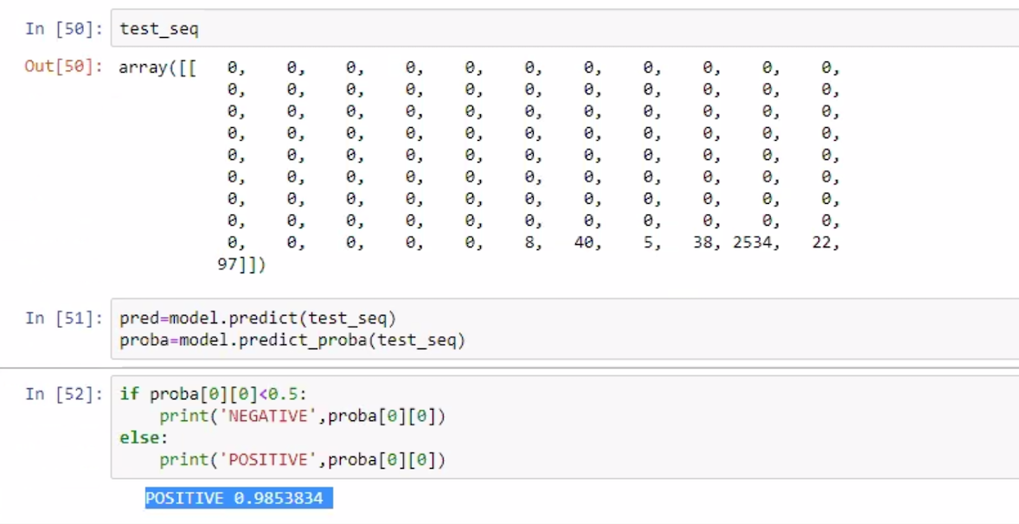
Example:

Slide 5
LITERATURE REVIEW AND DATA SET
Studies on sentiment analysis mainly focus on framework. construction, feature extraction, and polarity determination. This project presents a survey on the latest development in sentiment analysis and apply LSTM starting from text cleaning and preprocessing under the Natural Language Processing (NLP) methods to build deep learning model and prediction, some of the existing challenges are due to the slang words, new accents and spelling mistakes The area of sentiment analysis has become so large that any individual researcher would face several issues when keeping track of all the activities in the area and the information overload.

Slide 6
METHODOLOGY
In this work, we will go through the steps of cleaning and preprocessing for text and convert each sentence into a vector we applied here TF-IDF algorithm to covert sentences . TF-IDF stands for (term frequency-inverse document frequency)
Stop words are very frequently used common words like ‘and’, ‘are’, ‘this’ etc. They are not useful in the classification of documents. So they must be removed.
One another common text preprocessing technique is to remove the punctuations from the text data. This is again a text standardization process that will help to treat 'hurray' and 'hurray!' in the same way.
As well this is example, the words: “presentation”, “presented”, “presenting” could all be reduced to a common representation “present”

Slide 7
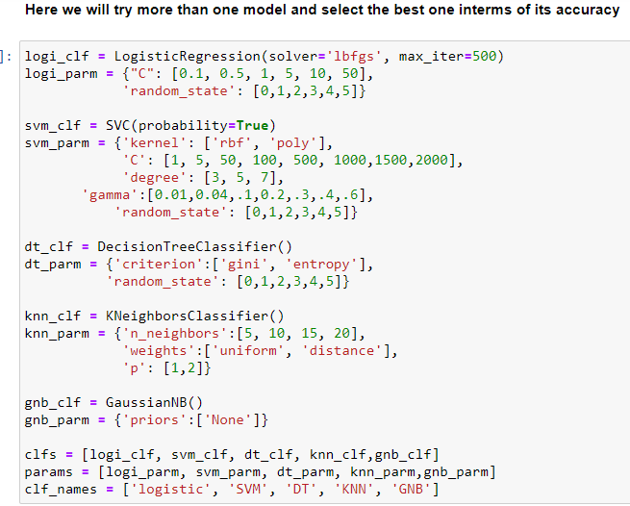
Data Mining Models Our problem here is a classification problem and after applying clean and preprocessing methods in addition word embedding method and here, we applied TF-IDF on our text and then we tried to train more machine learning estimator to compare its performance a. (SVM, Logistic Regression, Decision Tree, KNN, Bayesian Classifier):

Slide 8
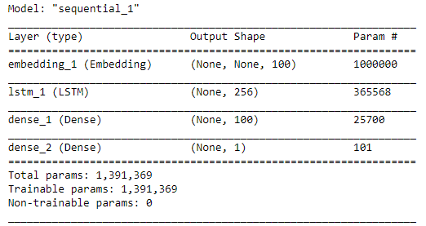
We applied deep learning algorithms aim to achieve or increase the current accuracy we applied Long Short-Term Memory (LSTM) A special variation of RNN, Long Short-Term Memory (LSTM) networks is discussed. LSTM showed a striking accuracy in language modeling and speech recognition. We will be varying different forms of LSTM for our text classification purpose. A LSTM network contains LSTM units along with the input and output network layer units. In addition we applied LSTM Network with simple architecture with only 2 layer we achieved 98 percentage accuracy in training #####after 20 epoch

Slide 9
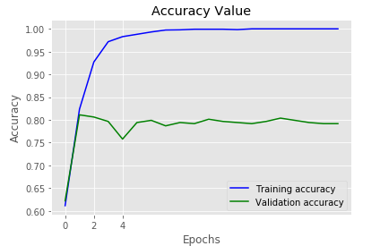
Keras offers an Embedding layer that can be used for neural networks on text data. Normally the embedding matrix is ​​learned during the same model learning, to adapt the best vectors for each object. And we achieved 79 percentage accuracy on test data.

Slide 10
Data and workflow Challenges
Here we worked in text processing and text usually winds up having very bad accuracy/F1 measure the main challenges we faced here to detect a more in-depth sentiment/emotion meaning is how to extract emotions like how much hate there is inside the opinion, how much happiness, how much sadness. In addition how to detect the object that the opinion is positive for and the object that the opinion is negative in same time For example, if you say, "She won him!", this means a positive sentiment for her and a negative sentiment for him, at the same time. Also Sentiment Towards Aspects of an Entity A review of a product or service can express sentiment towards various aspects. For example,
a restaurant review can speak positively about the service but express a negative attitude towards the food. There is now a growing amount of work in detecting aspects of products in text and also in determining sentiment towards these aspects

Slide 11
CONCLUSION
Here we demonstrate the motivation of studying sentiment analysis and its application in the marketing specially we also pursue through the text cleaning and processing methods towards applying machine learning algorithms and we compare the result obtained by applying deep learning LSTM model and we note there are significate improvement happened in terms of the accuracy on validation data. On this work for machine learning estimators we only applied one method in the area of word embedding TF-IDF by achieving 61 percentage accuracy with best estimators and parameters founded in support vector machine SVM this value maybe increased if we applying another method in terms of text transformation techniques. And then applied LSTM model as a deep learning estimators by achieving 80 percentage accuracy on validation data.

Slide 12
References
B. Liu, Sentiment Analysis and Opinion Mining, Morgan & Claypool, 2012.
W. Medhat, A. Hassan and H. Korashy, "Sentiment analysis algorithms and applications:A survey," Ain Shams Engineering Journal, vol. 5, no. 4, pp. 1093-1113, 2014.
A. K. Nassirtoussi, S. Aghabozorgi, T. Y. Waha and D. C. L. N. b, "Text mining for market prediction: A systematic review," Expert Systems with Applications, no. 41, p. 7653–7670, 2014.
D. K. d. '. ics.uci.edu, "Sentiment Labelled Sentences Data Set," UCI Machine Learning Repository, 2015.
S. Qaiser and R. Ali, "Text Mining: Use of TF-IDF to Examine the Relevance of Words to Documents," International Journal of Computer Applications, vol. 181, p. 0975 – 8887, 2018.
Dr.S.Kannan and Vairaprakash Gurusamy, "Preprocessing Techniques for Text Mining," in Conference: RTRICS, Podi, 2014.
S. Gerard and B. Christopher, "Term-weighting approaches in automatic text retrieval," Information Processing & Management, vol. 24, no. 5, pp. 513-523, 1987.
A. Taneja and A. Arora, "Recommendation research trends: Review, approaches and open issues," International Journal of Web Engineering and Technology , Vols. 13, No. 2, no. 2, 2018.
A. Frome, G. S.Corrado, J. Shlens and S. Bengio, Artists, DeViSE: A deep visual-semantic embedding model. [Art]. Google, Inc, 2013.
J. Pennington, R. Socher and C. D. Manning, "Glove: Global Vectors for Word Representation," in Conference: Proceedings of the 2014 Conference on Empirical Methods in Natural Language Processing (EMNLP), 2014.
M. Naili, A. H. Chaibi and H. H. B. Ghezala, "Comparative study of word embedding methods in topic segmentation," in International Conference on Knowledge Based and Intelligent Information and Engineering, Marseille, France, 2017.
S. Pala, D. S. Ghosha and D. A. Nag, "SENTIMENTANALYSIS IN THE LIGHT OF LSTM RECURRENT NEURALNETWORKS," in International Conference on Information Technology and Applied Mathematics, 2018.
J. B. PhD, "Machine Learning Mastery," 4 October 2017. [Online]. Available: https://machinelearningmastery.com/use-word-embedding-layers-deep-learning-keras/.
S. M. Mohammad, A Practical Guide to Sentiment Analysis, Ottawa: National Research Council Canada, 2015.

