Slide 1
Cairo University | Faculty of Engineering | CMPS451 — Spring 2026
Anomaly Detection in
Large-Scale System Logs
Using Apache Spark
Abdallah ElMahdy | Noor Tantawy | George Ayman | Elhussien Awad
Team 19

Slide 2
The Problem
"How can we build a scalable anomaly detection platform that analyzes large-scale web server log data to identify abnormal patterns early, providing actionable insights that help organizations improve system reliability and prevent critical failures?"
Every day, web servers generate millions of log entries.
Buried inside them are the early warning signs of attacks, failures, and outages.
5 Defined Anomaly Types
Traffic
Spike
High Error
Rate
Scanning /
Probing
Server
Error
Bot
Traffic

Slide 3
The Data — 14.8 Million Requests
14.8M
7.5%
1.8%
0
Total log entries
processed
Bot traffic
detected
Error
rows
Null timestamps
(perfect parsing)
Two Datasets — Unified into One Schema
Dataset 1 — Apache Common
Dataset 2 — Apache Combined
access_log.txt • ~4.5M rows
2009 logs • No user agent
Bot detection: unavailable
Fields: IP, timestamp, method, endpoint, status, bytes
web_server_access_log.txt • ~10.3M rows
2019 logs (Iran e-commerce) • Has user agent
Bot detection: 10 keyword signatures
Fields: + referrer, user_agent, is_bot

Slide 4
Key Business Findings
🤖 Googlebot = #1 traffic source
🕐 Errors peak at 4am, not noon
IPs 66.249.66.194 & 66.249.66.91 make 665K requests combined — the two busiest IPs on the server are Google crawlers consuming resources that could be rate-limited.
Error rate is highest overnight (2.85%) when bot traffic dominates, lowest at noon (1.44%) when humans dominate. Errors are caused by bots, not load.
🔍 115,562 scanning windows
📊 18.1% of windows anomalous
IPs probing >30 unique endpoints per minute — automated vulnerability reconnaissance. These should be flagged for WAF blocking immediately.
331,642 alerts per log period. Impossible for any human team to process. Our ML models rank by severity so analysts see the most critical events first.

Slide 5
Business Value
01
02
Replace Manual Review
Flag Scanners Automatically
Transform 14.8M raw log lines into a ranked severity list. Analysts review critical alerts first — not millions of rows.
IPs probing >30 unique endpoints/min are flagged in real time for WAF blocking before they find a vulnerability.
03
04
Alert on Server Failures
Scale to Production
Any 5xx response triggers immediate anomaly labeling. Server errors are caught at the first occurrence, not after users notice.
Built on Apache Spark — the same code runs on a single machine today and a 100-node cluster tomorrow with no changes.

Slide 6
PART II
Technical Deep Dive
Pipeline • Preprocessing • Feature Engineering • Models • Results

Slide 7
End-to-End Pipeline — Apache Spark local[*]
1
2
3
4
5
Preprocessing
→
Feature Eng.
→
Modeling
→
Evaluation
→
Visualization
14.8M rows
1.8M windows
LR + RF + KMeans
Metrics + CM
20 plots
main.py
Single entry point — one Spark session created once, passed to all modules. Each module returns a DataFrame to the next stage. Schema validated between stages.
main.py
Unified Schema (11 columns):
ip • timestamp • method • endpoint • status_code • bytes • user_agent • is_bot • is_error • status_class • source
Pseudo-distributed mode: local[*] — one machine, multiple parallel worker processes across all CPU cores
Models saved to disk after training — pipeline can resume from any stage without re-running earlier stages

Slide 8
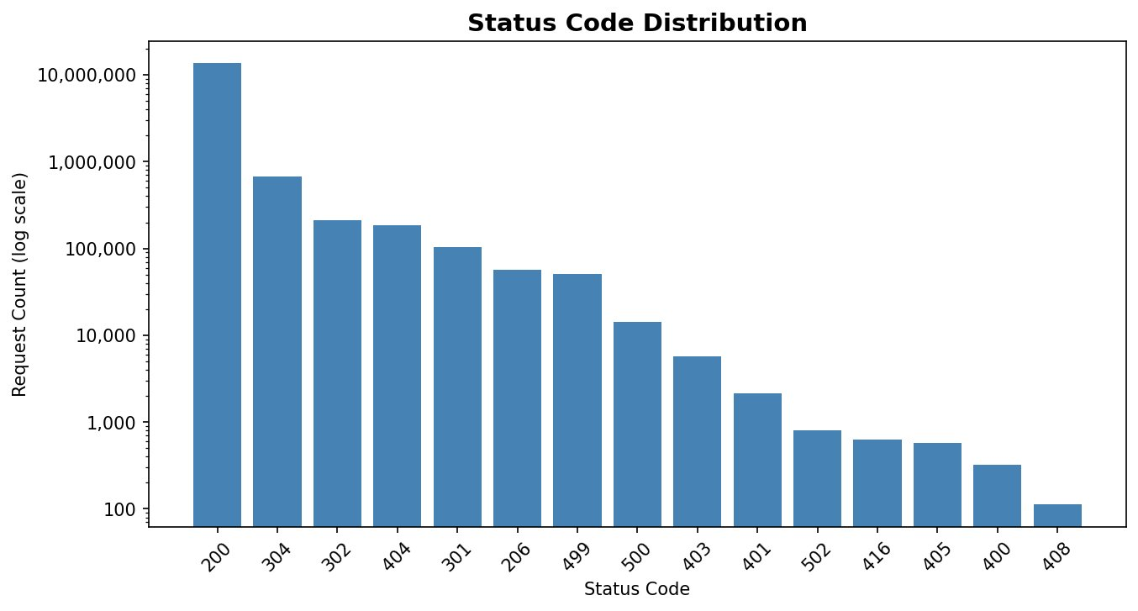
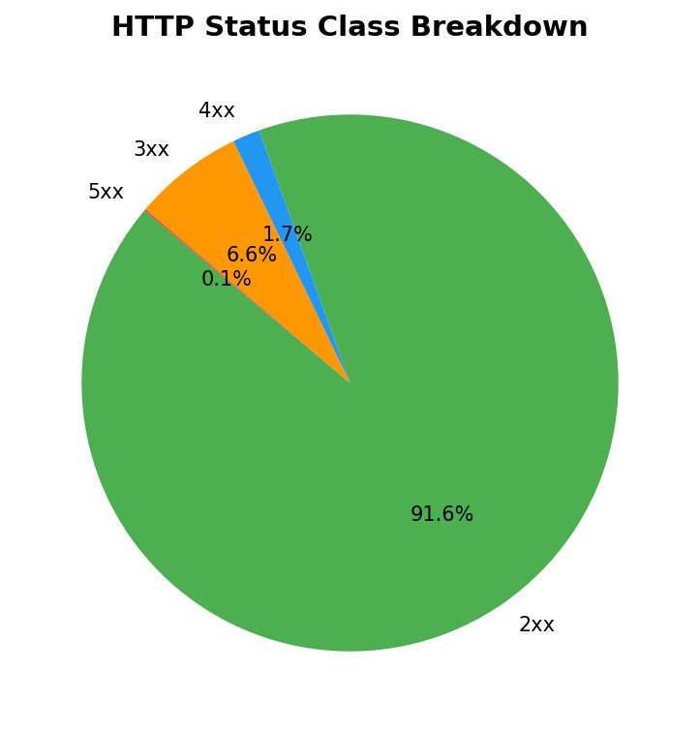
Preprocessing — Two Formats, One Schema
91.6% success rate — server was healthy during the log period
14,842,672 rows • 0 null timestamps • 7.5% bot traffic • 1.8% error rows
Both datasets unified via unionByName — Dataset 1 rows have user_agent=NULL and is_bot=0

Slide 9
Feature Engineering — Per IP Per Minute Window
10 Behavioral Features
Anomaly Definitions (TA Feedback)
1. request_count
traffic_spike
request_count > 200 /min
2. error_count
3. avg_bytes
high_error_rate
error_rate > 30%
4. unique_endpoints
scanning
unique_endpoints > 30 /min
5. bot_requests
6. off_hours_requests
server_error
fatal_count > 0 (5xx present)
7. fatal_count
8. medium_count
bot_traffic
user agent keyword match
9. low_count
normal
none of the above
10. error_rate
Severity score = (fatal_count/total)×0.40 + (medium_count/total)×0.25 + error_rate×0.20 + (request_count/200)×0.15 → low / medium / high

Slide 10
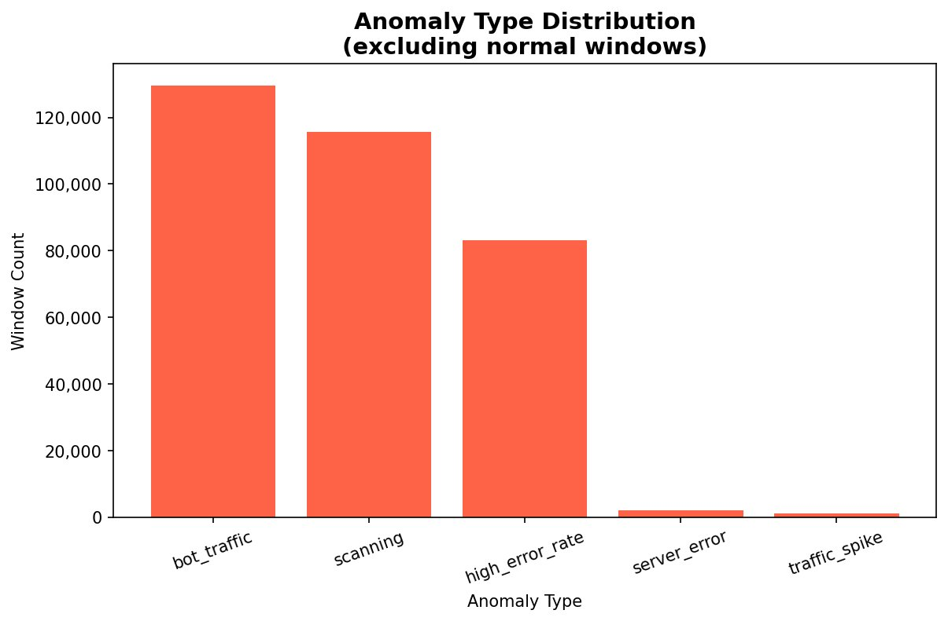
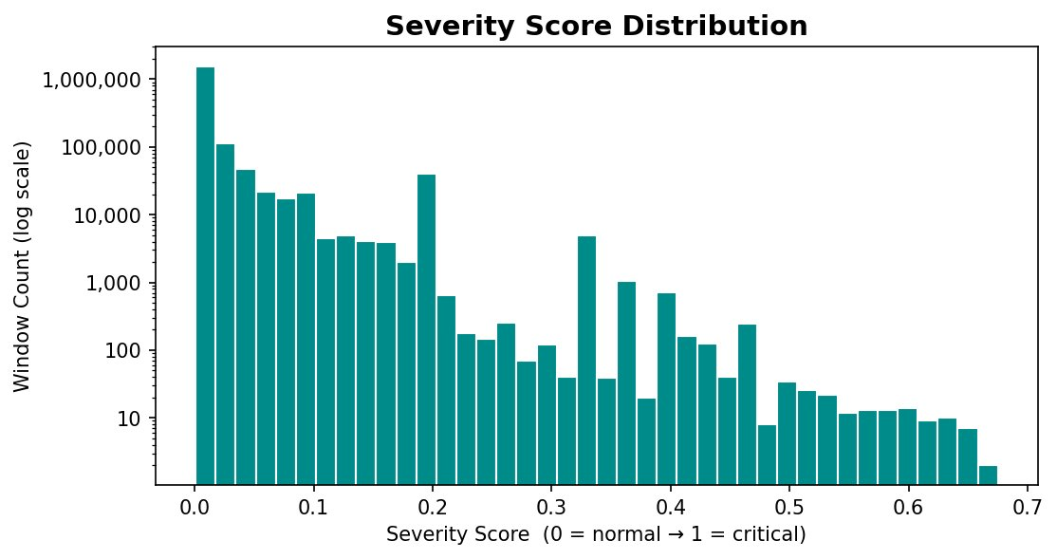
Anomaly Distribution — 1,831,664 Windows Analyzed
18.1% of windows anomalous • Max severity score: 0.67 • No high-severity events (server was stable)
129,612
115,562
83,193
2,073
1,202
bot_traffic
scanning
high_error_rate
server_error
traffic_spike

Slide 11
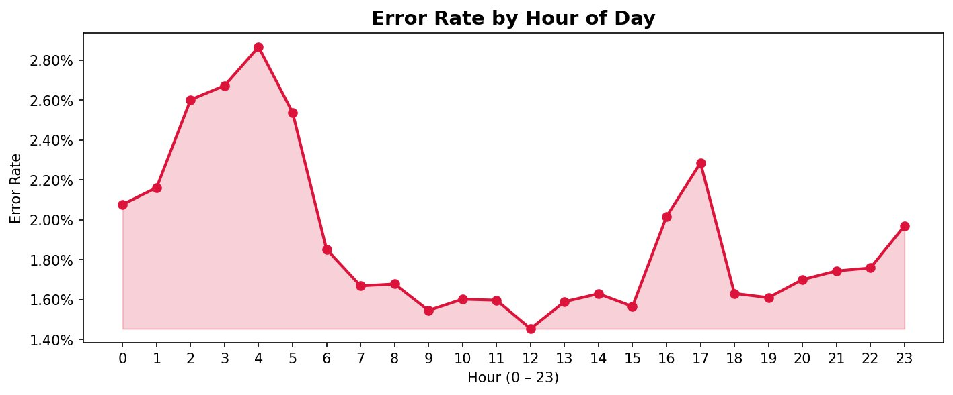
Key Temporal Insight — Errors Peak at 4am, Not Noon
Error rate is HIGHEST at 4am (2.85%) — LOWEST at noon (1.44%)
During low-traffic overnight hours, bot/crawler activity dominates and bots hit deprecated endpoints. At noon, human traffic dominates and bots are a smaller fraction — so error rate drops. Errors are caused by non-human traffic patterns, not by server load.

Slide 12
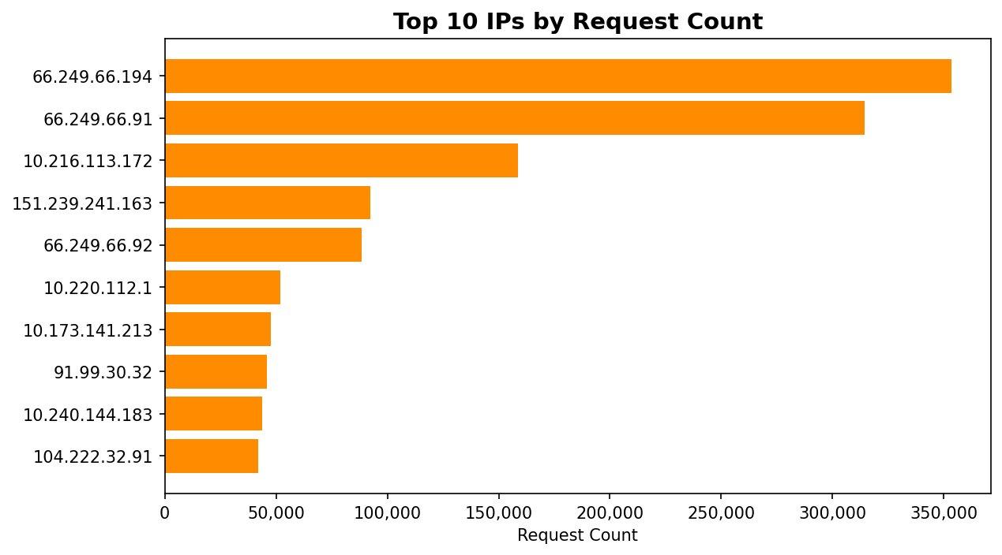
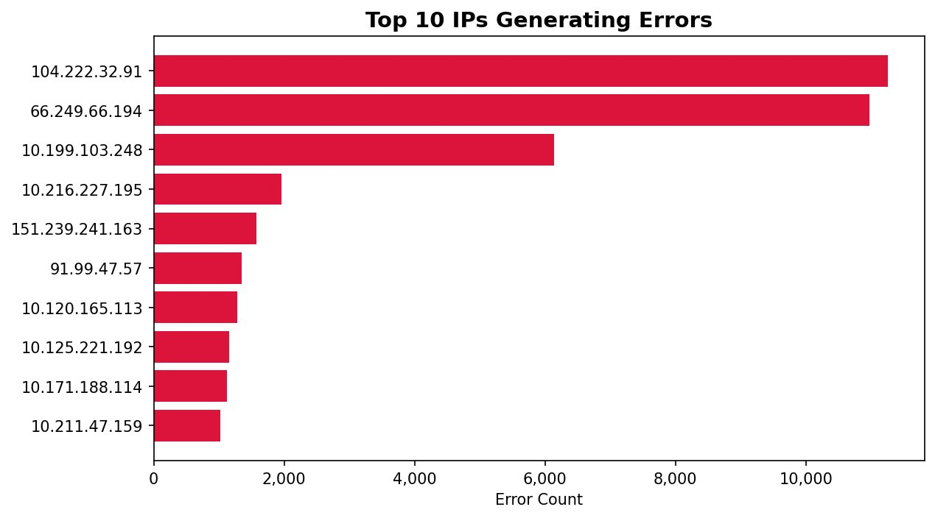
Top IPs — Googlebot is #1 Traffic Source
66.249.66.x: Googlebot (2 IPs) — 665K requests combined. Rate-limit via robots.txt.
104.222.32.91: #10 in volume but #1 in errors (11K) — aggressive probing, WAF candidate.
10.x.x.x range: Internal network IPs — monitoring traffic from within the infrastructure.

Slide 13
Three Models — Three Purposes
Logistic Regression
Random Forest
K-Means (k=3–8)
PURPOSE
PURPOSE
PURPOSE
Interpretability
Production Accuracy
Discovery
Multinomial LR with L2 regularization. Tells us WHICH features matter most. Hyperparameter grid search over regParam and elasticNetParam.
Non-parametric ensemble. KNN substitute (spark-knn unavailable). Grid search over numTrees and maxDepth. Natively handles multi-class.
Unsupervised clustering — finds natural groupings WITHOUT labels. Uses k-means|| initialization. Best k selected by silhouette score.
Val F1: 0.9501
Val F1: 0.9990
Best k=4, Sil: 0.8636
60% Train | 20% Validation | 20% Test — Fixed seed=42 for reproducibility

Slide 14
Results — Test Set Performance (365,903 windows)
95.67%
99.92%
0.8630
Logistic Regression
Accuracy
Random Forest
Accuracy
K-Means
Silhouette Score
K-Means Cluster Composition
C0
C1
C2
C3
349,639 windows
16,600 windows
16 windows
631 windows
normal + bot_traffic (85%)
scanning (85%)
server_error (100%)
high_error_rate + scanning
Regular low-intensity activity
Automated reconnaissance
★ Pure server failures — no labels needed!
Mixed borderline anomalies

Slide 15
Unsuccessful Trials — What We Learned
✗
K-Means k≠4
→
Native KNN
k=3 merged scanning+bot into one cluster. k=5–8 over-segmented normal traffic. k=4 gave best silhouette (0.8636) and interpretability.
spark-knn library unavailable. Random Forest selected as principled substitute — non-parametric, handles multi-class, scales better. RF outperformed LR significantly.
✗
LR regParam=0.1
!
High severity @ 0.7
F1 dropped from 0.95 → 0.85. Heavy regularization collapsed predictions to majority class (normal). LR needs minimal regularization on this well-separated space.
Zero windows reached 0.7. Not a bug — the server had no catastrophic events. Max observed score was 0.67. The formula is correct; the data is healthy.
✗
1-Hour Windows
Produced only 180K windows (vs 1.8M at 1-min). A 30-second DDoS probe averages away in an hourly window. 1-minute resolution is required for actionable detection.

Slide 16
Future Work & Enhancements
01 Real-Time Streaming
02 Automated IP Blocking
03 IP Geolocation
Replace spark.read.text() with spark.readStream + Apache Kafka. Anomalies flagged within seconds of first suspicious request.
Connect anomaly output to firewall API (iptables / Cloudflare WAF). High-confidence scanning IPs blocked automatically.
Join with MaxMind GeoLite2 for country/ASN features. Detect coordinated geographic attacks.
04 Fully Distributed Mode
05 Autoencoder Detection
06 Adaptive Thresholds
Deploy on multi-machine cluster (GCP Dataproc / AWS EMR). Process terabyte-scale production logs.
Neural network trained on normal traffic only. High reconstruction error = anomaly. No labels required.
Rolling baseline approach. Thresholds adapt to traffic growth and seasonal patterns automatically.

Slide 17
Conclusion
"We built a working, scalable anomaly detection platform on 14.8M real-world log entries. Random Forest achieves 99.92% accuracy. K-Means silhouette of 0.8630 confirms natural cluster structure exists. The platform ran successfully in pseudo-distributed mode on a single machine."
14.8M
1.8M
99.92%
0.8630
20
Requests
Processed
Windows
Analyzed
RF
Accuracy
K-Means
Silhouette
Visualizations
Generated
Apache Spark • PySpark MLlib • Logistic Regression • Random Forest • K-Means • Pseudo-Distributed Mode
Team 19 | Abdallah ElMahdy • Noor Tantawy • George Ayman • Elhussien Awad
Cairo University — Faculty of Engineering — CMPS451 Spring 2026

