Slide 1
COVID19 US Adverse Reactions 2020 to 2024
Project group 2

Slide 2

History Since the beginning of the pandemic in 2020, over 1.1 million people have lost their lives to COVID-19 in the US. This devastating number was mitigated by the development of COVID-19 vaccines created by several manufacturers. While the vaccines have been instrumental in reducing COVID-19 cases and fatalities, they are not without their drawbacks. Today, we will examine the data surrounding individuals who received the vaccine and experienced adverse reactions

Slide 3
Question
Who would be most likely to have an adverse reaction to the Covid19 vaccine? Would they be male or female? What vaccine were they given? Where would they live? Are they likely to die from the adverse reaction?

Slide 4
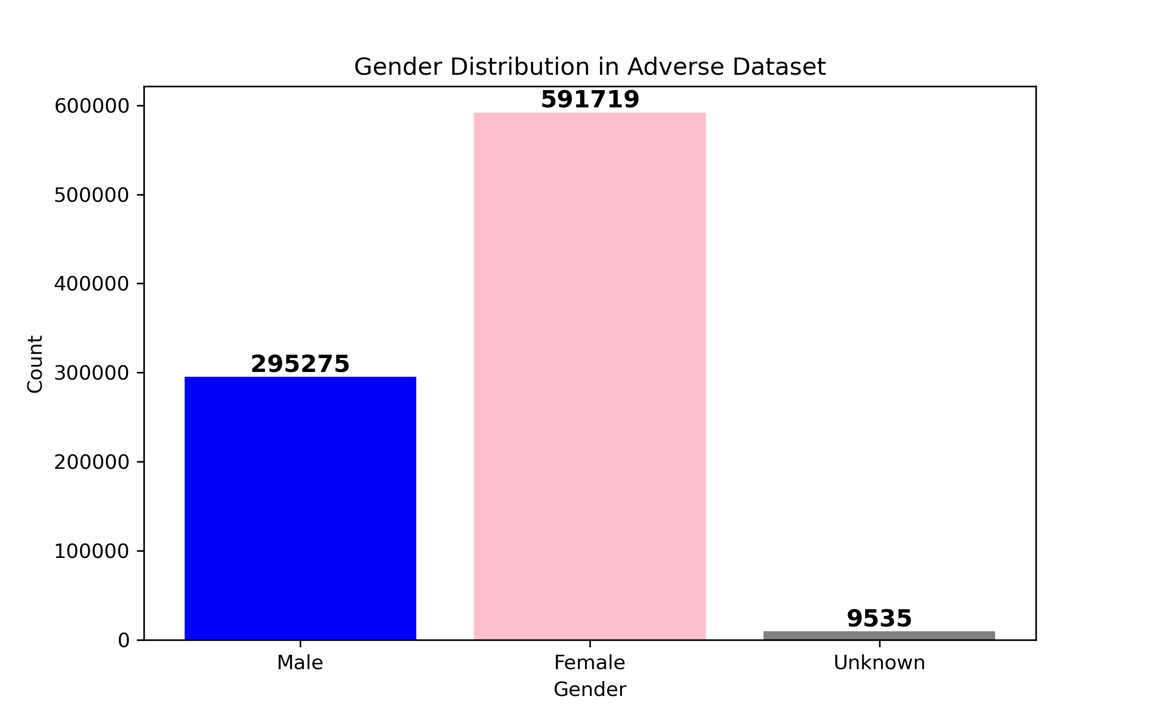
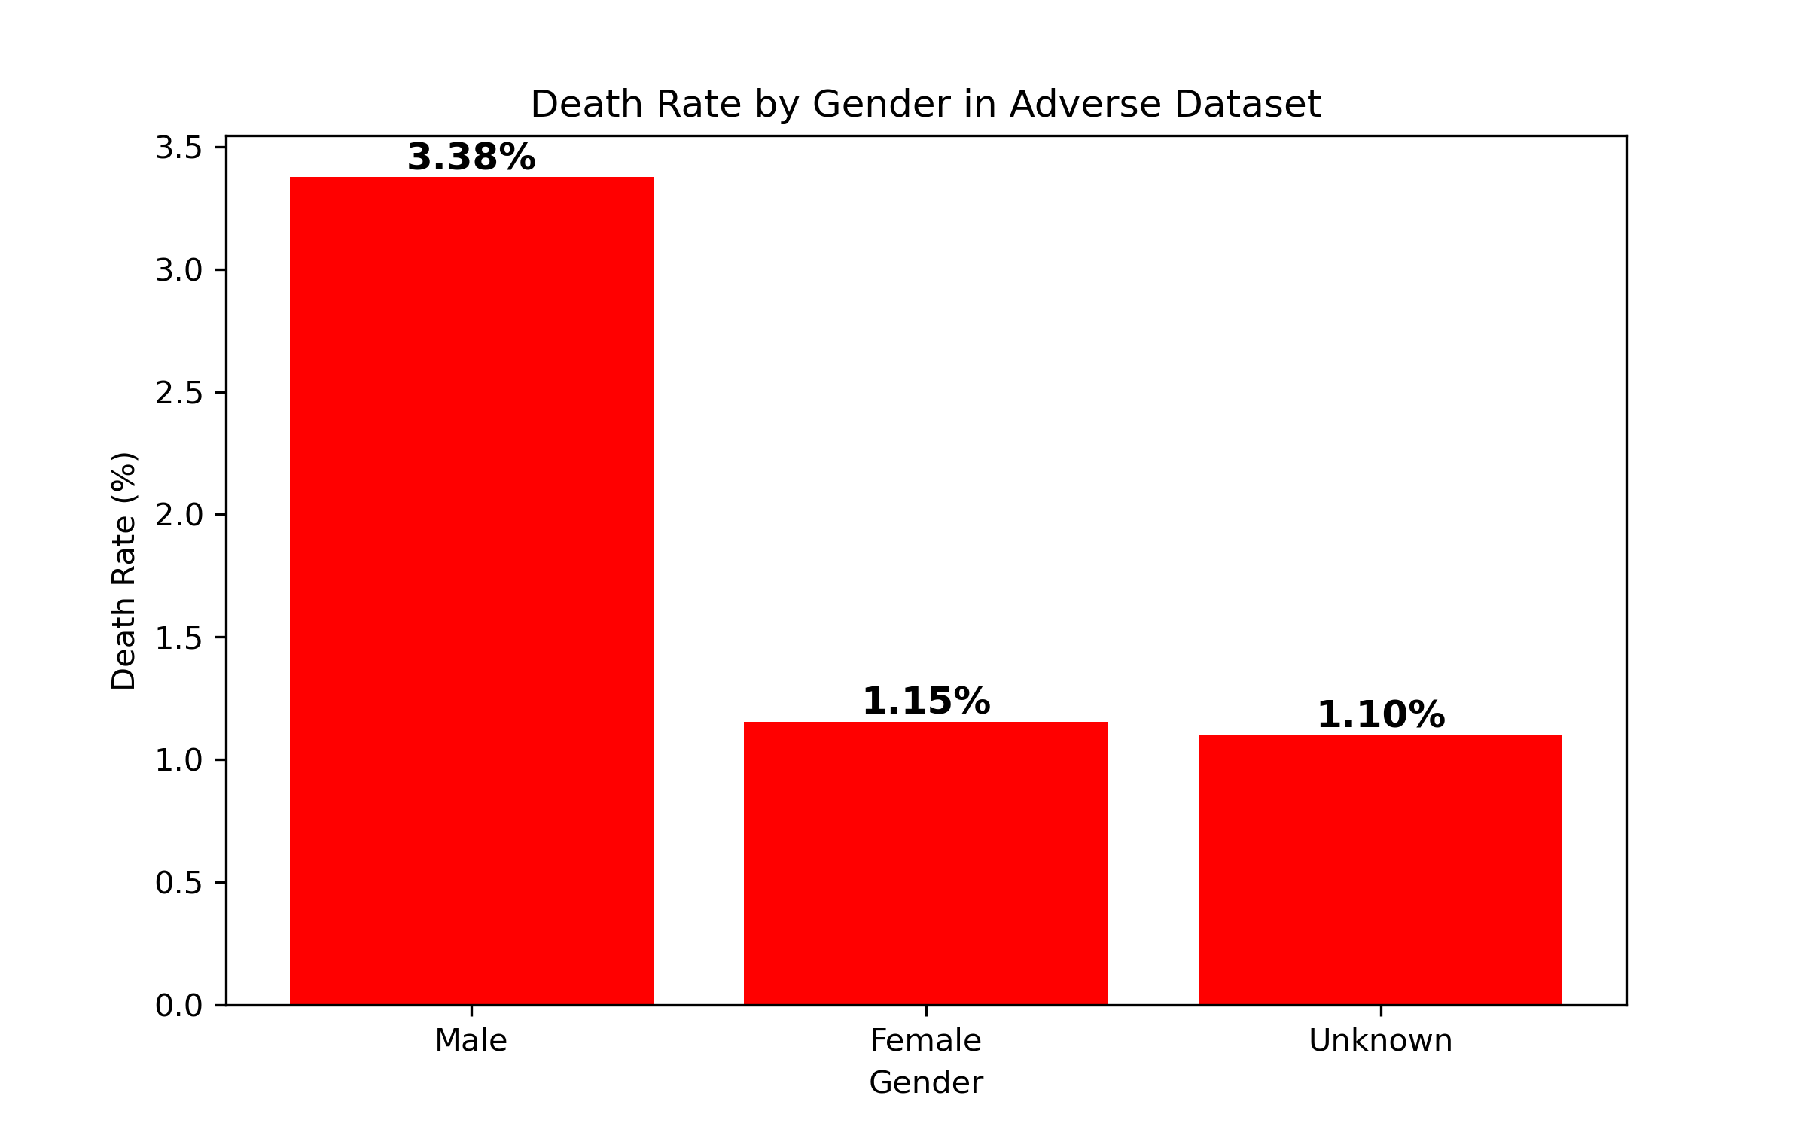
When examining the population, it becomes evident that females are nearly twice as likely as males to experience an adverse reaction.
Male 295,275
Female 591,719
Unknown 9,535
While the data shows that females are more likely to experience an adverse reaction, males are three times more likely to die as a result of such reactions.
Male 3.38%
Female 1.15%
Unknown 1.10%

Slide 5
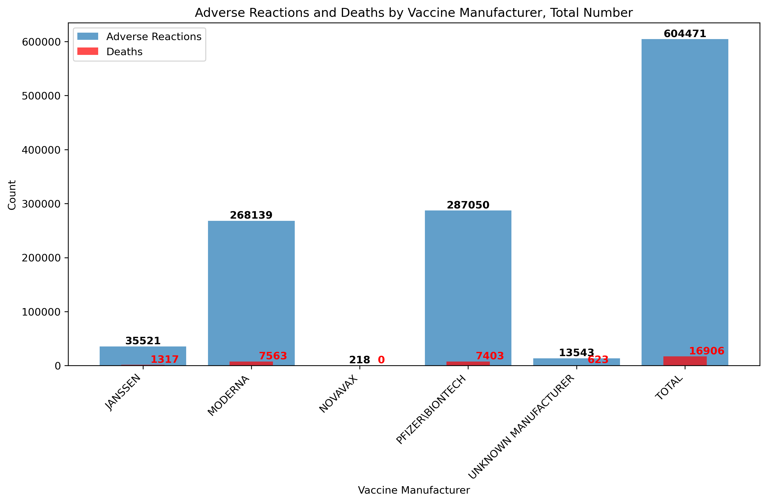
Total number of adverse reactions and deaths by manufacturer
The likelihood of experiencing an adverse reaction is significantly higher than that of death when a vaccine is administered. The higher number of reported events for Moderna and Pfizer does not indicate a greater risk; rather, it reflects the fact that these manufacturers have administered a larger number of vaccines

Slide 6
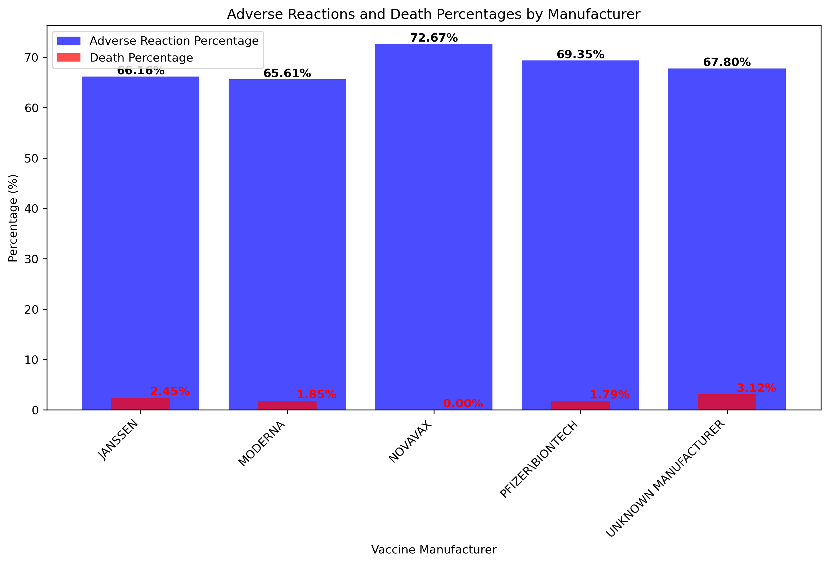
Discovery of missing Percentage data across Manufactures
The likelihood of experiencing an adverse reaction or death is relatively consistent across all vaccine manufacturers. However, there is a 20-30% rate of incomplete or missing data across all manufacturers, which may impact the accuracy of reported outcomes.

Slide 7
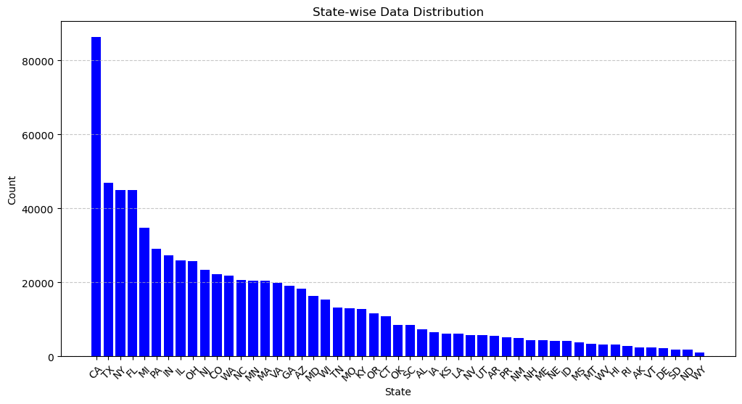
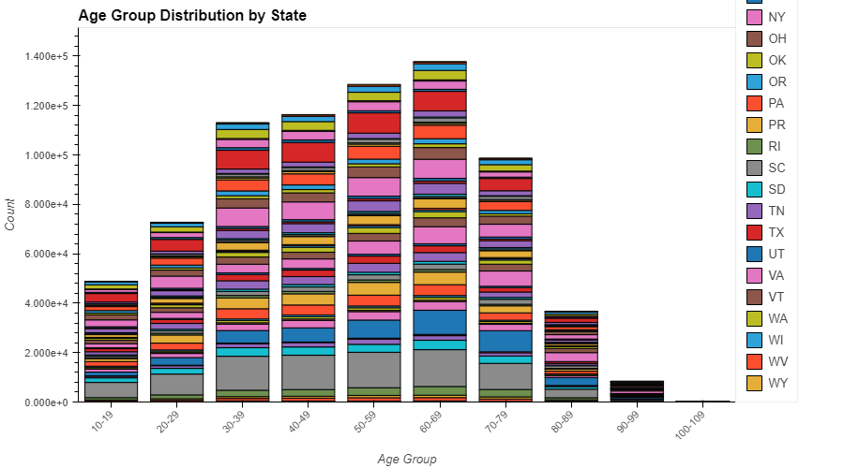
Relevant data check
These graphs show relevancy as to the accuracy of our data. Our data falls in line with what we would expect per state based upon population for adverse reactions.

Slide 8
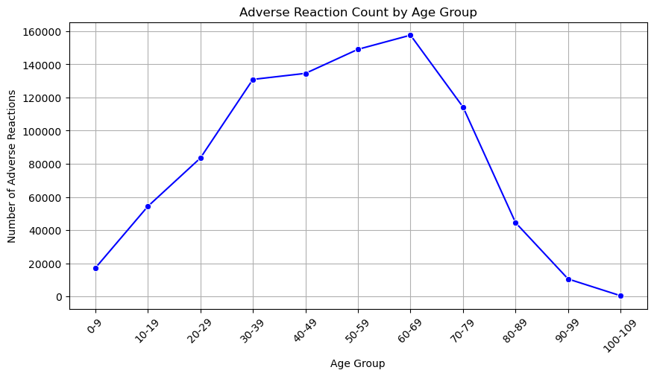
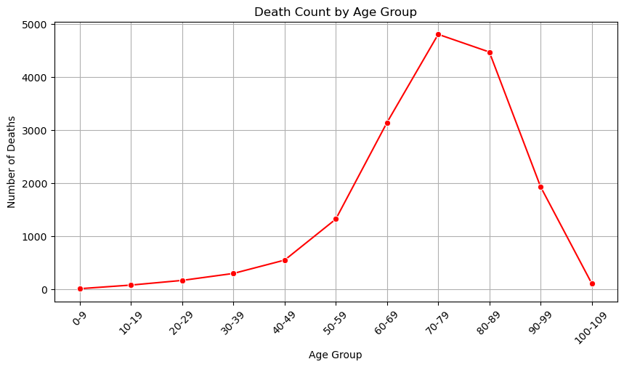
Adverse Reaction & Death by Age
Highest counts of adverse reactions:
1. 60-69: 157,615 adverse reactions
2. 50-59: 149,071 adverse reactions
Highest death counts from adverse reactions
1. 70-79: 4,803 deaths
2. 80-89: 4,470 deaths

Slide 9
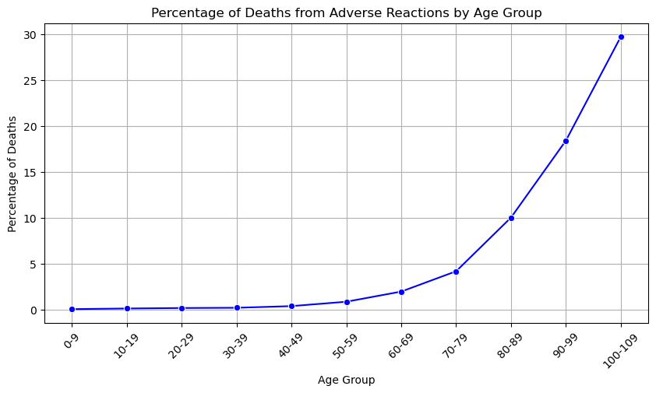
Percentage of Death from Adverse reaction by Age
Greatest percentage of death from adverse reaction was among 100-109 age group at 33.6%.​
​

Slide 10
Data Limitations
We do not know the total amount of vaccines given
The data contained fields with incomplete information that needed to be cleansed
Data is based on what has been reported and may not reflect all cases and adverse reactions

Slide 11

Results
From our research we have found that the person most likely to have an adverse reaction is a Female approximately 60 to 69 years of age, living in California, no matter the vaccine taken and they are less likely to die than their male counterparts.

Slide 12

Lance Cannon, Eli Crawley, Sandra Salazar, Luke Roberts, William Robertson

Slide 13
Data Sources
Vaccine Adverse Event Reporting System. 2024. VAERS https://vaers.hhs.gov/
COVID-19 World Vaccine Adverse Reactions Ayush Garg. 2024
https://www.kaggle.com/datasets/ayushggarg/covid19-vaccine-adverse-reactions?resource=download&select=VAERSVAX.csv
Centers for Disease Control and Prevention. 2023. "COVID-19 Vaccine Effectiveness." CDC.
https://www.cdc.gov/coronavirus/2019ncov/vaccines/effectiveness.html.
OpenAI. "ChatGPT-generated content about vaccine statistics." *ChatGPT*, 6 Feb. 2024, https://openai.com.

