Slide 1
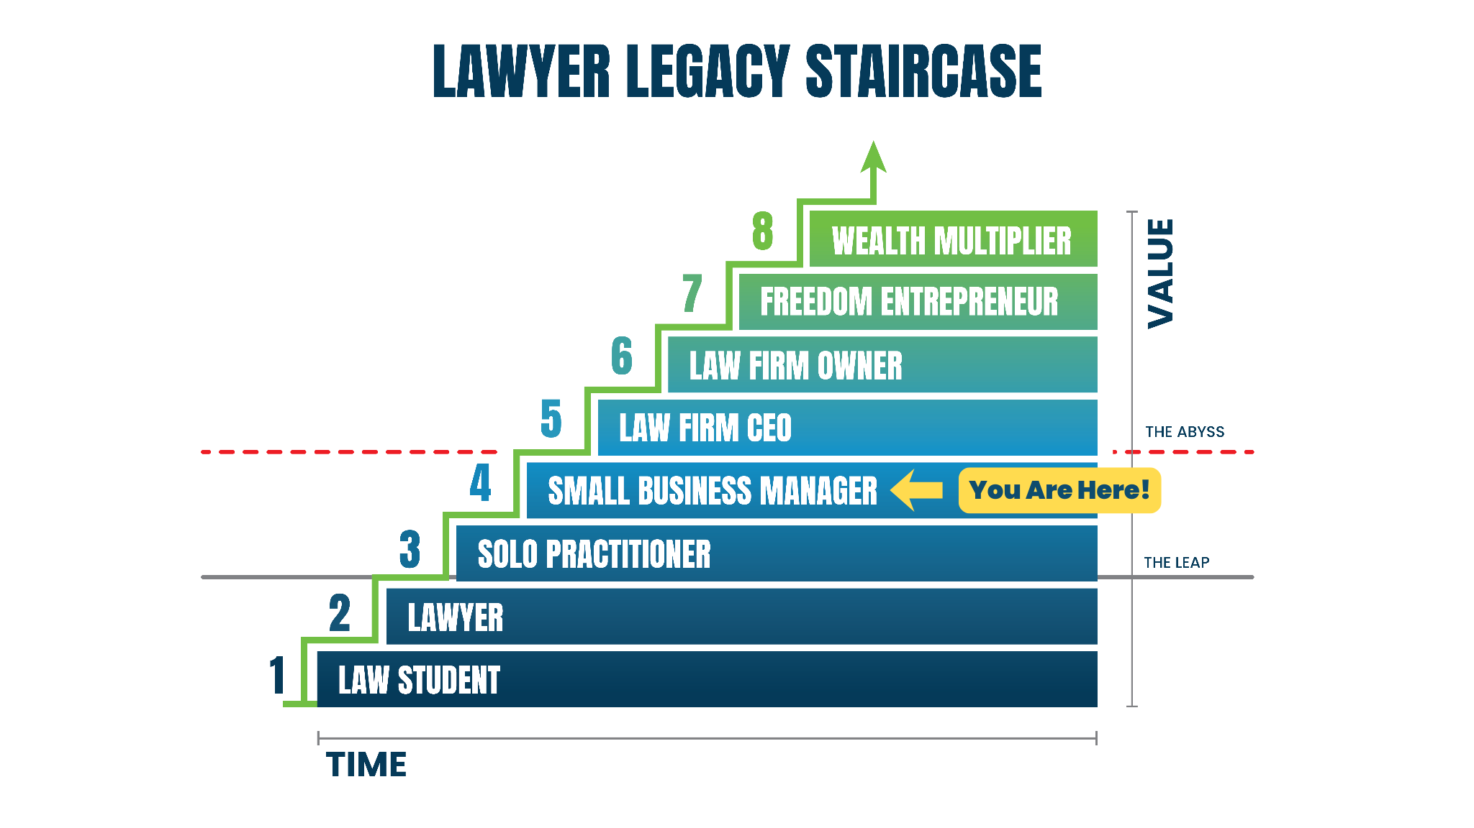

LAW FIRM GROWTH AUDIT · BLANCARTE LAW
Where Blancarte Law Stands Today
8 / 10
Lead Generation
Intake
Team
Profit Plan
CRITICAL
AMBER
AMBER
AMBER
COMPETITIVE URGENCY
100% from 1 referral
Leads falling through
No KPIs / bottleneck
No forecasting
KEY FINDINGS
✕
Zero reviews on every platform — invisible to prospects actively searching for an attorney
YOU ARE HERE
Stage 4: Small Business Manager → Goal: Stage 6, Law Firm Owner
✕
Website is a blank business card — no content, no SEO, no way for visitors to become leads
COMPETITOR LANDSCAPE
Goldstein Immigration
585 reviews
4 blocks away · PPC active
✕
Nearest competitor (Goldstein, 4 blocks away) has 585 reviews & PPC that doubled their intake
Manduley & Camisassa
376 reviews
Bilingual · top organic
Strong foundation: $1M revenue, capable team with Patricia & paralegals, new website in development
Gihan L. Thomas
961 reviews
#1 most-reviewed in LA
✓
Blancarte Law
0 reviews
← You are here
CONFIDENTIAL · Prepared by Randy Gold | SMB Team
1 / 3

Slide 2
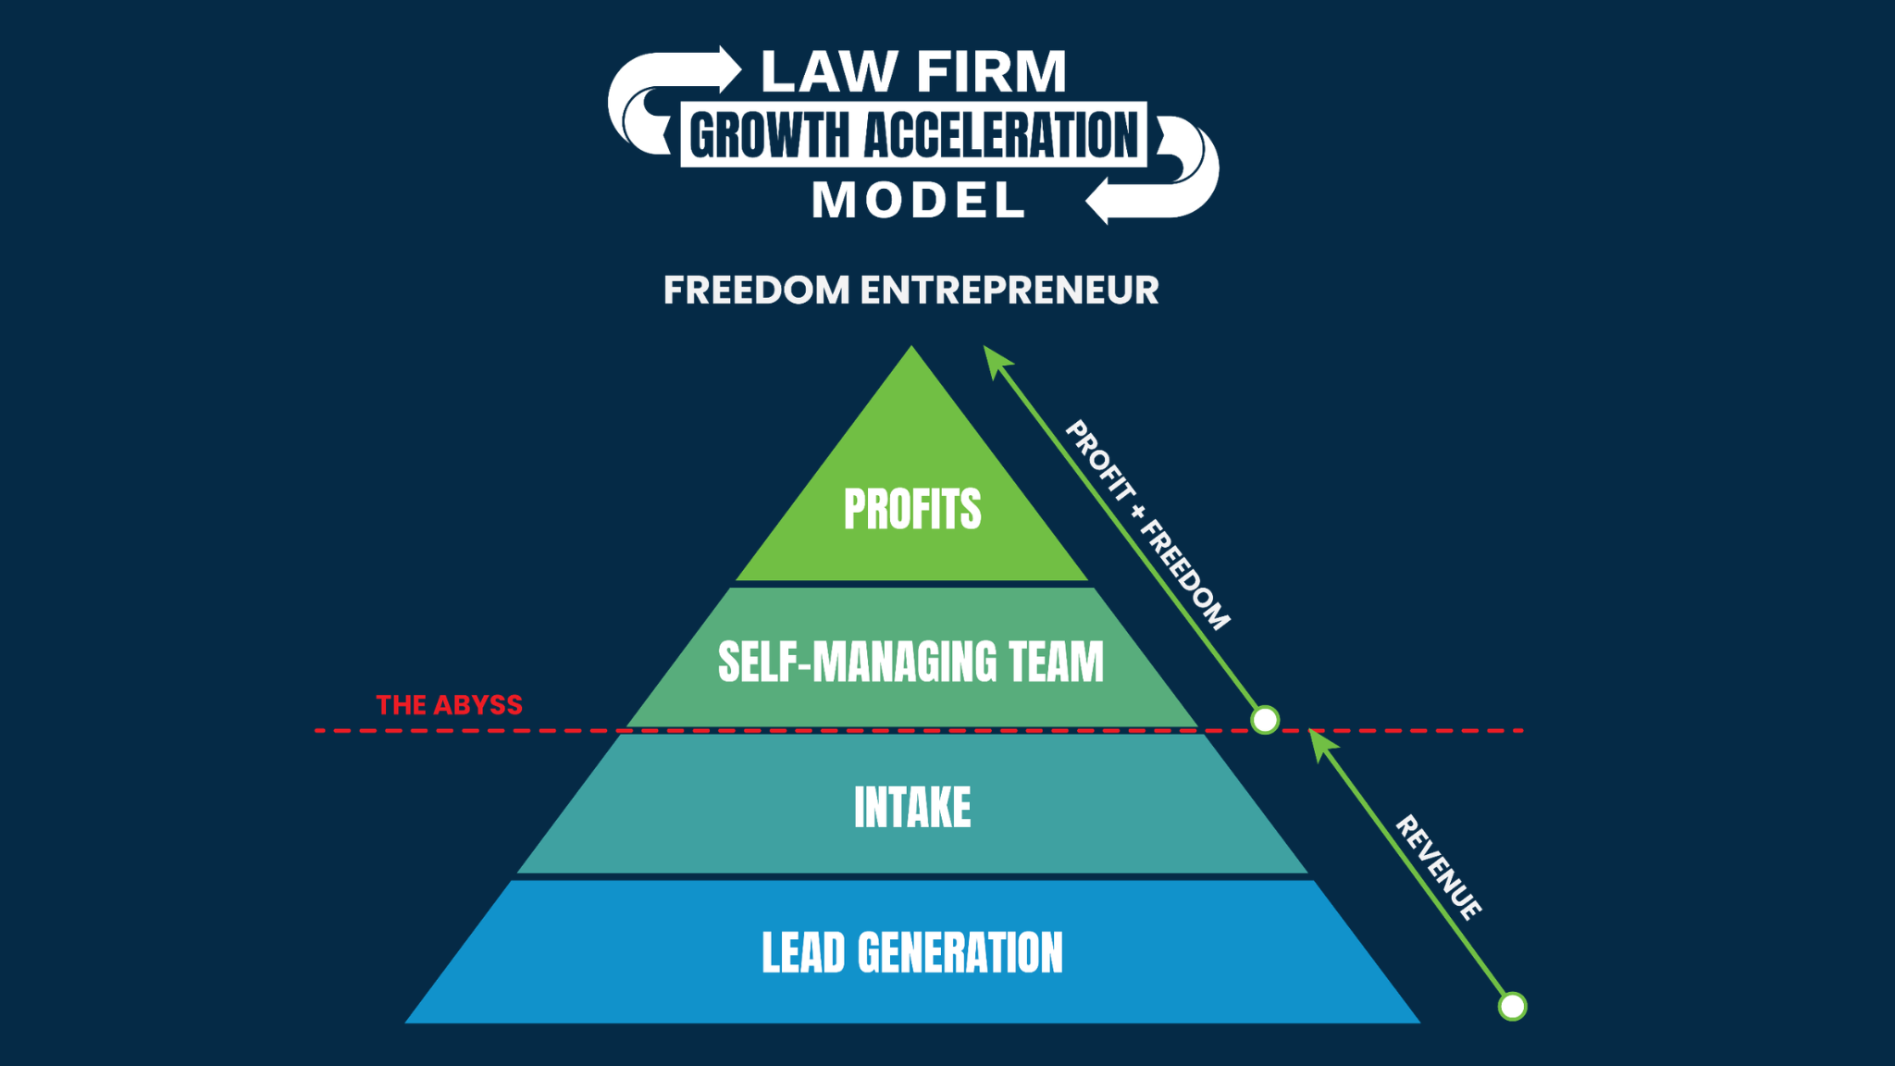
LAW FIRM GROWTH AUDIT · BLANCARTE LAW
Your Growth Plan: 3 Priorities to Reach $150K/Month
01
02
03
Build the
Marketing Engine
Fix Intake &
Stop Losing Cases
Install Team &
Profit Systems
Google Ads for immigration & criminal defense — live within 14 days of new website
Upgrade to 24/7 bilingual intake — no more missed after-hours or weekend calls
KPI scorecards for every role — Patricia owns day-to-day, attorneys own strategy
THE SMB TEAM MODEL
Local Service Ads (Google Screened) — the only ad format that appears above all results
Recorded call monitoring + lead-to-sign conversion rate tracking
Defined coverage plan for court days so the firm never stalls when both are out
All four pillars must work together. Missing any one means you can't have profit, freedom, and great client results at the same time.
Spanish-language Meta ads targeting LA's Hispanic immigrant community
Documented qualification script so every case type is handled consistently
Monthly financial dashboard: revenue by case type, cost per case, profit margin
$1M → $1.8M revenue Jesse & James take real time off
Fix NAP directory inconsistencies — zero-cost action that lifts local SEO immediately
CRM optimized for Patricia to manage intake performance without attorney input
Forecasting model so $150K/month is a tracked target, not a year-end surprise
Automated review requests: 10–15 new Google reviews per month from existing clients
Just +5 percentage points in close rate = ~3 more signed cases/month, zero new spend
Phase 3 outcome: firm runs without daily owner input — real vacations are possible
CONFIDENTIAL · Prepared by Randy Gold | SMB Team
2 / 3

Slide 3
LAW FIRM GROWTH AUDIT · BLANCARTE LAW
Your Investment & What Happens Next
FULL SERVICE MARKETING — GROWTH
PROJECTED RETURN ON AD SPEND
$3,397
Average case value:
$4,500
/mo
$4,997/mo
Conservative (7 cases/mo):
$31,500 revenue · 5.7× ROAS
Website · Google Ads · LSA · Meta Ads · GBP optimization · Monthly reporting
Aggressive (12 cases/mo):
$54,000 revenue · 6.75× ROAS
ELITE COACH PLUS
$2,200
WHAT HAPPENS IN THE FIRST 90 DAYS
/mo
$3,497/mo
Day 1
New website live — practice areas, bilingual content & contact forms
Weekly group coaching · KPI scorecards · Intake framework · Financial review cadence
Day 14
Google Ads, LSA & Spanish Meta campaigns launched — leads flowing
BUNDLE TOTAL
$5,597 / mo
Save $2,897/mo by bundling
Week 2
24/7 bilingual intake activated · Review generation system on
Week 3
KPI scorecards built · Patricia empowered to run day-to-day ops
+ Recommended ad spend: $5,500–$8,000/mo paid directly to Google & Meta — not to SMB Team
Month 3
Financial dashboard live · pipeline on track toward $150K/month
"You built $1M in revenue from referrals alone -- that's evidence of real skill and community trust. The system to turn that into $1.8M and your time back is what this plan builds."
CONFIDENTIAL · Prepared by Randy Gold | SMB Team
3 / 3

