Slide 1
Snowfall in Vermont: Future Outlook Eli Kravitz

Slide 2
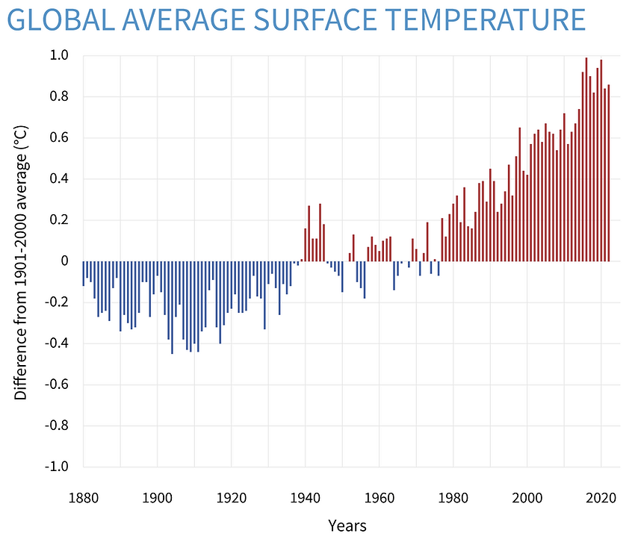
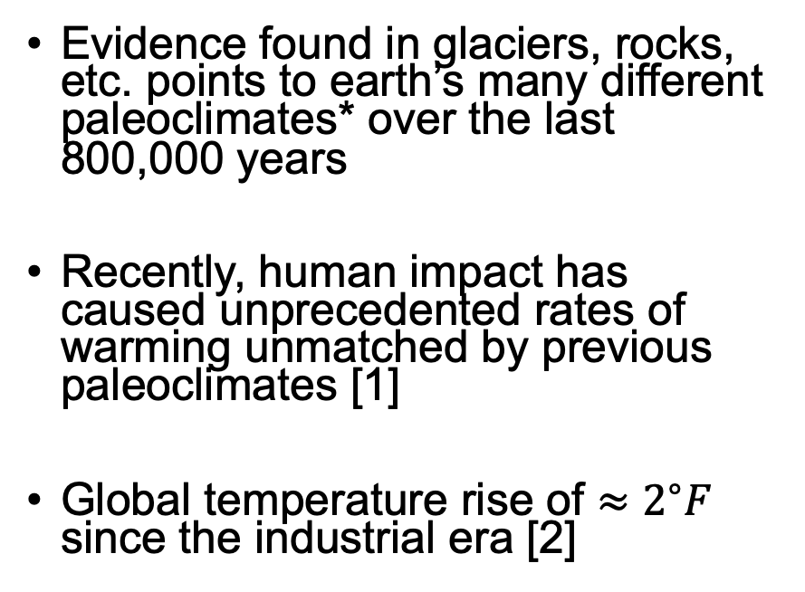
Introduction: World Weather
Evidence found in glaciers, rocks, etc. points to earth’s many different paleoclimates* over the last 800,000 years
Recently, human impact has caused unprecedented rates of warming unmatched by previous paleoclimates [1]
Global temperature rise of $≈2^{∘}F$ since the industrial era [2]
Figure 1: global average surface temperature from 1880-2020, compared to 20th century average [2]
* Paleoclimate: prevalent climates in geological history

Slide 3
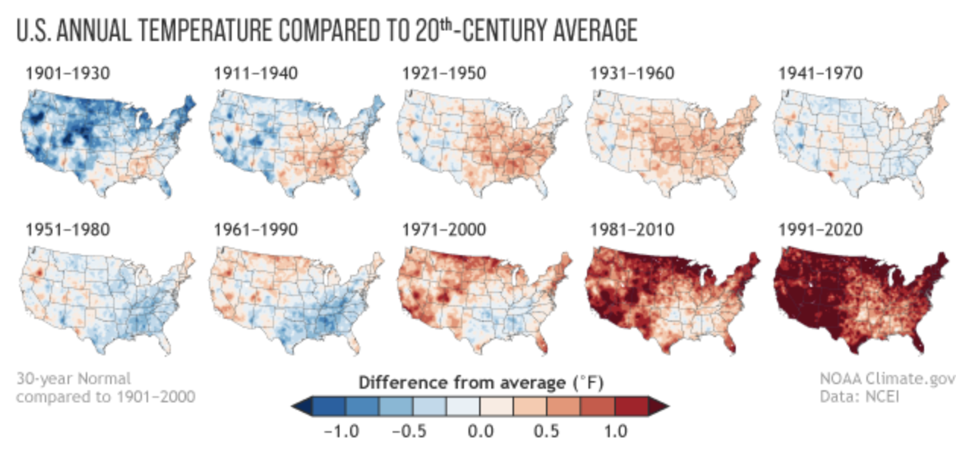
Introduction: U.S. Weather
U.S. has experienced higher than average temperatures and precipitation [3]
Figure 2: U.S. average surface temperature from 1901-2020, compared to the 20th century average [4]

Slide 4
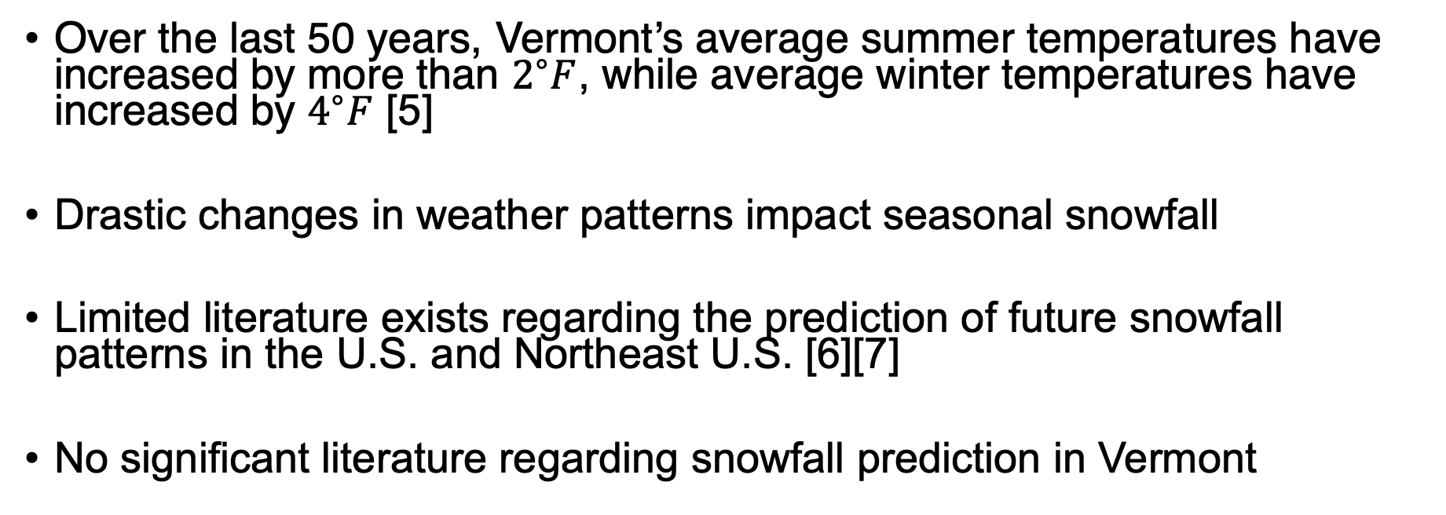
Introduction: Vermont Weather
Over the last 50 years, Vermont’s average summer temperatures have increased by more than $2^{∘}F$, while average winter temperatures have increased by $4^{∘}F$ [5]
Drastic changes in weather patterns impact seasonal snowfall
Limited literature exists regarding the prediction of future snowfall patterns in the U.S. and Northeast U.S. [6][7]
No significant literature regarding snowfall prediction in Vermont

Slide 5
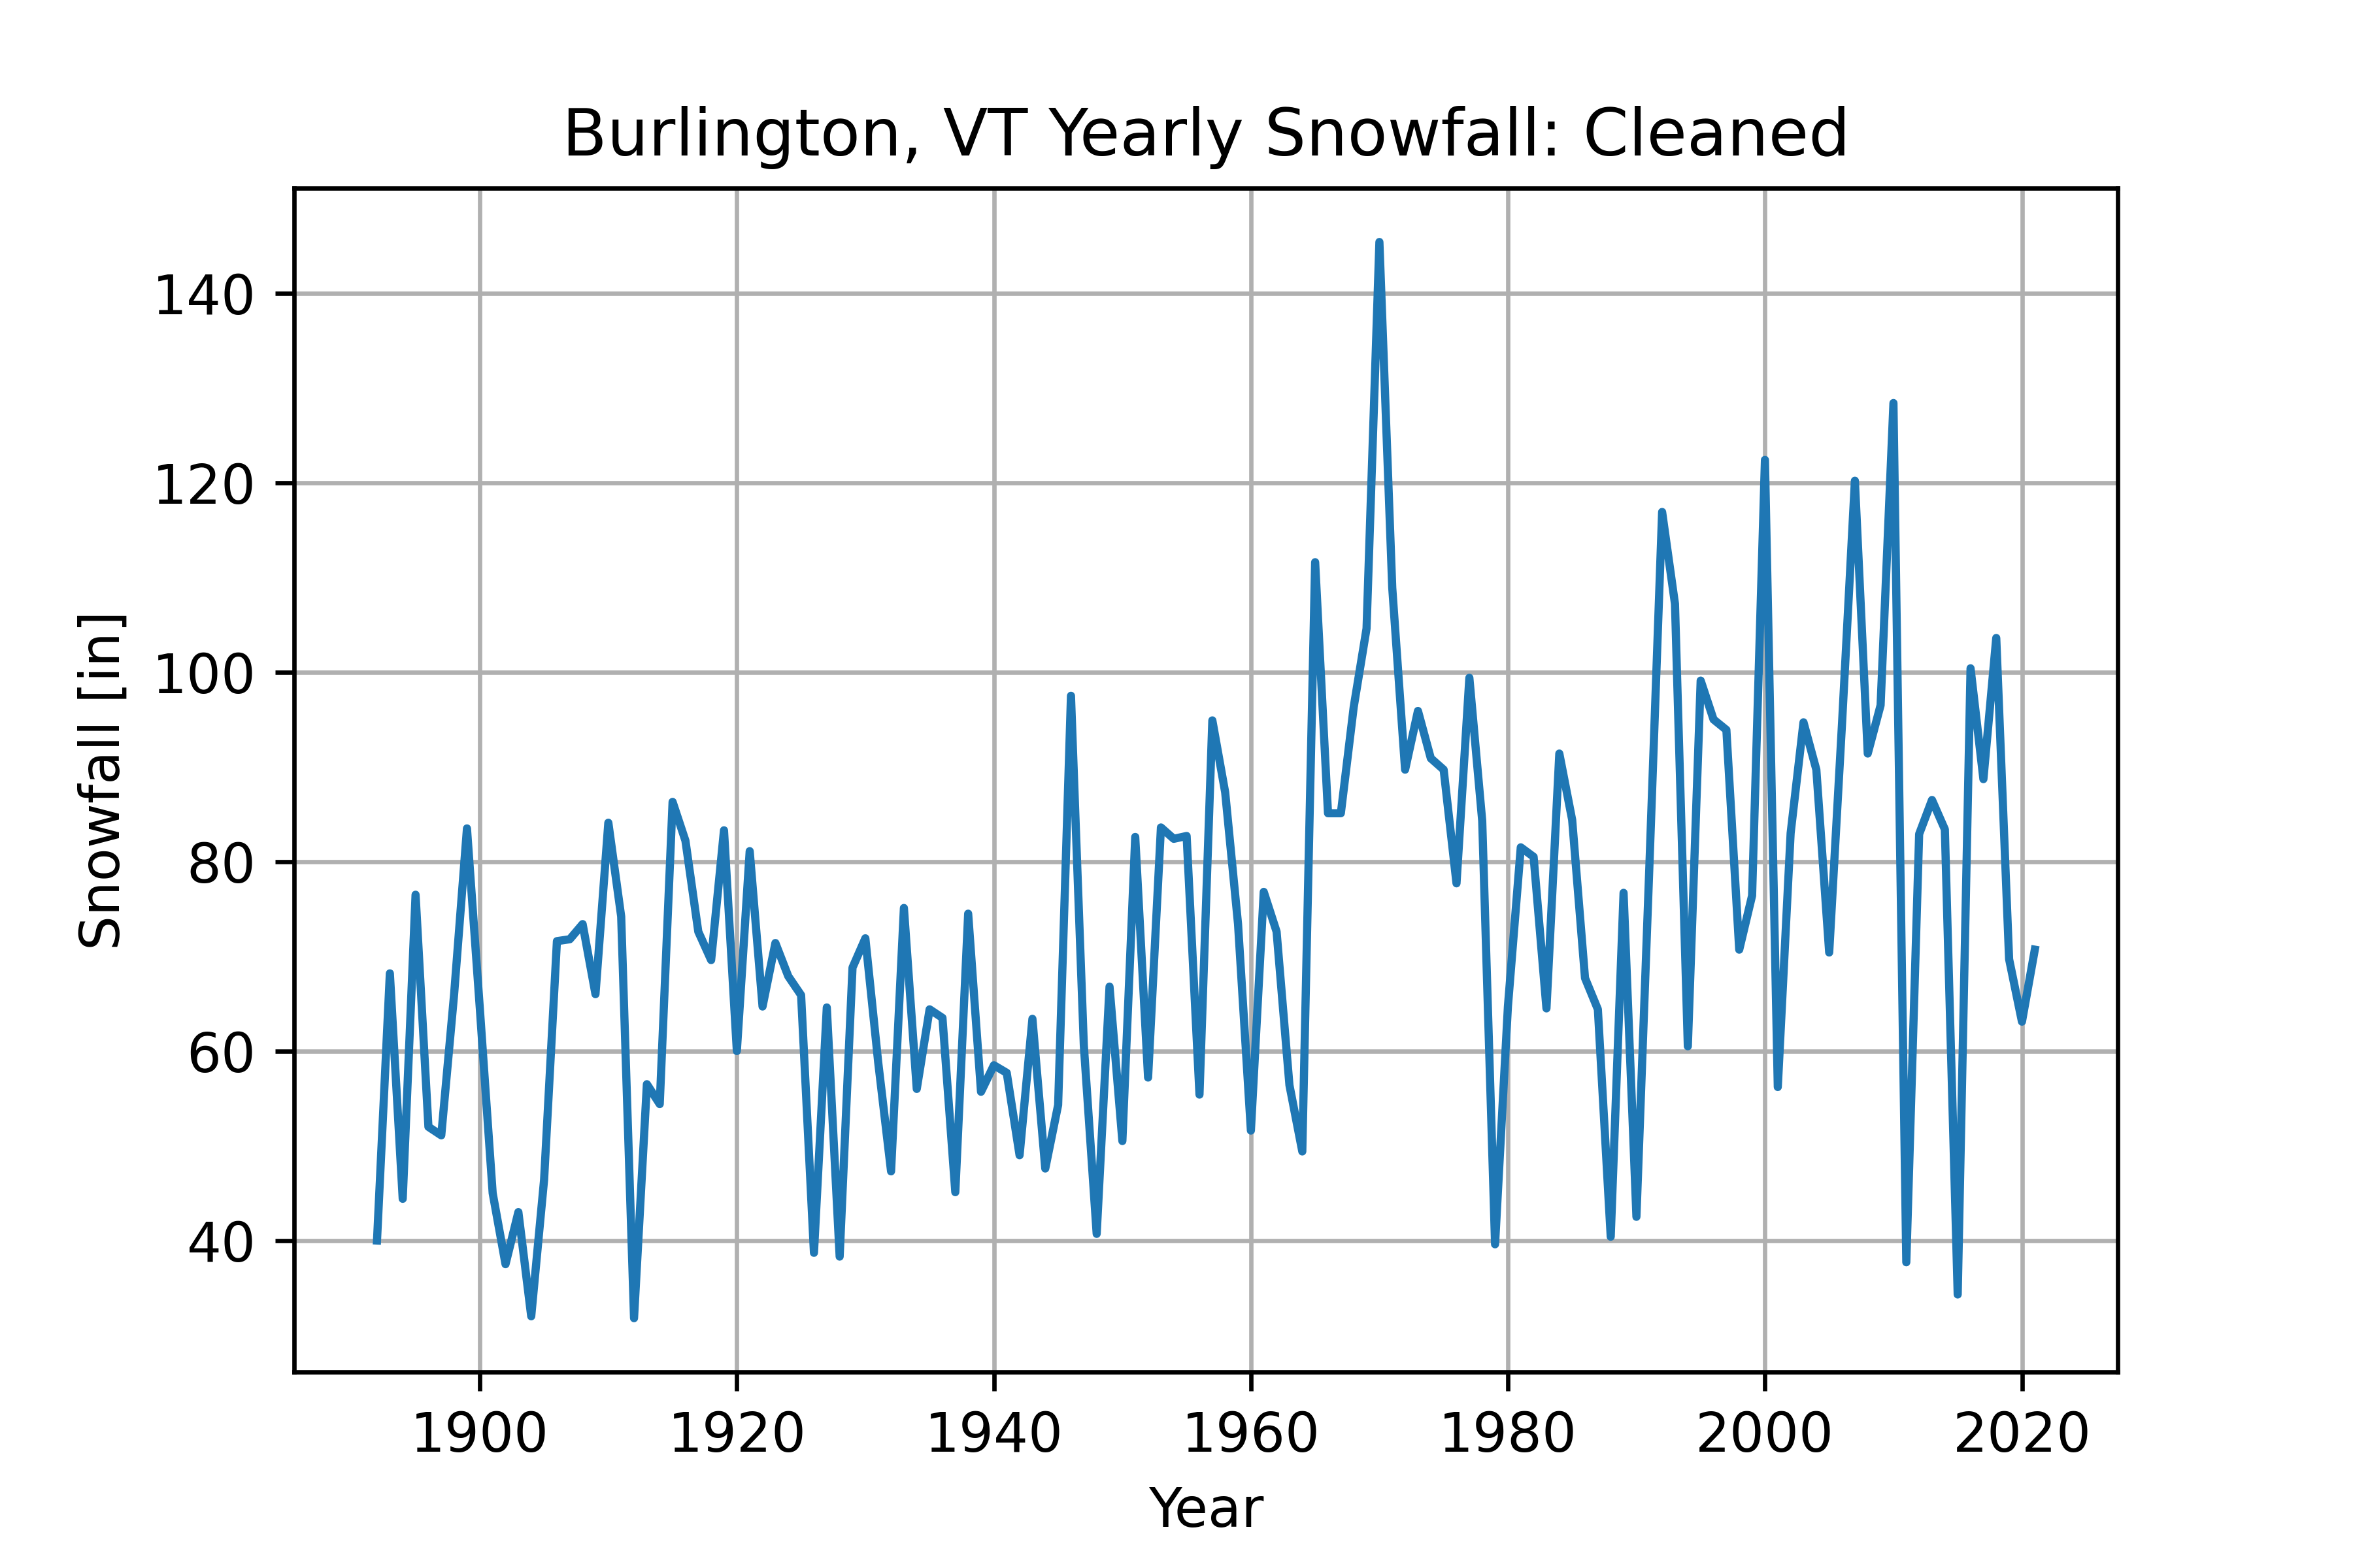
Research Goals
Burlington, VT Yearly Snowfall
Goal of this work is to predict future Vermont snowfall based on other weather features
Why not predict snowfall directly?
Snowfall trends are erratic (Figure 3)
Snowfall is dependent on other features (i.e. temperature) that are rapidly changing
Who does this benefit?
Economies that depend on snowfall (skiing, tourism, etc.)
Climatologists
Figure 3: snowfall data for Burlington, VT from 1892-2022 (data from https://www.weather.gov/btv/historicalSnow)

Slide 6
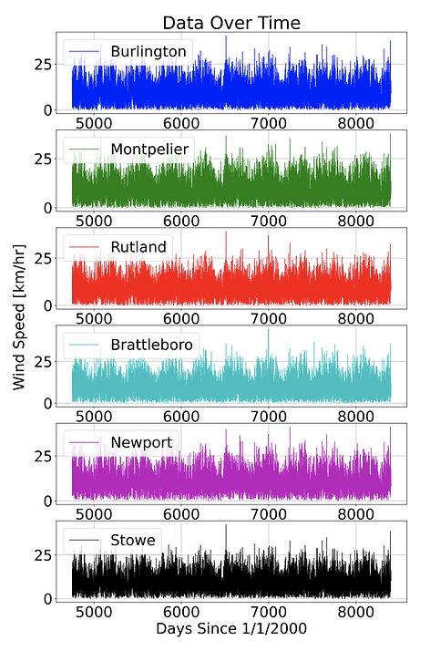
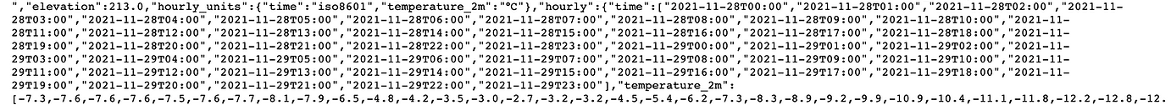
Data
Historical weather data gathered from Open-Meteo
10 years of hourly weather data gathered from six Vermont towns
Data includes 13 weather features (temperature, wind speed, etc.) as well as snowfall
Figure 4: raw data query in json format
Figure 5: cleaned data plotted

Slide 7
Method: Outline
What is needed to predict future snowfall?
A method for forecasting weather features into the future
A means of mapping weather features to snowfall
What methods can be used to achieve the above?
Time series forecasting
Neural networks (NNs)

Slide 8
Method: Time Series Forecasting
Time series forecasting is a means of predicting future time series data from historical time series data
Time series forecasting was completed independently for each of the 13 input features
Assumption: the features do not depend on each other (this is a major assumption, but given time/resource constraints is necessary)
Used Facebook’s Prophet algorithm [8]
Generalized Additional Model that uses a Bayesian approach to quantify uncertainty [9]

Slide 9
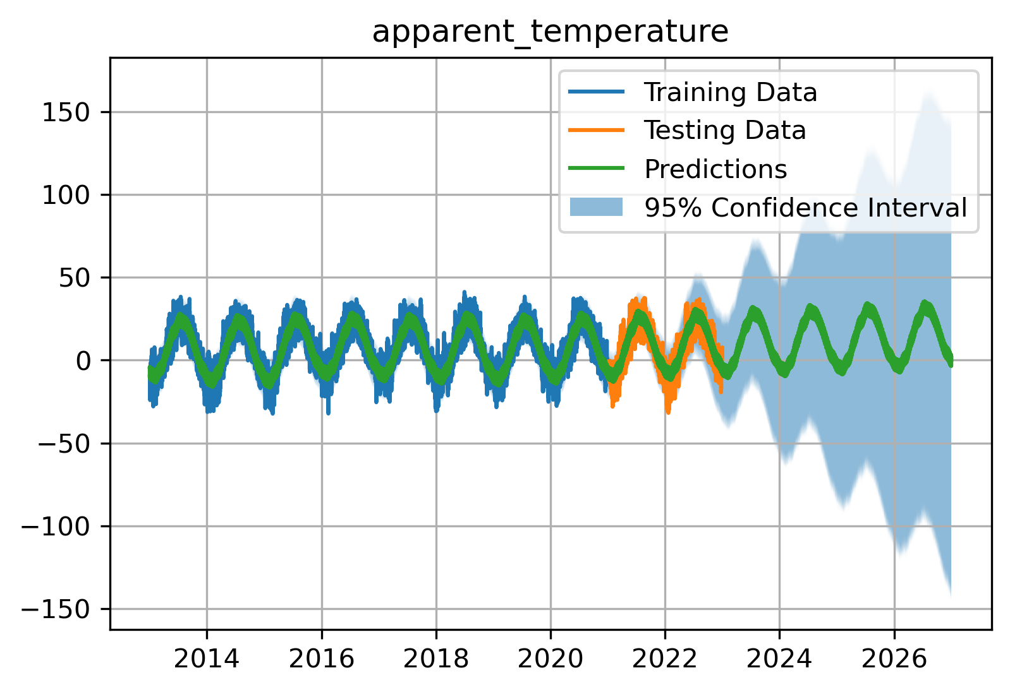
Results: Time Series Forecasting
Model captures seasonal trends
Uncertainty increases as time horizon from training data increases
Model may make non-physical predictions
Why? Because linear fit was used, which does not allow for constraints (logistic fit can impose constraints but drastically increases compute time)
Figure 6: time series forecasting for apparent temperature

Slide 10
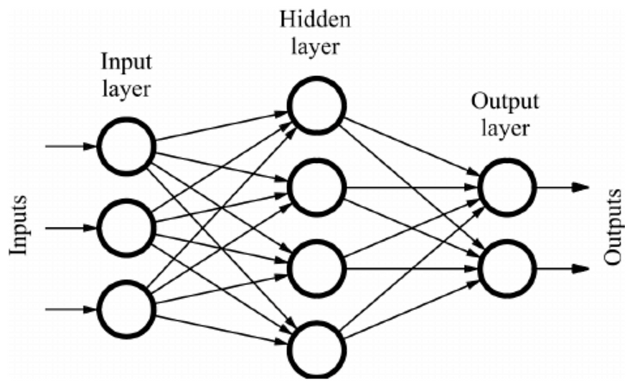
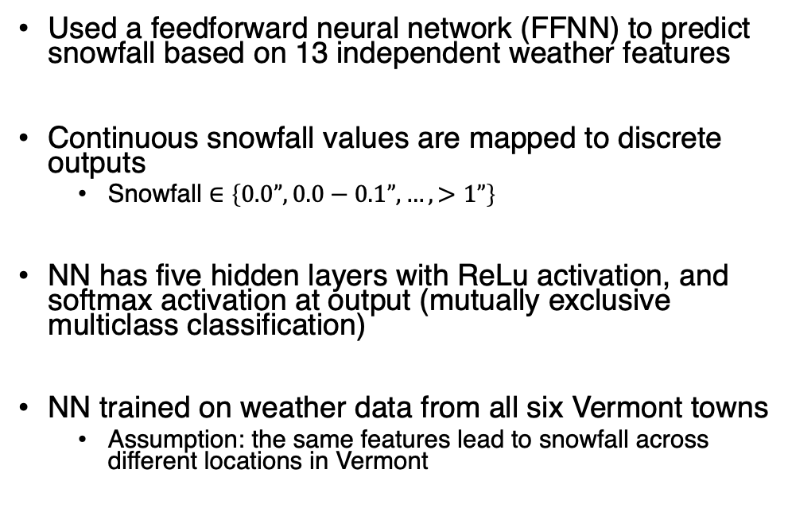
Method: Neural Networks
Used a feedforward neural network (FFNN) to predict snowfall based on 13 independent weather features
Continuous snowfall values are mapped to discrete outputs
Snowfall $∈\left\{0.0”, 0.0−0.1”, …, >1”\right\}$
NN has five hidden layers with ReLu activation, and softmax activation at output (mutually exclusive multiclass classification)
NN trained on weather data from all six Vermont towns
Assumption: the same features lead to snowfall across different locations in Vermont
Figure 7: FFNN structure [10]

Slide 11
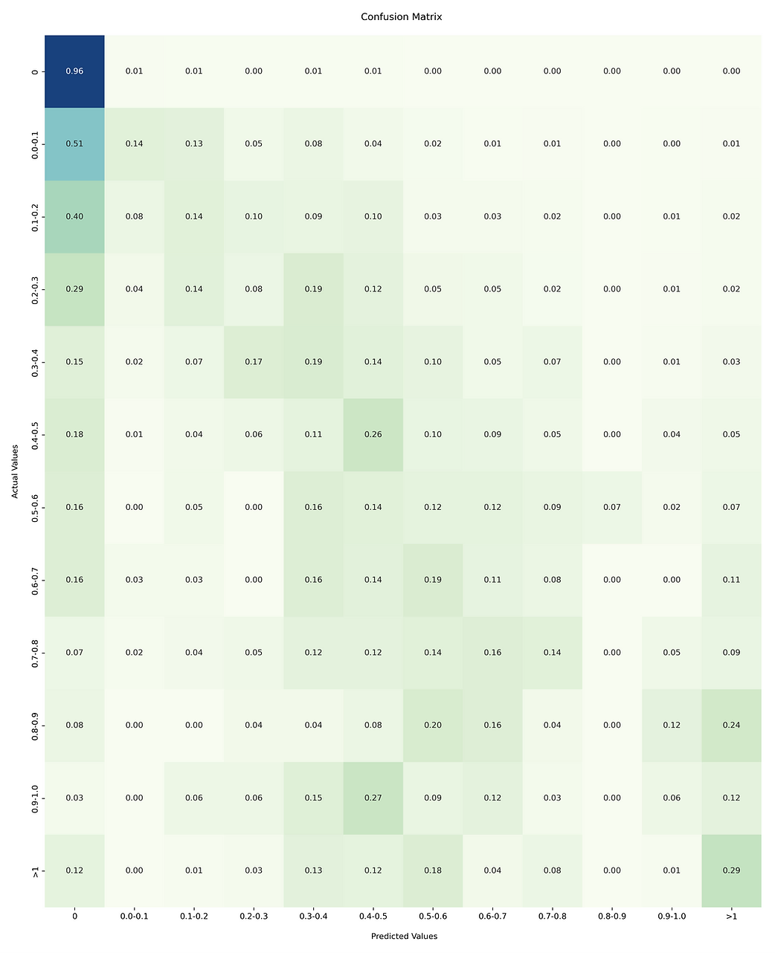
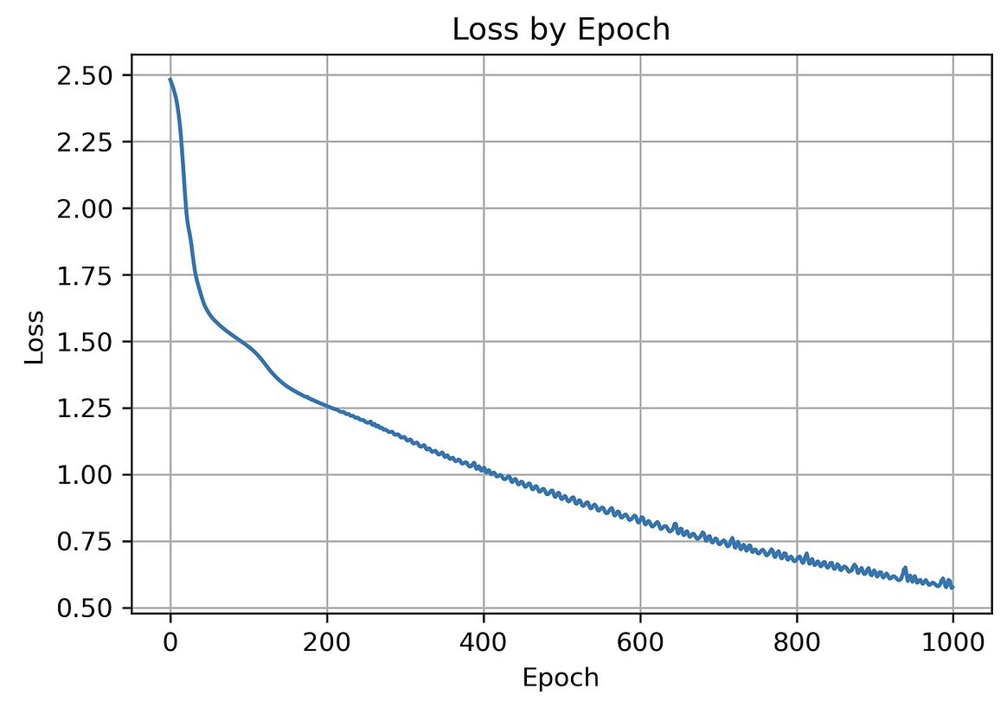
Results: Neural Networks
NN was trained for 1000 epochs
Confusion matrix indicates imperfect performance
Figure 8: FFNN training loss
Figure 9: FFNN normalized confusion matrix

Slide 12
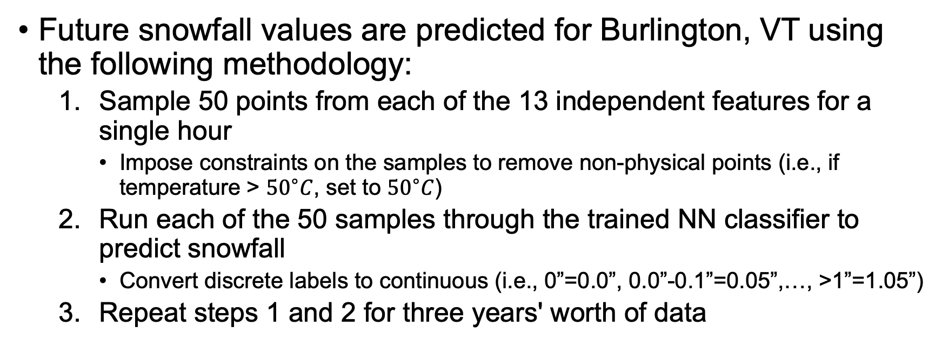
Method: Simulation
Future snowfall values are predicted for Burlington, VT using the following methodology:
Sample 50 points from each of the 13 independent features for a single hour
Impose constraints on the samples to remove non-physical points (i.e., if temperature > ${50}^{∘}C$, set to ${50}^{∘}C$)
Run each of the 50 samples through the trained NN classifier to predict snowfall
Convert discrete labels to continuous (i.e., 0”=0.0”, 0.0”-0.1”=0.05”,…, >1”=1.05”)
Repeat steps 1 and 2 for three years' worth of data

Slide 13
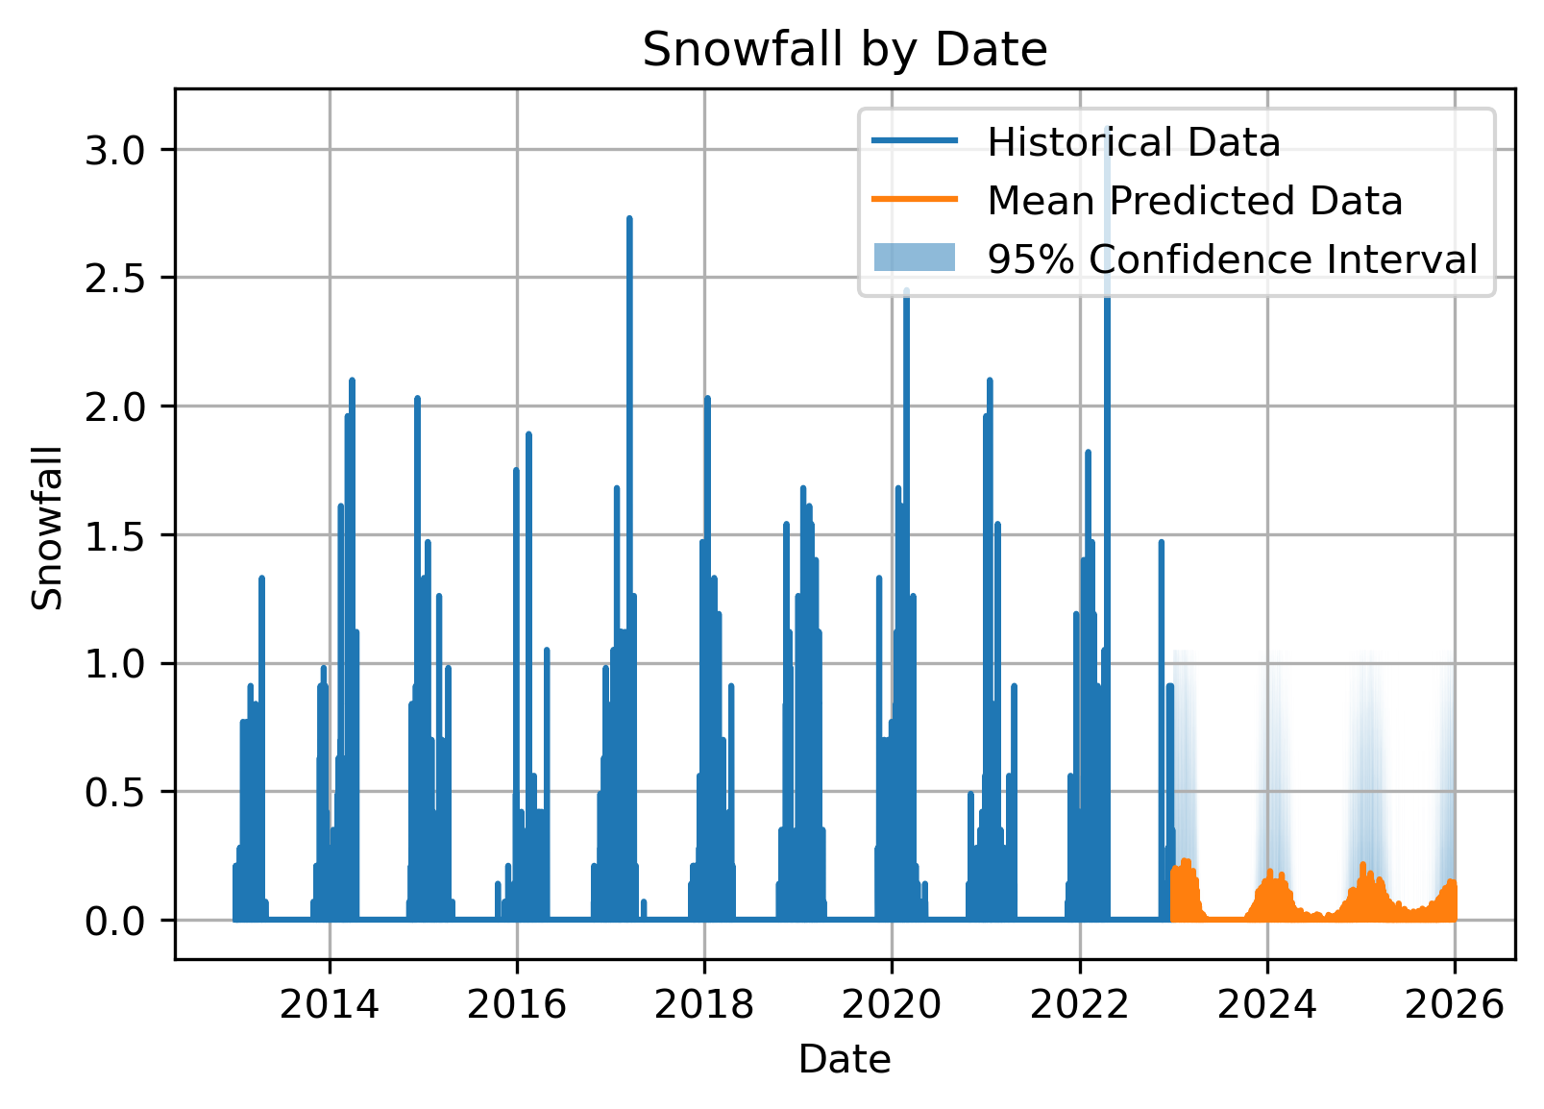
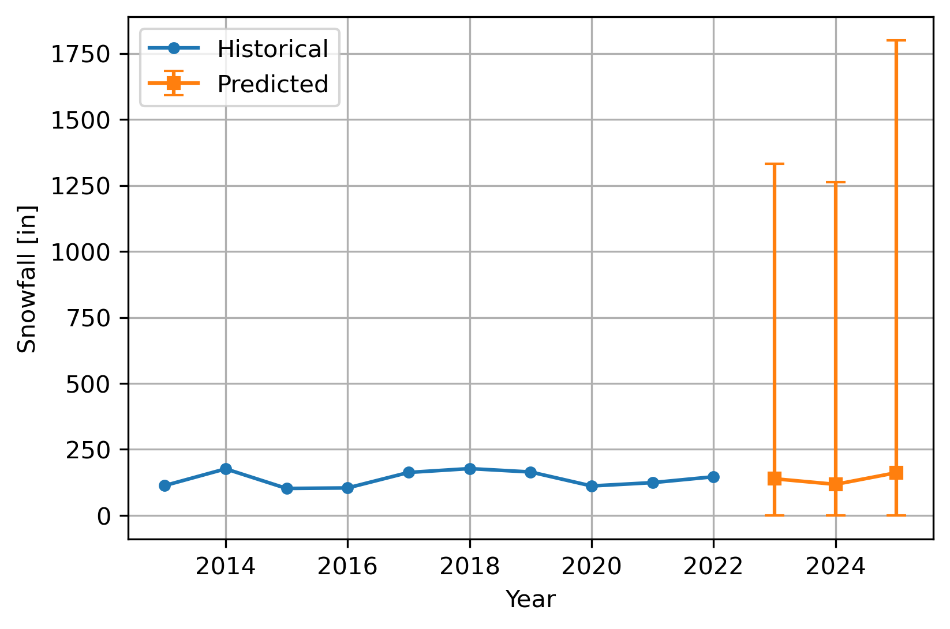
Results: Simulation
Model tends to drastically over-predict frequency of snowfall events, and under-predict intensity of individual events
Why are predictions poor?
Assumed features were independent in time series forecasting: NN is likely to be presented with data it was not trained on
NN was not adequately modeled/trained: a more sophisticated model would likely produce a more optimal confusion matrix
Figure 10: three years of hourly snowfall predictions
Figure 11: three years of yearly snowfall predictions

Slide 14
Conclusions
Developed a framework to predict future snowfall in Vermont
Used time series forecasting to propagate independent features into the future
Used a FFNN to map between independent features and snowfall
Created a simulation environment to predict statistical distribution of future snowfall
Framework could be extended to other geographic regions

Slide 15
Future Work
Time series forecasting
Impose physical constraints on samples
Do not assume feature independence
Neural network
Optimize structure of NN
Optimize hyperparameter tuning
Simulation
Run simulation on other Vermont towns
Run simulation with more historical data (i.e., 50 years) and propagate further into the future (i.e., 10 years)

Slide 16
References
[1] Riebeek, Holli. Global Warming. NASA, 3 June 2010, https://earthobservatory.nasa.gov/features/GlobalWarming.
[2] Rebecca Lindsey and Luann Dahlman. “Climate Change: Global Temperature.” NOAA Climate.gov, 28 Jan. 2023, https://www.climate.gov/news-features/understanding-climate/climate-change-global-temperature.
[3] “Climate Change Indicators: Weather and Climate.” EPA, Environmental Protection Agency, 1 Aug. 2022, https://www.epa.gov/climate-indicators/weather-climate.
[4] Lindsey, Rebecca. “Climate Change and the 1991-2020 U.S. Climate Normals.” NOAA Climate.gov, 19 Apr. 2021, https://www.climate.gov/news-features/understanding-climate/climate-change-and-1991-2020-us-climate-normals.
[5] “Climate Change.” Vermont Department of Health, 22 Mar. 2019, https://www.healthvermont.gov/health-environment/climate-health/climate-change.
[6] Kluver, Daria, and Daniel Leathers. “Winter Snowfall Prediction in the United States Using Multiple Discriminant Analysis.” International Journal of Climatology, vol. 35, no. 8, 2014, pp. 2003–2018., https://doi.org/10.1002/joc.4103.
[7] Burakowski, Elizabeth A., et al. “Trends in Wintertime Climate in the Northeastern United States: 1965–2005.” Journal of Geophysical Research, vol. 113, no. D20, 2008, https://doi.org/10.1029/2008jd009870.
[8] Krieger, Mitchell. “Time Series Analysis with Facebook Prophet: How It Works and How to Use It.” Medium, Towards Data Science, 2 Feb. 2022, https://towardsdatascience.com/time-series-analysis-with-facebook-prophet-how-it-works-and-how-to-use-it-f15ecf2c0e3a.
[9] “Introduction.” PyData, https://pydata.org/amsterdam2019/schedule/presentation/6/build-facebooks-prophet-in-pymc3-bayesian-time-series-analyis-with-generalized-additive-models/.
[10] DeepAI. “Feed Forward Neural Network.” DeepAI, DeepAI, 17 May 2019, https://deepai.org/machine-learning-glossary-and-terms/feed-forward-neural-network.

