Slide 1
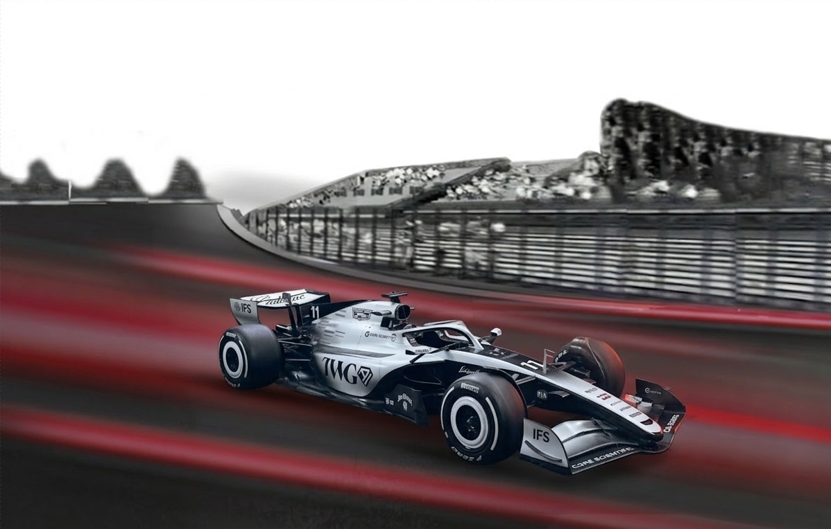

Formula 1
Formula 1
Telemetry Insights Visual Dashboard
Project Report By:
Eli Rose, Caden Williamson, Sam Brooks,
Blake Dismore, Kolby Stoll, and Nicholas Calhoun

Slide 2
Problem
Formula 1 is one of the most data-driven sports, yet driver impact is often overlooked
Engineers want to identify optimal lap patterns
Drivers benefit from objective performance feedback
What is hard about F1 telemetry analysis?
Raw lap data is massive, multidimensional, and difficult
to interpret
Hard to identify patterns in driver performance manually
Need automated way to group similar laps and identify driving styles

Slide 3
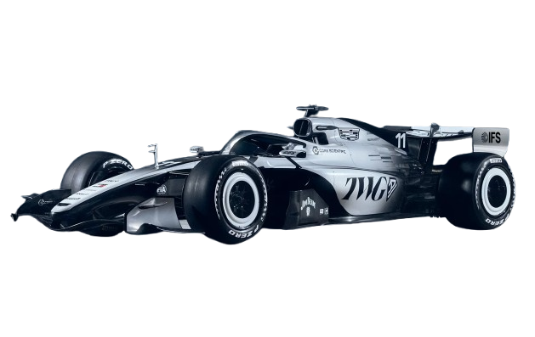
Objective
Transform raw F1 telemetry into meaningful driver insights​
Identify performance patterns through clustering algorithms​
  Group drivers into "driving styles"
Develop an interactive dashboard for intuitive data exploration
Given the choice between two open source F1 data sources​
  Tracing Insights vs FastF1​
Notes:
1 minute

Slide 4

Data Ingestion

Slide 5
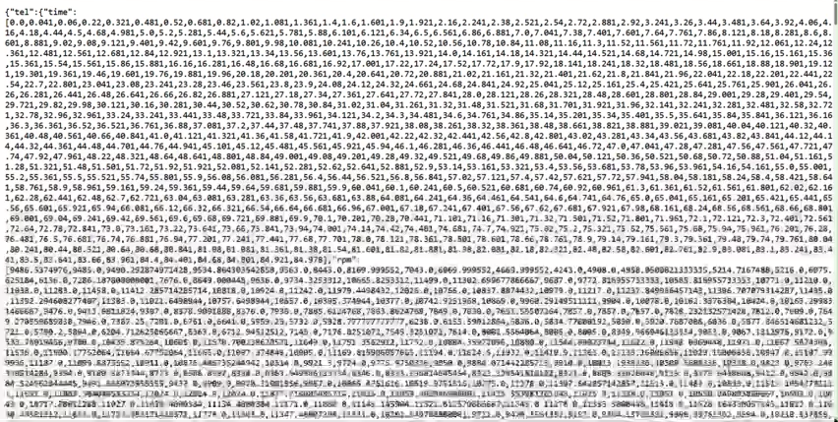
Initial Tracing Insights Data
Telemetry output for a single lap

Slide 6




Database Design
Started with a
1 Table Architecture
Transitioned to a
2 Table Architecture
Finalized a
48 Table Architecture
Conglomerate Table
Full Table Scan
SELECT Statements
  ~2 minutes per driver
Metadata Table vs Telemetry Table
Schema Rework
SELECT Statements
  ~1 minute per driver
  2x times speedup
2 Tables (Metadata / Telemetry) Per Race
Indexing / Table Rework
SELECT Statements
  ~1 second per driver
  60x speedup

Slide 7
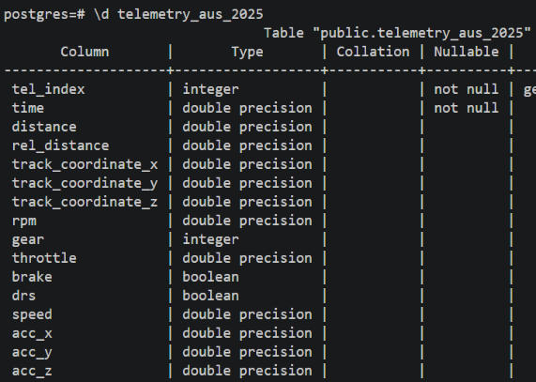
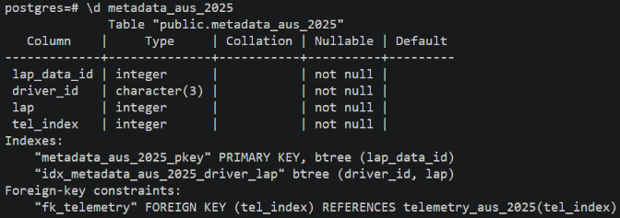
Database Schema
Indexing in Metadata for Fast Queries
~ 18,000,000 Total Telemetry Records!!
~ 750,000 Records Per Table
48 Total Tables
Notes:
45 seconds

Slide 8
Data Processing

Slide 9
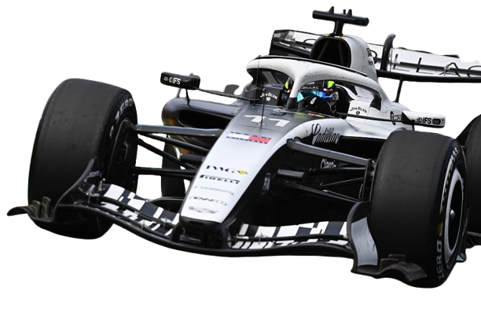
Metric Selection for Clustering
14 Total Telemetry Metrics
8 Selected Metrics
Throttle, RPM, Gear, Brake, Speed, Accel_x, Accel_y, Accel_z, Pos_x, Pos_y, Pos_z, Time, Rel_distance, and DRS
Throttle, RPM, Gear, Brake, Speed, Accel_x, Accel_y, Accel_z
Indexed by Relative Distance
Notes:
30 seconds (Sam)

Slide 10
Data Preprocessing
Data Reindexing
Aligned all lap data to track distance
Interpolated from existing data
Grid of 500 points per lap
Data Normalization
Scaled all telemetry metrics to a [0, 1] range
Applied a 5-lap rolling window for local min-max normalization
Removed mechanical bias from faster / slower cars
Outlier Detection
Dropped laps with low average speed
Used a 1.5 x IQR for a lower bound
Detected pit laps, caution laps, laps with strange traffic

Slide 11
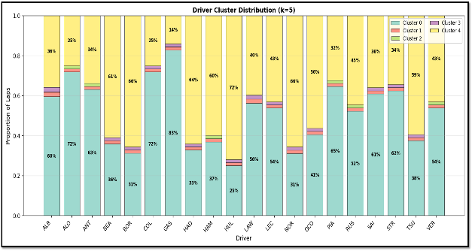
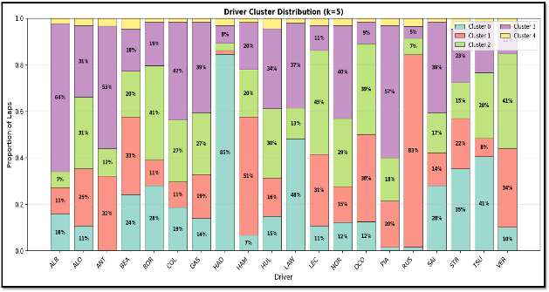
Dimensionality Reduction (PCA)
Without PCA
With PCA

Slide 12
Clustering

Slide 13
Clustering Algorithm Selection
These options are the most common unsupervised machine learning algorithms
K-Means
Hierarchical
Gaussian
DBSCAN
SELECTED
TESTED
TESTED
TESTED
✔ STRENGTHS
✔ STRENGTHS
✔ STRENGTHS
✔ STRENGTHS
Fast & scalable to 18M+ records
Works well after PCA reduction
Easy to tune cluster count (k)
No need to pre-specify k
Dendrogram reveals structure
Soft/probabilistic assignments
Handles elliptical clusters
No cluster count needed
Auto-detects noise/outliers
✘ LIMITATIONS
✘ LIMITATIONS
✘ LIMITATIONS
O(n²) memory — too slow for 18M+ records
Cannot scale to full 2025 season
Works best on smaller data sets
Assumes Gaussian distributions
Unstable on high-dim PCA space
Higher compute cost
Struggles with varying density
ε tuning sensitive — poor cluster consistency across tracks
✘ LIMITATIONS
Requires pre-specifying k
Assumes convex clusters
Silhouette: 0.0653 | Davies-Bouldin: 2.61
Ruled out: memory constraint
Ruled out: distribution assumption mismatch
Ruled out: inconsistent clusters per race
Four algorithms evaluated — K-Means selected for performance and interpretability

Slide 14
K-Means Clustering
Cluster Representation Examples
Cluster Evaluation Methods:
Elbow Method – identifies diminishing returns in cluster separation
Silhouette Score – measures cluster cohesion vs separation
Davies-Bouldin Index – evaluates cluster similarity (lower is better)
Cluster 1
High Aggression
High RPM, throttle, speed — peak-performance laps
Cluster 2
Controlled Push
Elevated throttle, measured braking — raceable pace
Cluster 3
Balanced
Avg. across all metrics — representative race lap
Cluster 4
Our Findings after many experimental models
K-Means at 6 clusters produced the most well-balanced clusters (~1-2 outlier groups per race)
Clusters can vary wildly depending on the track
Metrics can be misleading
Cautious
Lower throttle/speed — caution laps or degradation
Cluster 5
Conservation
Low RPM, heavy coasting — tire/fuel management
We leave it up to the user to explore
the data and label the groups

Slide 15
Front End

Slide 16



Deployment Stack
Accessed through a porkbun domain, served through NGINX, hosted on an AWS EC2 Instance.

Slide 17
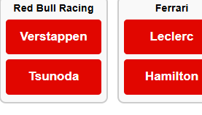
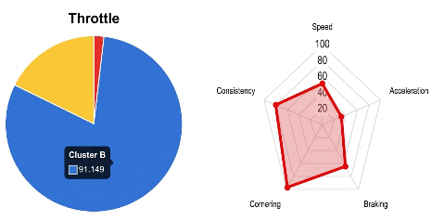
Use Cases
Track Selection
Driver
Selection
Statistics Exploration
Dropdown lists all 24 circuits from the 2025 season.
Click on a driver to view their metrics and make comparisons.
One pie chart per metric.
Throttle, RPM, Gear, Brake, Acceleration, etc.
Radar Charts displaying
multivariate clustering results.
Notes:
30 seconds (Sam)

Slide 18
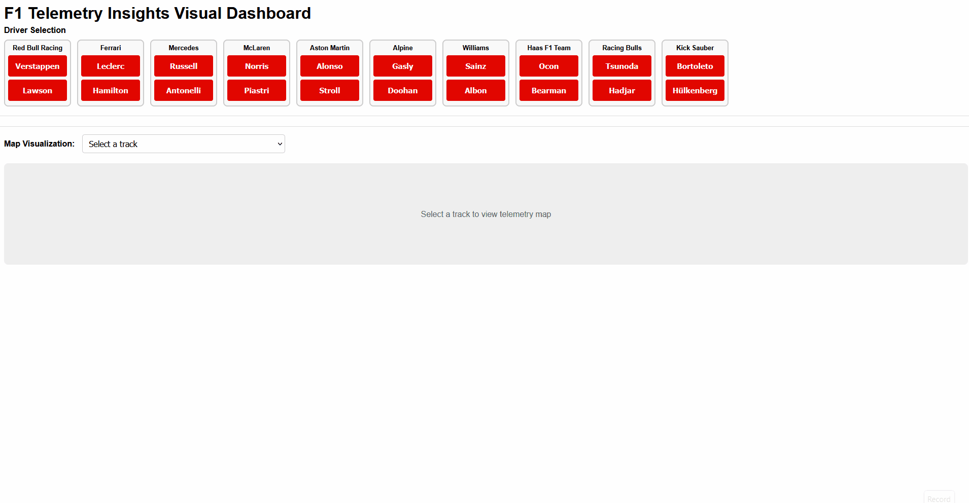
Website
Insert technical info on front end

Slide 19
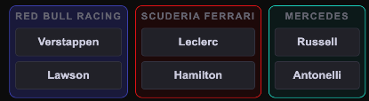

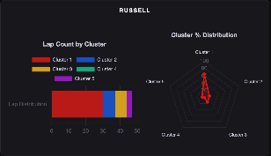
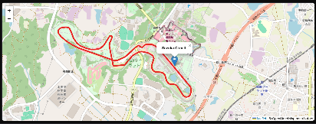
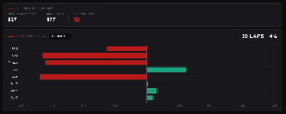
Updated Use Cases
Driver
Selection
Statistics Exploration
Map Visualization
Click on a driver to view their metrics and make comparisons.
Bar chart shows lap count
by cluster
Radar Chart displays
clustering distribution.
Includes lap ingestion summary for further clustering analysis
Track Selection
Dropdown menu updates map visualization and statistics block
Notes:
30 seconds (Sam)

Slide 20
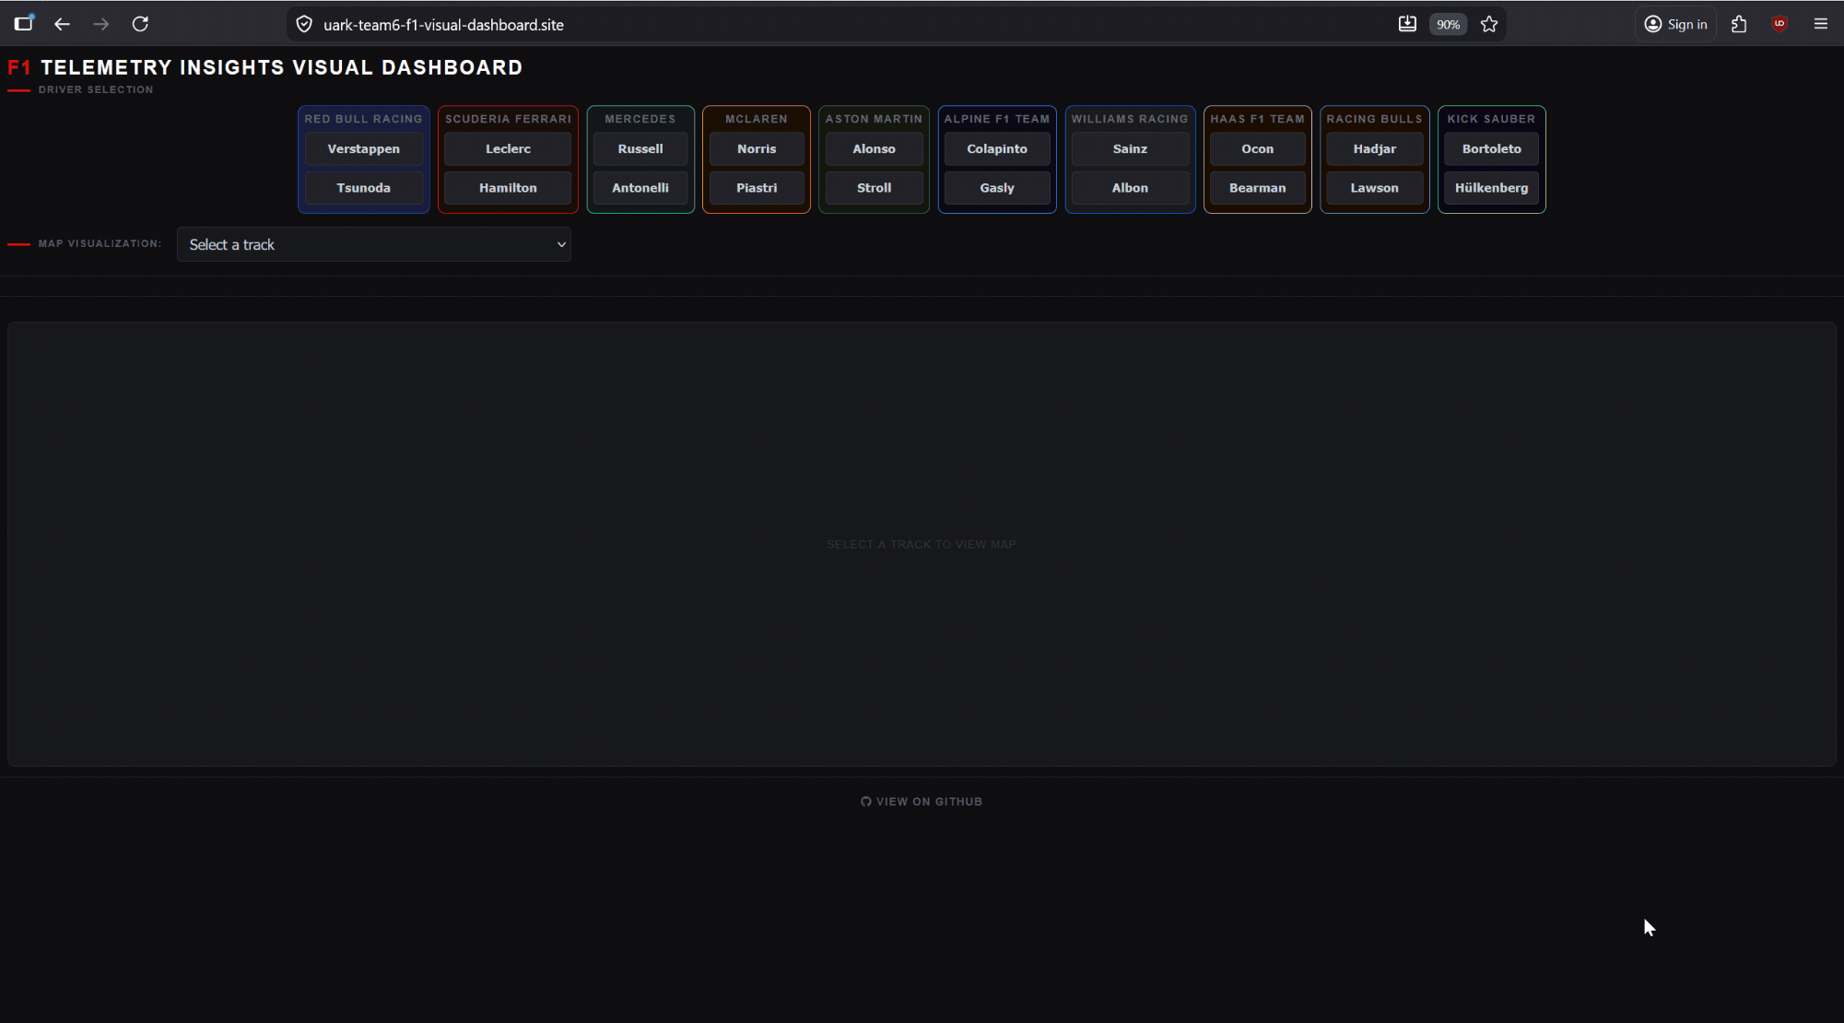
Website V2

Slide 21
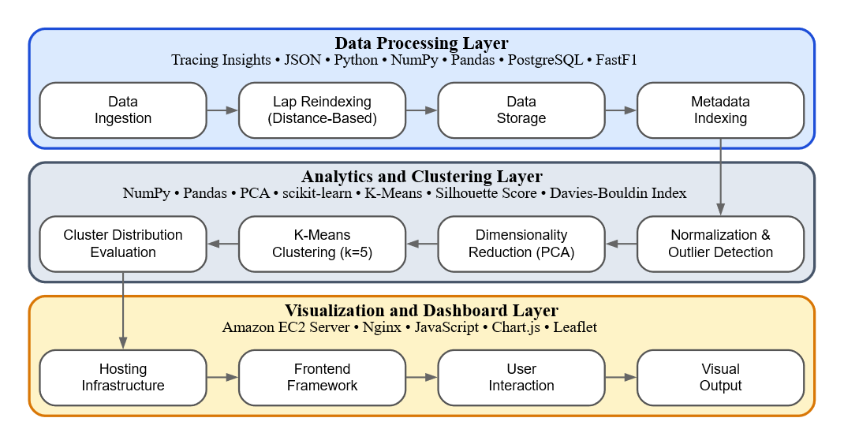
Architecture
Notes:
1 minute
30 Seconds on AWS EC2 (Sam)

Slide 22
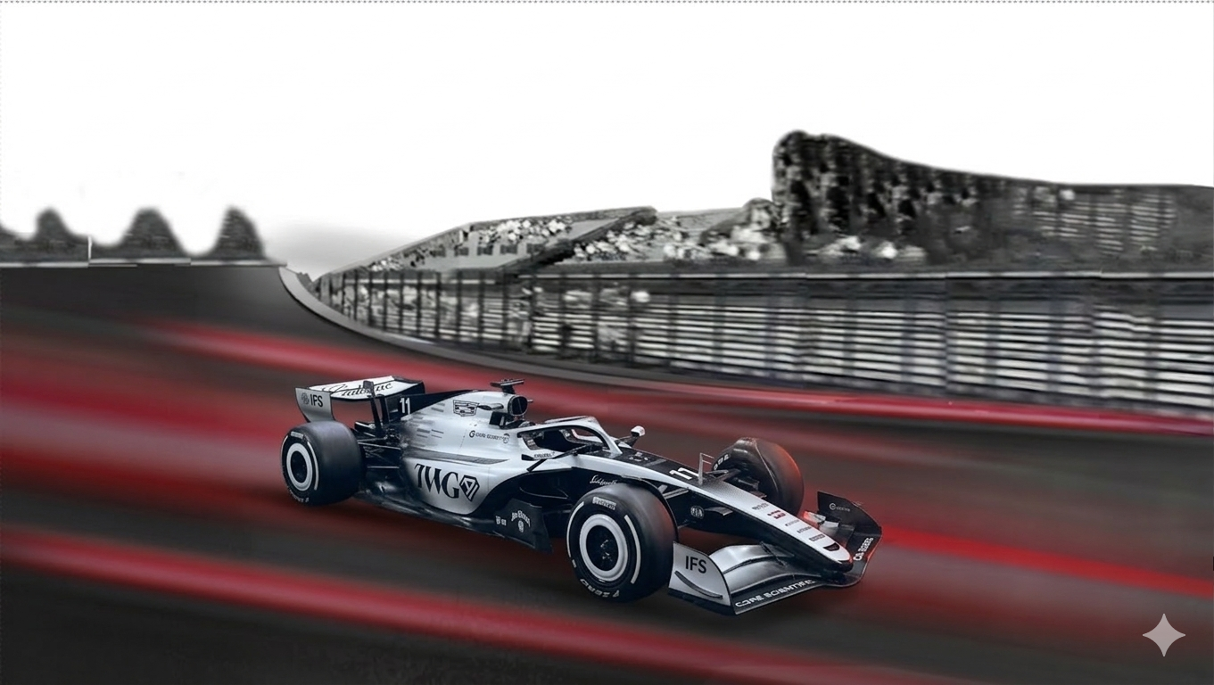

Formula 1
Formula 1
Telemetry Insights Visual Dashboard
All the way back to the starting line...

