Slide 1
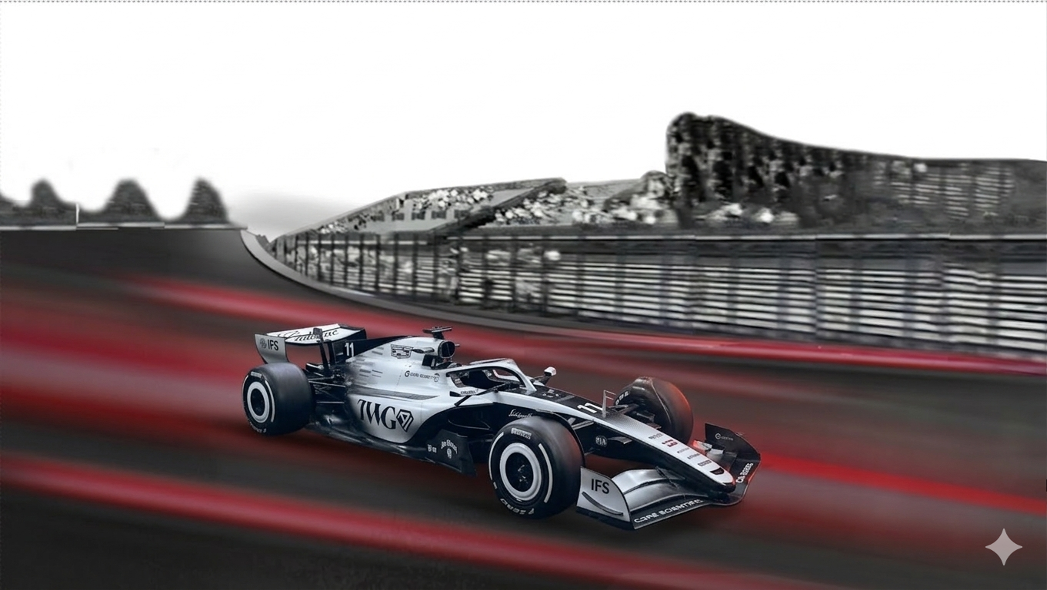

Formula 1
Formula 1
Telemetry Insights Visual Dashboard
Project Report By:
Eli Rose, Caden Williamson, Sam Brooks,
Blake Dismore, Kolby Stoll, and Nicholas Calhoun

Slide 2
Problem
Formula 1 is one of the most data-driven sports, yet driver impact is often overlooked
Engineers want to identify optimal lap patterns
Drivers benefit from objective performance feedback
What is hard about F1 telemetry analysis?
Raw lap data is massive, multidimensional, and difficult
to interpret
Hard to identify patterns in driver performance manually
Need automated way to group similar laps and identify driving styles

Slide 3
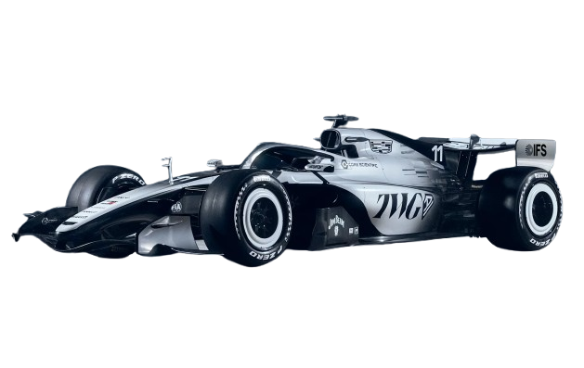
Objective
Transform raw F1 telemetry into meaningful driver insights​
Identify performance patterns through clustering algorithms​
  Group drivers into "driving styles"
Develop an interactive dashboard for intuitive data exploration
Given the choice between two open source F1 data sources​
  Tracing Insights vs FastF1​
Notes:
1 minute

Slide 4
Architecture
Notes:
1 minute
30 Seconds on AWS EC2 (Sam)

Slide 5
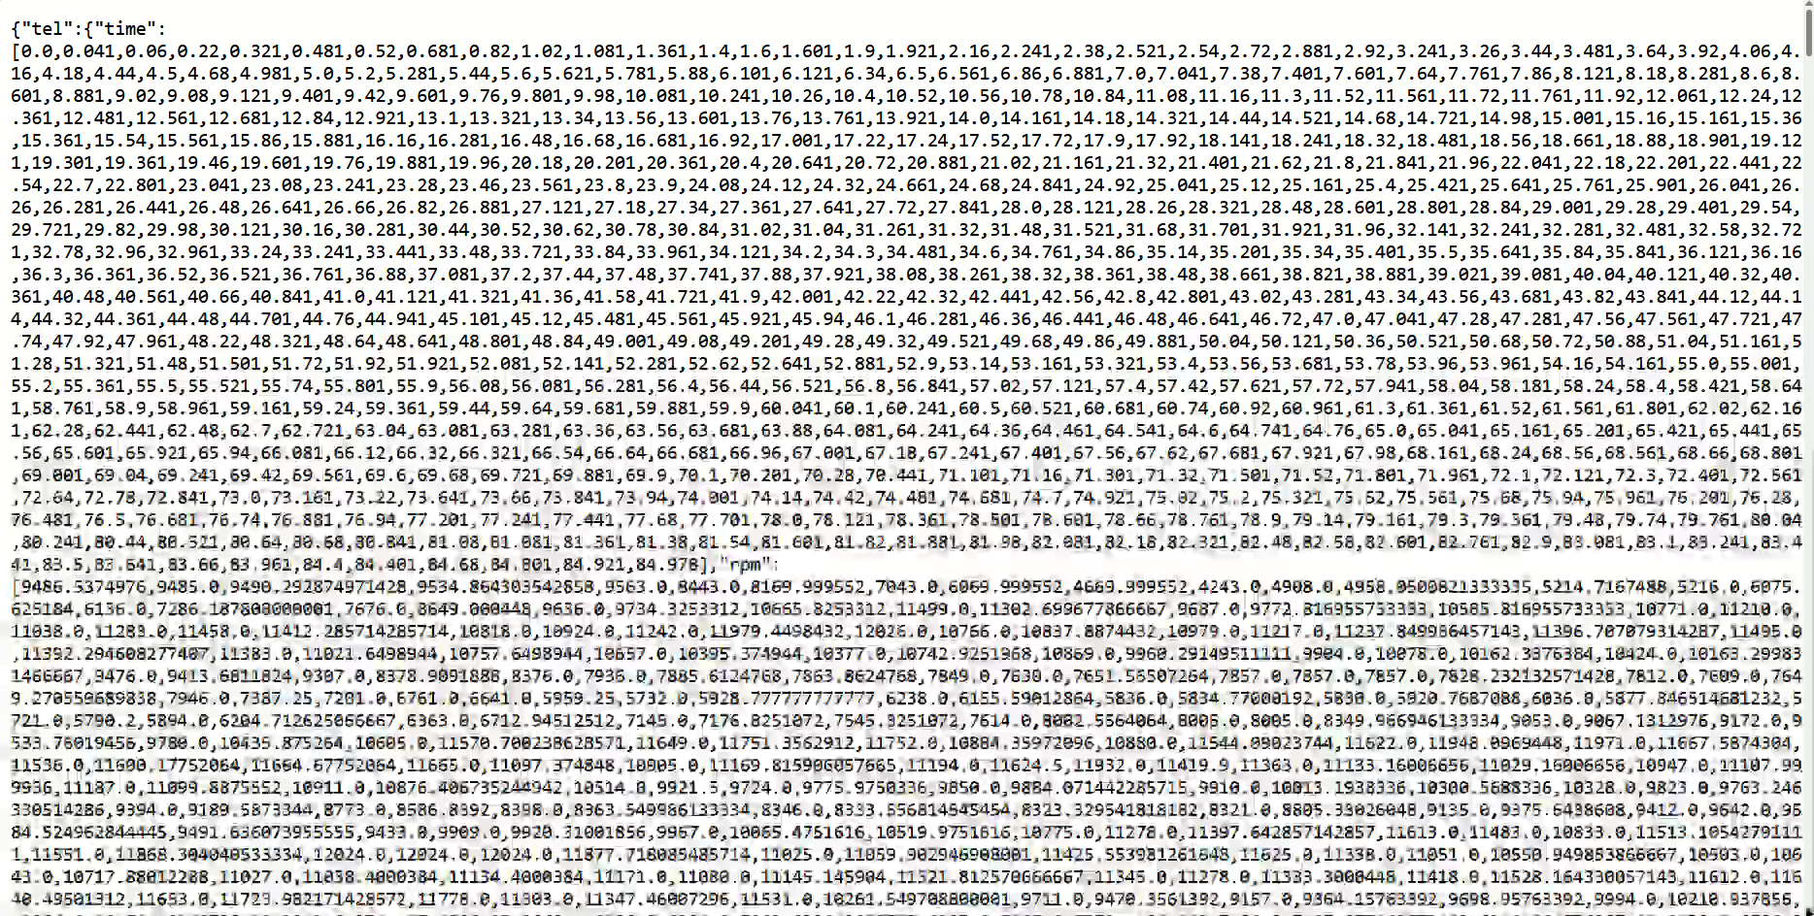
Initial Tracing Insights Data
Telemetry output for a single lap
14 Total Telemetry Metrics
8 Selected Metrics
Throttle, RPM, Gear, Brake, Speed, Accel_x, Accel_y, Accel_z
Indexed by Relative Distance

Slide 6
Clustering Algorithm Selection
These options are the most common unsupervised machine learning algorithms
K-Means
Hierarchical
Gaussian
DBSCAN
SELECTED
TESTED
TESTED
TESTED
✔ STRENGTHS
✔ STRENGTHS
✔ STRENGTHS
✔ STRENGTHS
Fast & scalable to 18M+ records
Works well after PCA reduction
Easy to tune cluster count (k)
No need to pre-specify k
Dendrogram reveals structure
Soft/probabilistic assignments
Handles elliptical clusters
No cluster count needed
Auto-detects noise/outliers
✘ LIMITATIONS
✘ LIMITATIONS
✘ LIMITATIONS
O(n²) memory — too slow for 18M+ records
Cannot scale to full 2025 season
Works best on smaller data sets
Assumes Gaussian distributions
Unstable on high-dim PCA space
Higher compute cost
Struggles with varying density
ε tuning sensitive — poor cluster consistency across tracks
✘ LIMITATIONS
Requires pre-specifying k
Assumes convex clusters
Silhouette: 0.0653 | Davies-Bouldin: 2.61
Ruled out: memory constraint
Ruled out: distribution assumption mismatch
Ruled out: inconsistent clusters per race
Four algorithms evaluated — K-Means selected for performance and interpretability

Slide 7
K-Means Clustering
Cluster Representation Examples
Cluster Evaluation Methods:
Elbow Method – identifies diminishing returns in cluster separation
Silhouette Score – measures cluster cohesion vs separation
Davies-Bouldin Index – evaluates cluster similarity (lower is better)
Cluster 1
High Aggression
High RPM, throttle, speed — peak-performance laps
Cluster 2
Controlled Push
Elevated throttle, measured braking — raceable pace
Cluster 3
Balanced
Avg. across all metrics — representative race lap
Cluster 4
Our Findings after many experimental models
K-Means at 6 clusters produced the most well-balanced clusters (~1-2 outlier groups per race)
Clusters can vary wildly depending on the track
Metrics can be misleading
Cautious
Lower throttle/speed — caution laps or degradation
Cluster 5
Conservation
Low RPM, heavy coasting — tire/fuel management
We leave it up to the user to explore
the data and label the groups

Slide 8



Deployment Stack
Accessed through a porkbun domain, served through NGINX, hosted on an AWS EC2 Instance.

Slide 9

Website
uark-team6-f1-visual-dashboard.site

Slide 10
Formula 1
Formula 1
Telemetry Insights Visual Dashboard
All the way back to the starting line...

