Slide 1

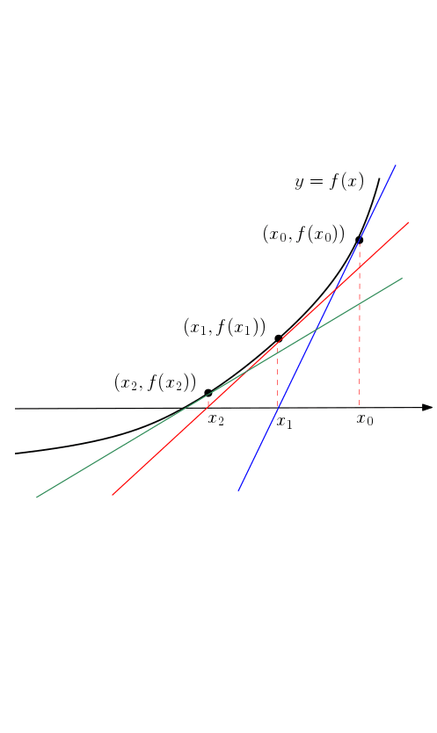
Statistical Analysis Presentation
Presented by: Elias Medig
Due: Monday, 27 January 2025

Slide 2
Agenda
1. Introduction
2. Descriptive Statistics
3. Inferential Statistics
4. Findings
5. Conclusion & Recommendation
6. Appendix

Slide 3


Introduction
According to the Office for National Statistics (2018), approximately 57% of individuals aged 16 or older in Great Britain consumed alcohol in 2017, based on responses from their study.
This presentation takes a closer look at the data by analysing it with statistical methods.
Data from Health Survey for England
R Studio for Data Analytics
Tasks: 1

Slide 4
Descriptive Statistics
Metric | Measurement
How many people are included in the sample? | 10617
What is the percentage of people who drink alcohol? | 63.2%*
What is the percentage of women in the sample? | 57.7%
What is the highest educational level? | NVQ4/NVQ5/Degree or equiv.
What is percentage of divorced and separated people? | 5.6%**
*if the samples with no response are excluded the number would be 78.65%
**if the samples with no response are excluded the number would be 6.9%
Tasks: 2a, 2b, 2c, 2d, 2e

Slide 5
Descriptive Statistics
Metric | Household Size | BMI | Age at last birthday
Mean | 2.85 | 25.92 | 41.56
Median | 3 | 25.59 | 42
Mode | 2 | 25.32 | 64
Minimum | 1 | 8.34 | 0
Maximum | 10 | 65.28 | 100
Range | 1 - 10 | 8.34 – 65.28 | 0 - 100
Standard Deviation | 1.36 | 6.14 | 23.83
Tasks: 2f

Slide 6
Inferential Statistics
Tasks: 3a

Slide 7
Inferential Statistics
Null Hypothesis: The data shows no statistically relevant correlation between gender and alcohol consumption
R Query: t.test(totalwu ~ Sex, data = HSE_2011)
Result: The p-value was < 2.2e-16. This indicates that the null hypothesis can be rejected which means that there is an association between gender and alcohol consumption. Male people tend to consume more alcohol.
Tasks: 3a

Slide 8
Inferential Statistics
Null Hypothesis: The data shows no statistically relevant correlation between regions and alcohol consumption
R Query: HSE_2011$gor1 <- factor(HSE_2011$gor1) kruskal.test(totalwu ~ gor1, data = HSE_2011)
Result: The p-value was 2.199e-14. This result indicates that the null hypothesis can be rejected which means that there is a correlation between region and alcohol consumption.
Tasks: 3b

Slide 9
Inferential Statistics
Region | % drinking
London | 69%
North West | 76%
Yorks & Humber | 77%
West Midlands | 77%
North East | 81%
East Midlands | 82%
East of England | 82%
South East | 82%
South West | 84%
Tasks: 3b

Slide 10
Inferential Statistics
Tasks: 3b

Slide 11
Inferential Statistics
Null Hypothesis: The valid height of men is the same as the valid height of women.
R Query: t.test(htval ~ Sex, data = HSE_2011)
Result: The p-value was < 2.2e-16. This indicates that the null hypothesis can be rejected which means that there is a statistical difference in height between men and women.
Tasks: 3c I

Slide 12
Inferential Statistics
Null Hypothesis: The valid weight of men is the same as the valid weight of women.
R Query: t.test(wtval ~ Sex, data = HSE_2011
Result: The p-value was < 2.2e-16. This indicates that the null hypothesis can be rejected which means that there is a statistical difference in weight between men and women.
Tasks: 3c II

Slide 13
Inferential Statistics
R Query for creation of Correlation Matrix:
df_corr <- data.frame( drinks_now = HSE_2011$dnnow, total_income = HSE_2011$totinc, age = HSE_2011$Age, sex = HSE_2011$Sex )
cor_mat
Tasks: 3d

Slide 14
Inferential Statistics
Correlation Matrix:
 | Drinks | Income | Age | Gender
Drinks | 1 | 0.073 | 0.077 | 0.116
Income | 0.073 | 1 | 0.051 | 0.003
Age | 0.076 | 0.051 | 1 | - 0.016
Gender | 0.117 | 0.003 | - 0.016 | 1
Note: We could use the cor.test() function for further analysis of each correlation in the correlation matrix. This way we could get a better understanding of the p-value of each correlation.
Most correlations are very weak and besides Age and Gender all pairs have a positive correlation. The strongest correlation is found between gender and alcoholic consumption.
Tasks: 3d

Slide 15


Findings: Analytics Results
Gender and alcohol consumption
Region and alcohol consumption
Tasks: 4

Slide 16
Findings: Gender and Alcohol
Not only the amount but also the type of alcoholic beverage consumed is different. Men tend to preferer beer while woman drink more wine (Meier et al., 2021).
Alcohol consumption significantly increases the aggression between male and female poeple (Crane et al., 2016).
The alcohol consumption of women has increased, and the gender gap is narrowing over the last years due to sociocultural and economic factors (Moinuddin et al. 2016).
Hasin, Grant, and Weinflash (1988) found that male and female alcohol rehabilitation patients differed in drinking patterns and social consequences but showed no significant differences in dependence or health issues, despite females having a shorter history of problem drinking.
Tasks: 4

Slide 17

Conclusion & Recommendation
There is a significant difference in the amount of alcohol consumed between males and females, as well as across different regions where people live.
Recommendation
Rise Awareness
Further investigation of data and research
Adjust policies
Tasks: 5

Slide 18
Thank you
Presented by: Elias Medig Due: Monday, 27 January 2025

Slide 19
Appendix
References:
Office for National Statistics (2018) Adult drinking habits in Great Britain: 2017. [Online] Available from: https://www.ons.gov.uk/peoplepopulationandcommunity/healthandsocialcare/drugusealcoholandsmoking/bulletins/opinionsandlifestylesurveyadultdrinkinghabitsingreatbritain/2017 [Accessed 19 January 2022].
Meier, P.S., Holmes, J., Brennan, A. and Angus, C., 2021. Alcohol policy and gender: a modelling study estimating gender‐specific effects of alcohol pricing policies. Addiction, 116(9), pp.2372-2384.
Moinuddin, A., Goel, A., Saini, S., Bajpai, A. and Misra, R., 2016. Alcohol consumption and gender: a critical review. J Psychol Psychother, 6(3), pp.1-4.
Crane, C.A., Godleski, S.A., Przybyla, S.M., Schlauch, R.C. and Testa, M., 2016. The proximal effects of acute alcohol consumption on male-to-female aggression: A meta-analytic review of the experimental literature. Trauma, Violence, & Abuse, 17(5), pp.520-531.
Hasin, D.S., Grant, B.F. and Weinflash, J., 1988. Male/female differences in alcohol-related problems: Alcohol rehabilitation patients. International journal of the addictions, 23(5), pp.437-448.
Task: 6

