Slide 1

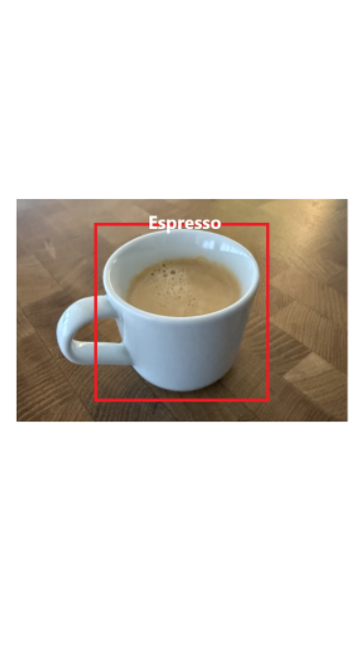
Individual Presentation: Neural Network for Object Detection
Presented by: Elias Medig

Slide 2
Agenda
Introduction
Dataset
Architecture
Activation Function
Loss Function
Epochs
Neural Network Strategy
Results
Conclusion
Appendix

Slide 3



1.1 Introduction
The goal is to develop a Neural Network for object recognition.
This is an espresso!

Slide 4
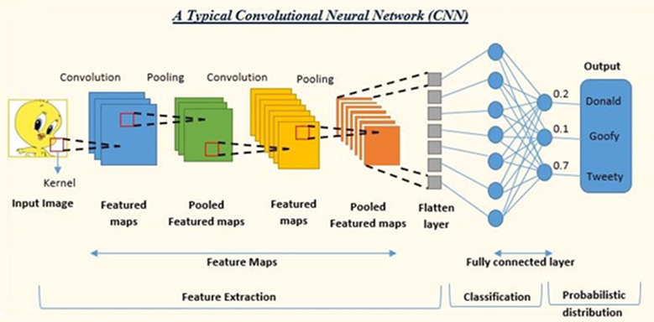
1.2 Introduction
Convolutional Neural Networks (CNNs) perform well in computer vision and are used for object detection tasks (Wu, 2017).
Image source: Lukmaan IAS (2024)

Slide 5
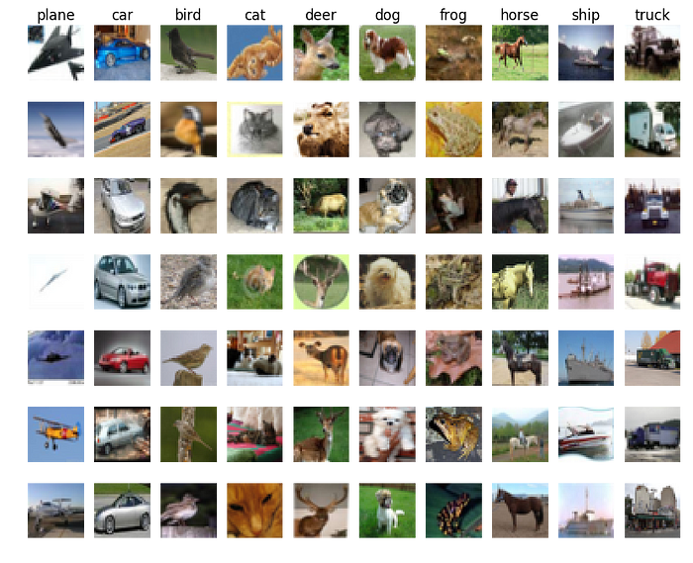
2.1 Dataset
We are using the CIFAR-10 dataset for object recognition
60’000 colored images
Size 32x32
10 classes (6’000 images per class)
Image source: Patel A. (2023)

Slide 6

2.2 Dataset
A validation dataset is important because it allows you to fine tune your model parameters (Xu and Goodacre, 2018).
Dataset sizes:
Training: 40’000
Test: 10’000
Validation: 10’000
CIFAR-10
TRAINING
VALIDATION
TEST
What should I learn?
Am I learning well?
How good am I?

Slide 7
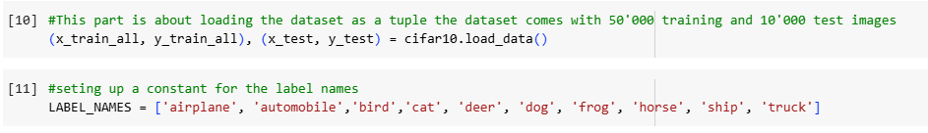
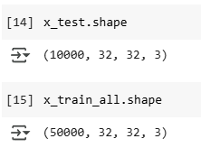
2.3 Dataset

Slide 8
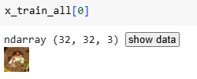
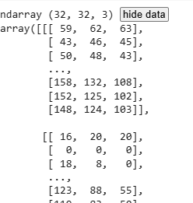


2.4 Dataset
1
2
3
4

Slide 9
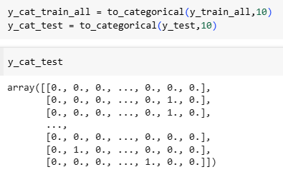
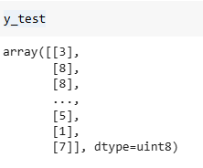
2.5 Dataset

Slide 10
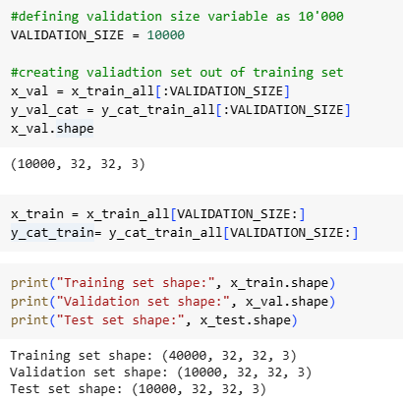
2.6 Dataset

Slide 11
3.1 Architecture
The architecture of our Convolutional Neural Network consists of a feature extraction block followed by a flatten layer, which converts multidimensional feature maps into a one-dimensional vector used for classification, ultimately enabling image detection.
INPUT
Feature Extraction
Convolution Layer with ReLU activation
Pooling Layer
Convolution Layer with ReLU activation
Pooling Layer
Flatten Layer
Classi-fication
Dense Layer
Classifier with Softmax activation
OUTPUT

Slide 12
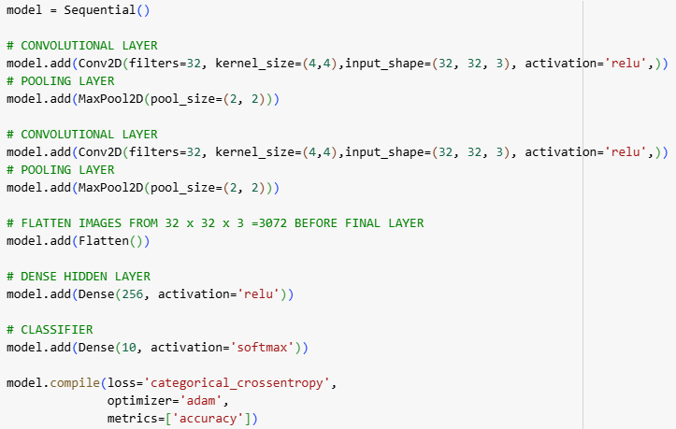
3.2 Architecture
INPUT
Convolution Layer with ReLU activation
Pooling Layer
Convolution Layer with ReLU activation
Pooling Layer
Flatten Layer
Dense Layer
Classifier with Softmax activation
OUTPUT

Slide 13
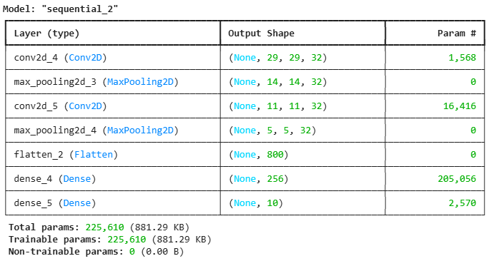
3.3 Architecture

Slide 14
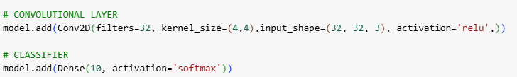
4.1 Activation Function
ReLU (Rectified Linear Unit) activation function is commonly used because it introduces nonlinearity while being computationally efficient (Goodfellow, 2016).
Softmax is typically used for the output layer in a multi-class classification problem since it converts the raw scores into a probability distribution over the classes (Goodfellow, 2016).

Slide 15
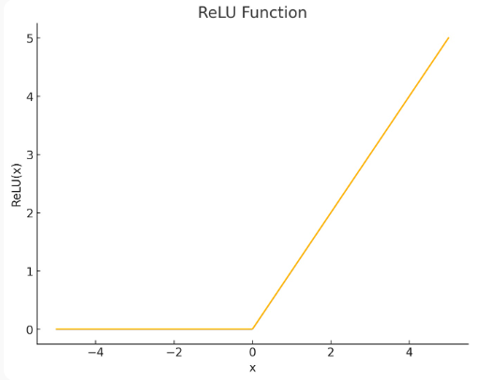
4.2 Activation Function
Rectified Linear Unit also known as ReLU is computationally efficient and encourages sparsity by outputting zero for negative inputs (Sharma, 2017).
Image source: University of Essex Online (2025)

Slide 16

5.1 Loss Function
We use categorical_crossentropy as our loss function
Categorical crossentropy is a loss function that measures the difference between the predicted probability distribution and the true class distribution, helping the model improve accuracy by minimizing this distance (Chollet, 2021).

Slide 17

6.1 Epochs
Implementation of early stop to avoid overfitting and to practice resource management.
Training the model using the datasets.

Slide 18
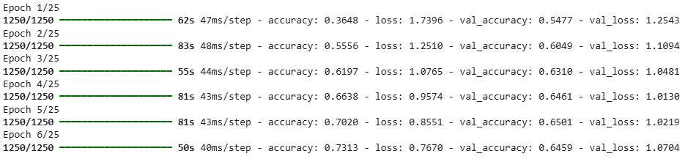
6.2 Epochs

Slide 19
7.1 Neural Network Strategy
From a strategical perspective my goal was to start with default parameters we used during the module and then move on to:
Adjusting the number of layers (Convolutional and ReLu)
Filters per layer
Adjust Kernel Sizes
Adjust number of Neurons (Dense Hidden Layer)
Adjust Patience of Early Stop
Adding dropout
Info: Dropout is a regularization technique used in neural networks to prevent overfitting (Srivastava et al., 2014).
from tensorflow.keras.layers import Dropout model.add(Dropout(0.5))

Slide 20
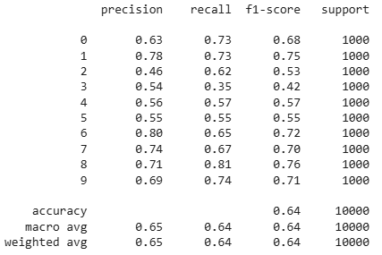
8.1.1 Results
Running the predictions against the validation set resulted in 64% accuracy. The process ended after 6 epochs.
Number of Layer: 2
Filters: 32,32
Adjust Kernel Sizes: 4,4 / 4,4
Number of Neurons: 256
Early Stop Patience: 2
Dropout: None

Slide 21
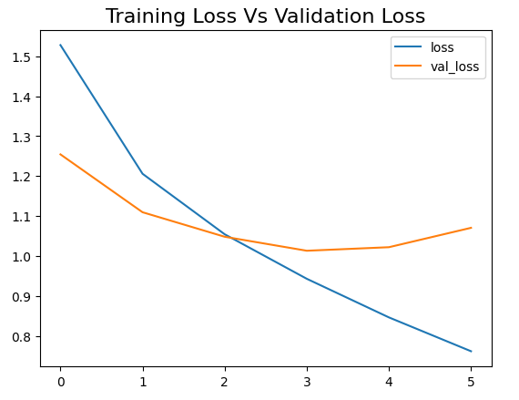
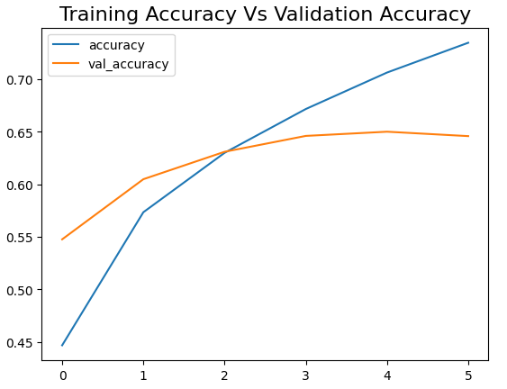
8.1.2 Results

Slide 22
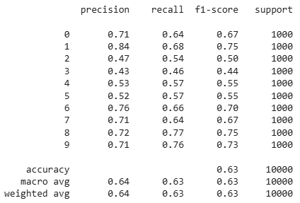
8.2.1 Results
Running the predictions against the validation set resulted in 63% accuracy. The process ended after 14 epochs.
Number of Layer: 3
Filters: 32,32,32
Adjust Kernel Sizes: 4,4 / 4,4 / 4,4
Number of Neurons: 512
Early Stop Patience: 4
Dropout: None

Slide 23
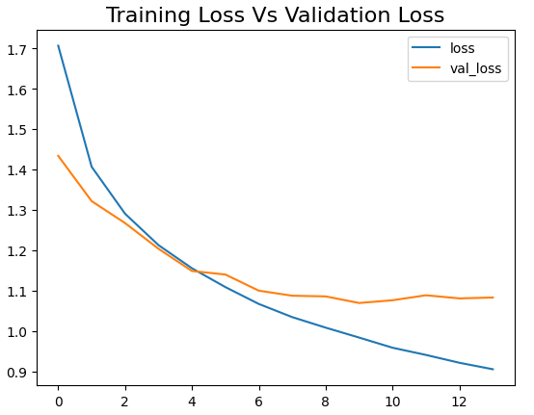
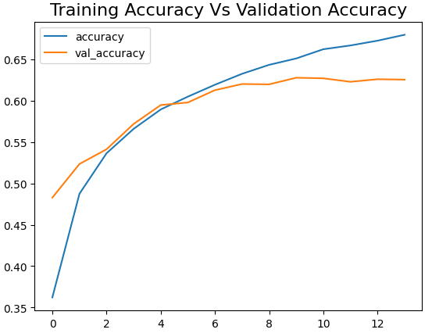
8.2.2 Results

Slide 24
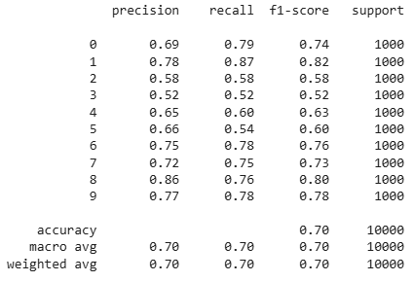
8.3.1 Results
Running the predictions against the validation set resulted in 70% accuracy. The process ended after 10 epochs.
Number of Layer: 3
Filters: 32,64,128
Adjust Kernel Sizes: 3,3 / 3,3 / 3,3
Number of Neurons: 256
Early Stop Patience : 2
Dropout: 0.5

Slide 25
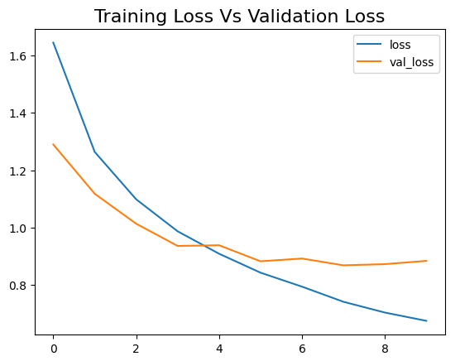
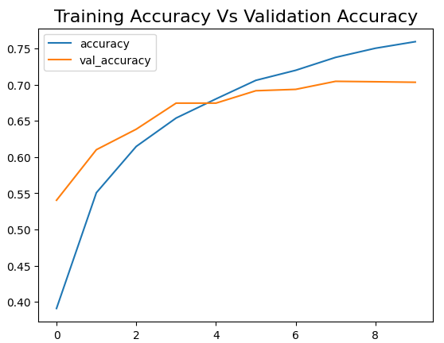
8.3.2 Results

Slide 26
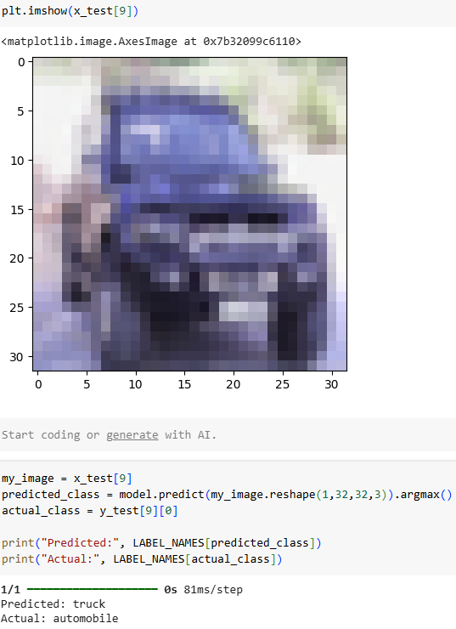
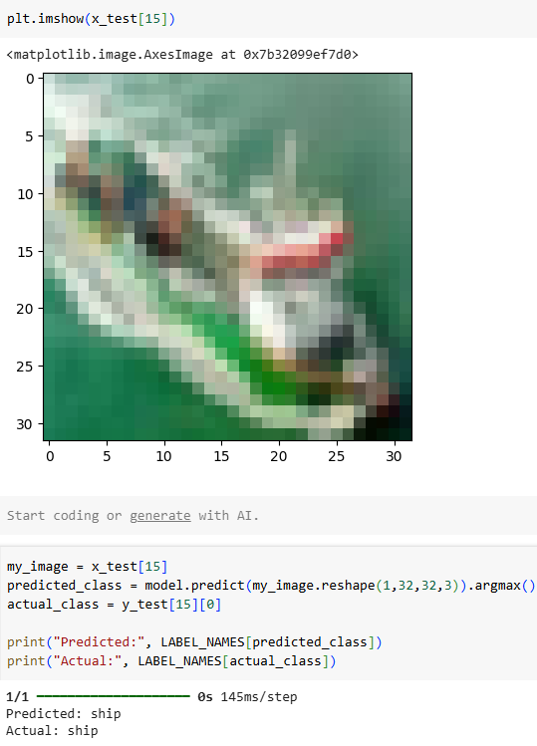
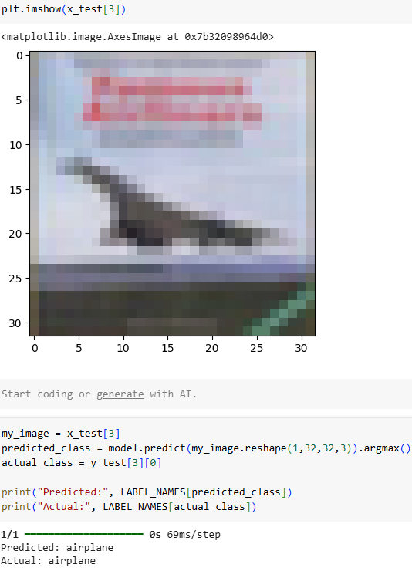
8.4 Results

Slide 27

9.1 Conclusion
The CIFAR-10 dataset only required minor adjustments before training.
A well planed model architecture and pre-defined approach is essential.
Fine tuning parameters is essential for prediction accuracy.

Slide 28
Thank you
Presented by: Elias Medig
Due: Monday, 14 April 2025

Slide 29
10.1 Appendix
The full code can be found in the transcript
CIFAR-10 dataset. Available at: https://www.cs.toronto.edu/~kriz/cifar.html (Accessed: 7 April 2025)
Lukmaan IAS. (2024, December 18). Convolutional Neural Networks (CNN): An in-depth exploration [Blog post]. Retrieved from https://blog.lukmaanias.com/2024/12/18/convolutional-neural-networks-cnn-an-in-depth-exploration/
Wu, J., 2017. Introduction to convolutional neural networks. National Key Lab for Novel Software Technology. Nanjing University. China, 5(23), p.495.
Patel, A., 2023. The Power of Deep Learning in Image Recognition. Artificial Intelligence in Plain English, 15 February. Available at: https://ai.plainenglish.io/the-power-of-deep-learning-in-image-recognition-65e3485541d0 (Accessed: 7 April 2025).
Sharma, A.V. (2017) Understanding Activation Functions in Neural Networks. The Theory Of Everything. Available at: https://medium.com/the-theory-of-everything/understanding-activation-functions-in-neural-networks-9491262884e0 (Accessed: 7 April 2025).
Chollet, F. and Chollet, F., 2021. Deep learning with Python. simon and schuster.
Goodfellow, I., 2016. Deep learning.
Xu, Y. and Goodacre, R., 2018. On splitting training and validation set: a comparative study of cross-validation, bootstrap and systematic sampling for estimating the generalization performance of supervised learning. Journal of analysis and testing, 2(3), pp.249-262.
University of Essex Online (2025) ‘Artificial Neural Network (ANN)’ [Online learncast]. In: Machine Learning. University of Essex. Available at: https://www.my-course.co.uk/mod/scorm/player.php?a=17531¤torg=articulate_rise&scoid=35136&sesskey=qbh3fNljxo&display=popup&mode=normal (Accessed: 7 April 2025).
Srivastava, N., Hinton, G., Krizhevsky, A., Sutskever, I. and Salakhutdinov, R., 2014. Dropout: a simple way to prevent neural networks from overfitting. The journal of machine learning research, 15(1), pp.1929-1958.

