Slide 1

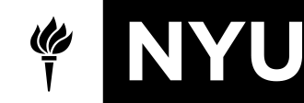
Hierarchical-approach
Multi-label Classification
Yilu Peng
2019/05/07

Slide 2
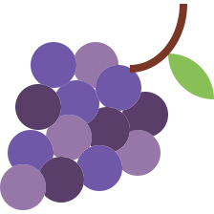




Background
Extreme multi-label learning is an important research problem as it has many applications in tagging, recommendation and ranking.
For example, given a user’s buying or viewing history, one might wish to build an extreme multi-label classifier that recommends the subset of millions of items that the user might wish to buy or view next.
$$f( )$$
maps a user’s feature vector to a set of labels
treat each item to be recommended as a separate label
Notes:
Background

Slide 3
Prior Work
LPSR(Label Partitioning by Sub-linear Ranking):
A base multi-label classifier was learnt for the entire label set.
（This step governs the overall training complexity and prediction accuracy）
Node Partition: a variant of k-means over the feature vectors
The Multi-label Random Forest (MLRF):
Did not learn a base classifier. Instead, an ensemble of randomized trees was learnt.
Node Partition: a multi-label variant of the Gini index defined over the set of positive labels in the node
(Learning randomized forests and brute force optimize Gini index is expensive when there are a large number of training points and labels)
Both LPSR and MLRF have high training costs.
Notes:
Prior Work

Slide 4
FastXML
FastXML learns an ensemble of trees and does not need to rely on base classifiers
Each node has its own separator w to decide which child(left or right) node to go to.

Slide 5









Build Tree
FastXML algorithm:
Each non-leaf node stores information:
n.leftnode, n.rightnode,
n.w (linear seperator at each node)
n.id (instances at this node)
Each leaf node stores:
n.id (instances at this node)
n.P (average scores for labels at this leaf)
When the number of instances for a node is small enough,
this node is processed to be a leaf. Leaf node no longer splits.
Each tree is grown recursively until no node splits.
Notes:
Build Tree

Slide 6
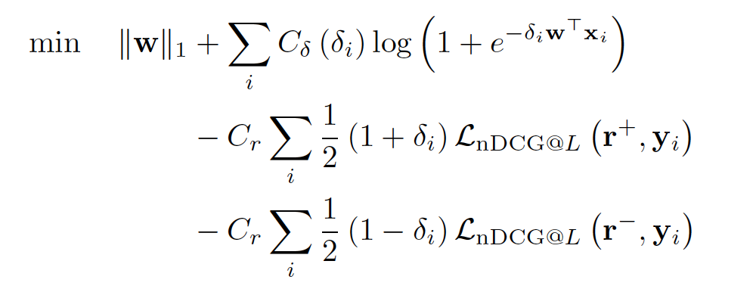
Objective
Node Partition Objective for FastXML
First term: L1 regularizer on w which ensures that it is sparse
Second term: Logistic loss term that finds a hyperplane that separates the variables well
Third and Fourth term: nDCG score which measures the quality of ranking (higher is better)
Notes:
optimize

Slide 7
Random initialization
Randomly separate the users to left or right partition:
Notes:
optimize

Slide 8



Optimize
Induced item ranking from the random partition:
Rank returns the indices of the L largest elements of y, ranked in descending order
Notes:
optimize

Slide 9
Cumulative Gain
Top k ranked items
Calculate Cumulative Gain:
Go to the first ranked item,
If the user likes it, add 1,
otherwise do nothing;
go to the second ranked item,
If the user likes it, add 1,
otherwise do nothing
1 | 1 | 0 | 0
0 | 1 | 1 | 0
1 | 0 | 1 | 0
1 | 1 | 0 | 0
1 | 1 | 0 | 0
Notes:
Split node

Slide 10
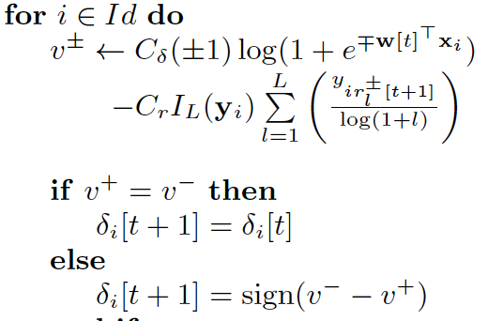
Optimize
For each item, re-calculate the objective and decide if this item is better off staying at this partition or switch partition:
Logistic loss of the hyperplane separator
nDCG score
C delta and Cr are user specified parameters which determines the relative importance of these terms
Switch the item’s partition if it’s better off doing so
Notes:
optimize

Slide 11
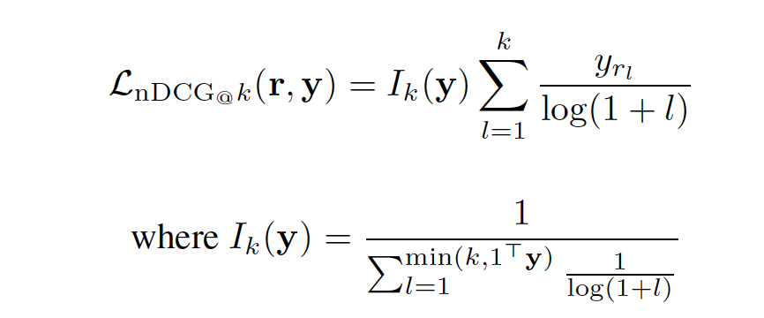
nDCG
For a single user id:
nDCG score to optimize partition:
DCG measures not only the relevance, but also the ranking quality.
The gain is accumulated from the top of the result list to the bottom, with the gain of each result discounted at lower ranks.
Ideal DCG (IDCG) : DCG score for best possible DCG through position p.
nDCG therefore becomes a number between 0 and 1
Notes:
optimize

Slide 12
Optimize
Induced item ranking from the random partition:
Notes:
optimize

Slide 13
Optimize
For each item, re-calculate the partial objective for left and right side,
and decide if this item is better off staying at this partition or switch partition:
Logistic loss of the hyperplane separator
nDCG score
C delta and Cr are user specified parameters which determines the relative importance of these terms
Switch the item’s partition if it’s better off doing so
Notes:
optimize

Slide 14
Optimize
This iteration terminates when the item partition does not change any more:
nDCG score cannot be improved any more.
Each user in the node has their liked items ranked as highly as possible.
Notes:
optimize

Slide 15
Optimize
When the item partition is stable(nDCG score cannot be improved any more),
find the hyperplane separator w for this item partition:
Notes:
optimize

Slide 16
Prediction
Notes:
Prediction

Slide 17
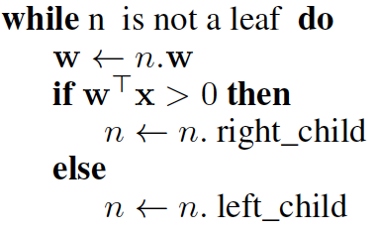





Prediction
Notes:
Build Tree

Slide 18
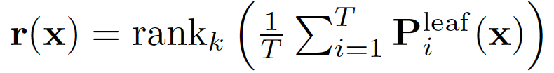
Prediction
Take top k ranked labels from the average of predictions(from all trees)
Notes:
Prediction

Slide 19
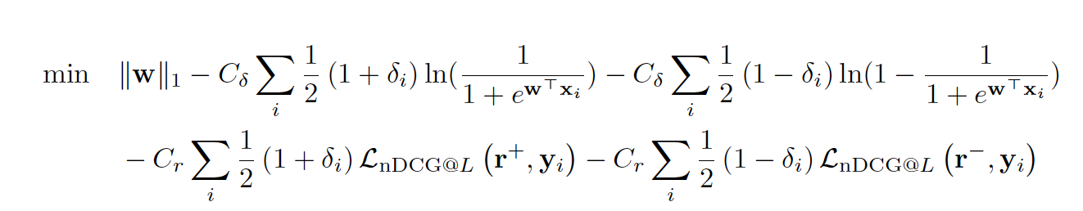
Change the Objective
Change the objective function for partition:
The cross entropy loss is closely related to the Kullback-Leibler divergence between the empirical distribution and the predicted distribution.
This loss has a probability interpretation.
This function is not naturally represented as a product of the true label and the predicted value, but is convex and can be minimized using stochastic gradient descent methods.
Notes:
Change the Objective

Slide 20
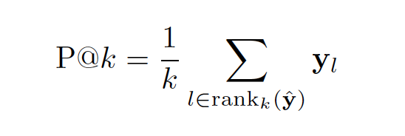
Change the Objective
Precision score for partition:
Precision is the ratio of correctly predicted positive observations to the total predicted positive observations
Notes:
Change the Objective

Slide 21
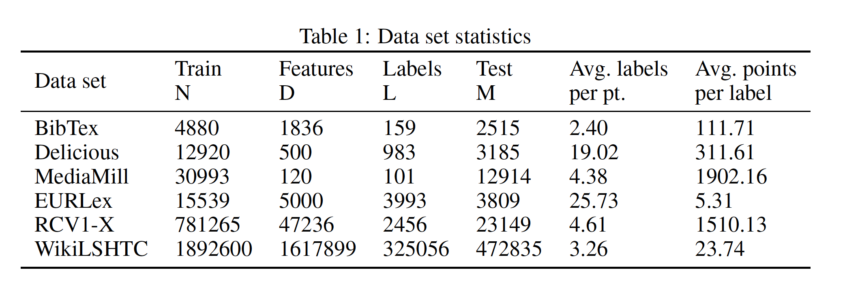
Experiments
Notes:
Experiment

Slide 22
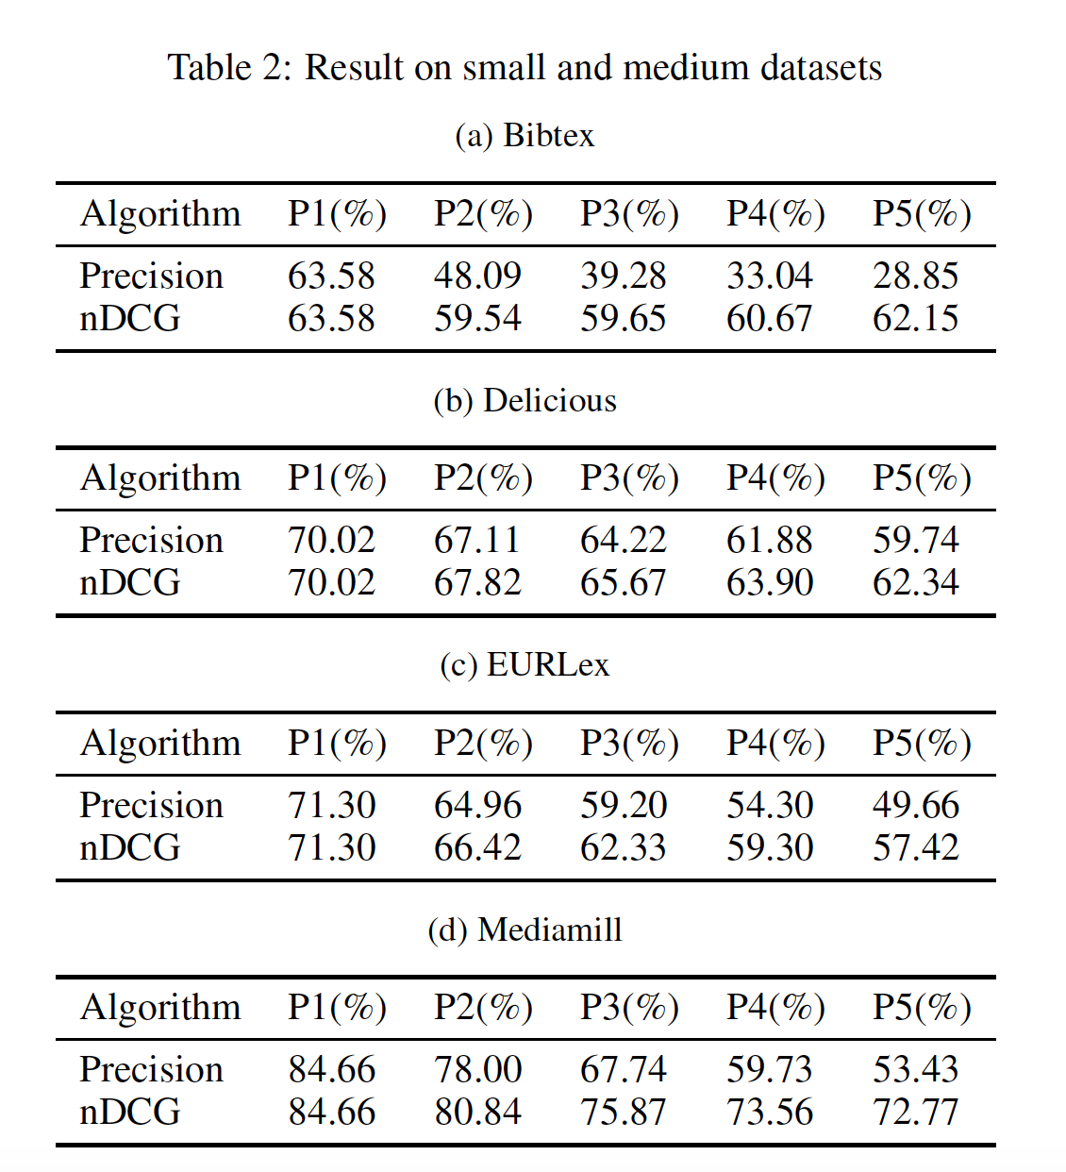
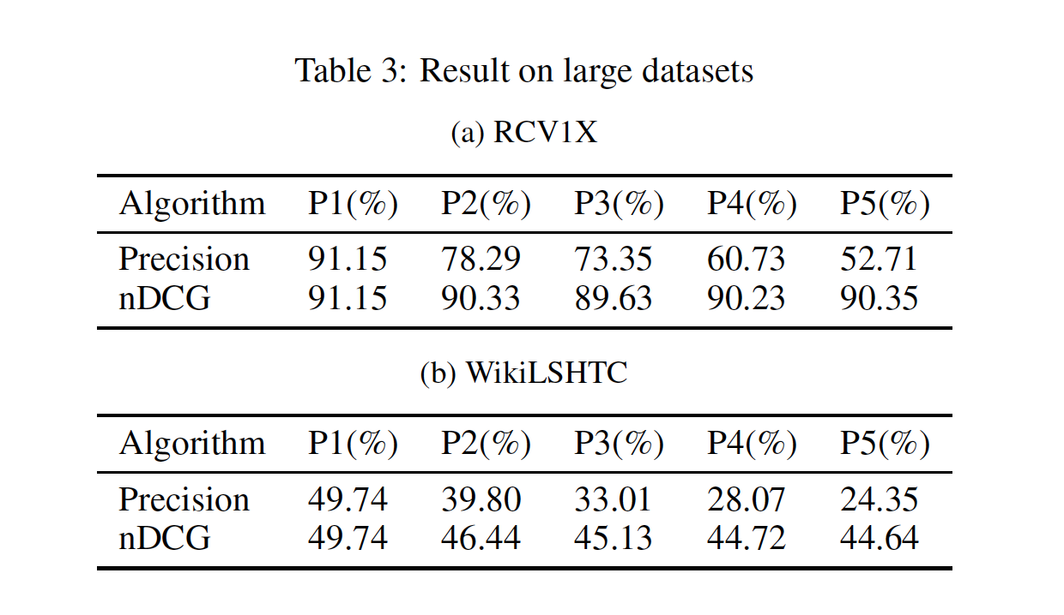
Experiments
Experiments compares the performance of nDCG score to Precision score
P@k corresponds to the number of relevant labels on the first k predicted results.
Notes:
Experiment

Slide 23
Conclusion
The key new feature in FastXML was a novel node partitioning objective function which optimizes an nDCG based ranking loss over all the labels.
I compared the Precision score metric with nDCG metric with experiments.
The objective function for partition may be changed for improvements: Hinge loss maximizes the margin between our decision boundary and data points;
Cross-entropy loss introduces a better probability interpretation.
Notes:
Experiment

