Slide 1

Test Launch Findings

Slide 2
In the test rollout of the tablet, overall success with 72% of people thought experience was at least good
2 restaurants with tablets at bar areas
50 customers at the restaurants
16 survey questions asked to customers
Summary

Slide 3
In this test, we wanted to measure
Bugs/Glitches come with the software
User experience for the customers
Do the tablets reduce time spent waiting for a seat
Overview

Slide 4
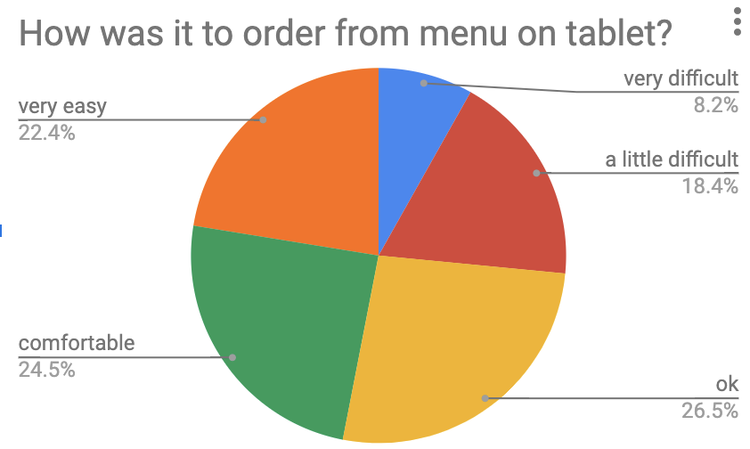
Findings

Slide 5
Order accuracy from test was 72%
Increase order accuracy closer to 100% with user design and code checking improvements
Next Steps

Slide 6
Test had 12% of users reporting glitches in software
Reduce glitches/bugs in tablet system to 0% with improved error code handling
Next Steps

