Slide 1
Custom Alpine Shell
Elia Hänggi, Matthew Fahrni

Slide 2
Result
Custom Alpine Shell
Easier Directory Navigation and Manipulation
Integrated «classic» terminal
Logger

Slide 3
Motivation
Deeper understanding how a shell works
Greater understanding in kernel
Better knowledge in C

Slide 4
Alpine
What is Alpine?
Linux Distribution, Focus on Security, Simplicity, Resource Efficiency
Why did we choose Alpine Linux?
Resource Efficiency
Fast Setup
Not GNU => Manual Implementation
No GUI with file-explorer

Slide 5
Implementation
Written in C
Core of the Shell is Command Line Interpreter (CLI)
Parser scans input from user
Input is split into tokens and parsed to Executor
Executor executes commands

Slide 6
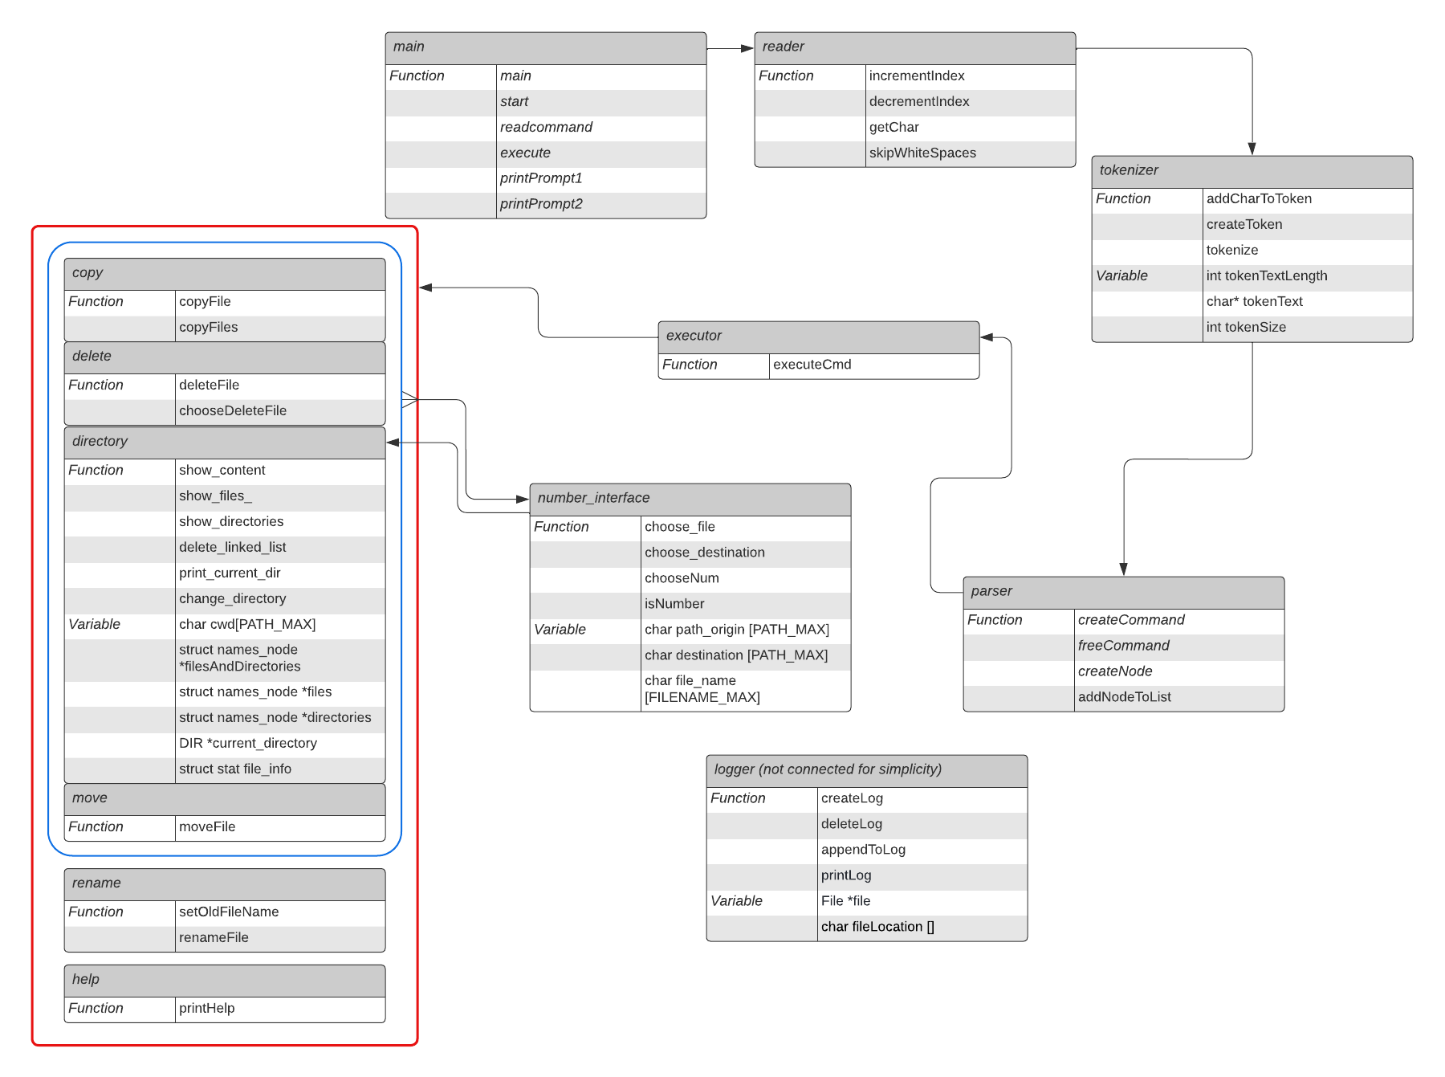

Slide 7
Difficulties
Directory Management
C
Missing Data Structures
Memory Leaks, Segmentation Faults
Windows/Linux/Alpine
Unforseen bugs

Slide 8
Demo/ Video/ Screenshots?

